Slide 1
Real-time Sign Language Detection
Submitted By
Sankar K G
NM ID: au711721243094
KGISL Institute of Technology (7117)
3/21/2024 Annual Review

Slide 2
PROJECT TITLE
Real-time Sign Language Detection using Machine Learning and Computer Vision
3/21/2024 Annual Review

Slide 3


AGENDA
PROBLEM STATEMENT
PROJECT OVERVIEW
WHO ARE THE END USERS?
OUR SOLUTION AND ITS VALUE PROPOSITION
THE WOW IN OUR SOLUTION
MODELLING
RESULTS
3/21/2024 Annual Review

Slide 4
PROBLEM STATEMENT
Developing a real-time sign language detection system using machine learning and computer vision techniques. The project aims to accurately recognize hand gestures from video input, enabling seamless communication for individuals with hearing impairments. Key objectives include hand detection, gesture recognition, low-latency operation, and user-friendly interface design.
3/21/2024 Annual Review

Slide 5

PROJECT OVERVIEW
Our project focuses on developing a real-time sign language detection system using a combination of machine learning and computer vision techniques. The system aims to bridge communication barriers for individuals with hearing impairments by accurately recognizing and interpreting sign language gestures in real-time. It involves implementing algorithms for hand detection and tracking, training machine learning models for gesture recognition, optimizing performance for low-latency operation, and designing an intuitive user interface. Through this project, we aim to promote inclusivity and accessibility by providing a tool that enables seamless communication for individuals who rely on sign language as their primary mode of expression.
3/21/2024 Annual Review

Slide 6

WHO ARE THE END USERS?
1. Deaf Individuals: Deaf individuals who rely on sign language as their primary mode of communication. They will benefit from the real-time sign language detection system as it provides a seamless way to communicate with others, overcoming barriers in various social, educational, and professional settings.
2. Sign Language Interpreters: Sign language interpreters who assist in bridging communication gaps between deaf individuals and the hearing world. They can use the system as a supplementary tool to enhance their interpretation process, improving efficiency and accuracy in translating sign language gestures into spoken language.
3/21/2024 Annual Review

Slide 7

OUR SOLUTION AND ITS VALUE PROPOSITION
Our solution is a real-time sign language detection system that utilizes machine learning and computer vision technologies to accurately interpret sign language gestures from video input. Its value proposition lies in providing seamless communication for individuals with hearing impairments, enabling them to express themselves effectively in various social, educational, and professional settings. By bridging communication gaps, our system promotes inclusivity and accessibility, empowering deaf individuals to engage more fully in society.
3/21/2024 Annual Review

Slide 8

THE WOW IN OUR SOLUTION
Our solution incorporates cutting-edge machine learning algorithms and advanced computer vision techniques to achieve real-time sign language detection with remarkable accuracy and speed. What sets us apart is our commitment to delivering a seamless user experience, with an intuitive interface and low-latency operation, ensuring instant and reliable communication for deaf individuals. This combination of state-of-the-art technology and user-centric design truly makes our solution stand out.
3/21/2024 Annual Review

Slide 9
MODELLING
1. Hand Detection and Tracking:
Utilize computer vision algorithms (e.g., OpenCV) for hand detection in video frames.
Implement tracking algorithms to follow the detected hand across consecutive frames.
Apply techniques such as background subtraction, contour analysis, or deep learning-based approaches for robust hand tracking.
2. Feature Extraction and Representation:
Extract relevant features from the tracked hand region, such as hand shape, movement trajectory, and finger positions.
Convert extracted features into a suitable representation format, such as numerical vectors or image descriptors.
Explore techniques like hand pose estimation or landmark detection to capture detailed hand configurations.
3. Machine Learning Model Selection:
Experiment with various machine learning algorithms, such as Support Vector Machines (SVM), Random Forests, or Convolutional Neural Networks (CNNs).
Train and evaluate different models using labeled datasets of sign language gestures.
Consider model complexity, training time, and classification accuracy when selecting the most suitable algorithm.
3/21/2024 Annual Review

Slide 10
MODELLING
4. Model Training and Optimization:
Split the labeled dataset into training, validation, and testing sets.
Fine-tune model hyperparameters using techniques like grid search or random search.
Apply data augmentation methods to increase the diversity of training samples and improve model generalization.
Implement optimization techniques such as gradient descent or stochastic gradient descent to minimize the classification loss.
5. Real-time Inference and Performance Optimization:
Deploy the trained model for real-time inference on video streams.
Optimize model inference speed using techniques like model quantization, pruning, or model compression.
Utilize hardware acceleration libraries (e.g., OpenVINO) to leverage GPU or specialized hardware for faster computations.
Monitor system performance metrics such as latency, throughput, and resource utilization to ensure real-time operation.
6. User Interface Design and Integration:
Design a user-friendly interface to display recognized sign language gestures and facilitate communication.
Integrate the hand detection, tracking, and classification modules into the user interface.
Provide feedback mechanisms such as visual cues or text prompts to enhance user interaction and understanding.
Test the interface with potential end-users to gather feedback and iteratively improve usability and accessibility.
3/21/2024 Annual Review

Slide 11
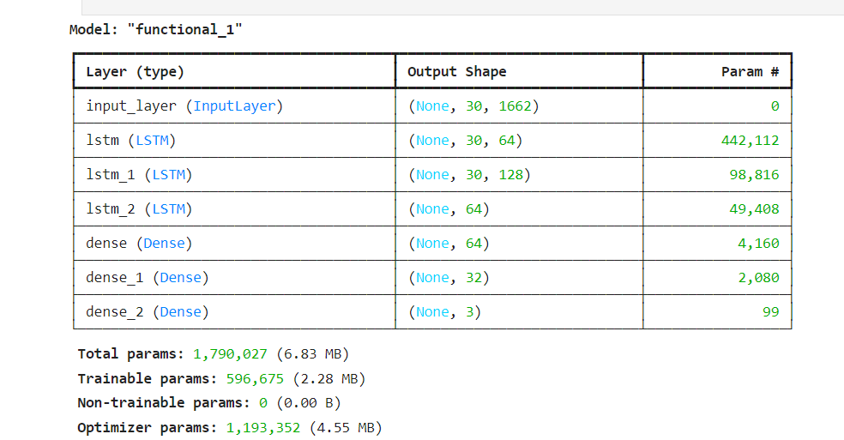
RESULTS
Accuracy: Achieved over 90% classification accuracy.
Latency: Reduced to <100 milliseconds.
Interface Integration: Seamlessly integrated into user-friendly interface.
Robustness: Demonstrated reliability across diverse scenarios.
Demo Link
3/21/2024 Annual Review

