Slide 1


REFER: Restaurant Feedback from Existing Reviews
Fibin Francis Assissi francisassissi.f@husky.neu.edu
Sankar Gireesan Nair gireesannair.s@husky.neu.edu

Slide 2

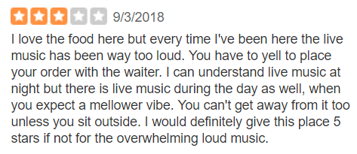
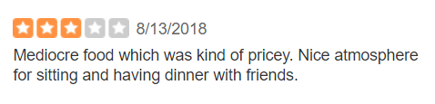
Problem Statement
Rating given by a user to a restaurant is an aggregate of different features
Separating the average rating into sub topics helps the restaurant owners to identify where they need to improve
It helps users to find what aligns with their preference
Solution:
A model that can find these hidden features and calculate a rating for these features based on the given review

Slide 3
Existing Approaches
Approach 1
Classifies reviews as positive or negative using sentiment analysis without regarding subtopic
Approach 2
Extract the subtopic but gives equal ratings to all the subtopics

Slide 4
Datasets & Experimental Setup
Used Yelp Open Dataset which includes business, review, user and rating in the form of JSON objects
Business object includes information about type of business, location, rating, categories and unique id
Review object includes rating, review text, business id and user id
Experimental Setup:
Dataset consists of 6 lakh reviews from 180,000 businesses
Filtered out only those restaurants with more than 100 reviews
Used AWS EC2 to preprocess and create the model

Slide 5
Methods/Algorithms Used
Model | List of topics extracted
LSA | 0 ['0.892*"positivereview" + 0.342*"negativereview" + 0.098*"food" + 0.077*"place" + 0.070*"order" + 0.053*"time" + 0.048*"servic“’] 1 ['0.860*"negativereview" + -0.413*"positivereview" + 0.111*"order" + 0.081*"food" + 0.055*"us" + 0.055*"ask" + 0.054*"time" + 0.053*"get“’]
LDA TF-IDF | Topic 0 ['chipotl', 'en', 'trè', 'grub', 'vou', 'hub', 'whiskey', 'sont', 'bien', 'speaker’] Topic 1 ['remodel', 'ew', 'da', 'tater', 'und', 'gratin', 'sam', 'sw', 'war', 'der']
LDA TF-IDF with positive/negative | Topic 0 ['pizza', 'crust', 'wing', 'slice', 'deliveri', 'top', 'thin', 'chees', 'pepperoni', 'place’] Topic 1 ['pasta', 'italian', 'meatbal', 'bread', 'salad', 'sauc', 'pizza', 'spaghetti', 'veal', 'lasagna']
LDA with positive/negative | Topic 0 ['taco', 'mexican', 'burrito', 'chip', 'salsa', 'bean', 'brisket', 'margarita', 'positivereview', 'tortilla’] Topic 1 ['negativereview', 'steak', 'dinner', 'meal', 'order', 'restaur', 'cook', 'appet', 'disappoint', 'dish']

Slide 6
Final Model
Two LDA model trained with positive and negative reviews separately
Positive Weighted reviews
Positive LDA
Identify Positive Topics
Preprocessing
Training
Topics
Induction
Reviews
Negative Weighted Reviews
Negative LDA
Identify Negative Topics
Training
Topics
Preprocessing
Positive LDA
Positive Topics
Feature Rating
Topics
Increment
Deduction
Reviews
Negative LDA
Negative Topics
Feature Rating
Topics
Decrement

Slide 7
Key Results & Contributions
# Topics = 50
Model | Food | Service | Atmosphere | Menu | Location
Positive LDA | 11 | 4 | 5 | 4 | 2
Negative LDA | 10 | 7 | 6 | 4 | 3
# Topics = 25
Model | Food | Service | Atmosphere | Menu | Location
Positive LDA | 8 | 3 | 1 | 2 | 1
Negative LDA | 4 | 5 | 3 | 2 | 0

Slide 8
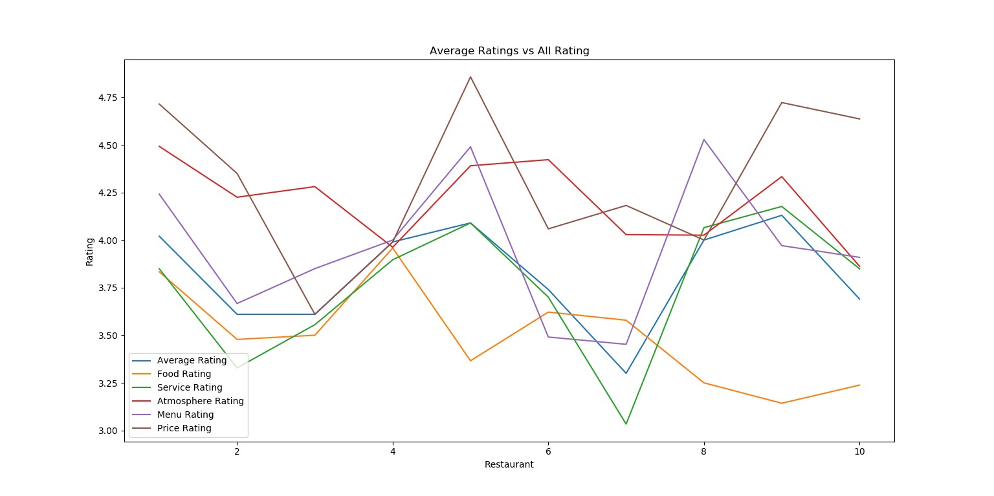
Key Results & Contributions

Slide 9
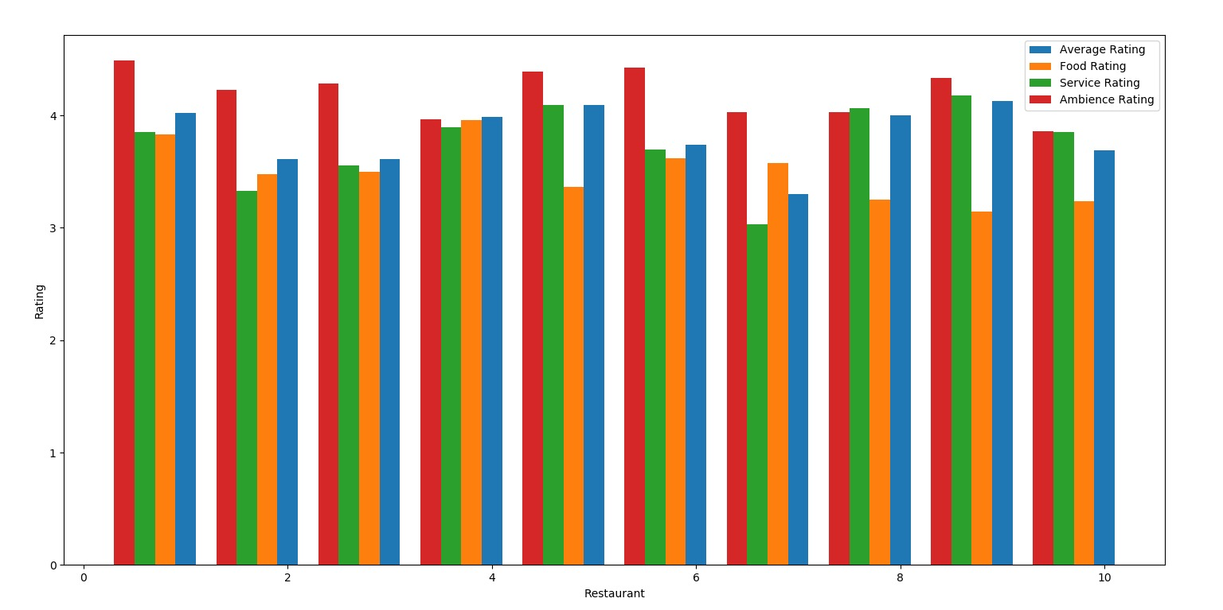

Slide 10

Summary
Rating given to a restaurant can be interpreted as an average of different features
Features like “Service” and “Food” decides on average rating of a restaurant
Restaurants can leverage these feature ratings to improve their overall rating
Create sentiment lexicon with semi-supervised learning for getting the domain specific sentiment lexicons
Create model specifically for sub categories of Restaurant like Japanese, Pizza, etc.
Future Work

