Slide 1
Toronto Coffee Demand Analysis

Slide 2
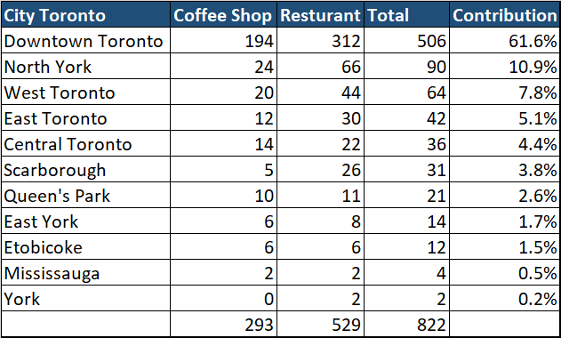

Slide 3
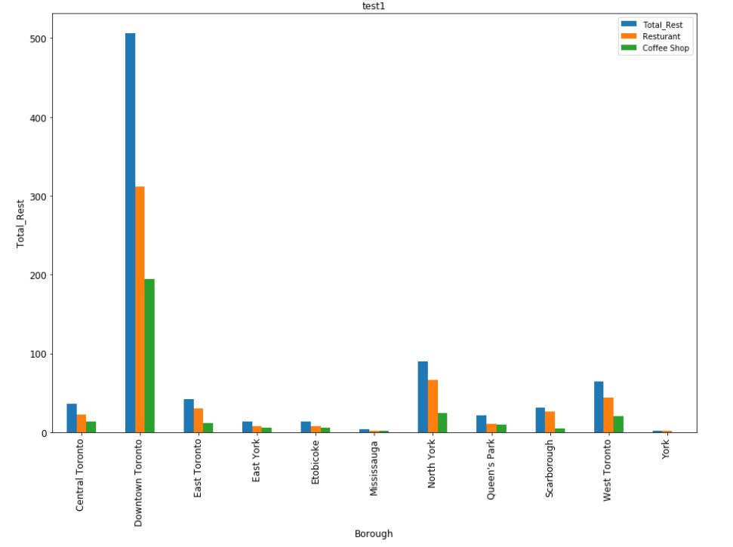

Slide 4
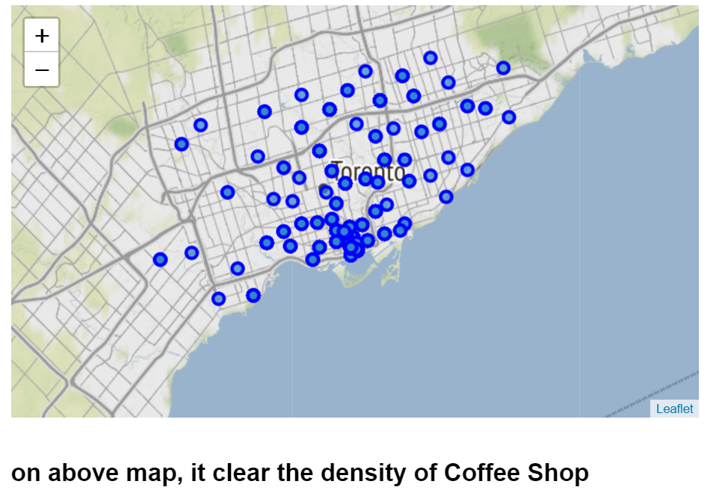

Slide 5
