Slide 1
MFA Authentication

Slide 2
Implementing Azure Multi-Factor Authentication (MFA) with Microsoft Authenticator for a WebAPI and React app
Prerequisites:
Azure AD Tenant: Ensure you have access to an Azure Active Directory tenant.
React App: Your React application for frontend.
WebAPI: ASP.NET Core WebAPI for backend.
Microsoft Authentication Library (MSAL): For both React and WebAPI.

Slide 3
Implementing Azure Multi-Factor Authentication (MFA) with Microsoft Authenticator for a WebAPI and React app
Prerequisites:
Azure AD Tenant: Ensure you have access to an Azure Active Directory tenant.
React App: Your React application for frontend.
WebAPI: ASP.NET Core WebAPI for backend.
Microsoft Authentication Library (MSAL): For both React and WebAPI.

Slide 4
Configure Azure AD for Your REACT Application
Register React App in Azure AD:
Go to the Azure portal.
Navigate to Azure Active Directory > App Registrations.
Click New Registration.
Fill in the details:
Name: React Frontend.
Supported Account Types: Choose the appropriate one (e.g., single tenant).
Redirect URI: Add the redirect URL (e.g., http://localhost:3000 for local development).
Click Register.

Slide 5
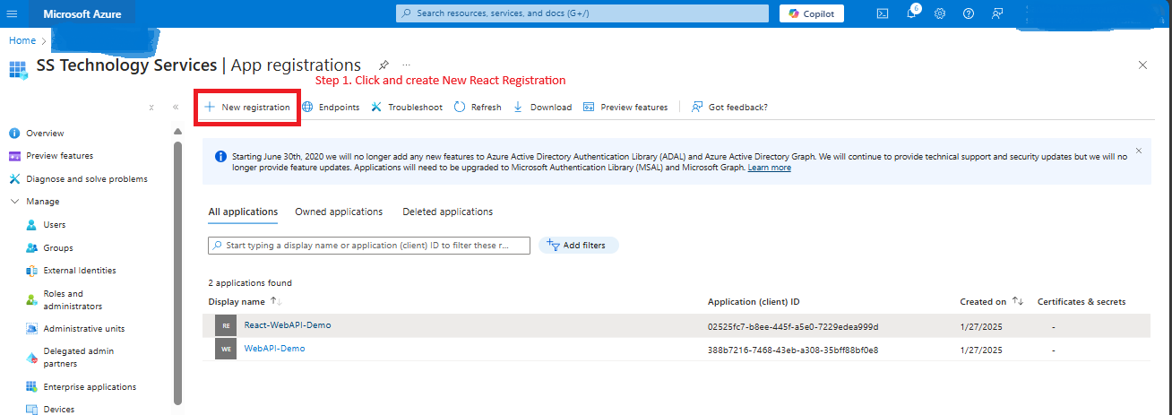

Slide 6
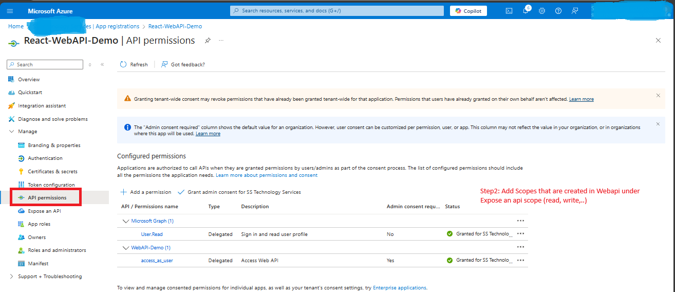

Slide 7
Configure Azure AD for Your WEBAPI Application
Register WebAPI in Azure AD:
Similarly same as React registration, register the WebAPI.
Add an Application ID URI for the API (e.g., api://{app-id}).
Under Expose an API, add a scope:
Scope name: access_as_user.
Admin consent: true.

Slide 8
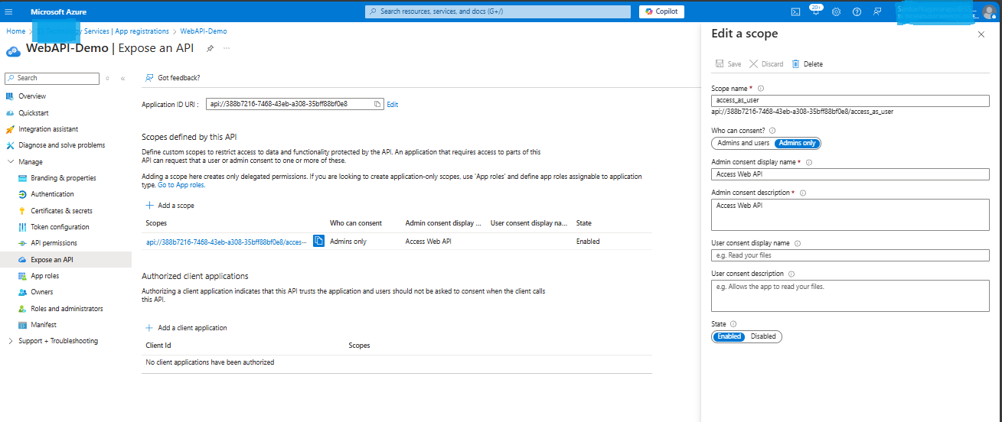

Slide 9
Set Up MFA in Azure AD
Go to Azure Active Directory > Security > Conditional Access.
Create a new policy:
Assign Users or Groups: Specify the internal users/groups.
Assign Cloud Apps or Actions: Choose the React and WebAPI apps.
Under Grant, require Multi-factor Authentication.
Enable the policy.
NOTE:
Use Conditional Access Policies (Preferred) if:
You need scalability and flexibility.
You want to enforce MFA based on apps, users, risk levels, or specific conditions.
You’re working in an enterprise environment where security requirements vary across apps and users.

Slide 10
Enable Authentication Methods for Passwordless or OTP-Like Sign-In Instead of TAP, configure Passwordless Authentication or SMS-based OTP using Azure AD's authentication methods. These methods work seamlessly with Conditional Access Policies.
Navigate to Azure AD > Security > Authentication Methods.
Enable Phone (SMS) Authentication:
Select Text Message (SMS).
Click Enable for All Users or Selected Groups.
Save the configuration.
Users will receive OTPs via SMS during login.
Enable Passwordless Phone Sign-In:
Select Microsoft Authenticator under Authentication Methods.
Ensure Enable Passwordless Phone Sign-In is turned on.
Assign this method to All Users or Specific Groups.
Enforce Conditional Access for These Methods:
Add these authentication methods (e.g., Phone Sign-In or SMS OTP) in your Conditional Access policy.

Slide 11
Configure Conditional Access Policies for OTP-Like Scenarios
To enforce OTP-like authentication (e.g., via SMS or Passwordless Phone Sign-In), configure your Conditional Access Policies as follows:
1. Create a Conditional Access Policy:
Navigate to Azure AD > Security > Conditional Access.
Click + New Policy.
2. Policy Setup:
Assignments:
Users and Groups: Select the users/groups you want this policy to apply to.
Cloud Apps or Actions: Select your React app or All Cloud Apps for broader enforcement.
3. Conditions (optional):
Set specific conditions like location, device platform, or risk-based triggers.
4. Grant Access:
Require Authentication Strength:
Choose Passwordless Authentication or Multi-Factor Authentication (depending on your method).

Slide 12
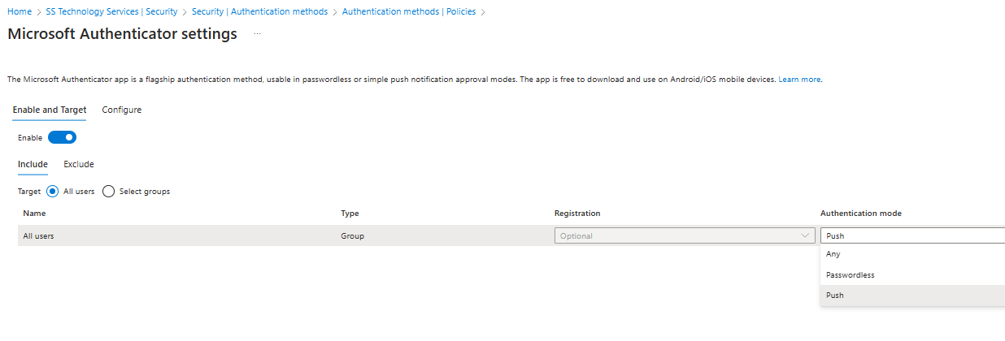

Slide 13
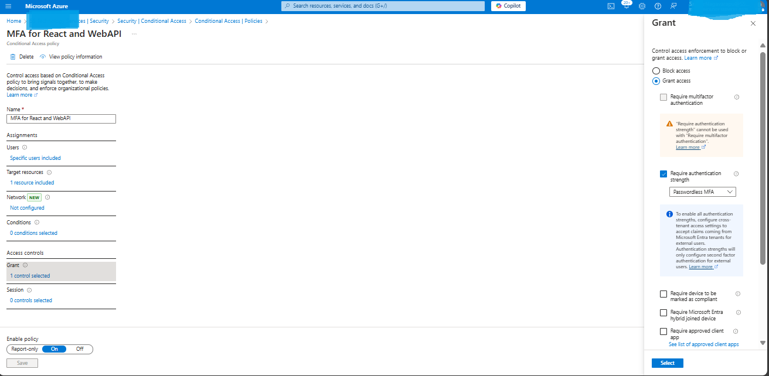

Slide 14
Set Up the Microsoft Authenticator App for Users
User Registration for MFA:
Users must register for MFA the first time they log in. Guide them to:
Go to https://aka.ms/mfasetup.
Sign in with their Azure AD credentials.
Follow the prompts to configure the Microsoft Authenticator app:
Download the app from the App Store or Google Play.
Open the app and select Add Account > Work or School Account.
Scan the QR code shown on the MFA setup page.

