Slide 1
Digital Portfolio
STUDENT NAME: S.NIVETHADEVI
REGISTER NO AND NMID:24132011802522068 And asanm20124132011802522068
DEPARTMENT:B.SC COMPUTER SCIENCE
COLLEGE: ARINGAR ANNA GOVERNMENT ARTS AND SCIENCE COLLGE ANNAMALAI UNIVERSITY

Slide 2
PROJECT TITLE
Digital Portfolio

Slide 3


AGENDA
Problem Statement
Project Overview
End Users
Tools and Technologies
Portfolio design and Layout
Features and Functionality
Results and Screenshots
Conclusion
Github Link
3/21/2024 Annual Review

Slide 4

PROBLEM STATEMENT
A digital portfolio solves the challenges of showcasing skills and
Projects effectively by providing an organized , accessible, and
visually appealing platfrom

Slide 5

PROJECT OVERVIEW
This project creates a digital portfolio to display
Personal skills , achievements , and projects in
A structured and visually engaging way

Slide 6

WHO ARE THE END USERS?
Students , jobs, seekers, professionals, employers, recruiters, and
Clients who review skills and achievements.

Slide 7
TOOLS AND TECHNIQUES
Tools: HTML, CSS, JAVASCRIPT,CANVA,GITHUB
Techniques: Responsive design, UI/UX, Multimedia,SEO,Navigation.

Slide 8
POTFOLIO DESIGN AND LAYOUT
Clean, user-friendly layout with clear sections for portfolio, skills, and achievements;
visually appealing design using consistent colors, typography and responsive structure.
8

Slide 9
FEATURES AND FUNCTIONALITY
Responsive design for all devices.
Easy navigation and search.
Selection for skills, projects and achievements.

Slide 10
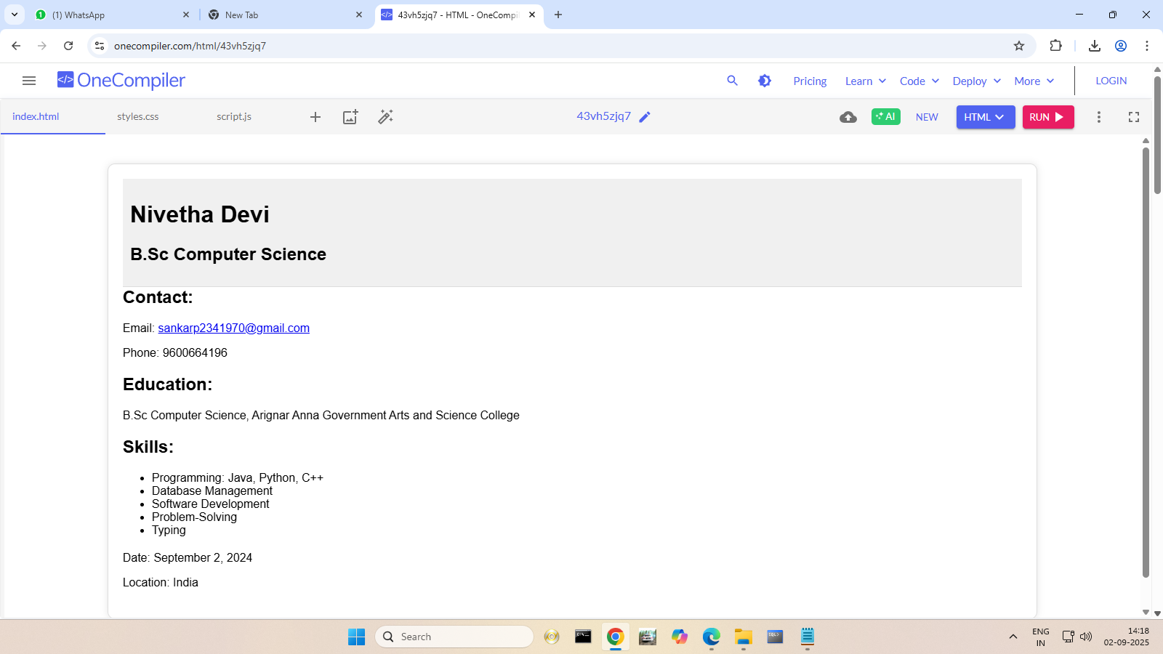
RESULTS AND SCREENSHOTS
A clear, accessible, and professional platform
To showcase skills and achievements.
3/21/2024 Annual Review
10

Slide 11
CONCLUSION
A digital portfolio effectively highlights skills and
Achievements, enhancing visibility and career opportunities.
11

