Slide 1
SCM
Source Code Management

Slide 2
SCM – Source Code Management
A source code management system (SCM) is software that provides coordination and services between members of a software development team
At the most basic level, it provides file management and version control so that team members don’t write over each other’s changes, and only the newest versions of files are identified for use in the workspace
SCMs also give developers the ability to work concurrently on files (in branches that may or may not converge),
Provides Ability to merge changes with other developers’ changes
Provides Ability to track and audit changes that were requested and made
Provides Ability to track bug-fix status and to perform releases
Types of SCM [ Centralized & Distributed ]
Examples of Centralized Version Control - CVS, Subversion (or SVN) and Perforce
Examples of Distributed Version Control - Mercurial, Git and Bazaar.

Slide 3
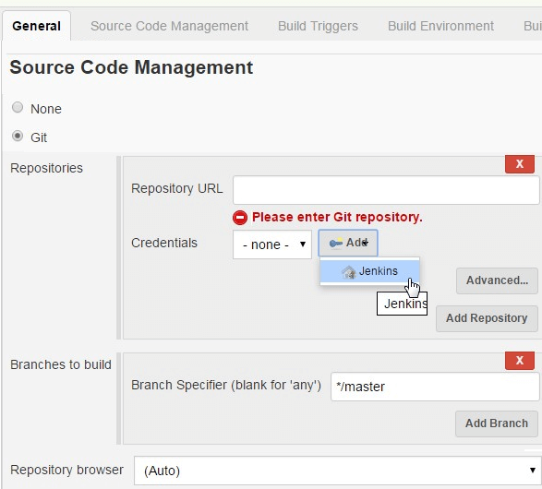

Slide 4
Notifications

Slide 5
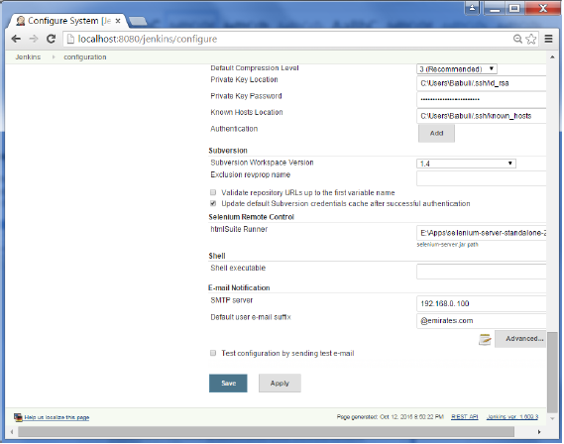
Notifications/Email integration
In all cases, a CI server must let the right people know about any new issues/Status/Build Failures, and it must be able to do so fast.
Alert the developer of a broken build as soon as possible.
Email Extension plugin
Slack Notification plugin

Slide 6
Artifacts

Slide 7
An artifact is one of many kinds of tangible by-products produced during the development of software.
An artifact might be a binary executable (a JAR or WAR file for a Java project, for example), or some other related deliverable, such as documentation or source code.
CopyArtifact plugin-publishing artifacts from Jenkins resources (from the current workspace, from the old builds of the same job or other jobs, ...) to remote locations .
ArtifactDeployer plugin -enables you to archive build artifacts to any remote locations such as to a separate file server (outside of JENKINS_HOME directory).
Storing Artifacts
Artifcats can be stored externally in Repository Manager like Nexus or Artifactory etc
Artifacts are stored in the JENKINS_HOME directory with all other elements such as job configuration files.

Slide 8
Jenkins CLI

Slide 9
Jenkins has a built-in command line interface that allows users and administrators to access Jenkins from a script or shell environment.
This can be convenient for scripting of routine tasks, bulk updates, troubleshooting, and more.
The command line interface can be accessed over SSH or with the Jenkins CLI client, a .jar file distributed with Jenkins.
download jar from <jenkins>/jnlpjars/jenkins-cli.jar
run as java –jar jenkins-cli.jar –s <jenkinsurl> help
add –nokeyauth if don’t want to use ssh key

Slide 10
Security

Slide 11
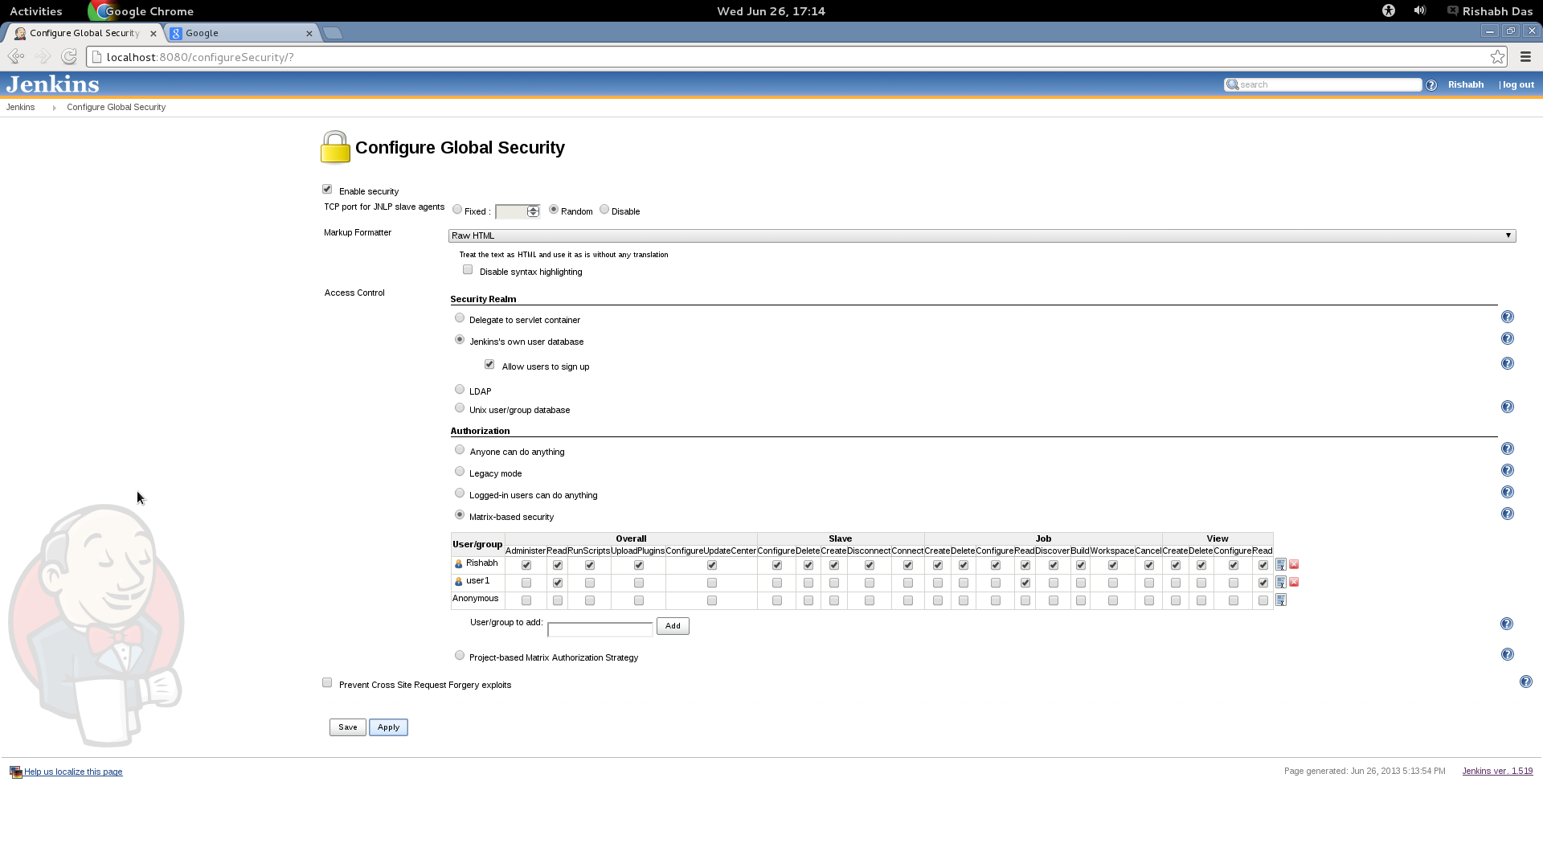
In Jenkins we have the ability to setup users and their relevant permissions on the Jenkins instance.
To configure Security in Jenkins- Click on Manage Jenkins and choose the ‘Configure Global Security’ option.

Slide 12
Thank you

