Slide 1
JENKINS

Slide 2
CICD
Continuous Integration (CI) is a development practice that requires developers to integrate code into a shared repository several times a day.
Continuous Delivery (CD) is the natural extension of Continuous Integration: an approach in which teams ensure that every change to the system is releasable, and that we can release any version at the push of a button.

Slide 3
Pipelines: What are they?
Once you have CI and CD in place, the deployable unit path is called a pipeline

Slide 4
CI TOOLS
CircleCI
Jenkins
TeamCity
Bamboo
GitLab

Slide 5
WHY JENKINS?
Jenkins is used to build and test your software projects continuously making it easier for developers to integrate changes to the project, and making it easier for users to obtain a fresh build
It also allows you to continuously deliver your software by integrating with a large number of testing and deployment technologies
With Jenkins, organizations can accelerate the software development process through automation
Jenkins integrates development life-cycle processes of all kinds, including build, document, test, package, stage, deploy, static analysis and much more

Slide 6
WHY JENKINS MAJORILY USED?
Jenkins is written in Java, so compatible with most of the operating systems.
It automatically triggers the build when the code gets a new commit.
Jenkins deploy code in different environment passing various tests, which makes it a Continuous Delivery tools also.
Jenkins can distribute the builds to different environments when using as Master-Slave Architecture.
It can even send notifications for builds such as emails or to the tools like Slack, Jira, etc

Slide 7
BAMBOO V/S JENKINS
Open Source
User Community
Plugins
Cloud Support
Setup Complexity
Integration with other tools
Project Support

Slide 8
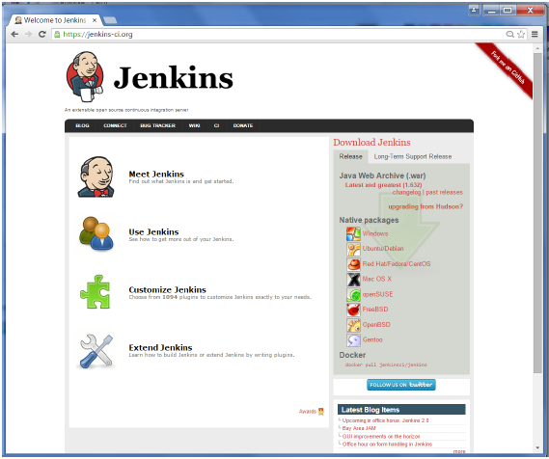
JENKINS INSTALLATION
Download Jenkins: https://jenkins-ci.org/

Slide 9

By default, the latest release and the Long-Term support release will be available for download. The past releases are also available for download. Click the Long-Term Support Release tab in the download section.

Slide 10
STARTING JENKINS
D:\>Java –jar Jenkins.war
After the command is run, various tasks will run, one of which is the extraction of the war file which is done by an embedded webserver called winstone.
D:\>Java –jar Jenkins.war Running from:
D:\jenkins.war Webroot: $user.home/ .jenkins Sep
29, 2015 4:10:46 PM winstone.Logger logInternal
INFO: Beginning extraction from war file
Once the processing is complete without major errors, the following line will come in the output of the command prompt.
INFO: Jenkins is fully up and running

Slide 11
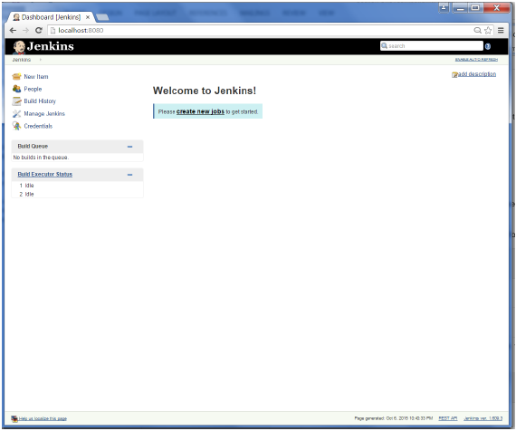
ACCESSING JENKINS
Once Jenkins is up and running, one can access Jenkins from the link − http://localhost:8080
This link will bring up the Jenkins dashboard.

Slide 12
SCM
Source Code Management

Slide 13
SCM – Source Code Management
A source code management system (SCM) is software that provides coordination and services between members of a software development team
At the most basic level, it provides file management and version control so that team members don’t write over each other’s changes, and only the newest versions of files are identified for use in the workspace
SCMs also give developers the ability to work concurrently on files Ability to merge changes with other developers’ changes
Ability to track and audit changes that were requested and made
Ability to track bug-fix status and to perform releases
Types of SCM [ Centralized & Distributed ]
Examples of Centralized Version Control - CVS, Subversion (or SVN) and Perforce
Examples of Distributed Version Control - Mercurial, Git and Bazaar.

Slide 14
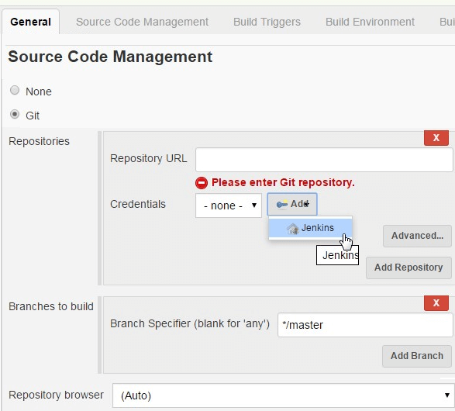

Slide 15
Notifications

Slide 16
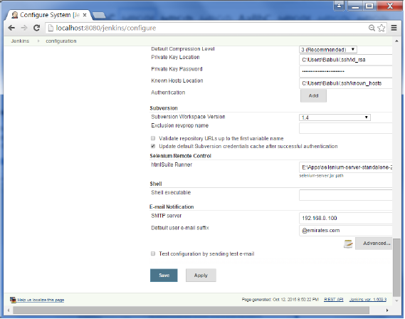
Notifications/Email integration
In all cases, a CI server must let the right people know about any new issues/Status/Build Failures, and it must be able to do so fast.
Alert the developer of a broken build as soon as possible.
Email Extension plugin
Slack Notification plugin

Slide 17
Artifacts

Slide 18
An artifact is by-products produced during the development of software.
An artifact might be a binary executable (a JAR or WAR file for a Java project, for example), or some other related deliverable, such as documentation or source code.
CopyArtifact plugin-publishing artifacts from Jenkins resources (from the current workspace, from the old builds of the same job or other jobs, ...) to remote locations .
ArtifactDeployer plugin -enables you to archive build artifacts to any remote locations shared on the build processor node(outside of JENKINS_HOME directory).
Storing Artifacts
Artifcats can be stored externally in Repository Manager like Nexus or Artifactory etc
Artifacts are stored in the JENKINS_HOME directory with all other elements such as job configuration files.

Slide 19
Jenkins CLI

Slide 20
Jenkins has a built-in command line interface that allows users and administrators to access Jenkins from a script or shell environment.
This can be convenient for scripting of routine tasks, bulk updates, troubleshooting, and more.
The command line interface can be accessed over SSH or with the Jenkins CLI client, a .jar file distributed with Jenkins.
download jar from <jenkins>/jnlpjars/jenkins-cli.jar
run as java –jar jenkins-cli.jar –s <jenkinsurl> help
add –nokeyauth if don’t want to use ssh key

Slide 21
Security

Slide 22
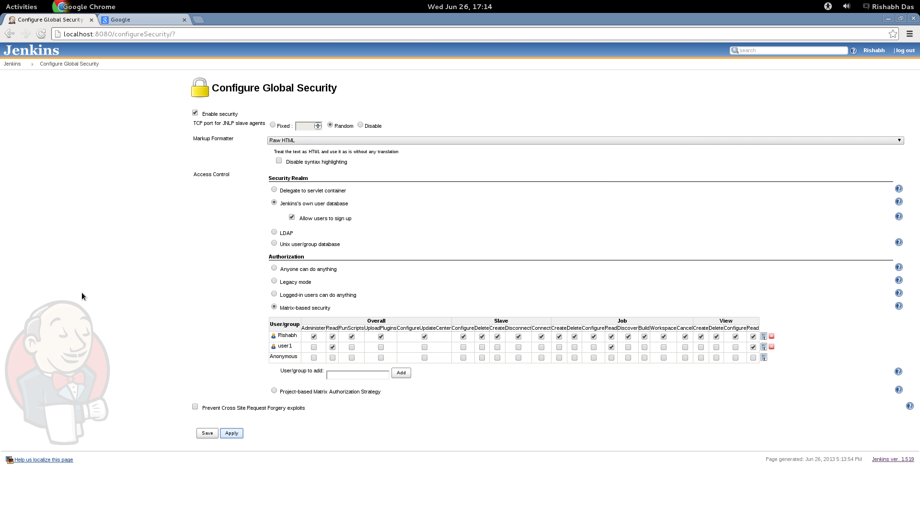
In Jenkins we have the ability to setup users and their relevant permissions on the Jenkins instance.
To configure Security in Jenkins- Click on Manage Jenkins and choose the ‘Configure Global Security’ option.

Slide 23
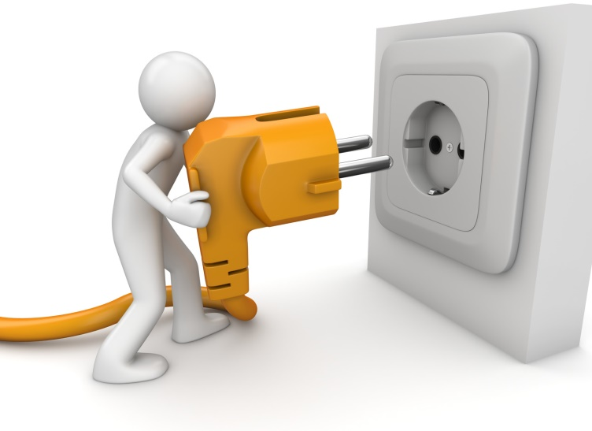
Plugins
Plugin is a software that adds a specific feature to an existing program
It can be installed on a Jenkins master
It is in the form of .hpi file
Plugins will be downloaded in JENKINS_HOME/plugins directory.

Slide 24
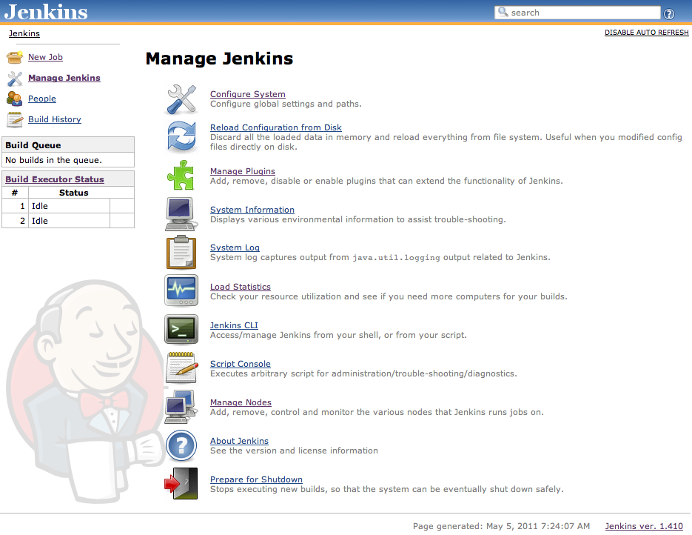
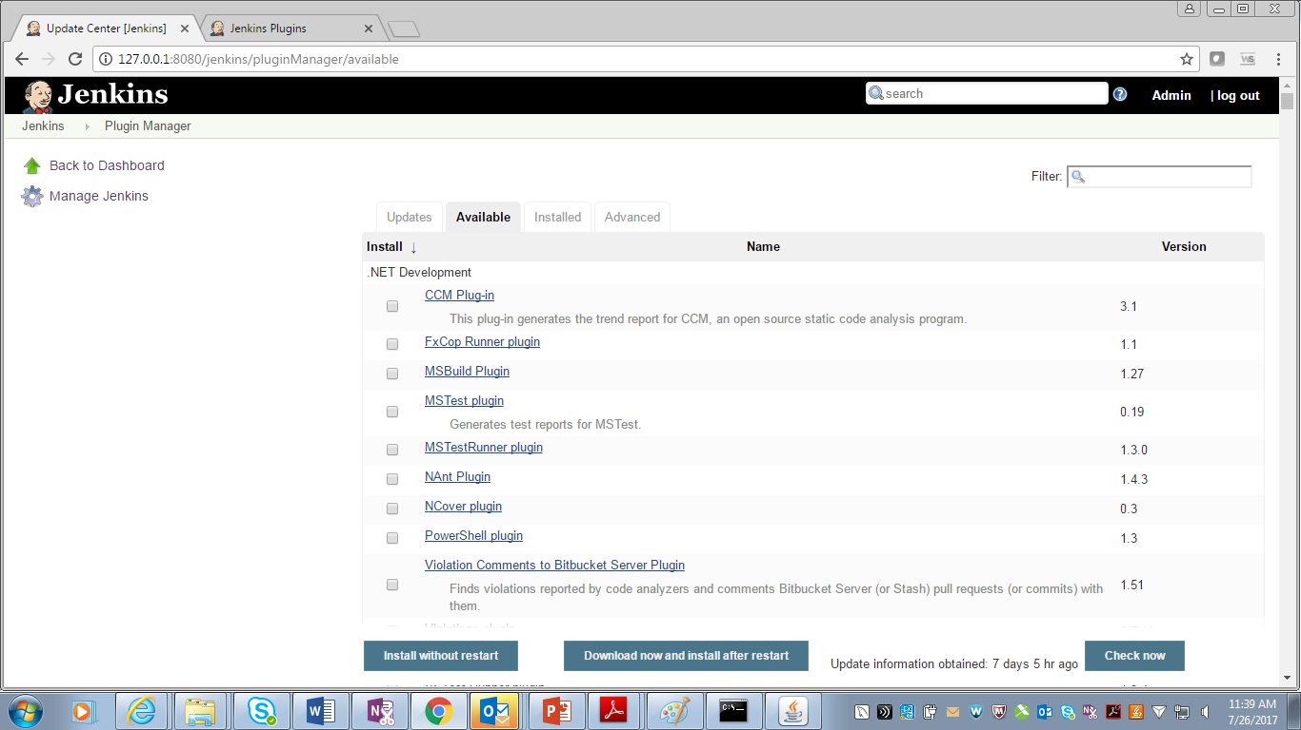

Slide 25
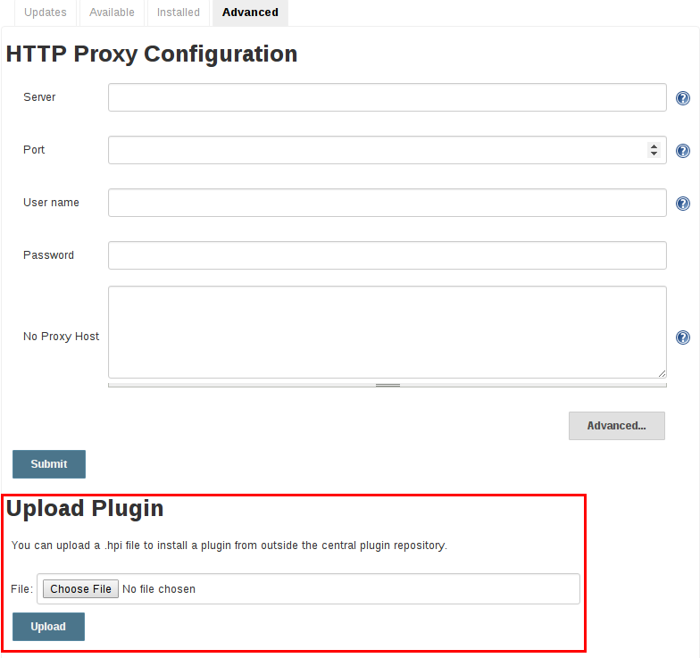
MANUALLY UPLOADING PLUGINS
Navigate to the Manage Jenkins > Manage Plugins page in the web UI.
Click on the Advanced tab.
Choose the .hpi file in Upload Plugin section.
Upload the plugin file.

Slide 26
PROJECTS/JOBS
Types of Project/jobs
Freestyle project-Use to do multiple operations and create simple tasks
Maven project-Use to build a maven projects by using pom.xml file
Pipeline-Jenkins Pipeline is written in a text file, which is called as the Jenkinsfile
Multi branch-Used to implement different Jenkinsfile for different branches of the same project.

Slide 27
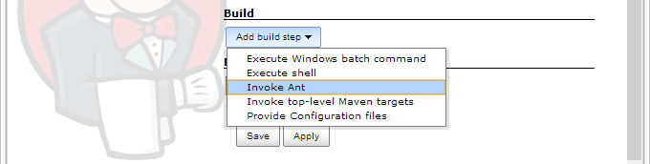
Configuring build tools
Build jobs are the basic currency of a Continuous Integration.
Jenkins supports three principal build tools: Ant, Maven, and the basic shell-script (or Batch script in Windows).
Using Jenkins plugins, you can also add support for other build tools and other languages, such as Gant, Grails, MSBuild, and many more
Navigate to ManageJenkins→configure tools to set the path of build tools.

Slide 28
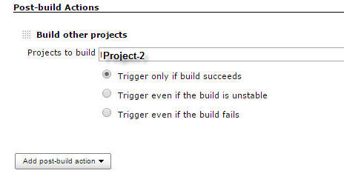
UPSTREAM/DOWNSTREAM
Upstream Job is Triggered before the actual Job
Downstream Job is Triggered after the actual job triggered.

Slide 29
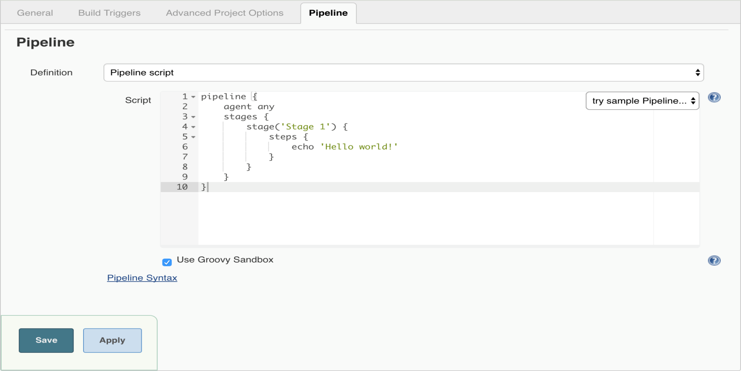
DECLARATIVE VS SCRIPTED
Jenkins file (declarative pipeline) the pipeline block defines all the work done throughout your entire Pipeline.

Slide 30
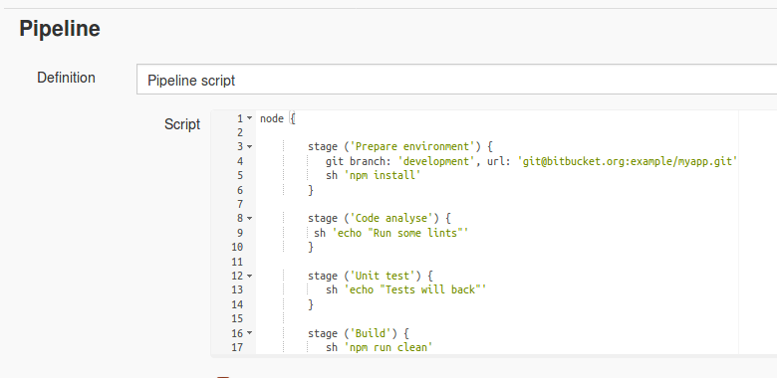
in scripted pipeline syntax, one or more node blocks do the core work throughout the entire pipeline

Slide 31
Thank you

