Slide 1

VRIDHI / CONSTRUCTIONS & DESIGNS
01 / 44 | USER TRAINING
SYSTEM INTRODUCTION
Vridhi
Project operations, connected
From project setup to review
Current-system training
Purchasing, materials, client receipts and labor
in one workspace.
A practical guide for operators, account
managers and support teams.
User permissions and project activity tracking
built into everyday work.
Source-reviewed edition | 16 October 2026
Learn the workflow, understand the numbers, and work within your permissions.
CURRENT SYSTEM | 16 OCT 2026 | Companion guide: docs/current_system_docs
01
Notes:
Vridhi
This deck describes the currently implemented React/FastAPI application, not the earlier HTML prototype. It uses editable schematic elements rather than live screenshots. All amounts and examples are illustrative. This is source-reviewed documentation, not a new end-to-end certification. Use the companion guides for detailed instructions and current boundaries.
Companion documentation / source: README.md; 01-getting-started.md
Demonstrations should use a training database. Do not publish credentials.

Slide 2

VRIDHI / CONSTRUCTIONS & DESIGNS
02 / 44 | USER TRAINING
SYSTEM MAP
One project, connected records
Different modules answer different questions about the same project.
Operational flow
Financial and review flow
Procurement: what was ordered and paid to
vendors?
Cash flow: what was billed to and received from
the client?
Inventory: what arrived, was used, and remains?
Overview: how do costs and project value
compare?
Labor: what was earned, certified, and paid?
Audit Log: who performed the recorded activity?
Always confirm the project before saving a business transaction.
CURRENT SYSTEM | 16 OCT 2026 | Companion guide: docs/current_system_docs
02
Notes:
One project, connected records
A PO records a commitment, not a stock receipt. A client receipt is not a vendor payment. Labor earnings and certified claims contribute to cost, while their payments describe cash settlement. Overview combines selected records rather than acting as a complete general ledger. Users is the standalone account directory and is not scoped to the selected project.
Companion documentation / source: 02-module-guide.md; 05-reports-and-calculations.md
Demonstrations should use a training database. Do not publish credentials.

Slide 3

VRIDHI / CONSTRUCTIONS & DESIGNS
03 / 44 | USER TRAINING
GETTING STARTED
Sign in and orient yourself
Accounts belong to the database, not to a particular computer.
First installation
Everyday sign-in
An empty database seeds the administrator
account and sample data.
Use your username or work email and
password.
Obtain the initial credential privately from the
installer.
Inactive accounts cannot sign in; contact a user
manager.
Change the initial credential before sharing the
installation.
A new computer using the same database uses
existing accounts.
No passwords or service credentials are included in this training deck.
CURRENT SYSTEM | 16 OCT 2026 | Companion guide: docs/current_system_docs
03
Notes:
Sign in and orient yourself
Startup creates missing mapped tables and seeds an empty database, but existing schemas still require Alembic migrations. User passwords are stored as Argon2id hashes. A correct password for a disabled account produces an explicit reactivation message. Password reset delivery by email is not presented as an available workflow; an authorized user manager performs the reset.
Companion documentation / source: 01-getting-started.md; 08-operations-and-troubleshooting.md
Demonstrations should use a training database. Do not publish credentials.

Slide 4

VRIDHI / CONSTRUCTIONS & DESIGNS
04 / 44 | USER TRAINING
NAVIGATION
Your workspace at a glance
Project context and permission-aware navigation guide every task.
Left side
Top bar
Projects opens the portfolio.
Day/Dark mode, local date and time.
WORKSPACE selects an accessible project and
shows its status.
My Details opens your account and permission
summary.
Only allowed project modules appear in the
menu.
Notes keeps temporary reminders across modules.
Sign out ends the session and clears session
notes.
Users remains independent of project selection.
On mobile, swipe the menu row and scroll wide tables inside their panels.
CURRENT SYSTEM | 16 OCT 2026 | Companion guide: docs/current_system_docs
04
Notes:
Your workspace at a glance
The project picker closes on selection, outside click or Escape. Selecting a new project re-evaluates module permissions. Audit Log needs both audit permission and an accessible selected project. The personal notepad is stored per account in the browser tab session rather than in PostgreSQL. Theme preferences use local storage.
Companion documentation / source: 01-getting-started.md; App.tsx
Demonstrations should use a training database. Do not publish credentials.

Slide 5
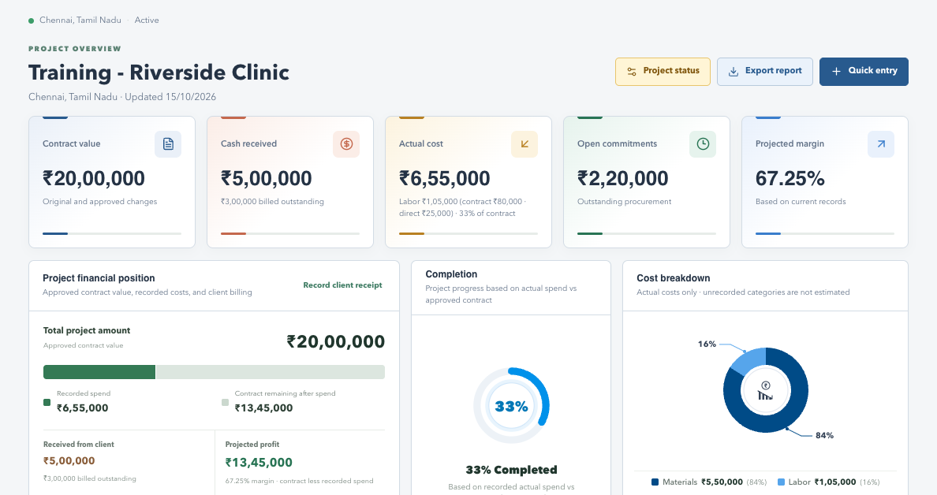
VRIDHI / VISUAL WALKTHROUGH
Workspace: find your controls
Actual application interface | Synthetic sample data | No live records
WHAT TO NOTICE
Left
The selected project and permitted menus.
Top
Theme, Notes, My Details and Sign out.
Main area
Project context, actions and current data.
SCREENSHOT SAMPLE - illustrated training data only; actual records and available actions vary by permission.
CURRENT SYSTEM | 16 OCT 2026 | Companion guide: docs/current_system_docs
05
Notes:
Workspace: find your controls
This is a screenshot of the real frontend rendered locally with synthetic browser-intercepted API responses. It is not a live production database screenshot. No account or business records were changed. Some screens are cropped to focus on their relevant content; lower sections continue below the visible area.
Left: The selected project and permitted menus.
Top: Theme, Notes, My Details and Sign out.
Main area: Project context, actions and current data.
Pair with original explanation slide 4. For complete steps, consult the companion documentation.

Slide 6

VRIDHI / CONSTRUCTIONS & DESIGNS
06 / 44 | USER TRAINING
LEFT MENU 01
Projects
Abstract: the portfolio and entry point for project operations.
What you see
What you do
Project cards grouped by lifecycle status.
Open a project card to work in that project.
Name, location, contract value and actual cost.
Use WORKSPACE to switch context.
Planning, Active, On Hold, Completed and
Cancelled groups.
Choose New Project to enter the setup form.
API authorization still governs project creation.
Portfolio figures reflect projects accessible to the signed-in account.
CURRENT SYSTEM | 16 OCT 2026 | Companion guide: docs/current_system_docs
06
Notes:
Projects
This is a dedicated abstract slide for the Projects menu. New Project is visible in the portfolio UI, but its endpoint requires Overview write authorization. A global account with an appropriate Overview profile is the practical project-independent creation path. Do not interpret a displayed creation button as evidence that any account can create projects.
Companion documentation / source: 02-module-guide.md; 03-workflow-walkthroughs.md
Demonstrations should use a training database. Do not publish credentials.

Slide 7
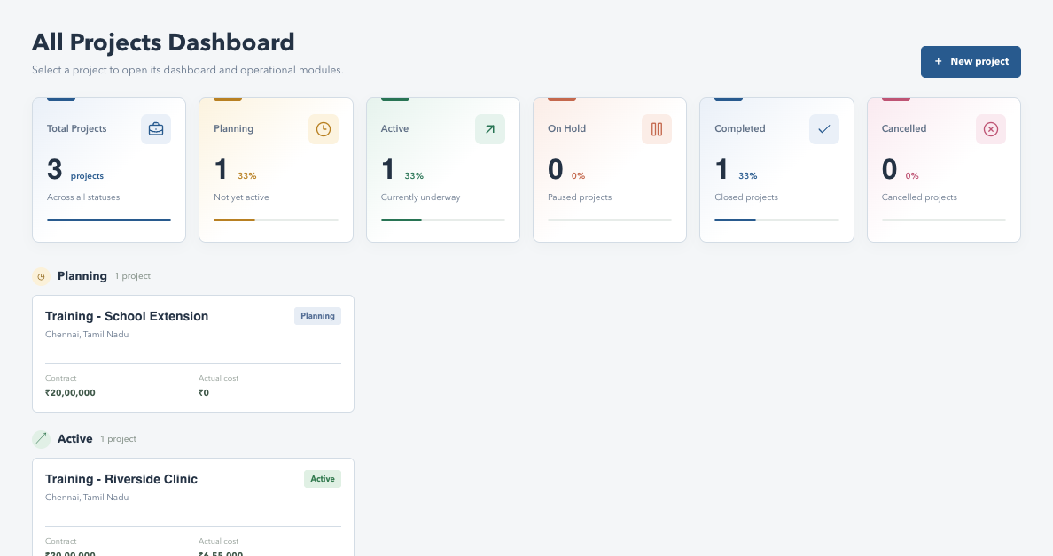
VRIDHI / VISUAL WALKTHROUGH
Projects: portfolio screen
Actual application interface | Synthetic sample data | No live records
WHAT TO NOTICE
Status groups
Planning, Active, On Hold and completed work.
Project cards
Name, location, value and recorded cost.
New project
Starts the setup form, subject to authorization.
SCREENSHOT SAMPLE - illustrated training data only; actual records and available actions vary by permission.
CURRENT SYSTEM | 16 OCT 2026 | Companion guide: docs/current_system_docs
07
Notes:
Projects: portfolio screen
This is a screenshot of the real frontend rendered locally with synthetic browser-intercepted API responses. It is not a live production database screenshot. No account or business records were changed. Some screens are cropped to focus on their relevant content; lower sections continue below the visible area.
Status groups: Planning, Active, On Hold and completed work.
Project cards: Name, location, value and recorded cost.
New project: Starts the setup form, subject to authorization.
Pair with original explanation slide 5. For complete steps, consult the companion documentation.

Slide 8
VRIDHI / CONSTRUCTIONS & DESIGNS
08 / 44 | USER TRAINING
LEFT MENU 02
Overview
Abstract: a consolidated snapshot of the selected project's health.
Read the project
Manage context
Contract value, actual cost, open commitments
and margin.
Review project status and status history.
Upload or download plan documents and inspect
value history.
Cost composition and monthly recorded costs.
Recent POs and client cash data when those
modules are allowed.
Permissioned actions: Update Status, Quick Entry
and Export.
Restricted linked sections remain empty in reports.
Overview cost is not the same as cash paid or remaining stock value.
CURRENT SYSTEM | 16 OCT 2026 | Companion guide: docs/current_system_docs
08
Notes:
Overview
Quick Entry currently opens purchase-order creation, so the actual save also needs the Procurement create/edit grant. Plan upload has its own action grant. An Overview-only account with export permission should not be blocked merely because Procurement or Cash flow is unavailable. The detailed calculation guide explains the basis of each number.
Companion documentation / source: 02-module-guide.md; 05-reports-and-calculations.md
Demonstrations should use a training database. Do not publish credentials.

Slide 9
VRIDHI / VISUAL WALKTHROUGH
Overview: dashboard screen
Actual application interface | Synthetic sample data | No live records
WHAT TO NOTICE
KPIs
Contract, client receipts, cost and margin.
Charts
Financial position and recorded cost mix.
Actions
Status, export and Quick Entry depend on permission.
SCREENSHOT SAMPLE - illustrated training data only; actual records and available actions vary by permission.
CURRENT SYSTEM | 16 OCT 2026 | Companion guide: docs/current_system_docs
09
Notes:
Overview: dashboard screen
This is a screenshot of the real frontend rendered locally with synthetic browser-intercepted API responses. It is not a live production database screenshot. No account or business records were changed. Some screens are cropped to focus on their relevant content; lower sections continue below the visible area.
KPIs: Contract, client receipts, cost and margin.
Charts: Financial position and recorded cost mix.
Actions: Status, export and Quick Entry depend on permission.
Pair with original explanation slide 6. For complete steps, consult the companion documentation.

Slide 10

VRIDHI / CONSTRUCTIONS & DESIGNS
10 / 44 | USER TRAINING
LEFT MENU 03
Procurement
Abstract: purchase orders, vendor installments and outstanding balances.
Register and totals
Actions
PO count, ordered value, paid value and
outstanding balance.
One grant enables both Create and Edit
Purchase Order.
Newest order date first; search vendor, item or PO.
Add Payment is an independent grant.
Payment filters: All, Pending, Partially paid and
Paid.
Review payment history and optional PO
images.
Page sizes: 10, 20, 50, 100 and 200.
Fully paid orders keep edit/payment restrictions.
An order does not increase received inventory until a receipt is recorded.
CURRENT SYSTEM | 16 OCT 2026 | Companion guide: docs/current_system_docs
10
Notes:
Procurement
PO amounts are based on line quantities and unit prices. The API prevents initial payment exceeding the total and additional payments exceeding the balance. Optional image formats are PNG/JPG/WEBP up to the configured 10 MB limit. Procurement export explicitly fetches all project orders, rather than carrying the current screen search/status filter.
Companion documentation / source: 02-module-guide.md; 03-workflow-walkthroughs.md; 05-reports-and-calculations.md
Demonstrations should use a training database. Do not publish credentials.

Slide 11
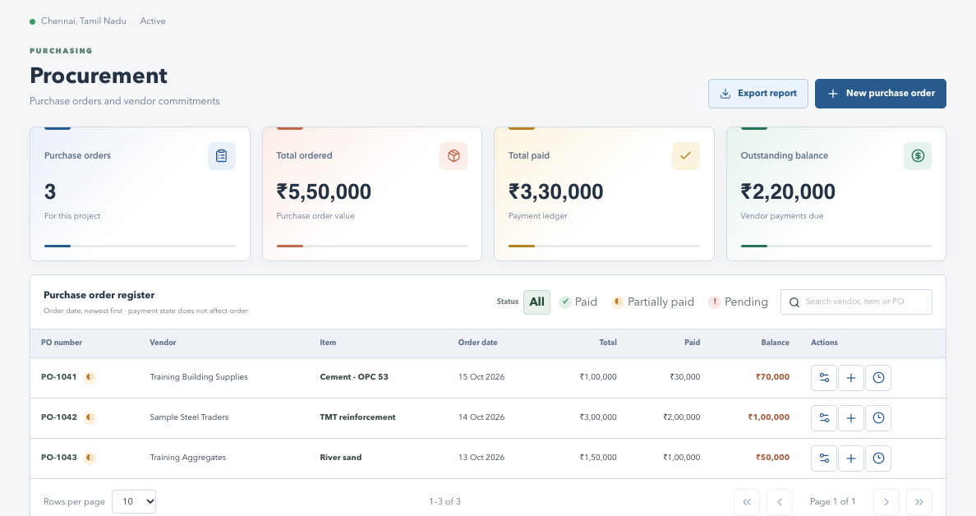
VRIDHI / VISUAL WALKTHROUGH
Procurement: register screen
Actual application interface | Synthetic sample data | No live records
WHAT TO NOTICE
Totals
Ordered, paid and outstanding vendor amounts.
Register
Search and payment filters above PO rows.
Row icons
Edit, payment and history follow grants and record state.
SCREENSHOT SAMPLE - illustrated training data only; actual records and available actions vary by permission.
CURRENT SYSTEM | 16 OCT 2026 | Companion guide: docs/current_system_docs
11
Notes:
Procurement: register screen
This is a screenshot of the real frontend rendered locally with synthetic browser-intercepted API responses. It is not a live production database screenshot. No account or business records were changed. Some screens are cropped to focus on their relevant content; lower sections continue below the visible area.
Totals: Ordered, paid and outstanding vendor amounts.
Register: Search and payment filters above PO rows.
Row icons: Edit, payment and history follow grants and record state.
Pair with original explanation slide 7. For complete steps, consult the companion documentation.

Slide 12

VRIDHI / CONSTRUCTIONS & DESIGNS
12 / 44 | USER TRAINING
LEFT MENU 04
Inventory
Abstract: material receipts, site consumption and available stock.
Read the material register
Record physical events
Ordered, open, received, consumed and
available quantities.
Receive Stock records actual inward quantity.
Use Stock records material consumed on site.
Material, vendor, unit and valuation context.
Receive and Use have separate action
permissions.
Search/material filters and paginated rows.
Stock ledger shows dated movements and
recorder details.
Check units, references and quantity before
submitting.
Remaining stock valuation should not equal all purchase-order costs.
CURRENT SYSTEM | 16 OCT 2026 | Companion guide: docs/current_system_docs
12
Notes:
Inventory
A PO makes a material available in the procurement-linked register, but it is not proof of receipt. Record references and notes so physical events can be traced later. Mixed units must not be treated as one meaningful total quantity. This report prints the rendered register, so users should check filters, page size and preview coverage.
Companion documentation / source: 02-module-guide.md; 03-workflow-walkthroughs.md
Demonstrations should use a training database. Do not publish credentials.

Slide 13
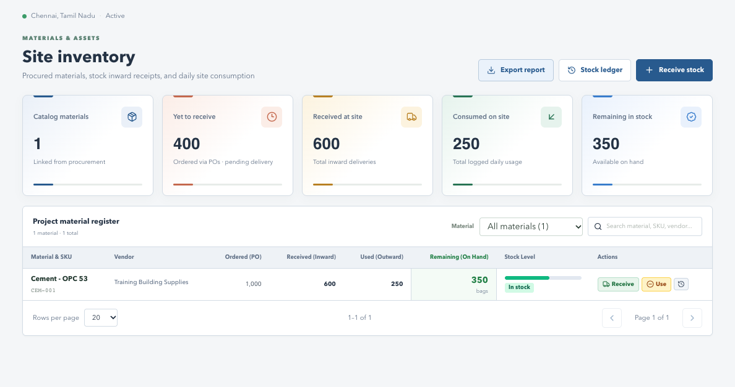
VRIDHI / VISUAL WALKTHROUGH
Inventory: material register
Actual application interface | Synthetic sample data | No live records
WHAT TO NOTICE
Stock
Ordered, received, used and available quantities.
Actions
Receive Stock and Stock ledger in the header.
Verify
Check units and source references before saving.
SCREENSHOT SAMPLE - illustrated training data only; actual records and available actions vary by permission.
CURRENT SYSTEM | 16 OCT 2026 | Companion guide: docs/current_system_docs
13
Notes:
Inventory: material register
This is a screenshot of the real frontend rendered locally with synthetic browser-intercepted API responses. It is not a live production database screenshot. No account or business records were changed. Some screens are cropped to focus on their relevant content; lower sections continue below the visible area.
Stock: Ordered, received, used and available quantities.
Actions: Receive Stock and Stock ledger in the header.
Verify: Check units and source references before saving.
Pair with original explanation slide 8. For complete steps, consult the companion documentation.

Slide 14

VRIDHI / CONSTRUCTIONS & DESIGNS
14 / 44 | USER TRAINING
LEFT MENU 05
Cash flow
Abstract: client billing applications, receipts and allocations.
What the numbers mean
Daily actions
Contract value: approved project/client value.
New Application records a client billing amount.
Billed to client: recorded billing applications.
Record Receipt captures date, method and
reference.
Cash received: all recorded client receipts.
Billed outstanding: unpaid allocated application
balance.
Allocate receipts to the intended application.
Search/page billing and receipt registers
separately.
Unallocated cash increases receipts but does not settle a specific bill.
CURRENT SYSTEM | 16 OCT 2026 | Companion guide: docs/current_system_docs
14
Notes:
Cash flow
Allocated receipts cannot exceed an application's remaining amount. Vendor payments and labor payments are not client receipts. The existing cash summary returns zero retainage values; do not present a complete retention-release workflow as implemented. Export scope depends on the rendered register filters/pages.
Companion documentation / source: 02-module-guide.md; 05-reports-and-calculations.md
Demonstrations should use a training database. Do not publish credentials.

Slide 15
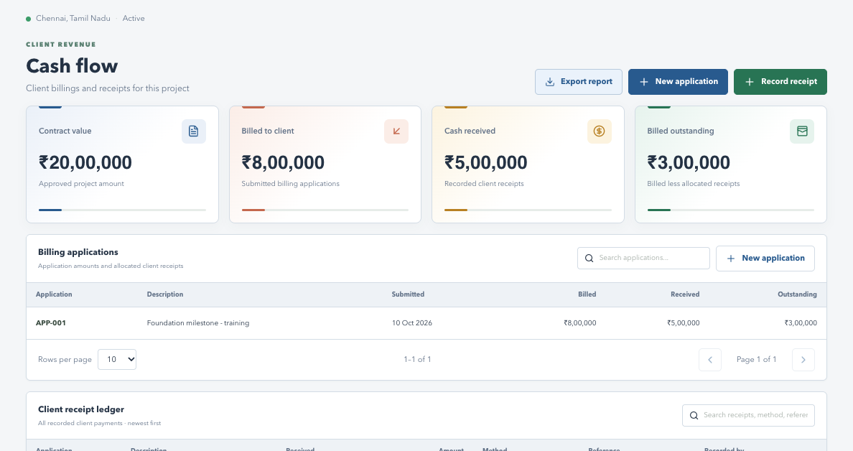
VRIDHI / VISUAL WALKTHROUGH
Cash flow: client money screen
Actual application interface | Synthetic sample data | No live records
WHAT TO NOTICE
Client totals
Contract, billed, received and outstanding.
Applications
Client billing entries and allocated receipts.
Actions
New application and Record receipt are separate grants.
SCREENSHOT SAMPLE - illustrated training data only; actual records and available actions vary by permission.
CURRENT SYSTEM | 16 OCT 2026 | Companion guide: docs/current_system_docs
15
Notes:
Cash flow: client money screen
This is a screenshot of the real frontend rendered locally with synthetic browser-intercepted API responses. It is not a live production database screenshot. No account or business records were changed. Some screens are cropped to focus on their relevant content; lower sections continue below the visible area.
Client totals: Contract, billed, received and outstanding.
Applications: Client billing entries and allocated receipts.
Actions: New application and Record receipt are separate grants.
Pair with original explanation slide 9. For complete steps, consult the companion documentation.

Slide 16

VRIDHI / CONSTRUCTIONS & DESIGNS
16 / 44 | USER TRAINING
LEFT MENU 06
Labor and Wages
Abstract: direct-worker records and subcontract-labor workflows.
Direct workers
Subcontract labor
Add/edit workers and their trades/contact details.
Create unit-rate or lump-sum labor contracts.
Log work with quantity, unit and rate.
Link plan baselines and supporting contract files.
Record wage payments; compare earned, paid
and payable.
Review changes and certify/reject progress
claims.
Activate/deactivate workers when appropriate.
Pay eligible claims and inspect file/history
records.
Earned/certified labor contributes to cost; payment is its settlement.
CURRENT SYSTEM | 16 OCT 2026 | Companion guide: docs/current_system_docs
16
Notes:
Labor and Wages
The page contains multiple independently paginated sections: contracts, review items, contract-change history, documents, workers, work entries and wages. Grants distinguish contract creation, worker actions, work logging, paying and downloads. Review endpoints map to the relevant contract/work action rather than old job-title roles.
Companion documentation / source: 02-module-guide.md; 04-users-and-permissions.md
Demonstrations should use a training database. Do not publish credentials.

Slide 17
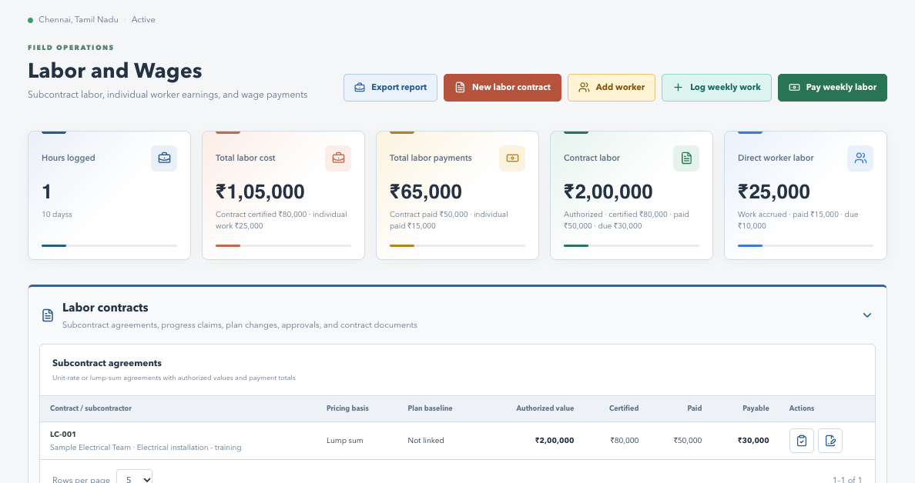
VRIDHI / VISUAL WALKTHROUGH
Labor and Wages: contracts and workers
Actual application interface | Synthetic sample data | No live records
WHAT TO NOTICE
Two paths
Direct workers and subcontract agreements.
Review
Claims and contract changes have review states.
History
Expand sections and inspect files, work and payments.
SCREENSHOT SAMPLE - illustrated training data only; actual records and available actions vary by permission.
CURRENT SYSTEM | 16 OCT 2026 | Companion guide: docs/current_system_docs
17
Notes:
Labor and Wages: contracts and workers
This is a screenshot of the real frontend rendered locally with synthetic browser-intercepted API responses. It is not a live production database screenshot. No account or business records were changed. Some screens are cropped to focus on their relevant content; lower sections continue below the visible area.
Two paths: Direct workers and subcontract agreements.
Review: Claims and contract changes have review states.
History: Expand sections and inspect files, work and payments.
Pair with original explanation slide 10. For complete steps, consult the companion documentation.

Slide 18

VRIDHI / CONSTRUCTIONS & DESIGNS
18 / 44 | USER TRAINING
LEFT MENU 07
Users
Abstract: standalone account directory and permission administration.
Directory
Account lifecycle
All non-deleted accounts, independent of selected
project.
Add/Edit through a two-step wizard.
Separate Reset, Activate/Deactivate, Delete and
History grants.
Search contact/account details and review account
status.
Username is immutable on Edit.
View opens a read-only details and permissions
popup.
Delete disables/hides the account but keeps its
history.
Export follows a separate Users export grant.
A Users-only account needs neither project assignment nor Global access.
CURRENT SYSTEM | 16 OCT 2026 | Companion guide: docs/current_system_docs
18
Notes:
Users
Password reset and deactivation revoke existing sessions. Reset/status/delete cannot target the current account. User History starts at 5 rows, with 10/20/50 options, and excludes login activities. It shows recorded actions by or affecting the user, which is different from the selected project's Audit Log.
Companion documentation / source: 02-module-guide.md; 04-users-and-permissions.md
Demonstrations should use a training database. Do not publish credentials.

Slide 19
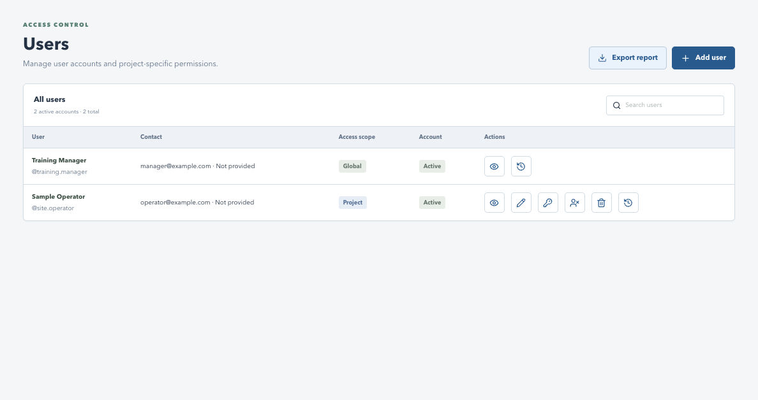
VRIDHI / VISUAL WALKTHROUGH
Users: directory and action icons
Actual application interface | Synthetic sample data | No live records
WHAT TO NOTICE
Directory
All users, not just the selected project's members.
Icons
View, Edit, Reset, Status, Delete and History.
Authorization
Only granted actions are available.
SCREENSHOT SAMPLE - illustrated training data only; actual records and available actions vary by permission.
CURRENT SYSTEM | 16 OCT 2026 | Companion guide: docs/current_system_docs
19
Notes:
Users: directory and action icons
This is a screenshot of the real frontend rendered locally with synthetic browser-intercepted API responses. It is not a live production database screenshot. No account or business records were changed. Some screens are cropped to focus on their relevant content; lower sections continue below the visible area.
Directory: All users, not just the selected project's members.
Icons: View, Edit, Reset, Status, Delete and History.
Authorization: Only granted actions are available.
Pair with original explanation slide 11. For complete steps, consult the companion documentation.

Slide 20
VRIDHI / CONSTRUCTIONS & DESIGNS
20 / 44 | USER TRAINING
LEFT MENU 08
Audit Log
Abstract: investigate recorded activities for one accessible project.
Table and filters
Tracked events
Username | Date/time | Activity | Record | Details |
Reference.
Visited Inventory and other tracked project
modules.
Newest first, with search and applied date/time
range.
Exported report from Inventory (export requested).
Saved business changes where audit events are
emitted.
Default 10 rows; options 20, 50 and 100.
Expand recorded changes for readable
explanations.
Export includes every matching project row.
An export request is not proof that the user saved or downloaded a PDF.
CURRENT SYSTEM | 16 OCT 2026 | Companion guide: docs/current_system_docs
20
Notes:
Audit Log
Audit Access and Export are standalone account grants, but project access is still necessary. Record is the entity type and Reference is its internal ID. Some historical events have no full before/after snapshot. This is not a complete click recorder or a reliable list of every failed operation.
Companion documentation / source: 02-module-guide.md; 05-reports-and-calculations.md
Demonstrations should use a training database. Do not publish credentials.

Slide 21
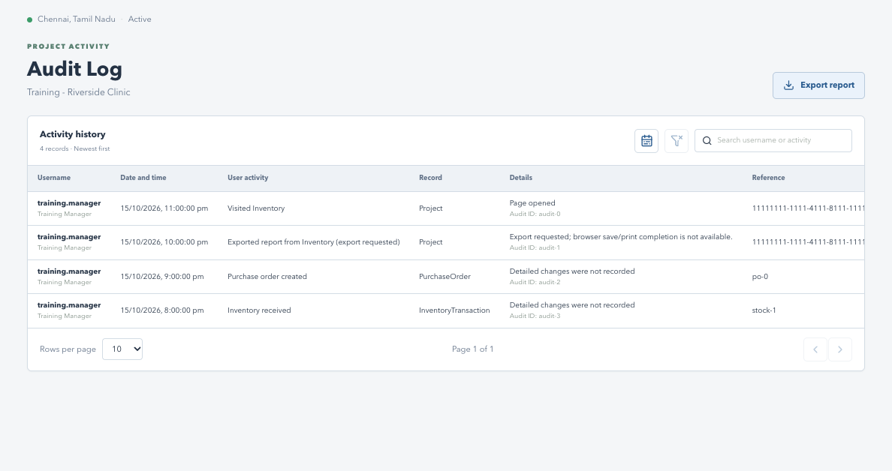
VRIDHI / VISUAL WALKTHROUGH
Audit Log: project activity table
Actual application interface | Synthetic sample data | No live records
WHAT TO NOTICE
Newest first
Actor, timestamp, activity and affected record.
Tools
Time range, clear filters and text search.
Export
All matching project records, not only this page.
SCREENSHOT SAMPLE - illustrated training data only; actual records and available actions vary by permission.
CURRENT SYSTEM | 16 OCT 2026 | Companion guide: docs/current_system_docs
21
Notes:
Audit Log: project activity table
This is a screenshot of the real frontend rendered locally with synthetic browser-intercepted API responses. It is not a live production database screenshot. No account or business records were changed. Some screens are cropped to focus on their relevant content; lower sections continue below the visible area.
Newest first: Actor, timestamp, activity and affected record.
Tools: Time range, clear filters and text search.
Export: All matching project records, not only this page.
Pair with original explanation slide 12. For complete steps, consult the companion documentation.

Slide 22
VRIDHI / CONSTRUCTIONS & DESIGNS
22 / 44 | USER TRAINING
WORKFLOW 01
New Project: from form to workspace
Walkthrough: Projects > New project > review > save.
1. Enter the baseline
2. Attach and verify
Project name and location.
Optional initial plan approval file and comment.
Approved budget and contract value: separate
amounts.
PDF, PNG, JPG/JPEG or DOCX; maximum 10 MB.
Save, then review Overview and the document
record.
Start date and initial status: Planning or Active.
Use nonnegative monetary values.
Assign the team and explicit permissions through
Users.
Create the right project once, then verify its context before entering records.
CURRENT SYSTEM | 16 OCT 2026 | Companion guide: docs/current_system_docs
22
Notes:
New Project: from form to workspace
The API authorizes creation through Overview write access. An initial plan sets a starting document, not a separate revised-value event. Uploaded original bytes live in the project's data/uploads directory; PostgreSQL holds metadata. Creating a project does not remove the need to configure team membership profiles.
Companion documentation / source: 03-workflow-walkthroughs.md
Demonstrations should use a training database. Do not publish credentials.

Slide 23
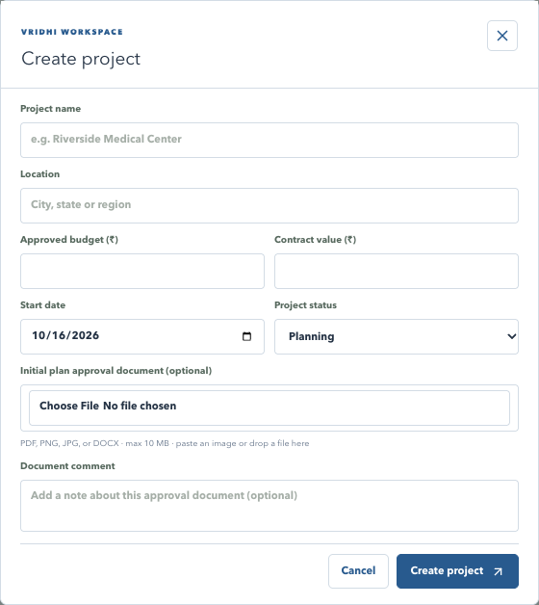
VRIDHI / VISUAL WALKTHROUGH
New Project: actual form
Actual application interface | Synthetic sample data | No live records
WHAT TO NOTICE
Identity
Enter project name and location.
Baseline
Budget, contract value, date and initial status.
Optional file
Choose, paste or drop an initial plan document.
SCREENSHOT SAMPLE - illustrated training data only; actual records and available actions vary by permission.
CURRENT SYSTEM | 16 OCT 2026 | Companion guide: docs/current_system_docs
23
Notes:
New Project: actual form
This is a screenshot of the real frontend rendered locally with synthetic browser-intercepted API responses. It is not a live production database screenshot. No account or business records were changed. Some screens are cropped to focus on their relevant content; lower sections continue below the visible area.
Identity: Enter project name and location.
Baseline: Budget, contract value, date and initial status.
Optional file: Choose, paste or drop an initial plan document.
Pair with original explanation slide 13. For complete steps, consult the companion documentation.

Slide 24
VRIDHI / CONSTRUCTIONS & DESIGNS
24 / 44 | USER TRAINING
WORKFLOW 02
Change project status safely
Walkthrough: Overview > Update status > comment > confirm.
Allowed transitions
Required review
Planning -> Active / On Hold / Cancelled.
Choose an offered next state; enter a meaningful
comment.
Active -> On Hold / Completed / Cancelled.
On Hold also requires a hold reason.
On Hold -> Active / Completed / Cancelled.
Completed requires explicit completion
confirmation.
Cancelled -> Planning; Completed has no next
state.
Refresh and review if another user changed the
version.
Review the new state and status-history entry after saving.
CURRENT SYSTEM | 16 OCT 2026 | Companion guide: docs/current_system_docs
24
Notes:
Change project status safely
The server uses the expected project version and the transition map, not arbitrary status changes. Keep the essential explanation in the required comment because the history persists that comment. The hold-reason control does not replace a meaningful status comment. Status transitions do not automatically imply every financial record has been reconciled.
Companion documentation / source: 03-workflow-walkthroughs.md; models.py PROJECT_STATUS_TRANSITIONS
Demonstrations should use a training database. Do not publish credentials.

Slide 25
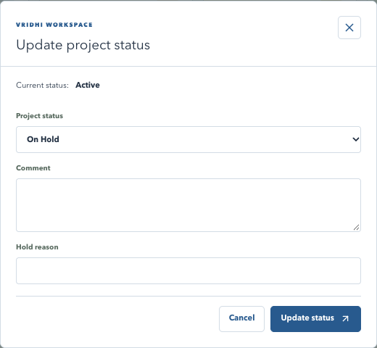
VRIDHI / VISUAL WALKTHROUGH
Project status: actual dialog
Actual application interface | Synthetic sample data | No live records
WHAT TO NOTICE
Current state
Shown before selecting the next status.
Comment
Explain the business reason for the change.
Conditional
Hold reason or completion confirmation may be required.
SCREENSHOT SAMPLE - illustrated training data only; actual records and available actions vary by permission.
CURRENT SYSTEM | 16 OCT 2026 | Companion guide: docs/current_system_docs
25
Notes:
Project status: actual dialog
This is a screenshot of the real frontend rendered locally with synthetic browser-intercepted API responses. It is not a live production database screenshot. No account or business records were changed. Some screens are cropped to focus on their relevant content; lower sections continue below the visible area.
Current state: Shown before selecting the next status.
Comment: Explain the business reason for the change.
Conditional: Hold reason or completion confirmation may be required.
Pair with original explanation slide 14. For complete steps, consult the companion documentation.

Slide 26

VRIDHI / CONSTRUCTIONS & DESIGNS
26 / 44 | USER TRAINING
WORKFLOW 03
Plan documents and project value
Files, estimate revisions and reports are different outputs.
Upload a revised plan
Retrieve or report
Allowed while Planning, Active or On Hold.
Download icon retrieves the original plan file.
Confirm current value and enter the new estimate.
Export Report prints the project report, not the
original.
Choose a supported nonempty file and optional
comment.
Revised-plan save updates the current estimate.
Review plan history and value history after saving.
Do not assume a separate project-value
approval queue.
Keep original documents and their recorded comments traceable.
CURRENT SYSTEM | 16 OCT 2026 | Companion guide: docs/current_system_docs
26
Notes:
Plan documents and project value
The upload endpoint validates the current estimate against the contract and checks file type/size/content. Supported revised plan types are PDF/PNG/JPG/DOCX. File bytes and database metadata must both be backed up. Completed/Cancelled projects reject these new plan uploads.
Companion documentation / source: 03-workflow-walkthroughs.md; 07-data-and-persistence.md
Demonstrations should use a training database. Do not publish credentials.

Slide 27
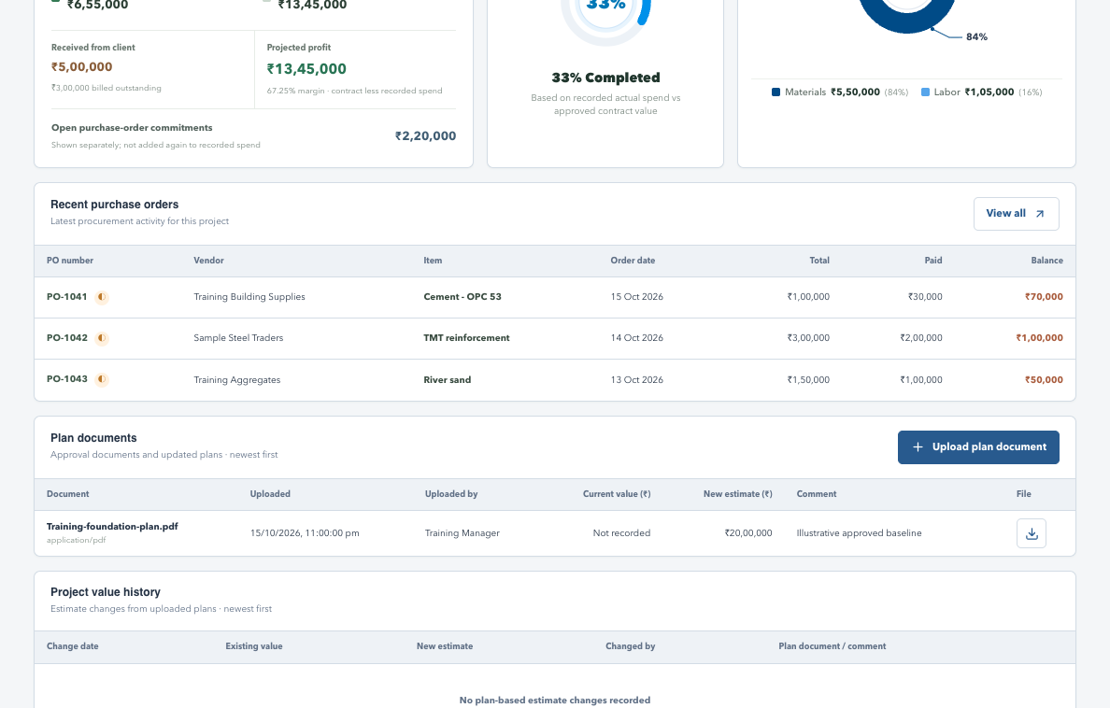
VRIDHI / VISUAL WALKTHROUGH
Plan documents: history and download
Actual application interface | Synthetic sample data | No live records
WHAT TO NOTICE
File metadata
Filename, uploader, time and comments.
Download
Icon retrieves the original file.
Value history
Revised plans can change the recorded estimate.
SCREENSHOT SAMPLE - illustrated training data only; actual records and available actions vary by permission.
CURRENT SYSTEM | 16 OCT 2026 | Companion guide: docs/current_system_docs
27
Notes:
Plan documents: history and download
This is a screenshot of the real frontend rendered locally with synthetic browser-intercepted API responses. It is not a live production database screenshot. No account or business records were changed. Some screens are cropped to focus on their relevant content; lower sections continue below the visible area.
File metadata: Filename, uploader, time and comments.
Download: Icon retrieves the original file.
Value history: Revised plans can change the recorded estimate.
Pair with original explanation slide 15. For complete steps, consult the companion documentation.

Slide 28
VRIDHI / CONSTRUCTIONS & DESIGNS
28 / 44 | USER TRAINING
WORKFLOW 04
Purchasing to stock: two separate events
Trace the order, receipt and consumption without mixing money and quantity.
Procurement path
Inventory path
Create PO -> verify quantity x price and vendor.
Receive actual quantity, with PO/reference when
applicable.
Optional initial payment -> check total and
balance.
Use material when consumed on site.
Later installments -> inspect payment history.
Verify available balance and the stock ledger.
Edit only while the record remains eligible.
Check units and separate Receive/Use grants.
Paying a vendor neither receives stock nor records site consumption.
CURRENT SYSTEM | 16 OCT 2026 | Companion guide: docs/current_system_docs
28
Notes:
Purchasing to stock: two separate events
For demonstration, use a test material and small quantities. Save a PO, receive only part of its quantity, then record some use. Compare ordered/open/received/consumed/available rows. The overview material cost uses orders, while inventory remaining value measures a different basis.
Companion documentation / source: 03-workflow-walkthroughs.md; 05-reports-and-calculations.md
Demonstrations should use a training database. Do not publish credentials.

Slide 29
VRIDHI / CONSTRUCTIONS & DESIGNS
29 / 44 | USER TRAINING
WORKFLOW 05
Labor: choose the correct cost path
Avoid double counting work, certification and payment.
Direct labor
Contract labor
Add worker -> log work quantity/unit/rate.
Create contract -> submit claim -> review/certify.
Work amount contributes to earnings and cost.
Certified claims contribute to cost.
Record wage payment as settlement.
Pay eligible claim and retain payment
references.
Compare earned, paid and payable.
Review scope/value changes through addenda.
Do not add payments to cost again when the work/claim is already counted.
CURRENT SYSTEM | 16 OCT 2026 | Companion guide: docs/current_system_docs
29
Notes:
Labor: choose the correct cost path
A full subcontract contract value is not automatically the same as certified work cost. Pending or rejected claims should not be treated as certified earnings. Supporting files and history downloads require their own action grants. The application is not a replacement for an independently audited payroll/accounting system.
Companion documentation / source: 03-workflow-walkthroughs.md; 05-reports-and-calculations.md
Demonstrations should use a training database. Do not publish credentials.

Slide 30
VRIDHI / CONSTRUCTIONS & DESIGNS
30 / 44 | USER TRAINING
ACCOUNT MANAGEMENT
Add/Edit User: two steps
Account details first, access configuration second.
Step 1: account details
Step 2: access
Full name; optional work email and contact
number.
Select projects and project permission scope.
Use shared selected projects or Global as
appropriate.
Unique username, fixed after account creation.
Password and confirmation; minimum six
characters.
Configure Users and Audit Log separately.
Review individual action grants, then save.
On Edit, leave password blank to keep it.
A password change through Edit still requires Reset Password permission.
CURRENT SYSTEM | 16 OCT 2026 | Companion guide: docs/current_system_docs
30
Notes:
Add/Edit User: two steps
Email is optional but validated and unique when supplied. Usernames permit letters/numbers/dot/underscore/hyphen and are validated by schema and route. Password hashes and session tokens are never shown in View. A user manager with Add/Edit should be trusted to assign access; least privilege should guide grants.
Companion documentation / source: 04-users-and-permissions.md; 03-workflow-walkthroughs.md
Demonstrations should use a training database. Do not publish credentials.

Slide 31
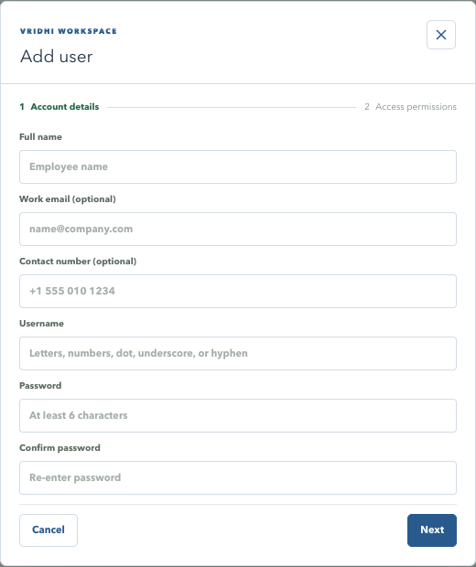
VRIDHI / VISUAL WALKTHROUGH
User wizard: account details
Actual application interface | Synthetic sample data | No live records
WHAT TO NOTICE
Required
Name, unique username and matching password.
Optional
Work email and contact number.
Next
Continue to access settings; do not save this sample.
SCREENSHOT SAMPLE - illustrated training data only; actual records and available actions vary by permission.
CURRENT SYSTEM | 16 OCT 2026 | Companion guide: docs/current_system_docs
31
Notes:
User wizard: account details
This is a screenshot of the real frontend rendered locally with synthetic browser-intercepted API responses. It is not a live production database screenshot. No account or business records were changed. Some screens are cropped to focus on their relevant content; lower sections continue below the visible area.
Required: Name, unique username and matching password.
Optional: Work email and contact number.
Next: Continue to access settings; do not save this sample.
Pair with original explanation slide 18. For complete steps, consult the companion documentation.

Slide 32

VRIDHI / CONSTRUCTIONS & DESIGNS
32 / 44 | USER TRAINING
AUTHORIZATION
Project permissions and access scopes
Permission profiles replace the old business-role model.
Choose the project scope
Choose module capability
Individual: configure each assigned project.
Access Allow/Block controls the page.
Shared: one saved profile for checked projects
only.
Read Export controls reporting.
Write All or only checked Partial actions.
Shared preset allows operational modules, not
Users.
Explicit project modules override the Global
baseline.
Global: baseline across all available projects.
Global automatically includes Users/Audit grants, not an override of every project restriction.
CURRENT SYSTEM | 16 OCT 2026 | Companion guide: docs/current_system_docs
32
Notes:
Project permissions and access scopes
Shared profiles are stored on the selected memberships; they do not automatically assign future projects. Blocked is the safe default for ordinary new project permission profiles. Create/Edit PO is combined but Add Payment remains separate. Quick Entry is a shortcut whose save still follows destination API authorization.
Companion documentation / source: 04-users-and-permissions.md
Demonstrations should use a training database. Do not publish credentials.

Slide 33
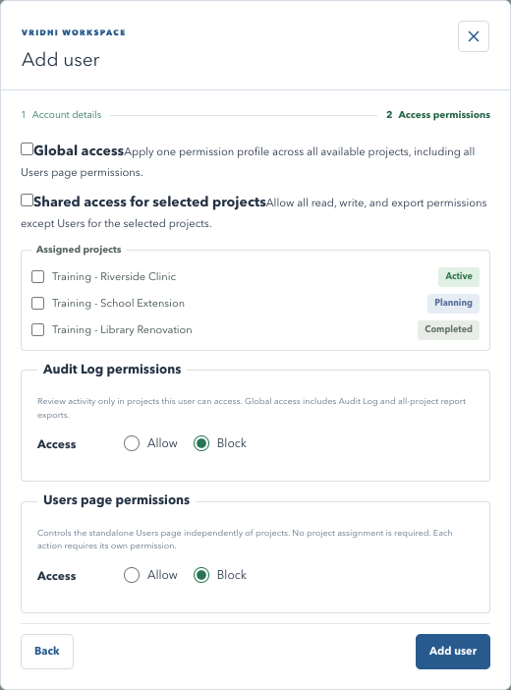
VRIDHI / VISUAL WALKTHROUGH
User wizard: access settings
Actual application interface | Synthetic sample data | No live records
WHAT TO NOTICE
Project scope
Global, shared selected, or individual profiles.
Assigned projects
Checkboxes include lifecycle status.
Separate sections
Audit Log and Users page permissions.
SCREENSHOT SAMPLE - illustrated training data only; actual records and available actions vary by permission.
CURRENT SYSTEM | 16 OCT 2026 | Companion guide: docs/current_system_docs
33
Notes:
User wizard: access settings
This is a screenshot of the real frontend rendered locally with synthetic browser-intercepted API responses. It is not a live production database screenshot. No account or business records were changed. Some screens are cropped to focus on their relevant content; lower sections continue below the visible area.
Project scope: Global, shared selected, or individual profiles.
Assigned projects: Checkboxes include lifecycle status.
Separate sections: Audit Log and Users page permissions.
Pair with original explanation slide 19. For complete steps, consult the companion documentation.

Slide 34
VRIDHI / CONSTRUCTIONS & DESIGNS
34 / 44 | USER TRAINING
AUTHORIZATION
Standalone Users and Audit permissions
Administrative menus have their own account-level access settings.
Users
Audit Log
Access and Export directory.
Separate Access and Export Report grants.
Add/Edit; Reset Password; Activate/Deactivate.
Still needs an accessible selected project.
Delete; History.
Global accounts include both capabilities.
Can be granted without any assigned project.
Read activity without granting operational writes.
Grant only the actions a person needs; self lifecycle actions are protected.
CURRENT SYSTEM | 16 OCT 2026 | Companion guide: docs/current_system_docs
34
Notes:
Standalone Users and Audit permissions
Users directory access is not filtered by the project selector. Reset and deactivation revoke sessions; deletion is a soft deletion retaining historical relationships. User History excludes login events and starts with 5 rows, unlike project Audit Log's default 10. Do not grant administrative Add/Edit merely to allow a user to see account details.
Companion documentation / source: 04-users-and-permissions.md
Demonstrations should use a training database. Do not publish credentials.

Slide 35

VRIDHI / CONSTRUCTIONS & DESIGNS
35 / 44 | USER TRAINING
AUDIT WORKFLOW
Investigate a time interval
Audit Log > calendar filter > choose range/time > Apply.
Select the interval
Review the results
Today / Yesterday / Last 7 days / This month
shortcuts.
Apply commits the draft range and resets
pagination.
Select start and end dates in the calendar.
Search narrows username/activity.
Choose From/To time on the analog dial.
Clear filters restores the full list.
Select hour, minute and AM/PM; confirm with
OK.
Export fetches all matching rows, newest first.
Local input is sent with timezone information; To includes its ending minute.
CURRENT SYSTEM | 16 OCT 2026 | Companion guide: docs/current_system_docs
35
Notes:
Investigate a time interval
Closing the date-range editor before Apply preserves the previous filter. Cancel in the time popup preserves the prior confirmed time. The calendar highlights today and uses the application theme. Record and Reference help identify affected entities; readable details depend on what the event actually captured.
Companion documentation / source: 03-workflow-walkthroughs.md; 05-reports-and-calculations.md
Demonstrations should use a training database. Do not publish credentials.

Slide 36
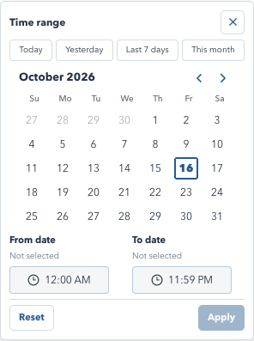
VRIDHI / VISUAL WALKTHROUGH
Audit filter: date range and time
Actual application interface | Synthetic sample data | No live records
WHAT TO NOTICE
Shortcuts
Today, Yesterday, Last 7 days and This month.
Range
Select dates, then From and To times.
Apply
Commits the draft range to search and export.
SCREENSHOT SAMPLE - illustrated training data only; actual records and available actions vary by permission.
CURRENT SYSTEM | 16 OCT 2026 | Companion guide: docs/current_system_docs
36
Notes:
Audit filter: date range and time
This is a screenshot of the real frontend rendered locally with synthetic browser-intercepted API responses. It is not a live production database screenshot. No account or business records were changed. Some screens are cropped to focus on their relevant content; lower sections continue below the visible area.
Shortcuts: Today, Yesterday, Last 7 days and This month.
Range: Select dates, then From and To times.
Apply: Commits the draft range to search and export.
Pair with original explanation slide 21. For complete steps, consult the companion documentation.

Slide 37

VRIDHI / CONSTRUCTIONS & DESIGNS
37 / 44 | USER TRAINING
REPORTING
Export Report: how PDF is created
The application prepares a report; your browser creates the saved PDF.
1. Prepare
2. Preview and save
Confirm project, permission and intended report
scope.
Browser print opens -> select Save as PDF.
Choose pages, orientation, scale and margins.
Select Export report and wait for data/fonts.
Review all rows/sections in the preview.
Company logo/name, report title and date are
included.
Save locally; Cancel does not save a document.
Screen Dark mode does not carry into the print
palette.
The export audit event records the request, not successful PDF completion.
CURRENT SYSTEM | 16 OCT 2026 | Companion guide: docs/current_system_docs
37
Notes:
Export Report: how PDF is created
The shared header still uses a Company Address placeholder, which should be replaced in the application before distributing official external documents. Personal Notes and navigation are print-hidden. Browser/OS naming and print controls vary; the app does not provide guaranteed server-rendered PDFs.
Companion documentation / source: 05-reports-and-calculations.md
Demonstrations should use a training database. Do not publish credentials.

Slide 38
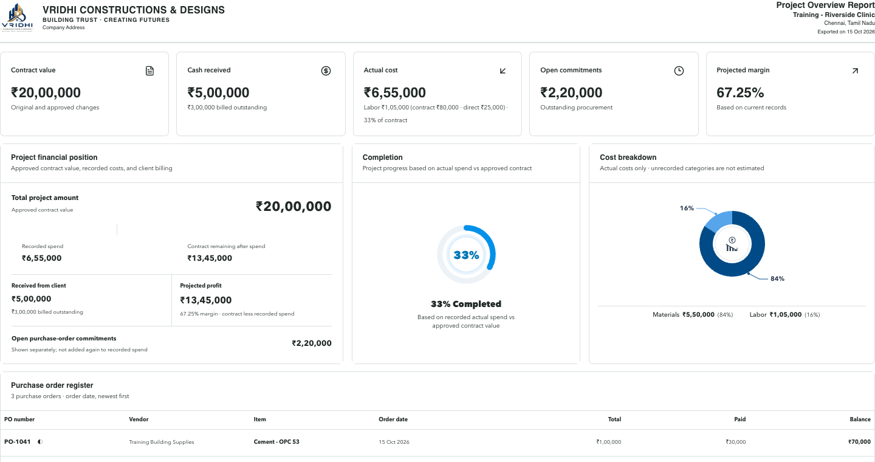
VRIDHI / VISUAL WALKTHROUGH
Export: sample printable report
Actual application interface | Synthetic sample data | No live records
WHAT TO NOTICE
Header
Company logo/name, report, project and export date.
Day palette
White surfaces, even from Dark screen mode.
Save
Browser Print > Save as PDF; check preview coverage.
SCREENSHOT SAMPLE - illustrated training data only; actual records and available actions vary by permission.
CURRENT SYSTEM | 16 OCT 2026 | Companion guide: docs/current_system_docs
38
Notes:
Export: sample printable report
This is a screenshot of the real frontend rendered locally with synthetic browser-intercepted API responses. It is not a live production database screenshot. No account or business records were changed. Some screens are cropped to focus on their relevant content; lower sections continue below the visible area.
Header: Company logo/name, report, project and export date.
Day palette: White surfaces, even from Dark screen mode.
Save: Browser Print > Save as PDF; check preview coverage.
Pair with original explanation slide 22. For complete steps, consult the companion documentation.

Slide 39
VRIDHI / CONSTRUCTIONS & DESIGNS
39 / 44 | USER TRAINING
REPORTING
Know what your report includes
Do not assume every export ignores pagination and filters.
Explicit full-data preparation
Rendered-section reports
Audit: every project row matching search and
time range.
Overview: restricted sections stay empty.
Inventory/Cash flow: check filters and pages.
Procurement: all project POs, not screen filters.
Labor: check pages and expanded sections.
Users: loaded directory with the current search.
Inspect preview before treating a PDF as
complete.
Original-file Download is different from Export report.
CURRENT SYSTEM | 16 OCT 2026 | Companion guide: docs/current_system_docs
39
Notes:
Know what your report includes
This is an intentionally explicit source-reviewed boundary. Only some export handlers fetch all pages. Printing CSS cannot manufacture rows that were not rendered. Users should choose larger page sizes or separate reports where appropriate. The Audit API retains a CSV technical option, but the current UI Export Report invokes browser PDF printing.
Companion documentation / source: 05-reports-and-calculations.md
Demonstrations should use a training database. Do not publish credentials.

Slide 40
VRIDHI / CONSTRUCTIONS & DESIGNS
40 / 44 | USER TRAINING
RECONCILIATION
Understand the financial numbers
Illustrative example: different bases do not imply a mismatch.
Cost and commitments
Client money and inventory
POs 100,000 + direct earnings 10,000 + certified
claims 20,000.
Billed 80,000; receipts 50,000.
Only 40,000 allocated -> billed outstanding
40,000.
Actual cost = INR 130,000.
Contract INR 200,000 -> projected margin 35%.
Remaining stock value is not all PO cost.
Vendor paid 30,000 -> PO outstanding 70,000.
Payments settle liabilities; do not add them to
cost twice.
Compare the same project, currency, date basis and record state.
CURRENT SYSTEM | 16 OCT 2026 | Companion guide: docs/current_system_docs
40
Notes:
Understand the financial numbers
All figures are illustrative, not current live balances. The current actual-cost basis is materials ordered plus direct work earnings plus certified labor claims. Projected margin is not final audited profit or cash balance. Mixed stock units require care. Full formula definitions are in the companion reporting guide.
Companion documentation / source: 05-reports-and-calculations.md
Demonstrations should use a training database. Do not publish credentials.

Slide 41

VRIDHI / CONSTRUCTIONS & DESIGNS
41 / 44 | USER TRAINING
PERSONAL WORKSPACE
My Details, Notes and mobile work
Small tools that support work across modules.
My Details and Notes
Responsive navigation
Badge opens read-only
account/contact/permission details.
WORKSPACE stays above the mobile menu
row.
Notes auto-save per account in the current
browser session.
Swipe menu items to reach allowed modules.
Wide registers scroll within panels.
Resize the left edge; collapse without clearing.
Notes becomes a constrained mobile drawer.
Clear asks confirmation; sign-out removes notes.
Temporary Notes are not an audit trail, shared record or database backup.
CURRENT SYSTEM | 16 OCT 2026 | Companion guide: docs/current_system_docs
41
Notes:
My Details, Notes and mobile work
Notes survive refresh in the same session but can disappear on tab/session closure or storage restrictions. They are excluded from printing. Account-specific storage prevents deliberate reuse between user IDs; users should still sign out on shared machines. A failed sign-out request does not deliberately clear notes before success.
Companion documentation / source: 01-getting-started.md
Demonstrations should use a training database. Do not publish credentials.

Slide 42

VRIDHI / CONSTRUCTIONS & DESIGNS
42 / 44 | USER TRAINING
TECHNICAL OVERVIEW
Architecture and safe storage
Understand the boundaries before operating or extending the system.
Application stack
Data protection boundaries
React/TypeScript + Vite + TanStack Query.
Passwords: salted one-way Argon2id hashes.
FastAPI + Pydantic + async SQLAlchemy.
Sessions: opaque cookie and stored token
digest.
PostgreSQL business data, sessions and audit.
Alembic manages changes to existing schemas.
Original files: project data/uploads directory.
HTTPS and storage encryption need deployment
setup.
Password hashing does not encrypt database files, uploads or local HTTP traffic.
CURRENT SYSTEM | 16 OCT 2026 | Companion guide: docs/current_system_docs
42
Notes:
Architecture and safe storage
The live API explorer at /docs is the authority for exact endpoint contracts. Route families separate projects, procurement, operations, labor, admin, audit and system services. Diagnostic JSONL logs are different from the audit_events business table. Legacy role/timecard tables may remain without representing current menus.
Companion documentation / source: 06-architecture-and-api-map.md; 07-data-and-persistence.md
Demonstrations should use a training database. Do not publish credentials.

Slide 43
VRIDHI / CONSTRUCTIONS & DESIGNS
43 / 44 | USER TRAINING
OPERATIONS
First run, backup and support
A working database and a recoverable installation matter as much as the UI.
Start and preserve
When something fails
Use the OS launcher and the intended
PostgreSQL database.
Check API readiness and the selected project first.
Review permission/action grants and record state.
Apply migrations before using updated schemas.
Refresh CSRF/session if expired; never bypass
checks.
Back up PostgreSQL and uploads together.
Test restoration in a separate environment.
Record time, action and request context for
support.
A Docker volume is persistence, not an independent backup.
CURRENT SYSTEM | 16 OCT 2026 | Companion guide: docs/current_system_docs
43
Notes:
First run, backup and support
Local PostgreSQL normally uses 5432 and the optional Docker service uses 5433. Changing DATABASE_URL does not copy data. A backend started without reload may need a managed restart after code changes. Secure secrets, configure HTTPS/cookies/origins and service supervision before network exposure. Known bootstrap passwords should not appear in the deck.
Companion documentation / source: 08-operations-and-troubleshooting.md
Demonstrations should use a training database. Do not publish credentials.

Slide 44
VRIDHI / CONSTRUCTIONS & DESIGNS
44 / 44 | USER TRAINING
WRAP-UP
Practice checklist and next steps
Use a training database, not live project records.
Practice the complete loop
Know where to look next
Create project -> update status with comment.
01 Getting started / 02 Module guide / 03
Workflows.
Create PO -> receive stock -> record use.
Record billing/receipt and direct work or contract
claim.
04 Permissions / 05 Reports and calculations.
06 Architecture / 07 Data / 08 Operations.
Review Audit Log and save one PDF report.
09 Evidence and acceptance / 10 Presenter
guide.
This source-reviewed guide explains current behavior; validate your operational release.
CURRENT SYSTEM | 16 OCT 2026 | Companion guide: docs/current_system_docs
44
Notes:
Practice checklist and next steps
Demonstrate a read-only account after the operational walkthrough to show permission differences. Confirm no real accounts or financial records are modified for training. Use the evidence checklist to plan UAT, restore drills and report reconciliation. Documentation must be refreshed when implementation changes; it is not a production-completeness estimate.
Companion documentation / source: 09-evidence-and-acceptance.md; 10-presentation-outline.md
Demonstrations should use a training database. Do not publish credentials.

