Slide 1

VRIDHI / CONSTRUCTIONS & DESIGNS
01 / 88 | USER TRAINING
Welcome to Vridhi Groups.
Build with clarity. Work with confidence.
See how your projects, people and company finances connect.
Turn everyday actions into clear, traceable records.
01
FIND YOUR WAY
02
CONNECT THE WORK
03
SEE THE BIG PICTURE
Get comfortable in your workspace.
Follow projects, purchases and teams.
Understand cash, reports and activity.
LET'S EXPLORE WHAT YOU CAN DO.
ILLUSTRATED SYSTEM TRAINING | 16 DEC 2026
01
Notes:
Welcome to Vridhi
Welcome participants and connect the training to their daily work. Introduce the three themes: orient yourself, connect operational records, and understand company finances and activity. Invite participants to keep one real workflow in mind as they follow the walkthroughs. Use synthetic training data for demonstrations, never live business submissions.
Presentation edition: 16 December 2026. Company Cashbook training added: 10 Dec 2026.

Slide 2
VRIDHI / CONSTRUCTIONS & DESIGNS
02 / 88 | USER TRAINING
SYSTEM INTRODUCTION
Vridhi
Project operations, connected
From project setup to review
Current-system training
Purchasing, materials, client receipts and labor
in one workspace.
A practical guide for operators, account
managers and support teams.
User permissions and project activity tracking
built into everyday work.
Source-reviewed edition | 16 December 2026
Learn the workflow, understand the numbers, and work within your permissions.
Company Cashbook training added: 10 Dec 2026 | New section before the closing checklist
02
CURRENT SYSTEM | 16 DEC 2026 | Companion guide: docs/current_system_docs
Notes:
Vridhi
This deck describes the currently implemented React/FastAPI application, not the earlier HTML prototype. It uses editable schematic elements rather than live screenshots. All amounts and examples are illustrative. This is source-reviewed documentation, not a new end-to-end certification. Use the companion guides for detailed instructions and current boundaries.
Companion documentation / source: README.md; 01-getting-started.md
Demonstrations should use a training database. Do not publish credentials.

Slide 3

VRIDHI / CONSTRUCTIONS & DESIGNS
03 / 88 | USER TRAINING
SYSTEM MAP
One project, connected records
Different modules answer different questions about the same project.
Operational flow
Financial and review flow
Procurement: what was ordered and paid to
vendors?
Cash flow: what was billed to and received from
the client?
Inventory: what arrived, was used, and remains?
Overview: how do costs and project value
compare?
Labor: what was earned, certified, and paid?
Audit Log: who performed the recorded activity?
Always confirm the project before saving a business transaction.
CURRENT SYSTEM | 16 DEC 2026 | Companion guide: docs/current_system_docs
03
Notes:
One project, connected records
A PO records a commitment, not a stock receipt. A client receipt is not a vendor payment. Labor earnings and certified claims contribute to cost, while their payments describe cash settlement. Overview combines selected records rather than acting as a complete general ledger. Users is the standalone account directory and is not scoped to the selected project.
Companion documentation / source: 02-module-guide.md; 05-reports-and-calculations.md
Demonstrations should use a training database. Do not publish credentials.

Slide 4

VRIDHI / CONSTRUCTIONS & DESIGNS
04 / 88 | USER TRAINING
GETTING STARTED
Sign in and orient yourself
Accounts belong to the database, not to a particular computer.
First installation
Everyday sign-in
An empty database seeds the administrator
account and sample data.
Use your username or work email and
password.
Obtain the initial credential privately from the
installer.
Inactive accounts cannot sign in; contact a user
manager.
Change the initial credential before sharing the
installation.
A new computer using the same database uses
existing accounts.
No passwords or service credentials are included in this training deck.
CURRENT SYSTEM | 16 DEC 2026 | Companion guide: docs/current_system_docs
04
Notes:
Sign in and orient yourself
Startup creates missing mapped tables and seeds an empty database, but existing schemas still require Alembic migrations. User passwords are stored as Argon2id hashes. A correct password for a disabled account produces an explicit reactivation message. Password reset delivery by email is not presented as an available workflow; an authorized user manager performs the reset.
Companion documentation / source: 01-getting-started.md; 08-operations-and-troubleshooting.md
Demonstrations should use a training database. Do not publish credentials.

Slide 5
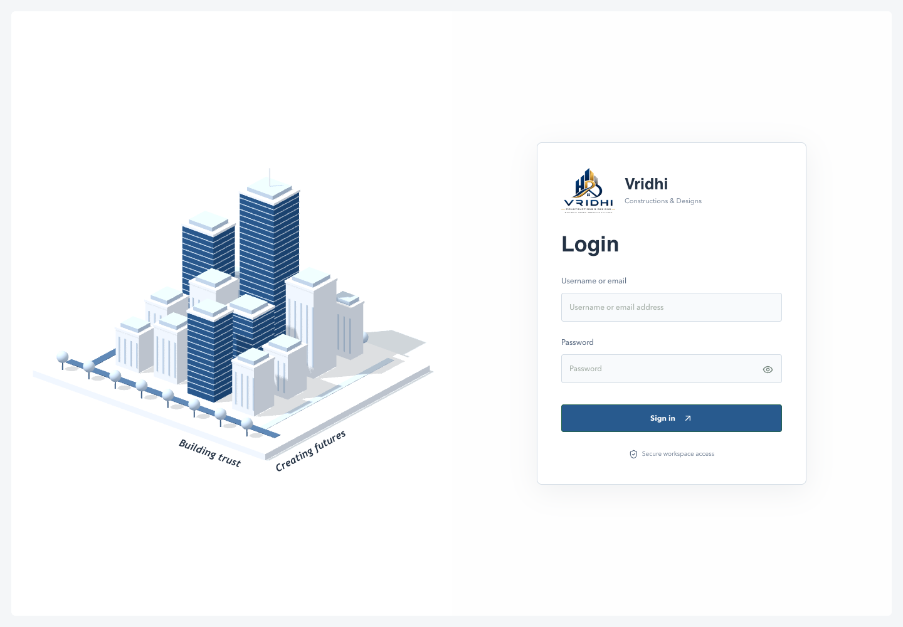
VRIDHI / CONSTRUCTIONS & DESIGNS
05 / 88 | USER TRAINING
GETTING STARTED / CLIENT WALKTHROUGH
Your first step: sign in to Vridhi
Actual Login screen | Empty form shown for demonstration | No credentials displayed
EXPLAIN TO THE CLIENT
1 Identify yourself
Enter your username
or registered work email.
2 Enter your password
Use the eye icon to show
or hide the password.
3 Open your workspace
Select Sign in. Access follows
your account permissions.
Keep credentials private. Inactive accounts must contact a user manager.
CURRENT SYSTEM | 16 DEC 2026 | Client demonstration
05

Slide 6

VRIDHI / CONSTRUCTIONS & DESIGNS
06 / 88 | USER TRAINING
NAVIGATION
Your workspace at a glance
Project context and permission-aware navigation guide every task.
Left side
Top bar
Projects opens the portfolio.
Day/Dark mode, local date and time.
WORKSPACE selects an accessible project and
shows its status.
My Details opens your account and permission
summary.
Only allowed project modules appear in the
menu.
Notes keeps temporary reminders across modules.
Sign out ends the session and clears session
notes.
Users remains independent of project selection.
On mobile, swipe the menu row and scroll wide tables inside their panels.
CURRENT SYSTEM | 16 DEC 2026 | Companion guide: docs/current_system_docs
06
Notes:
Your workspace at a glance
The project picker closes on selection, outside click or Escape. Selecting a new project re-evaluates module permissions. Audit Log needs both audit permission and an accessible selected project. The personal notepad is stored per account in the browser tab session rather than in PostgreSQL. Theme preferences use local storage.
Companion documentation / source: 01-getting-started.md; App.tsx
Demonstrations should use a training database. Do not publish credentials.

Slide 7
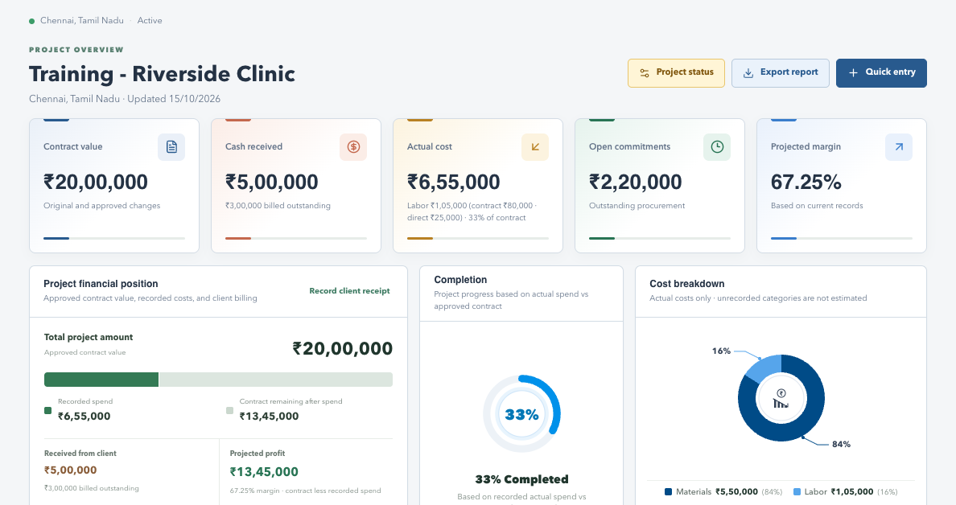
VRIDHI / VISUAL WALKTHROUGH
Workspace: find your controls
Actual application interface | Synthetic sample data | No live records
WHAT TO NOTICE
Left
The selected project and permitted menus.
Top
Theme, Notes, My Details and Sign out.
Main area
Project context, actions and current data.
SCREENSHOT SAMPLE - illustrated training data only; actual records and available actions vary by permission.
CURRENT SYSTEM | 16 DEC 2026 | Companion guide: docs/current_system_docs
07
Notes:
Workspace: find your controls
This is a screenshot of the real frontend rendered locally with synthetic browser-intercepted API responses. It is not a live production database screenshot. No account or business records were changed. Some screens are cropped to focus on their relevant content; lower sections continue below the visible area.
Left: The selected project and permitted menus.
Top: Theme, Notes, My Details and Sign out.
Main area: Project context, actions and current data.
Pair with original explanation slide 4. For complete steps, consult the companion documentation.

Slide 8

VRIDHI / CONSTRUCTIONS & DESIGNS
08 / 88 | USER TRAINING
LEFT MENU 01
Projects
Abstract: the portfolio and entry point for project operations.
What you see
What you do
Project cards grouped by lifecycle status.
Open a project card to work in that project.
Name, location, contract value and actual cost.
Use WORKSPACE to switch context.
Current Projects and Archived Projects
tabs; 10 projects per page.
Choose New Project to enter the setup form.
API authorization still governs project creation.
Portfolio figures reflect projects accessible to the signed-in account.
CURRENT SYSTEM | 16 DEC 2026 | Companion guide: docs/current_system_docs
08
Notes:
Projects
This is a dedicated abstract slide for the Projects menu. New Project is visible in the portfolio UI, but its endpoint requires Overview write authorization. A global account with an appropriate Overview profile is the practical project-independent creation path. Do not interpret a displayed creation button as evidence that any account can create projects. Completed and Cancelled projects can be moved to Archived Projects; see the Project Archive section.
Companion documentation / source: 02-module-guide.md; 03-workflow-walkthroughs.md
Demonstrations should use a training database. Do not publish credentials.

Slide 9
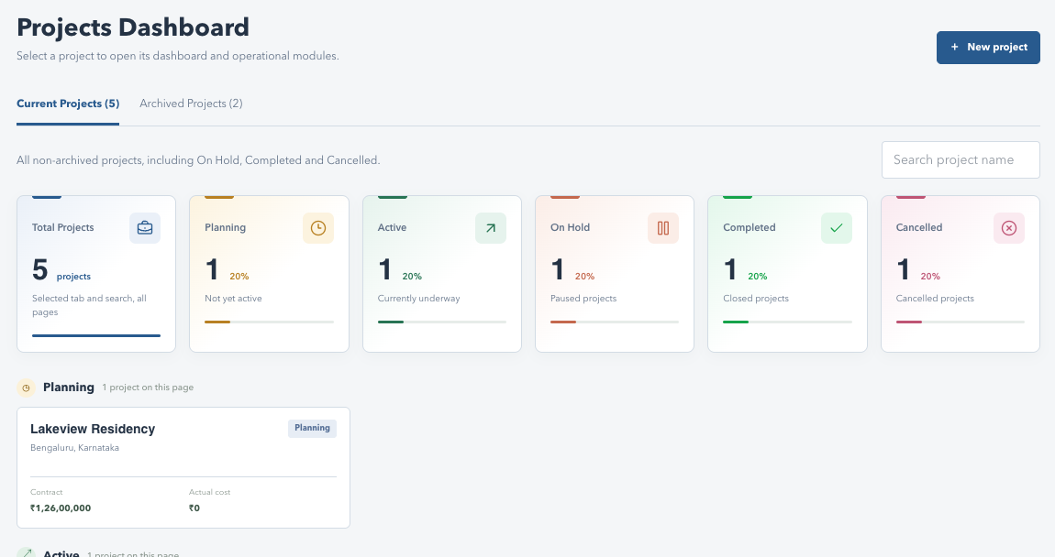
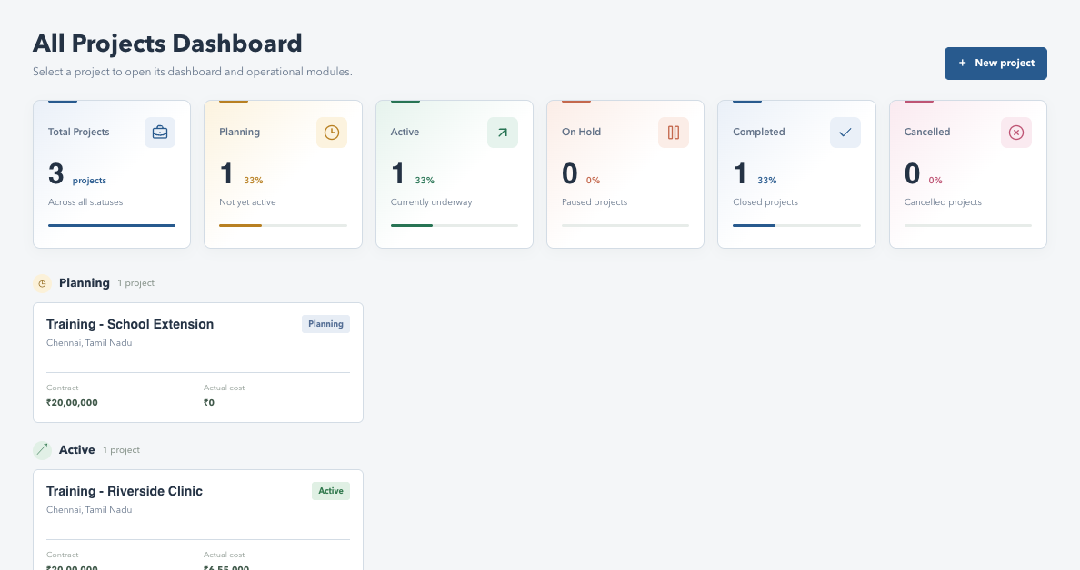
VRIDHI / VISUAL WALKTHROUGH
Projects: portfolio screen
Actual application interface | Synthetic sample data | No live records
WHAT TO NOTICE
Two tabs
Current and Archived Projects with counts.
Project cards
Name, location, value and recorded cost.
New project
Starts the setup form, subject to authorization.
SCREENSHOT SAMPLE - illustrated training data only; actual records and available actions vary by permission.
CURRENT SYSTEM | 16 DEC 2026 | Companion guide: docs/current_system_docs
09
Notes:
Projects: portfolio screen
This is a screenshot of the real frontend rendered locally with synthetic browser-intercepted API responses. It is not a live production database screenshot. No account or business records were changed. Some screens are cropped to focus on their relevant content; lower sections continue below the visible area.
Two tabs: Current and Archived Projects with counts; status tiles and groups follow the selected tab.
Project cards: Name, location, value and recorded cost.
New project: Starts the setup form, subject to authorization.
Pair with original explanation slide 5. For complete steps, consult the companion documentation.

Slide 10
VRIDHI / CONSTRUCTIONS & DESIGNS
10 / 88 | USER TRAINING
LEFT MENU 02
Overview
Abstract: a consolidated snapshot of the selected project's health.
Read the project
Manage context
Contract value, actual cost, open commitments
and margin.
Review project status and status history.
Upload or download plan documents and inspect
value history.
Cost composition and monthly recorded costs.
Recent POs and client cash data when those
modules are allowed.
Permissioned actions: Update Status, Quick Entry
and Export.
Restricted linked sections remain empty in reports.
Overview cost is not the same as cash paid or remaining stock value.
CURRENT SYSTEM | 16 DEC 2026 | Companion guide: docs/current_system_docs
10
Notes:
Overview
Quick Entry currently opens purchase-order creation, so the actual save also needs the Procurement create/edit grant. Plan upload has its own action grant. An Overview-only account with export permission should not be blocked merely because Procurement or Cash flow is unavailable. The detailed calculation guide explains the basis of each number.
Companion documentation / source: 02-module-guide.md; 05-reports-and-calculations.md
Demonstrations should use a training database. Do not publish credentials.

Slide 11
VRIDHI / VISUAL WALKTHROUGH
Overview: dashboard screen
Actual application interface | Synthetic sample data | No live records
WHAT TO NOTICE
KPIs
Contract, client receipts, cost and margin.
Charts
Financial position and recorded cost mix.
Actions
Status, export and Quick Entry depend on permission.
SCREENSHOT SAMPLE - illustrated training data only; actual records and available actions vary by permission.
CURRENT SYSTEM | 16 DEC 2026 | Companion guide: docs/current_system_docs
11
Notes:
Overview: dashboard screen
This is a screenshot of the real frontend rendered locally with synthetic browser-intercepted API responses. It is not a live production database screenshot. No account or business records were changed. Some screens are cropped to focus on their relevant content; lower sections continue below the visible area.
KPIs: Contract, client receipts, cost and margin.
Charts: Financial position and recorded cost mix.
Actions: Status, export and Quick Entry depend on permission.
Pair with original explanation slide 6. For complete steps, consult the companion documentation.

Slide 12

VRIDHI / CONSTRUCTIONS & DESIGNS
12 / 88 | USER TRAINING
LEFT MENU 03
Procurement
Abstract: purchase orders, vendor installments and outstanding balances.
Register and totals
Actions
PO count, ordered value, paid value and
outstanding balance.
One grant enables both Create and Edit
Purchase Order.
Newest order date first; search vendor, item or PO.
Add Payment is an independent grant.
Payment filters: All, Pending, Partially paid and
Paid.
Review payment history and optional PO
images.
Page sizes: 10, 20, 50, 100 and 200.
Fully paid orders keep edit/payment restrictions.
An order does not increase received inventory until a receipt is recorded.
CURRENT SYSTEM | 16 DEC 2026 | Companion guide: docs/current_system_docs
12
Notes:
Procurement
PO amounts are based on line quantities and unit prices. The API prevents initial payment exceeding the total and additional payments exceeding the balance. Optional image formats are PNG/JPG/WEBP up to the configured 10 MB limit. Procurement export explicitly fetches all project orders, rather than carrying the current screen search/status filter.
Companion documentation / source: 02-module-guide.md; 03-workflow-walkthroughs.md; 05-reports-and-calculations.md
Demonstrations should use a training database. Do not publish credentials.

Slide 13
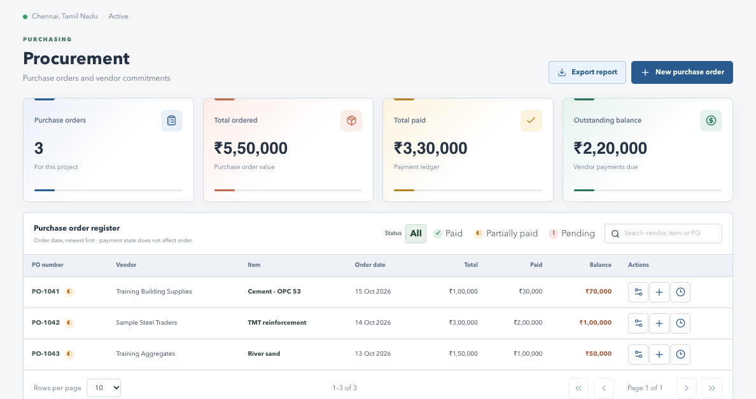
VRIDHI / VISUAL WALKTHROUGH
Procurement: register screen
Actual application interface | Synthetic sample data | No live records
WHAT TO NOTICE
Totals
Ordered, paid and outstanding vendor amounts.
Register
Search and payment filters above PO rows.
Row icons
Edit, payment and history follow grants and record state.
SCREENSHOT SAMPLE - illustrated training data only; actual records and available actions vary by permission.
CURRENT SYSTEM | 16 DEC 2026 | Companion guide: docs/current_system_docs
13
Notes:
Procurement: register screen
This is a screenshot of the real frontend rendered locally with synthetic browser-intercepted API responses. It is not a live production database screenshot. No account or business records were changed. Some screens are cropped to focus on their relevant content; lower sections continue below the visible area.
Totals: Ordered, paid and outstanding vendor amounts.
Register: Search and payment filters above PO rows.
Row icons: Edit, payment and history follow grants and record state.
Pair with original explanation slide 7. For complete steps, consult the companion documentation.

Slide 14

VRIDHI / CONSTRUCTIONS & DESIGNS
14 / 88 | USER TRAINING
LEFT MENU 04
Inventory
Abstract: material receipts, site consumption and available stock.
Read the material register
Record physical events
Ordered, open, received, consumed and
available quantities.
Receive Stock records actual inward quantity.
Use Stock records material consumed on site.
Material, vendor, unit and valuation context.
Receive and Use have separate action
permissions.
Search/material filters and paginated rows.
Stock ledger shows dated movements and
recorder details.
Check units, references and quantity before
submitting.
Remaining stock valuation should not equal all purchase-order costs.
CURRENT SYSTEM | 16 DEC 2026 | Companion guide: docs/current_system_docs
14
Notes:
Inventory
A PO makes a material available in the procurement-linked register, but it is not proof of receipt. Record references and notes so physical events can be traced later. Mixed units must not be treated as one meaningful total quantity. This report prints the rendered register, so users should check filters, page size and preview coverage.
Companion documentation / source: 02-module-guide.md; 03-workflow-walkthroughs.md
Demonstrations should use a training database. Do not publish credentials.

Slide 15
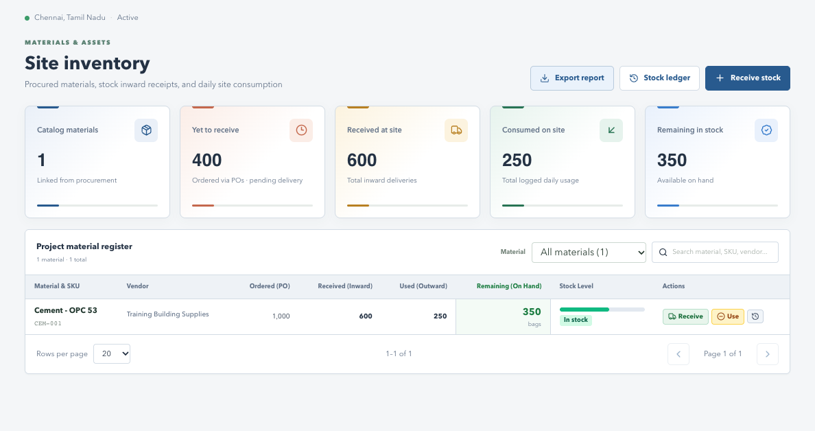
VRIDHI / VISUAL WALKTHROUGH
Inventory: material register
Actual application interface | Synthetic sample data | No live records
WHAT TO NOTICE
Stock
Ordered, received, used and available quantities.
Actions
Receive Stock and Stock ledger in the header.
Verify
Check units and source references before saving.
SCREENSHOT SAMPLE - illustrated training data only; actual records and available actions vary by permission.
CURRENT SYSTEM | 16 DEC 2026 | Companion guide: docs/current_system_docs
15
Notes:
Inventory: material register
This is a screenshot of the real frontend rendered locally with synthetic browser-intercepted API responses. It is not a live production database screenshot. No account or business records were changed. Some screens are cropped to focus on their relevant content; lower sections continue below the visible area.
Stock: Ordered, received, used and available quantities.
Actions: Receive Stock and Stock ledger in the header.
Verify: Check units and source references before saving.
Pair with original explanation slide 8. For complete steps, consult the companion documentation.

Slide 16

VRIDHI / CONSTRUCTIONS & DESIGNS
16 / 88 | USER TRAINING
LEFT MENU 05
Cash flow
Abstract: client billing applications, receipts and allocations.
What the numbers mean
Daily actions
Contract value: approved project/client value.
New Application records a client billing amount.
Billed to client: recorded billing applications.
Record Receipt captures date, method and
reference.
Cash received: all recorded client receipts.
Billed outstanding: unpaid allocated application
balance.
Allocate receipts to the intended application.
Search/page billing and receipt registers
separately.
Unallocated cash increases receipts but does not settle a specific bill.
CURRENT SYSTEM | 16 DEC 2026 | Companion guide: docs/current_system_docs
16
Notes:
Cash flow
Allocated receipts cannot exceed an application's remaining amount. Vendor payments and labor payments are not client receipts. The existing cash summary returns zero retainage values; do not present a complete retention-release workflow as implemented. Export scope depends on the rendered register filters/pages.
Companion documentation / source: 02-module-guide.md; 05-reports-and-calculations.md
Demonstrations should use a training database. Do not publish credentials.

Slide 17
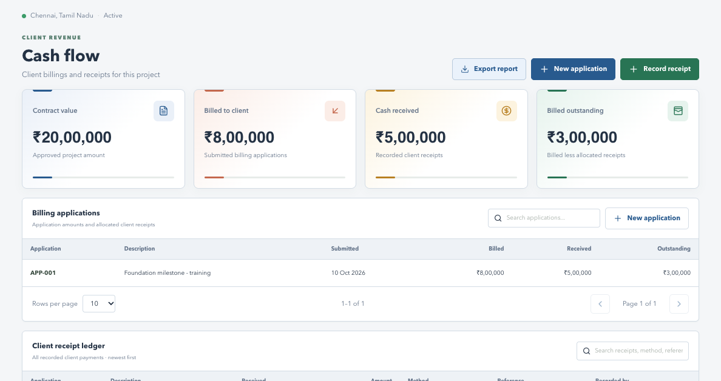
VRIDHI / VISUAL WALKTHROUGH
Cash flow: client money screen
Actual application interface | Synthetic sample data | No live records
WHAT TO NOTICE
Client totals
Contract, billed, received and outstanding.
Applications
Client billing entries and allocated receipts.
Actions
New application and Record receipt are separate grants.
SCREENSHOT SAMPLE - illustrated training data only; actual records and available actions vary by permission.
CURRENT SYSTEM | 16 DEC 2026 | Companion guide: docs/current_system_docs
17
Notes:
Cash flow: client money screen
This is a screenshot of the real frontend rendered locally with synthetic browser-intercepted API responses. It is not a live production database screenshot. No account or business records were changed. Some screens are cropped to focus on their relevant content; lower sections continue below the visible area.
Client totals: Contract, billed, received and outstanding.
Applications: Client billing entries and allocated receipts.
Actions: New application and Record receipt are separate grants.
Pair with original explanation slide 9. For complete steps, consult the companion documentation.

Slide 18

VRIDHI / CONSTRUCTIONS & DESIGNS
18 / 88 | USER TRAINING
LEFT MENU 06
Labor and Wages
Abstract: direct-worker records and subcontract-labor workflows.
Direct workers
Subcontract labor
Add/edit workers and their trades/contact details.
Create unit-rate or lump-sum labor contracts.
Log work with quantity, unit and rate.
Link plan baselines and supporting contract files.
Record wage payments; compare earned, paid
and payable.
Review changes and certify/reject progress
claims.
Activate/deactivate workers when appropriate.
Pay eligible claims and inspect file/history
records.
Earned/certified labor contributes to cost; payment is its settlement.
CURRENT SYSTEM | 16 DEC 2026 | Companion guide: docs/current_system_docs
18
Notes:
Labor and Wages
The page contains multiple independently paginated sections: contracts, review items, contract-change history, documents, workers, work entries and wages. Grants distinguish contract creation, worker actions, work logging, paying and downloads. Review endpoints map to the relevant contract/work action rather than old job-title roles.
Companion documentation / source: 02-module-guide.md; 04-users-and-permissions.md
Demonstrations should use a training database. Do not publish credentials.

Slide 19
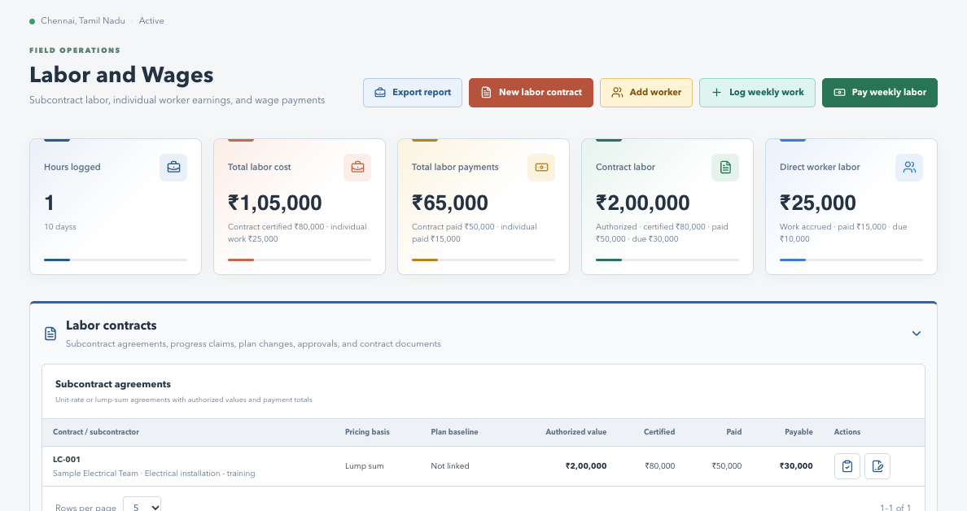
VRIDHI / VISUAL WALKTHROUGH
Labor and Wages: contracts and workers
Actual application interface | Synthetic sample data | No live records
WHAT TO NOTICE
Two paths
Direct workers and subcontract agreements.
Review
Claims and contract changes have review states.
History
Expand sections and inspect files, work and payments.
SCREENSHOT SAMPLE - illustrated training data only; actual records and available actions vary by permission.
CURRENT SYSTEM | 16 DEC 2026 | Companion guide: docs/current_system_docs
19
Notes:
Labor and Wages: contracts and workers
This is a screenshot of the real frontend rendered locally with synthetic browser-intercepted API responses. It is not a live production database screenshot. No account or business records were changed. Some screens are cropped to focus on their relevant content; lower sections continue below the visible area.
Two paths: Direct workers and subcontract agreements.
Review: Claims and contract changes have review states.
History: Expand sections and inspect files, work and payments.
Pair with original explanation slide 10. For complete steps, consult the companion documentation.

Slide 20

VRIDHI / CONSTRUCTIONS & DESIGNS
20 / 88 | USER TRAINING
LEFT MENU 07
Users
Abstract: standalone account directory and permission administration.
Directory
Account lifecycle
All non-deleted accounts, independent of selected
project.
Add/Edit through a two-step wizard.
Separate Reset, Activate/Deactivate, Delete and
History grants.
Search contact/account details and review account
status.
Username is immutable on Edit.
View opens a read-only details and permissions
popup.
Delete disables/hides the account but keeps its
history.
Export follows a separate Users export grant.
A Users-only account needs neither project assignment nor Global access.
CURRENT SYSTEM | 16 DEC 2026 | Companion guide: docs/current_system_docs
20
Notes:
Users
Password reset and deactivation revoke existing sessions. Reset/status/delete cannot target the current account. User History starts at 5 rows, with 10/20/50 options, and excludes login activities. It shows recorded actions by or affecting the user, which is different from the selected project's Audit Log.
Companion documentation / source: 02-module-guide.md; 04-users-and-permissions.md
Demonstrations should use a training database. Do not publish credentials.

Slide 21
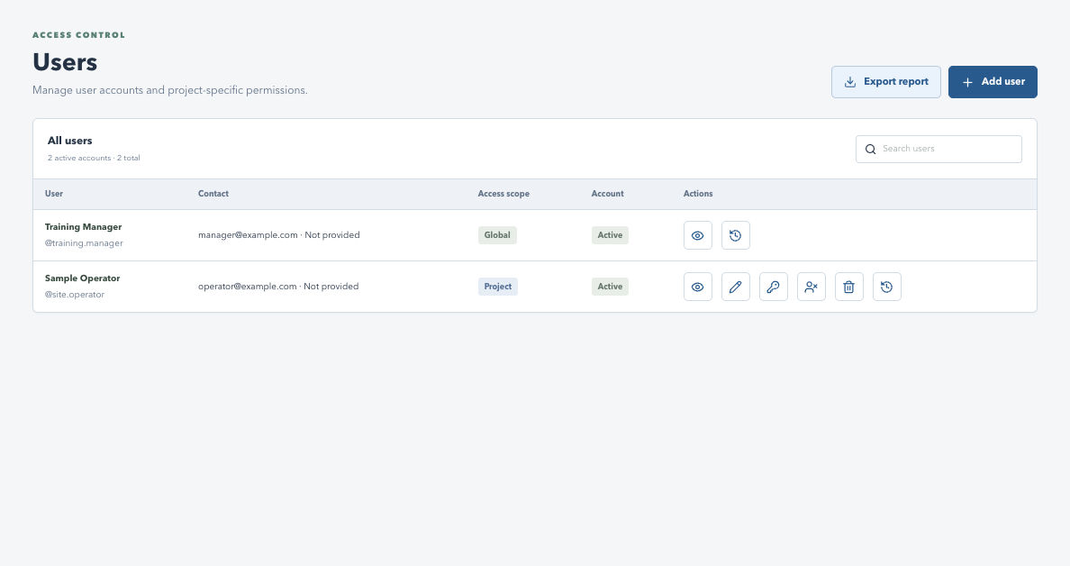
VRIDHI / VISUAL WALKTHROUGH
Users: directory and action icons
Actual application interface | Synthetic sample data | No live records
WHAT TO NOTICE
Directory
All users, not just the selected project's members.
Icons
View, Edit, Reset, Status, Delete and History.
Authorization
Only granted actions are available.
SCREENSHOT SAMPLE - illustrated training data only; actual records and available actions vary by permission.
CURRENT SYSTEM | 16 DEC 2026 | Companion guide: docs/current_system_docs
21
Notes:
Users: directory and action icons
This is a screenshot of the real frontend rendered locally with synthetic browser-intercepted API responses. It is not a live production database screenshot. No account or business records were changed. Some screens are cropped to focus on their relevant content; lower sections continue below the visible area.
Directory: All users, not just the selected project's members.
Icons: View, Edit, Reset, Status, Delete and History.
Authorization: Only granted actions are available.
Pair with original explanation slide 11. For complete steps, consult the companion documentation.

Slide 22
VRIDHI / CONSTRUCTIONS & DESIGNS
22 / 88 | USER TRAINING
LEFT MENU 08
Audit Log
Abstract: investigate recorded activities for one accessible project.
Table and filters
Tracked events
Username | Date and time | User activity |
Record | Details | View.
Visited Inventory and other tracked project
modules.
Newest first, with search and applied date/time
range.
Exported report from Inventory (export requested).
Saved business changes where audit events are
emitted.
Default 10 rows; options 20, 50 and 100.
Eye icon opens the Activity details
popup.
Export includes every matching project row.
An export request is not proof that the user saved or downloaded a PDF.
CURRENT SYSTEM | 16 DEC 2026 | Companion guide: docs/current_system_docs
22
Notes:
Audit Log
Audit Access and Export are standalone account grants, but project access is still necessary. Record is the entity type. Audit ID and Reference are shown only in the Activity details popup and the printed report. Some historical events have no full before/after snapshot. This is not a complete click recorder or a reliable list of every failed operation.
Companion documentation / source: 02-module-guide.md; 05-reports-and-calculations.md
Demonstrations should use a training database. Do not publish credentials.

Slide 23
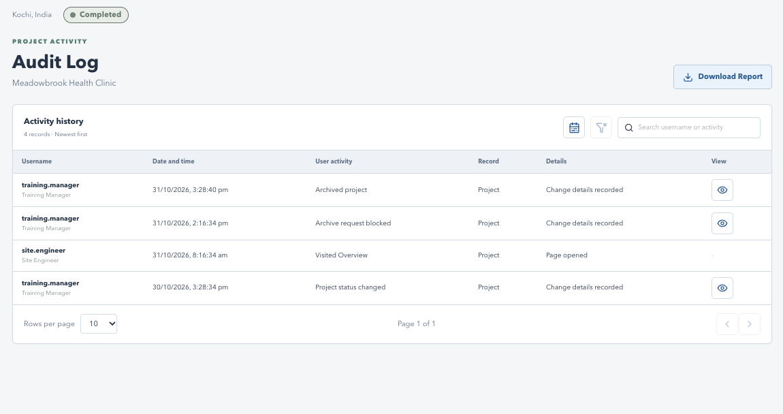
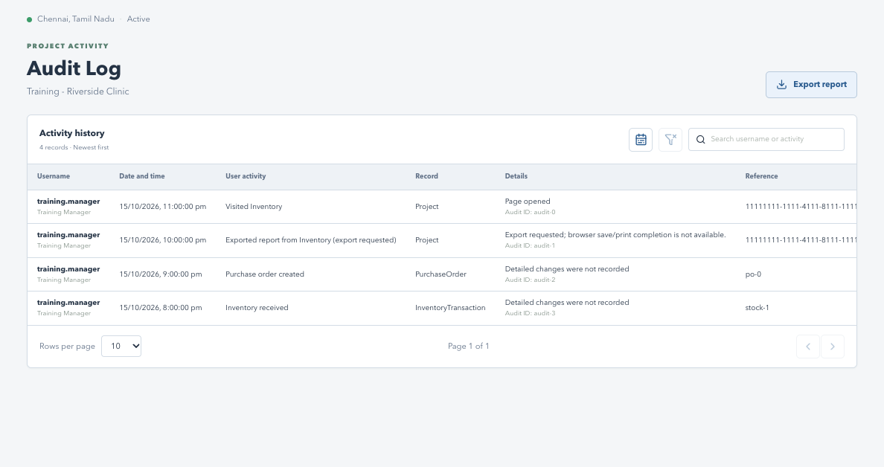
VRIDHI / VISUAL WALKTHROUGH
Audit Log: project activity table
Actual application interface | Synthetic sample data | No live records
WHAT TO NOTICE
Newest first
Actor, timestamp, activity and affected record.
Tools
Time range, clear filters and text search.
View
Eye icon opens the full activity details.
SCREENSHOT SAMPLE - illustrated training data only; actual records and available actions vary by permission.
CURRENT SYSTEM | 16 DEC 2026 | Companion guide: docs/current_system_docs
23
Notes:
Audit Log: project activity table
This is a screenshot of the real frontend rendered locally with synthetic browser-intercepted API responses. It is not a live production database screenshot. No account or business records were changed. Some screens are cropped to focus on their relevant content; lower sections continue below the visible area.
Newest first: Actor, timestamp, activity and affected record.
Tools: Time range, clear filters and text search.
View: the eye icon opens the Activity details popup; rows without recorded details show a dash. Download Report exports all matching project records, not only this page.
Pair with original explanation slide 12. For complete steps, consult the companion documentation.

Slide 24
VRIDHI / CONSTRUCTIONS & DESIGNS
24 / 88 | USER TRAINING
WORKFLOW 01
New Project: from form to workspace
Walkthrough: Projects > New project > review > save.
1. Enter the baseline
2. Attach and verify
Project name and location.
Optional initial plan approval file and comment.
Approved budget and contract value: separate
amounts.
PDF, PNG, JPG/JPEG or DOCX; maximum 10 MB.
Save, then review Overview and the document
record.
Start date and initial status: Planning or Active.
Use nonnegative monetary values.
Assign the team and explicit permissions through
Users.
Create the right project once, then verify its context before entering records.
CURRENT SYSTEM | 16 DEC 2026 | Companion guide: docs/current_system_docs
24
Notes:
New Project: from form to workspace
The API authorizes creation through Overview write access. An initial plan sets a starting document, not a separate revised-value event. Uploaded original bytes live in the project's data/uploads directory; PostgreSQL holds metadata. Creating a project does not remove the need to configure team membership profiles.
Companion documentation / source: 03-workflow-walkthroughs.md
Demonstrations should use a training database. Do not publish credentials.

Slide 25
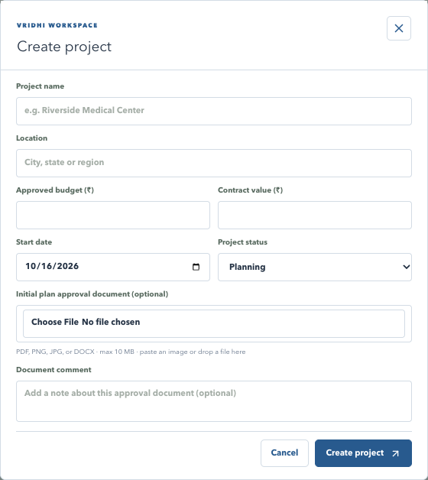
VRIDHI / VISUAL WALKTHROUGH
New Project: actual form
Actual application interface | Synthetic sample data | No live records
WHAT TO NOTICE
Identity
Enter project name and location.
Baseline
Budget, contract value, date and initial status.
Optional file
Choose, paste or drop an initial plan document.
SCREENSHOT SAMPLE - illustrated training data only; actual records and available actions vary by permission.
CURRENT SYSTEM | 16 DEC 2026 | Companion guide: docs/current_system_docs
25
Notes:
New Project: actual form
This is a screenshot of the real frontend rendered locally with synthetic browser-intercepted API responses. It is not a live production database screenshot. No account or business records were changed. Some screens are cropped to focus on their relevant content; lower sections continue below the visible area.
Identity: Enter project name and location.
Baseline: Budget, contract value, date and initial status.
Optional file: Choose, paste or drop an initial plan document.
Pair with original explanation slide 13. For complete steps, consult the companion documentation.

Slide 26
VRIDHI / CONSTRUCTIONS & DESIGNS
26 / 88 | USER TRAINING
WORKFLOW 02
Change project status safely
Walkthrough: Overview > Update status > comment > confirm.
Allowed transitions
Required review
Planning -> Active / On Hold / Cancelled.
Choose an offered next state; enter a meaningful
comment.
Active -> On Hold / Completed / Cancelled.
On Hold also requires a hold reason.
On Hold -> Active / Completed / Cancelled.
Completed requires explicit completion
confirmation.
Cancelled -> Planning; Completed has no next
state.
Refresh and review if another user changed the
version.
Review the new state and status-history entry after saving.
CURRENT SYSTEM | 16 DEC 2026 | Companion guide: docs/current_system_docs
26
Notes:
Change project status safely
The server uses the expected project version and the transition map, not arbitrary status changes. Keep the essential explanation in the required comment because the history persists that comment. The hold-reason control does not replace a meaningful status comment. Status transitions do not automatically imply every financial record has been reconciled.
Companion documentation / source: 03-workflow-walkthroughs.md; models.py PROJECT_STATUS_TRANSITIONS
Demonstrations should use a training database. Do not publish credentials.

Slide 27
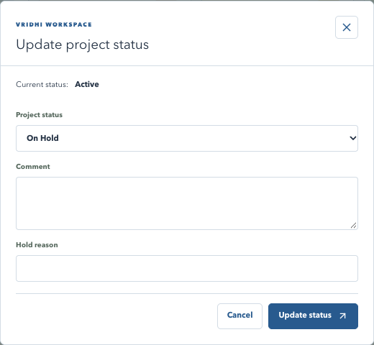
VRIDHI / VISUAL WALKTHROUGH
Project status: actual dialog
Actual application interface | Synthetic sample data | No live records
WHAT TO NOTICE
Current state
Shown before selecting the next status.
Comment
Explain the business reason for the change.
Conditional
Hold reason or completion confirmation may be required.
SCREENSHOT SAMPLE - illustrated training data only; actual records and available actions vary by permission.
CURRENT SYSTEM | 16 DEC 2026 | Companion guide: docs/current_system_docs
27
Notes:
Project status: actual dialog
This is a screenshot of the real frontend rendered locally with synthetic browser-intercepted API responses. It is not a live production database screenshot. No account or business records were changed. Some screens are cropped to focus on their relevant content; lower sections continue below the visible area.
Current state: Shown before selecting the next status.
Comment: Explain the business reason for the change.
Conditional: Hold reason or completion confirmation may be required.
Pair with original explanation slide 14. For complete steps, consult the companion documentation.

Slide 28

VRIDHI / CONSTRUCTIONS & DESIGNS
28 / 88 | USER TRAINING
WORKFLOW 03
Plan documents and project value
Files, estimate revisions and reports are different outputs.
Upload a revised plan
Retrieve or report
Allowed while Planning, Active or On Hold.
Download icon retrieves the original plan file.
Confirm current value and enter the new estimate.
Download Report prints the project report, not the
original.
Choose a supported nonempty file and optional
comment.
Revised-plan save updates the current estimate.
Review plan history and value history after saving.
Do not assume a separate project-value
approval queue.
Keep original documents and their recorded comments traceable.
CURRENT SYSTEM | 16 DEC 2026 | Companion guide: docs/current_system_docs
28
Notes:
Plan documents and project value
The upload endpoint validates the current estimate against the contract and checks file type/size/content. Supported revised plan types are PDF/PNG/JPG/DOCX. File bytes and database metadata must both be backed up. Completed/Cancelled projects reject these new plan uploads.
Companion documentation / source: 03-workflow-walkthroughs.md; 07-data-and-persistence.md
Demonstrations should use a training database. Do not publish credentials.

Slide 29
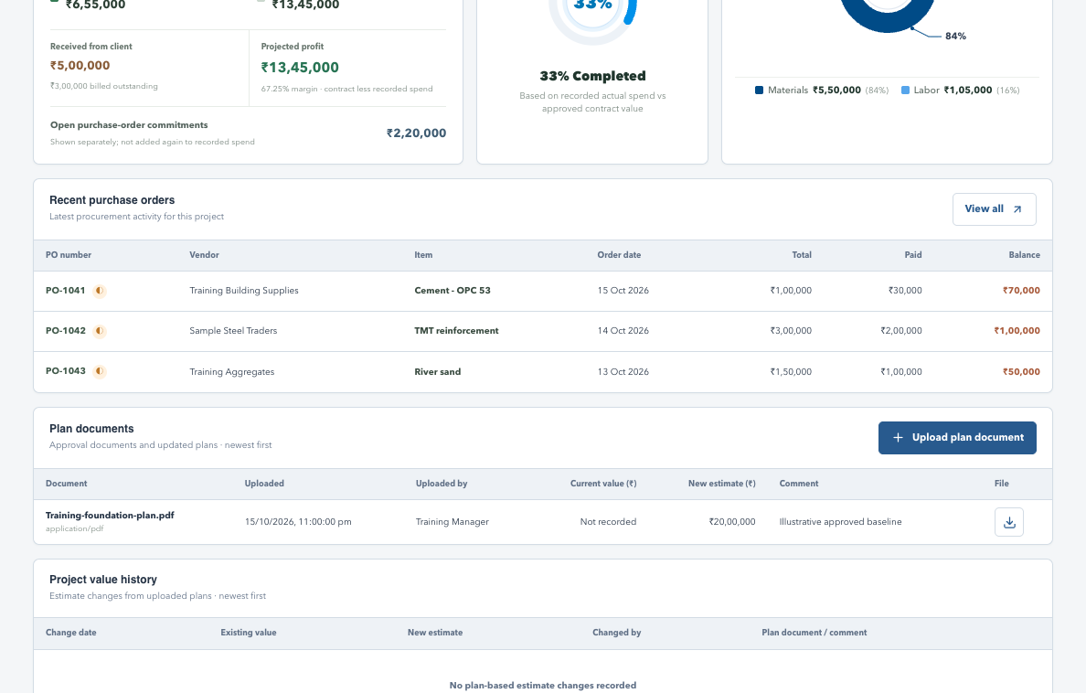
VRIDHI / VISUAL WALKTHROUGH
Plan documents: history and download
Actual application interface | Synthetic sample data | No live records
WHAT TO NOTICE
File metadata
Filename, uploader, time and comments.
Download
Icon retrieves the original file.
Value history
Revised plans can change the recorded estimate.
SCREENSHOT SAMPLE - illustrated training data only; actual records and available actions vary by permission.
CURRENT SYSTEM | 16 DEC 2026 | Companion guide: docs/current_system_docs
29
Notes:
Plan documents: history and download
This is a screenshot of the real frontend rendered locally with synthetic browser-intercepted API responses. It is not a live production database screenshot. No account or business records were changed. Some screens are cropped to focus on their relevant content; lower sections continue below the visible area.
File metadata: Filename, uploader, time and comments.
Download: Icon retrieves the original file.
Value history: Revised plans can change the recorded estimate.
Pair with original explanation slide 15. For complete steps, consult the companion documentation.

Slide 30
VRIDHI / CONSTRUCTIONS & DESIGNS
30 / 88 | USER TRAINING
WORKFLOW 04
Purchasing to stock: two separate events
Trace the order, receipt and consumption without mixing money and quantity.
Procurement path
Inventory path
Create PO -> verify quantity x price and vendor.
Receive actual quantity, with PO/reference when
applicable.
Optional initial payment -> check total and
balance.
Use material when consumed on site.
Later installments -> inspect payment history.
Verify available balance and the stock ledger.
Edit only while the record remains eligible.
Check units and separate Receive/Use grants.
Paying a vendor neither receives stock nor records site consumption.
CURRENT SYSTEM | 16 DEC 2026 | Companion guide: docs/current_system_docs
30
Notes:
Purchasing to stock: two separate events
For demonstration, use a test material and small quantities. Save a PO, receive only part of its quantity, then record some use. Compare ordered/open/received/consumed/available rows. The overview material cost uses orders, while inventory remaining value measures a different basis.
Companion documentation / source: 03-workflow-walkthroughs.md; 05-reports-and-calculations.md
Demonstrations should use a training database. Do not publish credentials.

Slide 31
VRIDHI / CONSTRUCTIONS & DESIGNS
31 / 88 | USER TRAINING
WORKFLOW 05
Labor: choose the correct cost path
Avoid double counting work, certification and payment.
Direct labor
Contract labor
Add worker -> log work quantity/unit/rate.
Create contract -> submit claim -> review/certify.
Work amount contributes to earnings and cost.
Certified claims contribute to cost.
Record wage payment as settlement.
Pay eligible claim and retain payment
references.
Compare earned, paid and payable.
Review scope/value changes through addenda.
Do not add payments to cost again when the work/claim is already counted.
CURRENT SYSTEM | 16 DEC 2026 | Companion guide: docs/current_system_docs
31
Notes:
Labor: choose the correct cost path
A full subcontract contract value is not automatically the same as certified work cost. Pending or rejected claims should not be treated as certified earnings. Supporting files and history downloads require their own action grants. The application is not a replacement for an independently audited payroll/accounting system.
Companion documentation / source: 03-workflow-walkthroughs.md; 05-reports-and-calculations.md
Demonstrations should use a training database. Do not publish credentials.

Slide 32
VRIDHI / CONSTRUCTIONS & DESIGNS
32 / 88 | USER TRAINING
ACCOUNT MANAGEMENT
Add/Edit User: two steps
Account details first, access configuration second.
Step 1: account details
Step 2: access
Full name; optional work email and contact
number.
Select projects and project permission scope.
Use shared selected projects or Global as
appropriate.
Unique username, fixed after account creation.
Password and confirmation; minimum six
characters.
Configure Users and Audit Log separately.
Review individual action grants, then save.
On Edit, leave password blank to keep it.
A password change through Edit still requires Reset Password permission.
CURRENT SYSTEM | 16 DEC 2026 | Companion guide: docs/current_system_docs
32
Notes:
Add/Edit User: two steps
Email is optional but validated and unique when supplied. Usernames permit letters/numbers/dot/underscore/hyphen and are validated by schema and route. Password hashes and session tokens are never shown in View. A user manager with Add/Edit should be trusted to assign access; least privilege should guide grants.
Companion documentation / source: 04-users-and-permissions.md; 03-workflow-walkthroughs.md
Demonstrations should use a training database. Do not publish credentials.

Slide 33
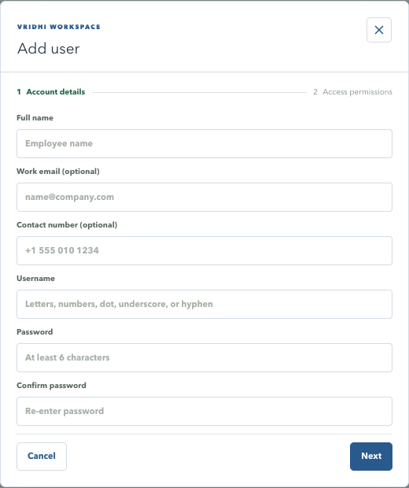
VRIDHI / VISUAL WALKTHROUGH
User wizard: account details
Actual application interface | Synthetic sample data | No live records
WHAT TO NOTICE
Required
Name, unique username and matching password.
Optional
Work email and contact number.
Next
Continue to access settings; do not save this sample.
SCREENSHOT SAMPLE - illustrated training data only; actual records and available actions vary by permission.
CURRENT SYSTEM | 16 DEC 2026 | Companion guide: docs/current_system_docs
33
Notes:
User wizard: account details
This is a screenshot of the real frontend rendered locally with synthetic browser-intercepted API responses. It is not a live production database screenshot. No account or business records were changed. Some screens are cropped to focus on their relevant content; lower sections continue below the visible area.
Required: Name, unique username and matching password.
Optional: Work email and contact number.
Next: Continue to access settings; do not save this sample.
Pair with original explanation slide 18. For complete steps, consult the companion documentation.

Slide 34

VRIDHI / CONSTRUCTIONS & DESIGNS
34 / 88 | USER TRAINING
AUTHORIZATION
Project permissions and access scopes
Permission profiles replace the old business-role model.
Choose the project scope
Choose module capability
Individual: configure each assigned project.
Access Allow/Block controls the page.
Shared: one saved profile for checked projects
only.
Read Export controls reporting.
Write All or only checked Partial actions.
Shared preset allows operational modules, not
Users.
Explicit project modules override the Global
baseline.
Global: baseline across all available projects.
Global automatically includes Users/Audit grants, not an override of every project restriction.
CURRENT SYSTEM | 16 DEC 2026 | Companion guide: docs/current_system_docs
34
Notes:
Project permissions and access scopes
Shared profiles are stored on the selected memberships; they do not automatically assign future projects. Blocked is the safe default for ordinary new project permission profiles. Create/Edit PO is combined but Add Payment remains separate. Quick Entry is a shortcut whose save still follows destination API authorization.
Companion documentation / source: 04-users-and-permissions.md
Demonstrations should use a training database. Do not publish credentials.

Slide 35
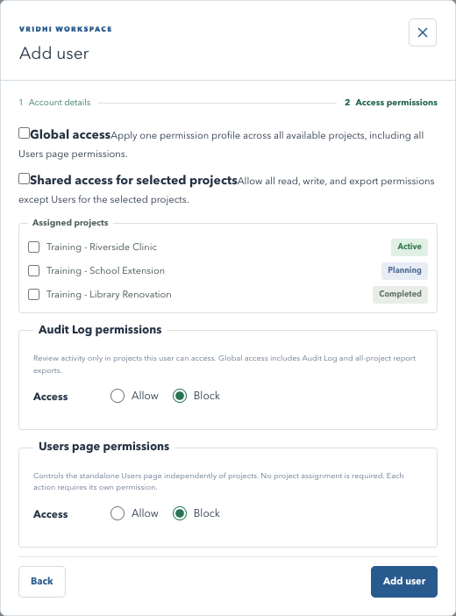
VRIDHI / VISUAL WALKTHROUGH
User wizard: access settings
Actual application interface | Synthetic sample data | No live records
WHAT TO NOTICE
Project scope
Global, shared selected, or individual profiles.
Assigned projects
Checkboxes include lifecycle status.
Separate sections
Audit Log and Users page permissions.
SCREENSHOT SAMPLE - illustrated training data only; actual records and available actions vary by permission.
CURRENT SYSTEM | 16 DEC 2026 | Companion guide: docs/current_system_docs
35
Notes:
User wizard: access settings
This is a screenshot of the real frontend rendered locally with synthetic browser-intercepted API responses. It is not a live production database screenshot. No account or business records were changed. Some screens are cropped to focus on their relevant content; lower sections continue below the visible area.
Project scope: Global, shared selected, or individual profiles.
Assigned projects: Checkboxes include lifecycle status.
Separate sections: Audit Log and Users page permissions.
Pair with original explanation slide 19. For complete steps, consult the companion documentation.

Slide 36
VRIDHI / CONSTRUCTIONS & DESIGNS
36 / 88 | USER TRAINING
AUTHORIZATION
Standalone Users and Audit permissions
Administrative menus have their own account-level access settings.
Users
Audit Log
Access and Export directory.
Separate Access and Download Report grants.
Add/Edit; Reset Password; Activate/Deactivate.
Still needs an accessible selected project.
Delete; History.
Global accounts include both capabilities.
Can be granted without any assigned project.
Read activity without granting operational writes.
Grant only the actions a person needs; self lifecycle actions are protected.
CURRENT SYSTEM | 16 DEC 2026 | Companion guide: docs/current_system_docs
36
Notes:
Standalone Users and Audit permissions
Users directory access is not filtered by the project selector. Reset and deactivation revoke sessions; deletion is a soft deletion retaining historical relationships. User History excludes login events and starts with 5 rows, unlike project Audit Log's default 10. Do not grant administrative Add/Edit merely to allow a user to see account details.
Companion documentation / source: 04-users-and-permissions.md
Demonstrations should use a training database. Do not publish credentials.

Slide 37

VRIDHI / CONSTRUCTIONS & DESIGNS
37 / 88 | USER TRAINING
AUDIT WORKFLOW
Investigate a time interval
Audit Log > calendar filter > choose range/time > Apply.
Select the interval
Review the results
Today / Yesterday / Last 7 days / This month
shortcuts.
Apply commits the draft range and resets
pagination.
Select start and end dates in the calendar.
Search narrows username/activity.
Choose From/To time on the analog dial.
Clear filters restores the full list.
Select hour, minute and AM/PM; confirm with
OK.
Export fetches all matching rows, newest first.
Local input is sent with timezone information; To includes its ending minute.
CURRENT SYSTEM | 16 DEC 2026 | Companion guide: docs/current_system_docs
37
Notes:
Investigate a time interval
Closing the date-range editor before Apply preserves the previous filter. Cancel in the time popup preserves the prior confirmed time. The calendar highlights today and uses the application theme. Record identifies the affected entity type, and the Activity details popup shows the Audit ID and Reference; readable details depend on what the event actually captured.
Companion documentation / source: 03-workflow-walkthroughs.md; 05-reports-and-calculations.md
Demonstrations should use a training database. Do not publish credentials.

Slide 38
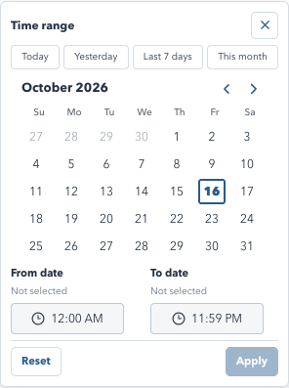
VRIDHI / VISUAL WALKTHROUGH
Audit filter: date range and time
Actual application interface | Synthetic sample data | No live records
WHAT TO NOTICE
Shortcuts
Today, Yesterday, Last 7 days and This month.
Range
Select dates, then From and To times.
Apply
Commits the draft range to search and export.
SCREENSHOT SAMPLE - illustrated training data only; actual records and available actions vary by permission.
CURRENT SYSTEM | 16 DEC 2026 | Companion guide: docs/current_system_docs
38
Notes:
Audit filter: date range and time
This is a screenshot of the real frontend rendered locally with synthetic browser-intercepted API responses. It is not a live production database screenshot. No account or business records were changed. Some screens are cropped to focus on their relevant content; lower sections continue below the visible area.
Shortcuts: Today, Yesterday, Last 7 days and This month.
Range: Select dates, then From and To times.
Apply: Commits the draft range to search and export.
Pair with original explanation slide 21. For complete steps, consult the companion documentation.

Slide 39

VRIDHI / CONSTRUCTIONS & DESIGNS
39 / 88 | USER TRAINING
REPORTING
Download Report: how PDF is created
The application prepares a report; your browser creates the saved PDF.
1. Prepare
2. Preview and save
Confirm project, permission and intended report
scope.
Browser print opens -> select Save as PDF.
Choose pages, orientation, scale and margins.
Select Download Report and wait for data/fonts.
Review all rows/sections in the preview.
Company logo/name, report title and date are
included.
Save locally; Cancel does not save a document.
Screen Dark mode does not carry into the print
palette.
The export audit event records the request, not successful PDF completion.
CURRENT SYSTEM | 16 DEC 2026 | Companion guide: docs/current_system_docs
39
Notes:
Download Report: how PDF is created
The shared header shows the company logo and name, report title and date; project reports also show the project status beside the project name. No company address is printed. Personal Notes and navigation are print-hidden. Browser/OS naming and print controls vary; the app does not provide guaranteed server-rendered PDFs.
Companion documentation / source: 05-reports-and-calculations.md
Demonstrations should use a training database. Do not publish credentials.

Slide 40
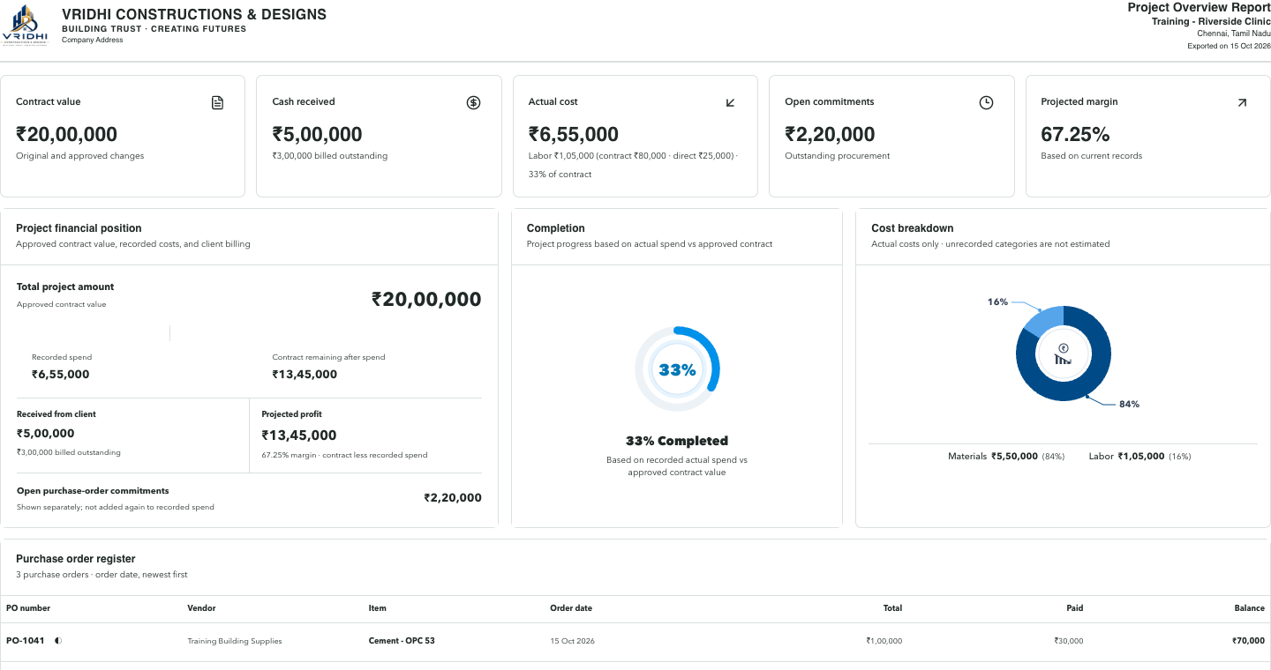
VRIDHI / VISUAL WALKTHROUGH
Export: sample printable report
Actual application interface | Synthetic sample data | No live records
WHAT TO NOTICE
Header
Company logo/name, report, project and export date.
Day palette
White surfaces, even from Dark screen mode.
Save
Browser Print > Save as PDF; check preview coverage.
SCREENSHOT SAMPLE - illustrated training data only; actual records and available actions vary by permission.
CURRENT SYSTEM | 16 DEC 2026 | Companion guide: docs/current_system_docs
40
Notes:
Export: sample printable report
This is a screenshot of the real frontend rendered locally with synthetic browser-intercepted API responses. It is not a live production database screenshot. No account or business records were changed. Some screens are cropped to focus on their relevant content; lower sections continue below the visible area.
Header: Company logo/name, report, project and export date.
Day palette: White surfaces, even from Dark screen mode.
Save: Browser Print > Save as PDF; check preview coverage.
Pair with original explanation slide 22. For complete steps, consult the companion documentation.

Slide 41
VRIDHI / CONSTRUCTIONS & DESIGNS
41 / 88 | USER TRAINING
REPORTING
Know what your report includes
Do not assume every export ignores pagination and filters.
Explicit full-data preparation
Rendered-section reports
Audit: every project row matching search and
time range.
Overview: restricted sections stay empty.
Inventory/Cash flow: check filters and pages.
Procurement: all project POs, not screen filters.
Labor: check pages and expanded sections.
Users: loaded directory with the current search.
Inspect preview before treating a PDF as
complete.
Original-file Download is different from Export report.
CURRENT SYSTEM | 16 DEC 2026 | Companion guide: docs/current_system_docs
41
Notes:
Know what your report includes
This is an intentionally explicit source-reviewed boundary. Only some export handlers fetch all pages. Printing CSS cannot manufacture rows that were not rendered. Users should choose larger page sizes or separate reports where appropriate. The Audit API retains a CSV technical option, but the current UI Download Report invokes browser PDF printing.
Companion documentation / source: 05-reports-and-calculations.md
Demonstrations should use a training database. Do not publish credentials.

Slide 42
VRIDHI / CONSTRUCTIONS & DESIGNS
42 / 88 | USER TRAINING
RECONCILIATION
Understand the financial numbers
Illustrative example: different bases do not imply a mismatch.
Cost and commitments
Client money and inventory
POs 100,000 + direct earnings 10,000 + certified
claims 20,000.
Billed 80,000; receipts 50,000.
Only 40,000 allocated -> billed outstanding
40,000.
Actual cost = INR 130,000.
Contract INR 200,000 -> projected margin 35%.
Remaining stock value is not all PO cost.
Vendor paid 30,000 -> PO outstanding 70,000.
Payments settle liabilities; do not add them to
cost twice.
Compare the same project, currency, date basis and record state.
CURRENT SYSTEM | 16 DEC 2026 | Companion guide: docs/current_system_docs
42
Notes:
Understand the financial numbers
All figures are illustrative, not current live balances. The current actual-cost basis is materials ordered plus direct work earnings plus certified labor claims. Projected margin is not final audited profit or cash balance. Mixed stock units require care. Full formula definitions are in the companion reporting guide.
Companion documentation / source: 05-reports-and-calculations.md
Demonstrations should use a training database. Do not publish credentials.

Slide 43

VRIDHI / CONSTRUCTIONS & DESIGNS
43 / 88 | USER TRAINING
PERSONAL WORKSPACE
My Details, Notes and mobile work
Small tools that support work across modules.
My Details and Notes
Responsive navigation
Badge opens read-only
account/contact/permission details.
WORKSPACE stays above the mobile menu
row.
Notes auto-save per account in the current
browser session.
Swipe menu items to reach allowed modules.
Wide registers scroll within panels.
Resize the left edge; collapse without clearing.
Notes becomes a constrained mobile drawer.
Clear asks confirmation; sign-out removes notes.
Temporary Notes are not an audit trail, shared record or database backup.
CURRENT SYSTEM | 16 DEC 2026 | Companion guide: docs/current_system_docs
43
Notes:
My Details, Notes and mobile work
Notes survive refresh in the same session but can disappear on tab/session closure or storage restrictions. They are excluded from printing. Account-specific storage prevents deliberate reuse between user IDs; users should still sign out on shared machines. A failed sign-out request does not deliberately clear notes before success.
Companion documentation / source: 01-getting-started.md
Demonstrations should use a training database. Do not publish credentials.

Slide 44

VRIDHI / CONSTRUCTIONS & DESIGNS
44 / 88 | USER TRAINING
TECHNICAL OVERVIEW
Architecture and safe storage
Understand the boundaries before operating or extending the system.
Application stack
Data protection boundaries
React/TypeScript + Vite + TanStack Query.
Passwords: salted one-way Argon2id hashes.
FastAPI + Pydantic + async SQLAlchemy.
Sessions: opaque cookie and stored token
digest.
PostgreSQL business data, sessions and audit.
Alembic manages changes to existing schemas.
Original files: project data/uploads directory.
HTTPS and storage encryption need deployment
setup.
Password hashing does not encrypt database files, uploads or local HTTP traffic.
CURRENT SYSTEM | 16 DEC 2026 | Companion guide: docs/current_system_docs
44
Notes:
Architecture and safe storage
The live API explorer at /docs is the authority for exact endpoint contracts. Route families separate projects, procurement, operations, labor, admin, audit and system services. Diagnostic JSONL logs are different from the audit_events business table. Legacy role/timecard tables may remain without representing current menus.
Companion documentation / source: 06-architecture-and-api-map.md; 07-data-and-persistence.md
Demonstrations should use a training database. Do not publish credentials.

Slide 45
VRIDHI / CONSTRUCTIONS & DESIGNS
45 / 88 | USER TRAINING
OPERATIONS
First run, backup and support
A working database and a recoverable installation matter as much as the UI.
Start and preserve
When something fails
Use the OS launcher and the intended
PostgreSQL database.
Check API readiness and the selected project first.
Review permission/action grants and record state.
Apply migrations before using updated schemas.
Refresh CSRF/session if expired; never bypass
checks.
Back up PostgreSQL and uploads together.
Test restoration in a separate environment.
Record time, action and request context for
support.
A Docker volume is persistence, not an independent backup.
CURRENT SYSTEM | 16 DEC 2026 | Companion guide: docs/current_system_docs
45
Notes:
First run, backup and support
Local PostgreSQL normally uses 5432 and the optional Docker service uses 5433. Changing DATABASE_URL does not copy data. A backend started without reload may need a managed restart after code changes. Secure secrets, configure HTTPS/cookies/origins and service supervision before network exposure. Known bootstrap passwords should not appear in the deck.
Companion documentation / source: 08-operations-and-troubleshooting.md
Demonstrations should use a training database. Do not publish credentials.

Slide 46
VRIDHI / CONSTRUCTIONS & DESIGNS
46 / 88 | USER TRAINING
COMPANY CASHBOOK / FEATURE TRAINING
Company Cashbook: cash, funding and review
Company-wide finances, independent of the selected project. INR only.
Four working tabs
Separate review trail
Cash Transactions: actual company receipts and
payments.
Company Audit Log has its own left-menu
permissions.
Borrowings: loans, principal repayment and
interest.
No duplicate History tab inside Cashbook.
Project transactions are not imported
automatically.
Project Profit & Loss and Owner Capital.
Keep cash movements, project projections and ownership concepts separate.
COMPANY CASHBOOK UPDATE | 10 DEC 2026 | Companion: 12-company-cashbook-training.md
46
Notes:
Company Cashbook: cash, funding and review
Introduce the Company menu. Cashbook is not a bank connection, complete general ledger or statutory profit statement. Do not duplicate project client receipts, vendor payments or labor payments as new company expenses. Company-account-to-company-account transfers are unsupported. Existing project training remains applicable.
Sources: 12-company-cashbook-training.md; 11-company-cashbook.md; 04-users-and-permissions.md
Screens use isolated synthetic API responses. No live database records were read or changed. Different screen fixtures are not a reconciled ledger. All worked amounts are illustrative. Use an isolated training database. No credentials are included.

Slide 47
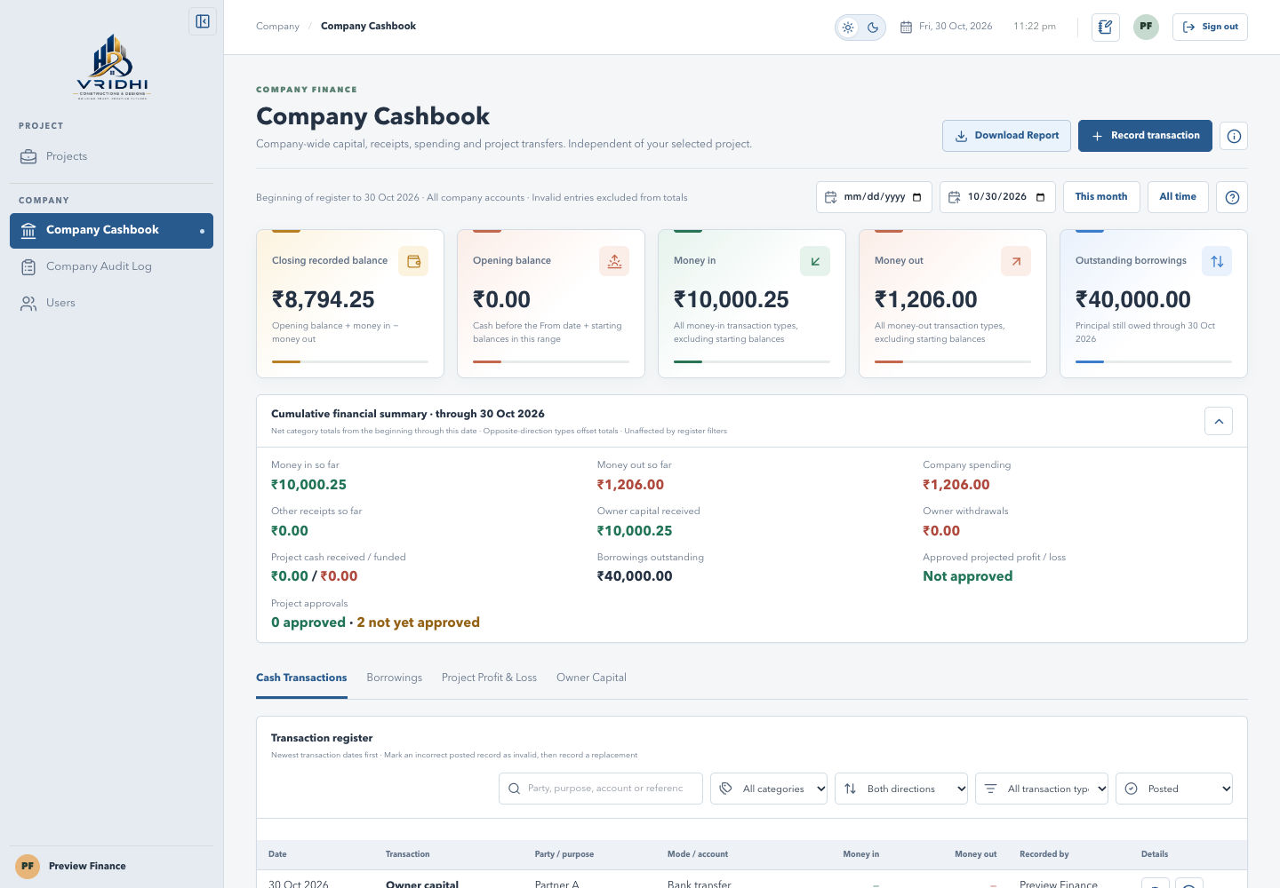
VRIDHI / CONSTRUCTIONS & DESIGNS
47 / 88 | USER TRAINING
COMPANY CASHBOOK / VISUAL WALKTHROUGH
Cashbook: orient yourself
Current application interface | Synthetic training data | No live records
WHAT TO NOTICE
Company scope
The page does not depend on a
selected project.
Financial context
Check dates, summary figures and
the cumulative summary.
Four tabs
Use the appropriate workflow; Audit
Log is a separate menu.
Cashbook View exposes company-wide finances, not only your assigned projects.
COMPANY CASHBOOK UPDATE | 10 DEC 2026 | Companion: 12-company-cashbook-training.md
47
Notes:
Cashbook: orient yourself
Point to the Company Cashbook and Company Audit Log menu entries. The Local Workspace badge is hidden. Explain that the active tab and summary-collapse preference are remembered; no History tab is present.
Sources: 12-company-cashbook-training.md; 11-company-cashbook.md; 04-users-and-permissions.md
Screens use isolated synthetic API responses. No live database records were read or changed. Different screen fixtures are not a reconciled ledger. All worked amounts are illustrative. Use an isolated training database. No credentials are included.

Slide 48
VRIDHI / CONSTRUCTIONS & DESIGNS
48 / 88 | USER TRAINING
COMPANY CASHBOOK / FEATURE TRAINING
Record cash once, in the correct workflow
Start with opening balances, then record real movements with meaningful references.
Before saving
Complete the transaction
Starting balance: once per account, not owner
capital.
Enter date, amount, party, mode, purpose and
account.
Choose Category, then Transaction type.
Project transfers require the linked INR project.
The type fixes Money in or Money out.
Save once; inspect the entry and recorder.
Future-dated entries are rejected. Borrowings must use the dedicated loan forms.
COMPANY CASHBOOK UPDATE | 10 DEC 2026 | Companion: 12-company-cashbook-training.md
48
Notes:
Record cash once, in the correct workflow
Bank transfer, UPI and Cheque require an account. Cash and Other can omit it, saving under Cash or Others. Global users can add categories/types; Record users can use saved options. New custom categories use the company-spending group. A money-in refund offsets its category. Starting entries affect opening balance, not period cash movement.
Sources: 12-company-cashbook-training.md; 11-company-cashbook.md; 04-users-and-permissions.md
Screens use isolated synthetic API responses. No live database records were read or changed. Different screen fixtures are not a reconciled ledger. All worked amounts are illustrative. Use an isolated training database. No credentials are included.

Slide 49
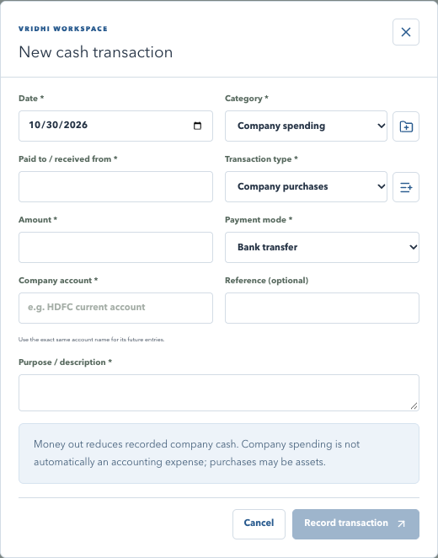
VRIDHI / CONSTRUCTIONS & DESIGNS
49 / 88 | USER TRAINING
COMPANY CASHBOOK / VISUAL WALKTHROUGH
Cash transaction: complete and review
Current application interface | Synthetic training data | No live records
WHAT TO NOTICE
Hierarchy
Category narrows transaction types
and their configured direction.
Required data
Check date, amount, purpose,
payment mode and account.
References
Use consistent party/account names;
link project transfers.
Starting cash is not a second capital contribution. Avoid double entry.
COMPANY CASHBOOK UPDATE | 10 DEC 2026 | Companion: 12-company-cashbook-training.md
49
Notes:
Cash transaction: complete and review
Demonstrate the form without submitting live records. Required inputs control save eligibility. Loan entries are intentionally excluded from the general form. Custom options require Global access.
Sources: 12-company-cashbook-training.md; 11-company-cashbook.md; 04-users-and-permissions.md
Screens use isolated synthetic API responses. No live database records were read or changed. Different screen fixtures are not a reconciled ledger. All worked amounts are illustrative. Use an isolated training database. No credentials are included.

Slide 50
VRIDHI / CONSTRUCTIONS & DESIGNS
50 / 88 | USER TRAINING
COMPANY CASHBOOK / FEATURE TRAINING
Reconcile cash, spending and principal
Illustrative example: no other balances or transactions.
Cash movements
Different totals
Start 100,000 + capital 50,000 + loan 20,000.
Company spending: INR 10,500.
Pay rent 10,000 + principal 5,000 + interest 500.
Outstanding principal: INR 15,000.
Closing recorded cash: INR 154,500.
Approved projected profit is separate from cash.
Closing cash = opening balance + money in - money out. Invalid entries are excluded.
COMPANY CASHBOOK UPDATE | 10 DEC 2026 | Companion: 12-company-cashbook-training.md
50
Notes:
Reconcile cash, spending and principal
Starting balances in the selected range are included in Opening balance. Money in/out exclude them. Register filters do not narrow summary cards; cumulative values run through the selected end date. Interest is spending; principal, capital, withdrawals and project funding are not company operating spending. This worked example is independent of the synthetic screen fixtures.
Sources: 12-company-cashbook-training.md; 11-company-cashbook.md; 04-users-and-permissions.md
Screens use isolated synthetic API responses. No live database records were read or changed. Different screen fixtures are not a reconciled ledger. All worked amounts are illustrative. Use an isolated training database. No credentials are included.

Slide 51
VRIDHI / CONSTRUCTIONS & DESIGNS
51 / 88 | USER TRAINING
COMPANY CASHBOOK / FEATURE TRAINING
Borrowings: distinguish principal and interest
One lender can have multiple loans; balances and payment status are aggregated.
New Loan
Loan Repayment
Enter lender, date, principal and payment details.
Enter principal and/or interest; Save.
Save creates one Money-in loan entry.
Up to two Money-out records are created.
Reuse the existing suggested lender name.
No repayment beyond outstanding principal.
Settled lenders reject further repayments, including interest-only payments.
COMPANY CASHBOOK UPDATE | 10 DEC 2026 | Companion: 12-company-cashbook-training.md
51
Notes:
Borrowings: distinguish principal and interest
Statuses are Unpaid, Partially paid and Paid, based on principal only. Interest does not change principal status. This is not a full amortization or accrued-interest engine. Lender names are case-insensitively reused.
Sources: 12-company-cashbook-training.md; 11-company-cashbook.md; 04-users-and-permissions.md
Screens use isolated synthetic API responses. No live database records were read or changed. Different screen fixtures are not a reconciled ledger. All worked amounts are illustrative. Use an isolated training database. No credentials are included.

Slide 52
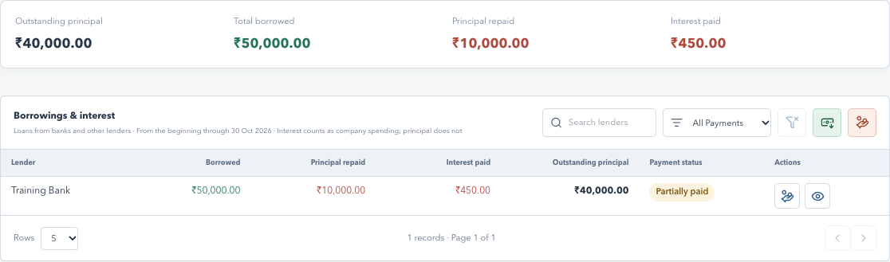
VRIDHI / CONSTRUCTIONS & DESIGNS
52 / 88 | USER TRAINING
COMPANY CASHBOOK / VISUAL WALKTHROUGH
Borrowings: totals, status and history
Current application interface | Synthetic training data | No live records
WHAT TO NOTICE
Summary strip
Outstanding, borrowed, principal
repaid and interest paid.
Lender controls
Search, payment-status filter and
clear action.
Eye icon
Open lender history and exact
transaction details.
Lender rows start at 5 per page; 10 and 20 are available.
COMPANY CASHBOOK UPDATE | 10 DEC 2026 | Companion: 12-company-cashbook-training.md
52
Notes:
Borrowings: totals, status and history
The lender filters affect rows, not summary totals. The lender report prints full matching history. Borrowing details has its own transaction details popup; closing it returns to lender history.
Sources: 12-company-cashbook-training.md; 11-company-cashbook.md; 04-users-and-permissions.md
Screens use isolated synthetic API responses. No live database records were read or changed. Different screen fixtures are not a reconciled ledger. All worked amounts are illustrative. Use an isolated training database. No credentials are included.

Slide 53
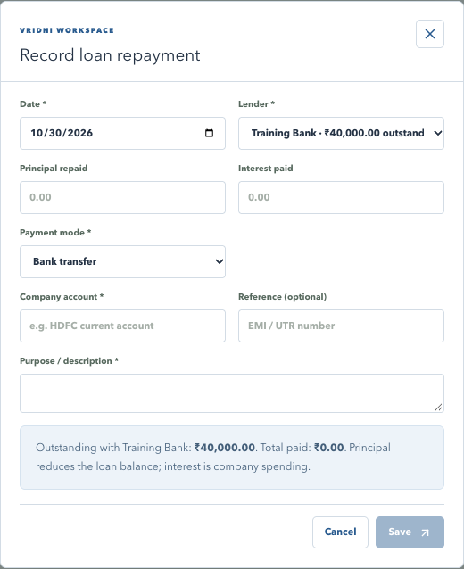
VRIDHI / CONSTRUCTIONS & DESIGNS
53 / 88 | USER TRAINING
COMPANY CASHBOOK / VISUAL WALKTHROUGH
Loan repayment: split the payment
Current application interface | Synthetic training data | No live records
WHAT TO NOTICE
Choose lender
Only lenders with outstanding
principal are eligible.
Split amounts
Principal and interest are recorded
separately.
Save
Review date, mode, account and
purpose first.
Principal reduces debt; interest contributes to company spending.
COMPANY CASHBOOK UPDATE | 10 DEC 2026 | Companion: 12-company-cashbook-training.md
53
Notes:
Loan repayment: split the payment
Show how an EMI can become two saved entries. If correcting a repayment, mark each incorrect principal/interest entry invalid separately in Cash Transactions, then enter the correct replacement through Borrowings.
Sources: 12-company-cashbook-training.md; 11-company-cashbook.md; 04-users-and-permissions.md
Screens use isolated synthetic API responses. No live database records were read or changed. Different screen fixtures are not a reconciled ledger. All worked amounts are illustrative. Use an isolated training database. No credentials are included.

Slide 54
VRIDHI / CONSTRUCTIONS & DESIGNS
54 / 88 | USER TRAINING
COMPANY CASHBOOK / FEATURE TRAINING
Project Profit & Loss: review before approval
Same live calculation as Overview; not final accounting profit.
Calculation basis
Approval control
Contract value minus purchase-order line costs.
Global access required; Through must be today.
Subtract recorded wage work and certified
claims.
Review breakdown, total project amount and
note.
Do not subtract their cash payments again.
Changed projection requires another approval.
Only approved projections count. The previous approved value stays until reapproved.
COMPANY CASHBOOK UPDATE | 10 DEC 2026 | Companion: 12-company-cashbook-training.md
54
Notes:
Project Profit & Loss: review before approval
Live calculations use all current source records, not historical From/Through reconstruction. Through filters saved approvals and transfers. Company overhead, GST, depreciation and funding are excluded. Results refresh every 15 seconds while visible, with manual Refresh calculations. Not approved is not assumed zero. Break-even can be approved. The server rejects stale review figures.
Sources: 12-company-cashbook-training.md; 11-company-cashbook.md; 04-users-and-permissions.md
Screens use isolated synthetic API responses. No live database records were read or changed. Different screen fixtures are not a reconciled ledger. All worked amounts are illustrative. Use an isolated training database. No credentials are included.

Slide 55
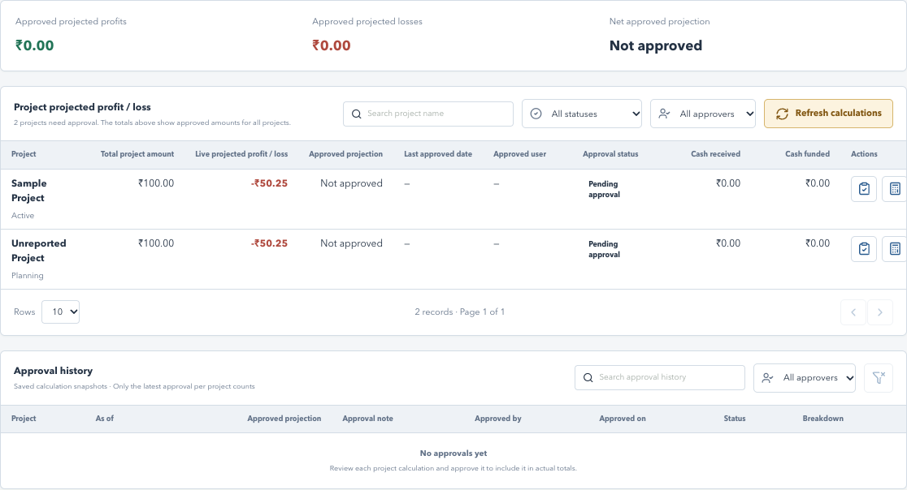
VRIDHI / CONSTRUCTIONS & DESIGNS
55 / 88 | USER TRAINING
COMPANY CASHBOOK / VISUAL WALKTHROUGH
Project results: current versus approved
Current application interface | Synthetic training data | No live records
WHAT TO NOTICE
Refresh
Amber Refresh calculations fetches
current source figures.
Review scope
Search/filter project rows; totals still
cover all approved projects.
History
Saved approvals retain reviewer,
date, note and breakdown.
Project list: 10/20/50 rows. Approval history: 5/10/20/50.
COMPANY CASHBOOK UPDATE | 10 DEC 2026 | Companion: 12-company-cashbook-training.md
55
Notes:
Project results: current versus approved
Explain the distinction between live projected result and latest approved projection. Approval snapshots are immutable. Same-day reapprovals preserve earlier snapshots. Legacy manual declarations are reference-only. Search and Approved by filters in approval history do not rewrite company totals.
Sources: 12-company-cashbook-training.md; 11-company-cashbook.md; 04-users-and-permissions.md
Screens use isolated synthetic API responses. No live database records were read or changed. Different screen fixtures are not a reconciled ledger. All worked amounts are illustrative. Use an isolated training database. No credentials are included.

Slide 56
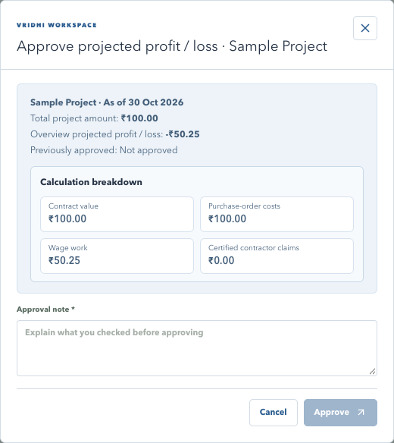
VRIDHI / CONSTRUCTIONS & DESIGNS
56 / 88 | USER TRAINING
COMPANY CASHBOOK / VISUAL WALKTHROUGH
Approval: inspect the saved basis
Current application interface | Synthetic training data | No live records
WHAT TO NOTICE
Contract value
Check Total project amount before
approving.
Cost breakdown
Review materials, wage work and
certified contractor claims.
Approval note
Record the review rationale; the
amount is not editable.
Approval saves an immutable snapshot, reviewer, timestamp, as-of date and note.
COMPANY CASHBOOK UPDATE | 10 DEC 2026 | Companion: 12-company-cashbook-training.md
56
Notes:
Approval: inspect the saved basis
Do not approve incomplete costs as final profit. If underlying source records change, refresh and review again. Approval snapshots cannot be marked invalid; correct the source and approve the revised calculation.
Sources: 12-company-cashbook-training.md; 11-company-cashbook.md; 04-users-and-permissions.md
Screens use isolated synthetic API responses. No live database records were read or changed. Different screen fixtures are not a reconciled ledger. All worked amounts are illustrative. Use an isolated training database. No credentials are included.

Slide 57
VRIDHI / CONSTRUCTIONS & DESIGNS
57 / 88 | USER TRAINING
COMPANY CASHBOOK / FEATURE TRAINING
Owner capital and safe corrections
Preserve the record trail instead of deleting financial history.
Owner Capital
Mark as invalid
Record actual contributions and withdrawals.
Review the incorrect entry and CC reference.
Use consistent descriptive owner names.
Enter a reason of at least five characters.
Movements do not define equity or profit share.
Confirm, then record the correct replacement.
Invalidation is irreversible; partner joining/exit settlement is not implemented.
COMPANY CASHBOOK UPDATE | 10 DEC 2026 | Companion: 12-company-cashbook-training.md
57
Notes:
Owner capital and safe corrections
Capital received so far and Withdrawals so far are cumulative through Through; table movements use selected dates. There is no ownership-percentage calculation or automatic settlement obligation. Mark as invalid preserves the original, actor, date and reason but excludes it from totals. It is not a generated reverse payment. Internal API names still use void.
Sources: 12-company-cashbook-training.md; 11-company-cashbook.md; 04-users-and-permissions.md
Screens use isolated synthetic API responses. No live database records were read or changed. Different screen fixtures are not a reconciled ledger. All worked amounts are illustrative. Use an isolated training database. No credentials are included.

Slide 58
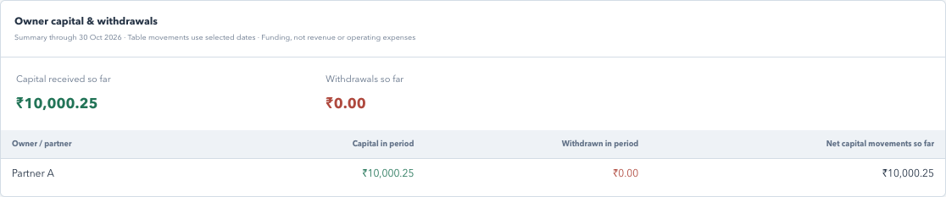
VRIDHI / CONSTRUCTIONS & DESIGNS
58 / 88 | USER TRAINING
COMPANY CASHBOOK / VISUAL WALKTHROUGH
Owner Capital: movements, not ownership
Current application interface | Synthetic training data | No live records
WHAT TO NOTICE
Lifetime figures
Capital received so far and
Withdrawals so far.
Owner rows
Selected-period
contributions/withdrawals and
cumulative movements.
Boundary
No automatic equity, partner joining
or exit settlement.
Starting balances are not inferred owner capital.
COMPANY CASHBOOK UPDATE | 10 DEC 2026 | Companion: 12-company-cashbook-training.md
58
Notes:
Owner Capital: movements, not ownership
Use this slide to distinguish descriptive owner names and funding movements from a legal partner register. Do not describe net capital movement as a calculated settlement amount.
Sources: 12-company-cashbook-training.md; 11-company-cashbook.md; 04-users-and-permissions.md
Screens use isolated synthetic API responses. No live database records were read or changed. Different screen fixtures are not a reconciled ledger. All worked amounts are illustrative. Use an isolated training database. No credentials are included.

Slide 59
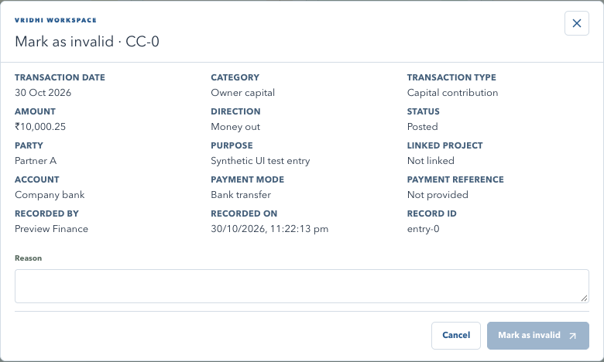
VRIDHI / CONSTRUCTIONS & DESIGNS
59 / 88 | USER TRAINING
COMPANY CASHBOOK / VISUAL WALKTHROUGH
Correction: Mark as invalid
Current application interface | Synthetic training data | No live records
WHAT TO NOTICE
Exact record
Review purpose, amount, date,
account and CC reference.
Reason
Explain the correction in at least five
characters.
Result
Record retained; active balances are
recalculated.
Use Mark as invalid, not deletion. Record the correct replacement separately.
COMPANY CASHBOOK UPDATE | 10 DEC 2026 | Companion: 12-company-cashbook-training.md
59
Notes:
Correction: Mark as invalid
Show the prohibition icon and confirmation dialog. Status labels and filters now say Marked as invalid. Company Audit Log displays the correction. Approval snapshots cannot use this action.
Sources: 12-company-cashbook-training.md; 11-company-cashbook.md; 04-users-and-permissions.md
Screens use isolated synthetic API responses. No live database records were read or changed. Different screen fixtures are not a reconciled ledger. All worked amounts are illustrative. Use an isolated training database. No credentials are included.

Slide 60
VRIDHI / CONSTRUCTIONS & DESIGNS
60 / 88 | USER TRAINING
COMPANY CASHBOOK / FEATURE TRAINING
Permission boundaries for company finances
Grant access independently for cash operations and activity review.
Company Cashbook
Company Audit Log
View: all company finances and saved entry
details.
View and Download Report are separate grants.
Audit access does not grant saved-entry access.
Record: transactions and invalidation.
Global includes both; others default blocked.
Download Report: financial/lender reports.
Only Global users approve project results or create custom categories/types.
COMPANY CASHBOOK UPDATE | 10 DEC 2026 | Companion: 12-company-cashbook-training.md
60
Notes:
Permission boundaries for company finances
Cashbook-only and audit-only accounts do not require project assignment. An account manager cannot delegate grants they do not have. The activity popup rechecks Company Cashbook View access before displaying an exact saved entry. Its export needs the originating log's Download Report grant, plus saved-entry read when applicable. There is no duplicate History tab.
Sources: 12-company-cashbook-training.md; 11-company-cashbook.md; 04-users-and-permissions.md
Screens use isolated synthetic API responses. No live database records were read or changed. Different screen fixtures are not a reconciled ledger. All worked amounts are illustrative. Use an isolated training database. No credentials are included.

Slide 61
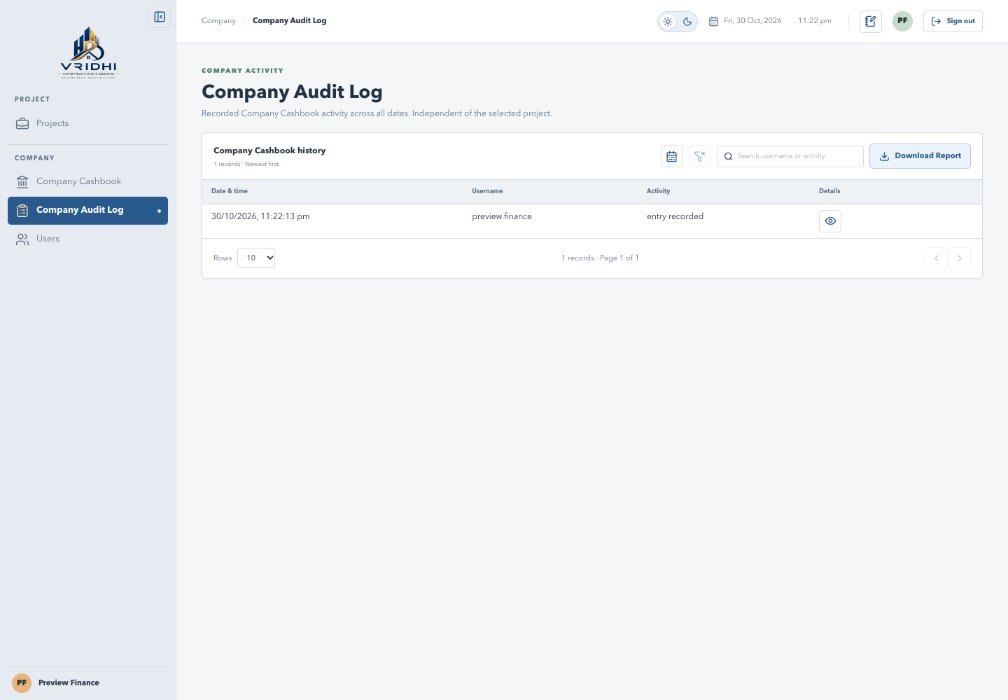
VRIDHI / CONSTRUCTIONS & DESIGNS
61 / 88 | USER TRAINING
COMPANY CASHBOOK / VISUAL WALKTHROUGH
Company Audit Log: investigate activity
Current application interface | Synthetic training data | No live records
WHAT TO NOTICE
Find events
Search user/activity/details/IDs and
apply date/time filters.
Recorded visits
Four Cashbook tabs and Company
Audit Log record visits.
Pagination
10 rows by default; 20, 50 and 100
available.
Company activities are separate from project Audit Log and account User History.
COMPANY CASHBOOK UPDATE | 10 DEC 2026 | Companion: 12-company-cashbook-training.md
61
Notes:
Company Audit Log: investigate activity
Activity list columns are Date & time, Username, Activity and the eye action. Report list contains only the first three, without details. Visit tracking cannot reconstruct earlier unrecorded visits. Filters and pagination do not create new visit events; refresh does.
Sources: 12-company-cashbook-training.md; 11-company-cashbook.md; 04-users-and-permissions.md
Screens use isolated synthetic API responses. No live database records were read or changed. Different screen fixtures are not a reconciled ledger. All worked amounts are illustrative. Use an isolated training database. No credentials are included.

Slide 62
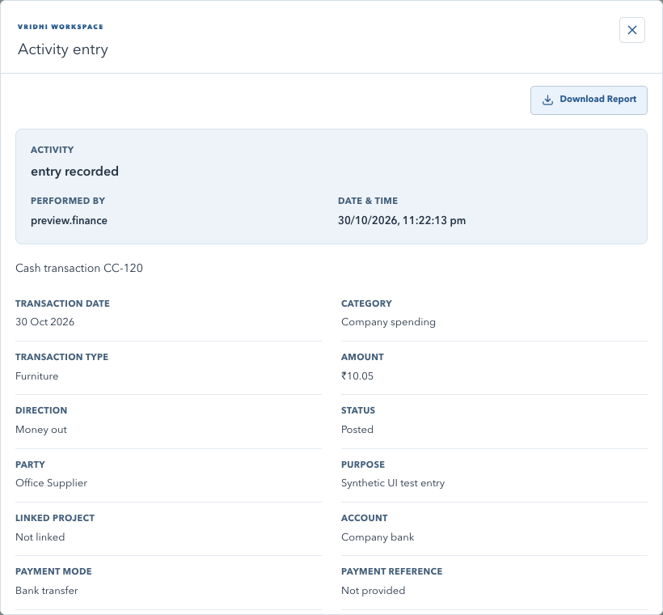
VRIDHI / CONSTRUCTIONS & DESIGNS
62 / 88 | USER TRAINING
COMPANY CASHBOOK / VISUAL WALKTHROUGH
Activity details: inspect and download
Current application interface | Synthetic training data | No live records
WHAT TO NOTICE
Activity summary
Activity, performer and local
date/time.
Exact entry
Loads by record ID; permission
denial is explicit.
Popup report
Download only the selected activity
and its displayed details.
Audit list report excludes details; the activity popup report includes them.
COMPANY CASHBOOK UPDATE | 10 DEC 2026 | Companion: 12-company-cashbook-training.md
62
Notes:
Activity details: inspect and download
The eye icon loads supported cash/loan/approval/custom-option records. Visits and report requests show logged event details instead. Entry details are the current saved record, not a reconstruction of every historical field. Single-activity exports are permission-checked and audited; users cannot download a denied/missing entry.
Sources: 12-company-cashbook-training.md; 11-company-cashbook.md; 04-users-and-permissions.md
Screens use isolated synthetic API responses. No live database records were read or changed. Different screen fixtures are not a reconciled ledger. All worked amounts are illustrative. Use an isolated training database. No credentials are included.

Slide 63
VRIDHI / CONSTRUCTIONS & DESIGNS
63 / 88 | USER TRAINING
COMPANY CASHBOOK / FEATURE TRAINING
Reports and a safe practice exercise
Download Report prepares content; the browser creates the PDF.
Choose the report
Training checklist
Financial report: active tab and matching rows.
Use synthetic data; reconcile the cash example.
Audit list: date/time, username and activity only.
Review a projection, approve, then change a
cost.
Activity popup: selected activity with details.
Correct an entry; test read-only and audit-only
access.
Print -> Save as PDF. Inspect every page; export request does not prove a file was saved.
COMPANY CASHBOOK UPDATE | 10 DEC 2026 | Companion: 12-company-cashbook-training.md
63
Notes:
Reports and a safe practice exercise
Cashbook and lender reports fetch all matching records. Audit filters apply to all exported list rows, not only the current page. Summary collapse state carries into the financial report. Branded reports use light print colors and the shared company header. Use 12-company-cashbook-training.md for the full feature reference, worked example and troubleshooting.
Sources: 12-company-cashbook-training.md; 11-company-cashbook.md; 04-users-and-permissions.md
Screens use isolated synthetic API responses. No live database records were read or changed. Different screen fixtures are not a reconciled ledger. All worked amounts are illustrative. Use an isolated training database. No credentials are included.

Slide 64
VRIDHI / CONSTRUCTIONS & DESIGNS
64 / 88 | USER TRAINING
PROJECT ARCHIVE / FEATURE TRAINING
Project Archive: close finished work safely
Move Completed or Cancelled projects out of daily work without losing history.
What archiving does
When to use it
Moves the project to the Archived Projects tab.
The project is Completed or Cancelled.
Makes every business record read-only.
Dues, stock and claims are settled.
Keeps approved profit / loss in Company
Cashbook.
Final profit / loss is approved in Cashbook.
Archive is reversible: UnArchive returns the project to Current Projects.
PROJECT ARCHIVE UPDATE | 31 OCT 2026 | Companion: 13-project-archive.md
64
Notes:
Project Archive: close finished work safely
Introduce the archive lifecycle. Archiving is not deletion and not a status change; the project keeps its Completed or Cancelled status. Planning, Active and On Hold projects cannot be archived. Visits, Audit Log and Download Report remain available for archived projects. Use 13-project-archive.md for the full reference, blockers list and troubleshooting.
Sources: 13-project-archive.md; 02-module-guide.md; 04-users-and-permissions.md; 05-reports-and-calculations.md
Screens use isolated synthetic API responses. No live database records were read or changed. Project names, amounts, users and dates are illustrative. Use an isolated training database. No credentials are included.

Slide 65
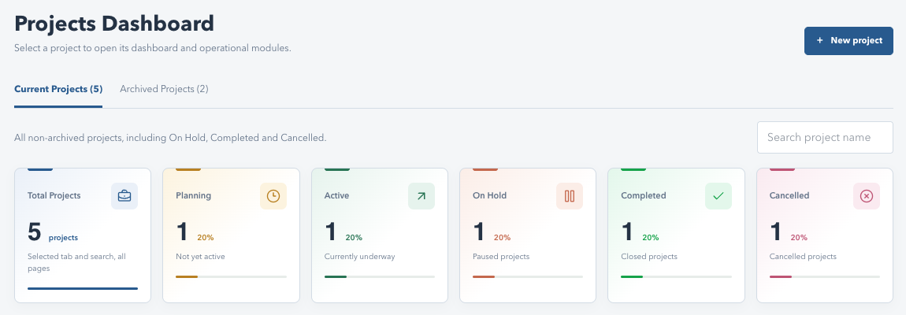
VRIDHI / CONSTRUCTIONS & DESIGNS
65 / 88 | USER TRAINING
PROJECT ARCHIVE / VISUAL WALKTHROUGH
Projects Dashboard: Current Projects tab
Current application interface | Synthetic training data | No live records
WHAT TO NOTICE
Two tabs
Current Projects (default) and
Archived Projects, each with a count.
Current scope
All non-archived work, including On
Hold, Completed and Cancelled.
Pagination
10 rows per page by default on both
tabs.
Archived projects are hidden from the Current tab and the WORKSPACE selector.
PROJECT ARCHIVE UPDATE | 31 OCT 2026 | Companion: 13-project-archive.md
65
Notes:
Projects Dashboard: Current Projects tab
The selected tab is remembered after refresh. Search applies to the active tab only. Summary tiles count the selected tab and search across all pages, not only the visible page.
Sources: 13-project-archive.md; 02-module-guide.md; 04-users-and-permissions.md; 05-reports-and-calculations.md
Screens use isolated synthetic API responses. No live database records were read or changed. Project names, amounts, users and dates are illustrative. Use an isolated training database. No credentials are included.

Slide 66
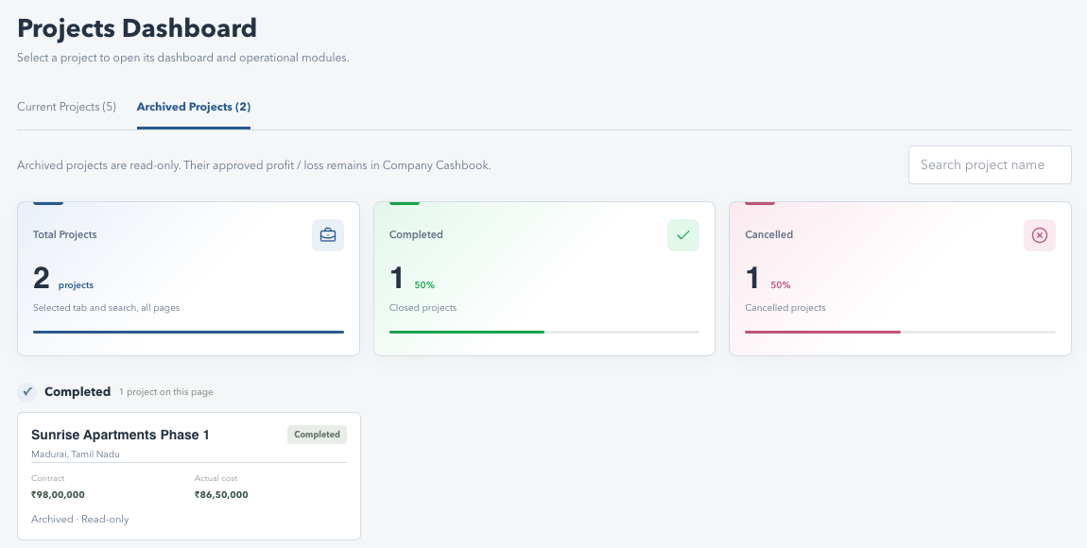
VRIDHI / CONSTRUCTIONS & DESIGNS
66 / 88 | USER TRAINING
PROJECT ARCHIVE / VISUAL WALKTHROUGH
Archived Projects tab
Current application interface | Synthetic training data | No live records
WHAT TO NOTICE
Only finished work
Tiles show Total, Completed (green)
and Cancelled.
Read-only cards
Each card shows Archived -
Read-only.
Open to review
Select a card to open its Overview,
reports and Audit Log.
Planning, Active and On Hold never appear in Archived Projects.
PROJECT ARCHIVE UPDATE | 31 OCT 2026 | Companion: 13-project-archive.md
66
Notes:
Archived Projects tab
Explain why only Completed and Cancelled groups exist: the server rejects archiving any other status. Opening an archived card is allowed for review; editing is blocked in every project module.
Sources: 13-project-archive.md; 02-module-guide.md; 04-users-and-permissions.md; 05-reports-and-calculations.md
Screens use isolated synthetic API responses. No live database records were read or changed. Project names, amounts, users and dates are illustrative. Use an isolated training database. No credentials are included.

Slide 67
VRIDHI / CONSTRUCTIONS & DESIGNS
67 / 88 | USER TRAINING
PROJECT ARCHIVE / FEATURE TRAINING
Before you archive: clear the blockers
The system checks the project and lists anything still outstanding.
Eligibility
Common blockers
Status must be Completed or Cancelled.
Outstanding vendor, client or worker dues.
Archive permission on the Overview module.
Open claims, certifications, addenda or stock.
A reason is required (up to 500 characters).
Profit / loss not approved, or approval is stale.
Resolve the listed items first; the popup shows nothing extra when there are no blockers.
PROJECT ARCHIVE UPDATE | 31 OCT 2026 | Companion: 13-project-archive.md
67
Notes:
Before you archive: clear the blockers
Blockers are recalculated by the server at the moment of archiving, so a stale screen cannot bypass them. If source records change after the profit / loss approval, the approval becomes stale and must be refreshed and approved again in Company Cashbook. A blocked attempt is recorded in the project Audit Log as Archive request blocked with the blocker list.
Sources: 13-project-archive.md; 02-module-guide.md; 04-users-and-permissions.md; 05-reports-and-calculations.md
Screens use isolated synthetic API responses. No live database records were read or changed. Project names, amounts, users and dates are illustrative. Use an isolated training database. No credentials are included.

Slide 68
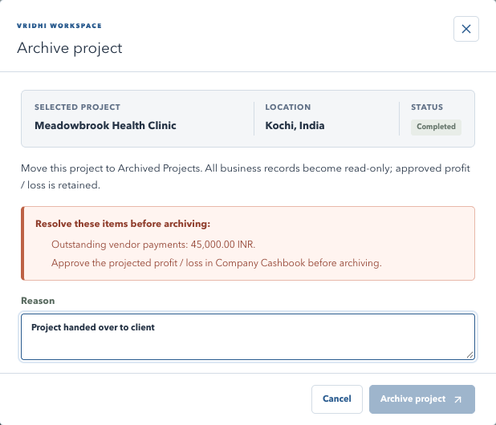
VRIDHI / CONSTRUCTIONS & DESIGNS
68 / 88 | USER TRAINING
PROJECT ARCHIVE / VISUAL WALKTHROUGH
Archive popup: resolve these items
Current application interface | Synthetic training data | No live records
WHAT TO NOTICE
Project details
Selected project, location and status
at the top.
Blocker list
Each outstanding item is listed in the
red panel.
Disabled action
Archive project stays disabled until
the list is clear.
Fix the blockers in their own modules, then reopen the Archive popup.
PROJECT ARCHIVE UPDATE | 31 OCT 2026 | Companion: 13-project-archive.md
68
Notes:
Archive popup: resolve these items
Open Overview and select Archive project. Walk through each blocker and point to the module that resolves it: Procurement for vendor dues, Cash flow for client billing, Labor and Wages for worker dues and claims, Inventory for stock, Company Cashbook > Project Profit & Loss for approval.
Sources: 13-project-archive.md; 02-module-guide.md; 04-users-and-permissions.md; 05-reports-and-calculations.md
Screens use isolated synthetic API responses. No live database records were read or changed. Project names, amounts, users and dates are illustrative. Use an isolated training database. No credentials are included.

Slide 69
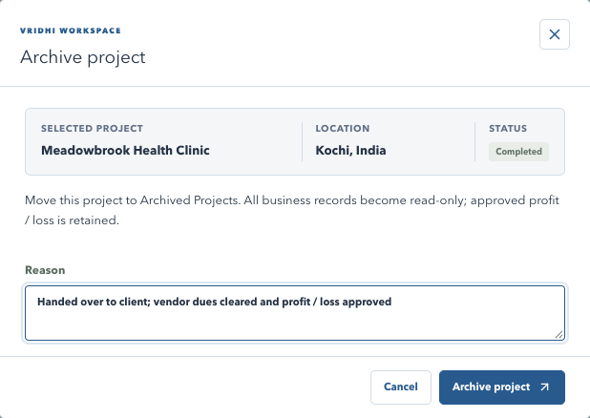
VRIDHI / CONSTRUCTIONS & DESIGNS
69 / 88 | USER TRAINING
PROJECT ARCHIVE / VISUAL WALKTHROUGH
Archive popup: give a reason and confirm
Current application interface | Synthetic training data | No live records
WHAT TO NOTICE
No blockers
Only the project details, summary
and Reason are shown.
Reason
Required; the box can be resized for
longer notes.
Confirm
Archive project moves it to Archived
Projects.
The reason is stored with the archive and shown on the Overview banner.
PROJECT ARCHIVE UPDATE | 31 OCT 2026 | Companion: 13-project-archive.md
69
Notes:
Archive popup: give a reason and confirm
The Reason field starts compact and can be resized vertically. Cancel closes without changes. After success the project disappears from Current Projects and the WORKSPACE selector.
Sources: 13-project-archive.md; 02-module-guide.md; 04-users-and-permissions.md; 05-reports-and-calculations.md
Screens use isolated synthetic API responses. No live database records were read or changed. Project names, amounts, users and dates are illustrative. Use an isolated training database. No credentials are included.

Slide 70
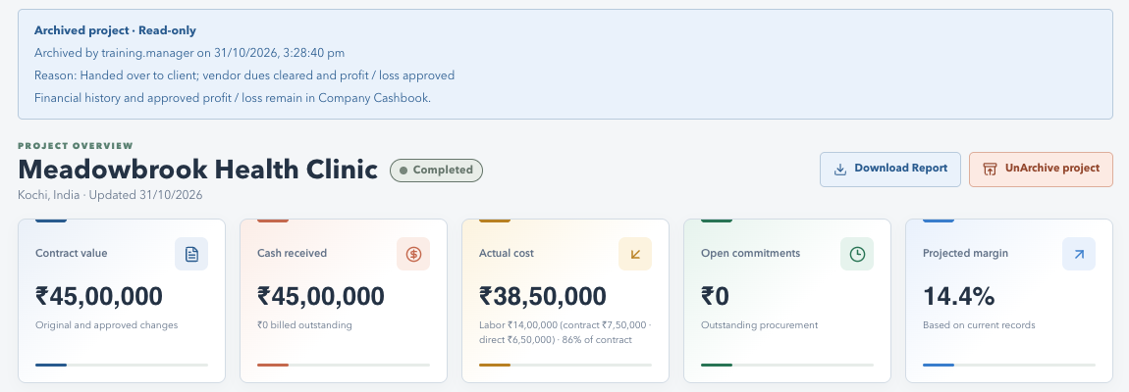
VRIDHI / CONSTRUCTIONS & DESIGNS
70 / 88 | USER TRAINING
PROJECT ARCHIVE / VISUAL WALKTHROUGH
Archived project: read-only Overview
Current application interface | Synthetic training data | No live records
WHAT TO NOTICE
Banner
Archived by user, date and time, and
the reason.
Status badge
Coloured status pill beside the
project name.
Actions
Only Download Report and
UnArchive project remain.
Every project module rejects create, edit and delete actions while archived.
PROJECT ARCHIVE UPDATE | 31 OCT 2026 | Companion: 13-project-archive.md
70
Notes:
Archived project: read-only Overview
The banner line about Company Cashbook appears only for users who can view Company Cashbook. Project status, Quick entry and other write actions are hidden; the server also enforces read-only access. The Overview report prints the company header first, then this banner, with the status beside the project name.
Sources: 13-project-archive.md; 02-module-guide.md; 04-users-and-permissions.md; 05-reports-and-calculations.md
Screens use isolated synthetic API responses. No live database records were read or changed. Project names, amounts, users and dates are illustrative. Use an isolated training database. No credentials are included.

Slide 71
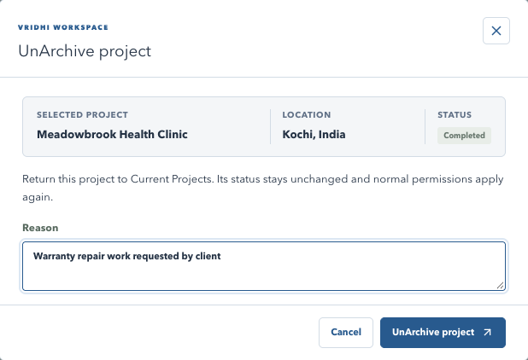
VRIDHI / CONSTRUCTIONS & DESIGNS
71 / 88 | USER TRAINING
PROJECT ARCHIVE / VISUAL WALKTHROUGH
UnArchive: return the project to work
Current application interface | Synthetic training data | No live records
WHAT TO NOTICE
Same popup
Project details plus a required
reason.
Status kept
Completed or Cancelled status does
not change.
Permissions
Normal editing rules apply again after
UnArchive.
Use UnArchive for genuine follow-up work such as warranty repairs.
PROJECT ARCHIVE UPDATE | 31 OCT 2026 | Companion: 13-project-archive.md
71
Notes:
UnArchive: return the project to work
UnArchive uses the same Archive permission. The project returns to Current Projects and the WORKSPACE selector. Archive it again once the follow-up is complete; each action is recorded separately in the Audit Log.
Sources: 13-project-archive.md; 02-module-guide.md; 04-users-and-permissions.md; 05-reports-and-calculations.md
Screens use isolated synthetic API responses. No live database records were read or changed. Project names, amounts, users and dates are illustrative. Use an isolated training database. No credentials are included.

Slide 72
VRIDHI / CONSTRUCTIONS & DESIGNS
72 / 88 | USER TRAINING
PROJECT ARCHIVE / FEATURE TRAINING
Permissions and audit trail
Archive is a separately granted action, and every attempt is traceable.
Who can archive
What is recorded
Action: Archive under the Overview module.
Archived project, UnArchived project.
Grant per project or through Global Permission.
Archive request blocked, with the blockers.
The same permission allows UnArchive.
User, date and time, reason and status.
Search the Audit Log for 'Archive' to see every archive-related event.
PROJECT ARCHIVE UPDATE | 31 OCT 2026 | Companion: 13-project-archive.md
72
Notes:
Permissions and audit trail
Users without the Archive action do not see the Archive or UnArchive button; the API also rejects the request. Account managers cannot grant permissions they do not hold. Archive events appear in the project Audit Log, which remains available for archived projects.
Sources: 13-project-archive.md; 02-module-guide.md; 04-users-and-permissions.md; 05-reports-and-calculations.md
Screens use isolated synthetic API responses. No live database records were read or changed. Project names, amounts, users and dates are illustrative. Use an isolated training database. No credentials are included.

Slide 73
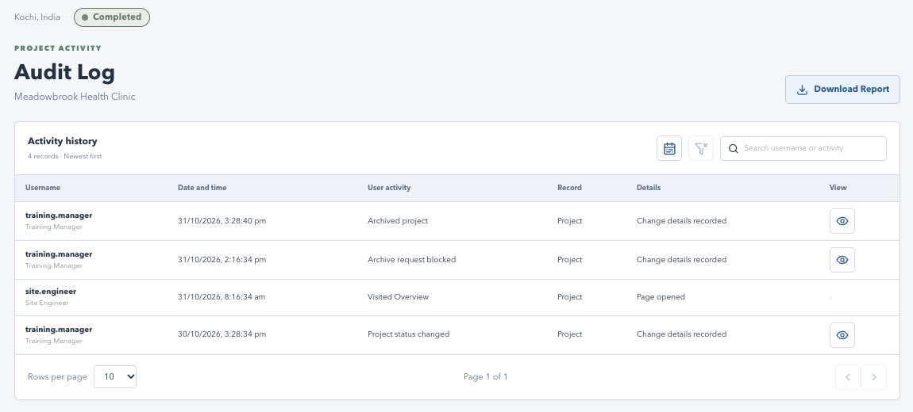
VRIDHI / CONSTRUCTIONS & DESIGNS
73 / 88 | USER TRAINING
PROJECT ARCHIVE / VISUAL WALKTHROUGH
Audit Log: archive activity
Current application interface | Synthetic training data | No live records
WHAT TO NOTICE
Columns
Username, Date and time, User
activity, Record, Details, View.
Eye icon
Shown only for rows with recorded
change details.
Search
Type Archive to filter archive-related
events.
The table stays compact; full details open in a popup.
PROJECT ARCHIVE UPDATE | 31 OCT 2026 | Companion: 13-project-archive.md
73
Notes:
Audit Log: archive activity
Rows without recorded details, such as page visits, show a dash in the View column. Audit ID and Reference are not table columns; they appear in the details popup footer and the printed report.
Sources: 13-project-archive.md; 02-module-guide.md; 04-users-and-permissions.md; 05-reports-and-calculations.md
Screens use isolated synthetic API responses. No live database records were read or changed. Project names, amounts, users and dates are illustrative. Use an isolated training database. No credentials are included.

Slide 74
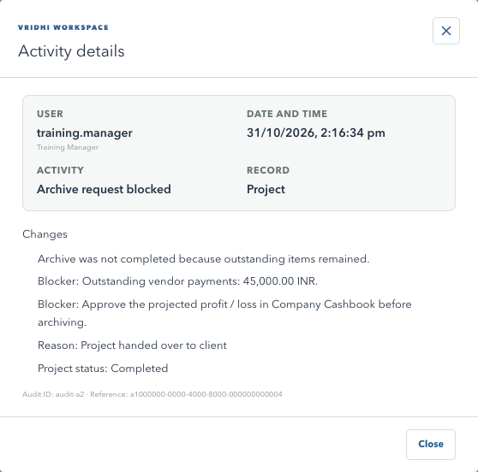
VRIDHI / CONSTRUCTIONS & DESIGNS
74 / 88 | USER TRAINING
PROJECT ARCHIVE / VISUAL WALKTHROUGH
Activity details popup
Current application interface | Synthetic training data | No live records
WHAT TO NOTICE
Summary
User, date and time, activity and
record.
Changes
Blockers, reason and project status
as recorded.
Identifiers
Audit ID and Reference in the small
footer.
Use the popup to explain exactly why an archive was blocked or completed.
PROJECT ARCHIVE UPDATE | 31 OCT 2026 | Companion: 13-project-archive.md
74
Notes:
Activity details popup
This example shows a blocked request with two blockers and the entered reason. Successful archive and UnArchive entries show the reason and the status at the time of the action.
Sources: 13-project-archive.md; 02-module-guide.md; 04-users-and-permissions.md; 05-reports-and-calculations.md
Screens use isolated synthetic API responses. No live database records were read or changed. Project names, amounts, users and dates are illustrative. Use an isolated training database. No credentials are included.

Slide 75
VRIDHI / CONSTRUCTIONS & DESIGNS
75 / 88 | USER TRAINING
PROJECT ARCHIVE / FEATURE TRAINING
Reports and a safe practice exercise
Archived projects can still be reviewed and reported.
Reports
Training checklist
Download Report works on archived projects.
Try archiving an Active project; note the rule.
Header: logo, title, date and status pill.
Complete a project; review blockers; archive.
Archive banner prints below the header.
Check read-only, Audit Log; then UnArchive.
Use synthetic training data only; never archive a live project for practice.
PROJECT ARCHIVE UPDATE | 31 OCT 2026 | Companion: 13-project-archive.md
75
Notes:
Reports and a safe practice exercise
The report header no longer prints a company address. The status pill appears beside the project name. Print -> Save as PDF; the export request does not prove that a file was saved. For the full step-by-step procedure, FAQ and troubleshooting see 13-project-archive.md.
Sources: 13-project-archive.md; 02-module-guide.md; 04-users-and-permissions.md; 05-reports-and-calculations.md
Screens use isolated synthetic API responses. No live database records were read or changed. Project names, amounts, users and dates are illustrative. Use an isolated training database. No credentials are included.

Slide 76
VRIDHI / CONSTRUCTIONS & DESIGNS
76 / 88 | USER TRAINING
BACKUP & RESTORE / FEATURE TRAINING
Backup & Restore: protect company data
Save everything in one encrypted file and bring it back whenever it is needed.
What one backup file holds
Why it matters
Projects, archived projects and every module.
Protects against disk failure, theft or mistakes.
Company Cashbook, borrowings and approvals.
Encrypted: a passphrase is always required.
Users, permissions and all audit history.
You choose where the file is saved.
Every uploaded document and image.
Upload a copy to Google Drive or email it to
yourself.
A backup kept only on this computer is not safe: always move a copy elsewhere.
BACKUP & RESTORE UPDATE | 31 OCT 2026 | Companion: 14-backup-and-restore.md
76
Notes:
Backup & Restore: protect company data
Company > Backup & Restore saves the whole system into one encrypted .vbak file. Sign-in sessions, temporary request records, diagnostic logs, browser settings and the .env file are not included. The application keeps no long-term copies on this computer; the user saves the file and uploads it to Google Drive or another safe place manually.
Sources: 14-backup-and-restore.md; 04-users-and-permissions.md; 07-data-and-persistence.md; 08-operations-and-troubleshooting.md
Screens use isolated synthetic API responses. No live database records were read or changed. Names, counts, files and dates are illustrative. Use an isolated training database. No credentials or real passphrases are included.

Slide 77
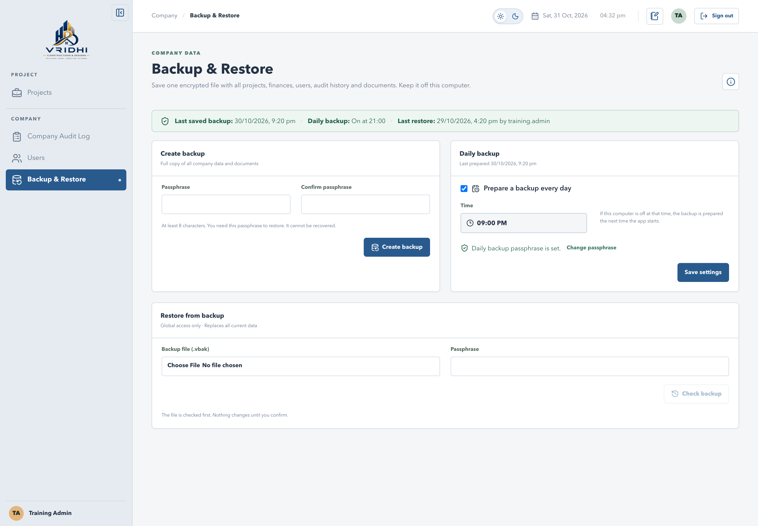
VRIDHI / CONSTRUCTIONS & DESIGNS
77 / 88 | USER TRAINING
BACKUP & RESTORE / VISUAL WALKTHROUGH
The Backup & Restore page
Current application interface | Synthetic training data | No live records
WHAT TO NOTICE
Status strip
Shows the last saved backup, daily
backup and last restore with who did
it.
Two cards, side by side
Create backup and Daily backup.
Restore from backup
Global access only, full width below.
The strip turns amber if nothing has been saved yet or for more than 2 days.
BACKUP & RESTORE UPDATE | 31 OCT 2026 | Companion: 14-backup-and-restore.md
77
Notes:
The Backup & Restore page
Open Company > Backup & Restore. The status strip shows the last saved backup, whether the daily backup is on, and the last successful restore with the username. It shows Never when nothing is recorded, and turns amber when no backup has been saved or none for two days.
Sources: 14-backup-and-restore.md; 04-users-and-permissions.md; 07-data-and-persistence.md; 08-operations-and-troubleshooting.md
Screens use isolated synthetic API responses. No live database records were read or changed. Names, counts, files and dates are illustrative. Use an isolated training database. No credentials or real passphrases are included.

Slide 78
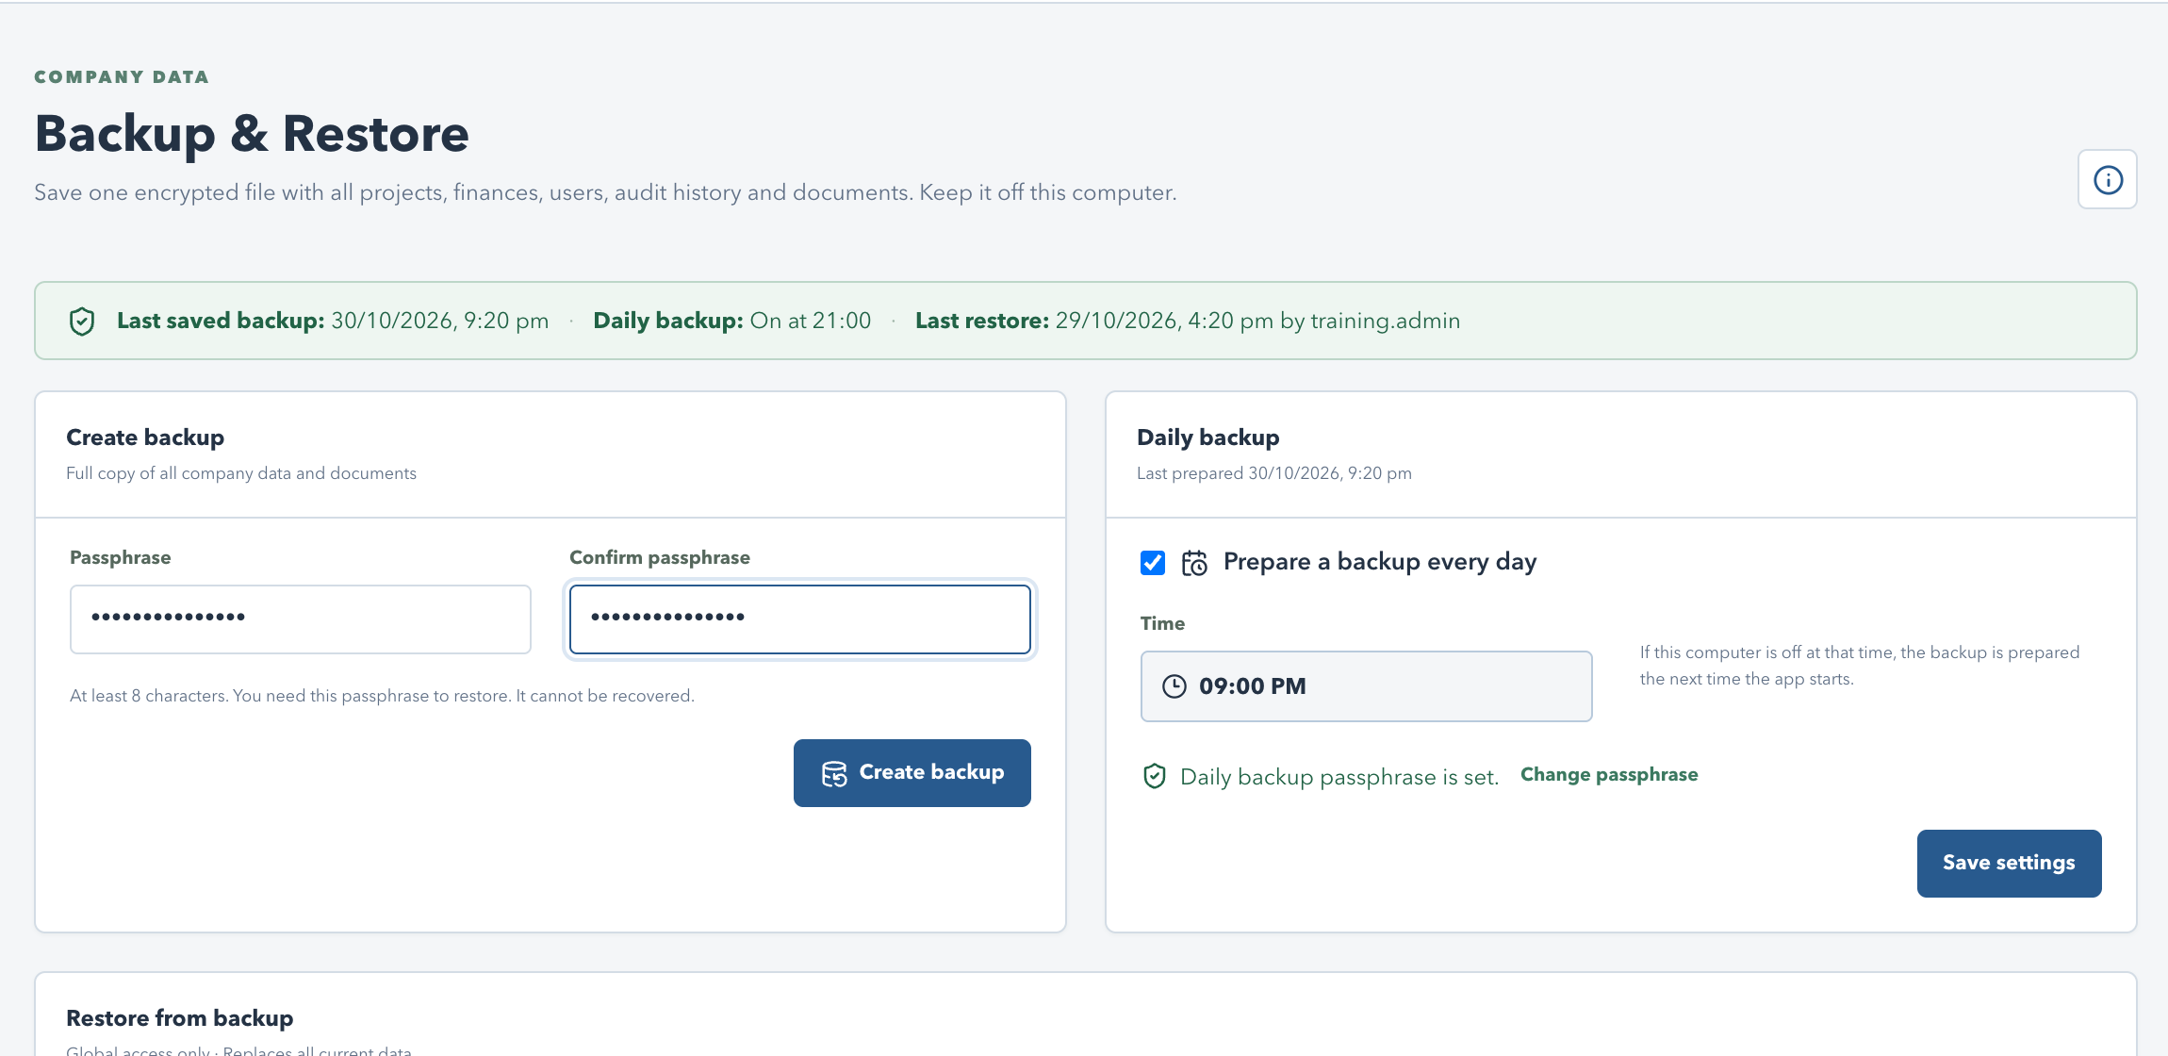
VRIDHI / CONSTRUCTIONS & DESIGNS
78 / 88 | USER TRAINING
BACKUP & RESTORE / VISUAL WALKTHROUGH
Step 1: create a backup with a passphrase
Current application interface | Synthetic training data | No live records
WHAT TO NOTICE
Passphrase
At least 8 characters; enter it twice.
Store it separately
It cannot be recovered or reset.
Create backup
Packs the database and all
documents.
No passphrase, no restore: keep it in a password manager, not next to the file.
BACKUP & RESTORE UPDATE | 31 OCT 2026 | Companion: 14-backup-and-restore.md
78
Notes:
Step 1: create a backup with a passphrase
Enter and confirm a passphrase of at least eight characters, then select Create backup. Progress is shown while the database and documents are packed. The file is encrypted with AES-256-GCM; a wrong passphrase and a damaged file show the same message.
Sources: 14-backup-and-restore.md; 04-users-and-permissions.md; 07-data-and-persistence.md; 08-operations-and-troubleshooting.md
Screens use isolated synthetic API responses. No live database records were read or changed. Names, counts, files and dates are illustrative. Use an isolated training database. No credentials or real passphrases are included.

Slide 79
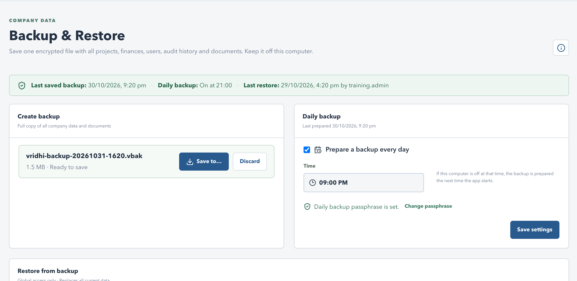
VRIDHI / CONSTRUCTIONS & DESIGNS
79 / 88 | USER TRAINING
BACKUP & RESTORE / VISUAL WALKTHROUGH
Step 2: save the file off this computer
Current application interface | Synthetic training data | No live records
WHAT TO NOTICE
Save to...
Chrome and Edge open a Save as
dialog to pick the folder.
Other browsers
The file downloads; then select I've
saved it.
Discard
Throws the unsaved file away.
Then upload the file to Google Drive or email it to yourself.
BACKUP & RESTORE UPDATE | 31 OCT 2026 | Companion: 14-backup-and-restore.md
79
Notes:
Step 2: save the file off this computer
The ready file can be downloaded once. After it is saved the server copy is removed, so backups do not pile up on this computer. An unsaved backup is discarded automatically after 24 hours.
Sources: 14-backup-and-restore.md; 04-users-and-permissions.md; 07-data-and-persistence.md; 08-operations-and-troubleshooting.md
Screens use isolated synthetic API responses. No live database records were read or changed. Names, counts, files and dates are illustrative. Use an isolated training database. No credentials or real passphrases are included.

Slide 80
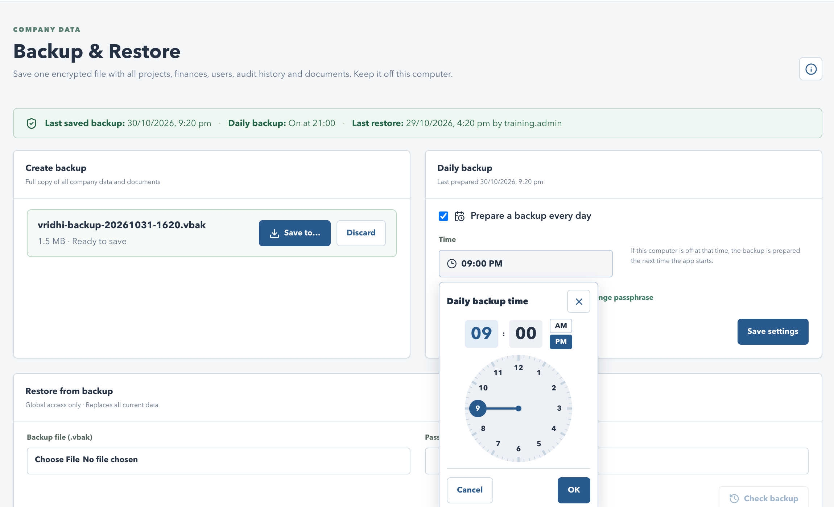
VRIDHI / CONSTRUCTIONS & DESIGNS
80 / 88 | USER TRAINING
BACKUP & RESTORE / VISUAL WALKTHROUGH
Daily backup with the analog clock
Current application interface | Synthetic training data | No live records
WHAT TO NOTICE
Turn it on
Prepare a backup every day; default
9:00 PM.
Pick the time
Same analog clock as the Audit Log
filter: hour, minute, AM/PM, OK.
Passphrase
Set once; used for daily files.
Daily settings are Global access only. Save settings applies the schedule.
BACKUP & RESTORE UPDATE | 31 OCT 2026 | Companion: 14-backup-and-restore.md
80
Notes:
Daily backup with the analog clock
Select Time to open the analog clock, choose the hour then the minutes and AM/PM, and select OK. Cancel leaves the time unchanged. If the computer is off at that time, the backup is prepared the next time the app starts. The daily passphrase is stored encrypted on this computer.
Sources: 14-backup-and-restore.md; 04-users-and-permissions.md; 07-data-and-persistence.md; 08-operations-and-troubleshooting.md
Screens use isolated synthetic API responses. No live database records were read or changed. Names, counts, files and dates are illustrative. Use an isolated training database. No credentials or real passphrases are included.

Slide 81
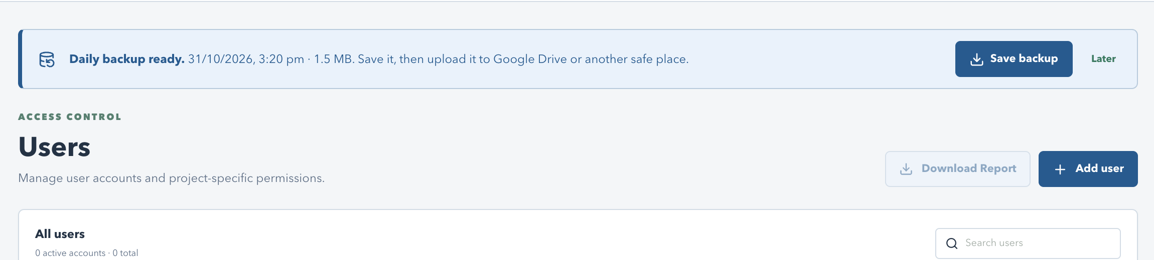
VRIDHI / CONSTRUCTIONS & DESIGNS
81 / 88 | USER TRAINING
BACKUP & RESTORE / VISUAL WALKTHROUGH
Daily backup ready prompt
Current application interface | Synthetic training data | No live records
WHAT TO NOTICE
Banner on every page
Shown to users with backup access.
Save backup
Save it, then upload it to a safe place.
Later
Hides the prompt until the browser
tab is closed.
Saving removes the waiting copy; a newer daily backup replaces an unsaved one.
BACKUP & RESTORE UPDATE | 31 OCT 2026 | Companion: 14-backup-and-restore.md
81
Notes:
Daily backup ready prompt
Only the latest waiting daily backup is kept. The status strip warns when no backup has been saved for two days or when the last daily backup failed.
Sources: 14-backup-and-restore.md; 04-users-and-permissions.md; 07-data-and-persistence.md; 08-operations-and-troubleshooting.md
Screens use isolated synthetic API responses. No live database records were read or changed. Names, counts, files and dates are illustrative. Use an isolated training database. No credentials or real passphrases are included.

Slide 82
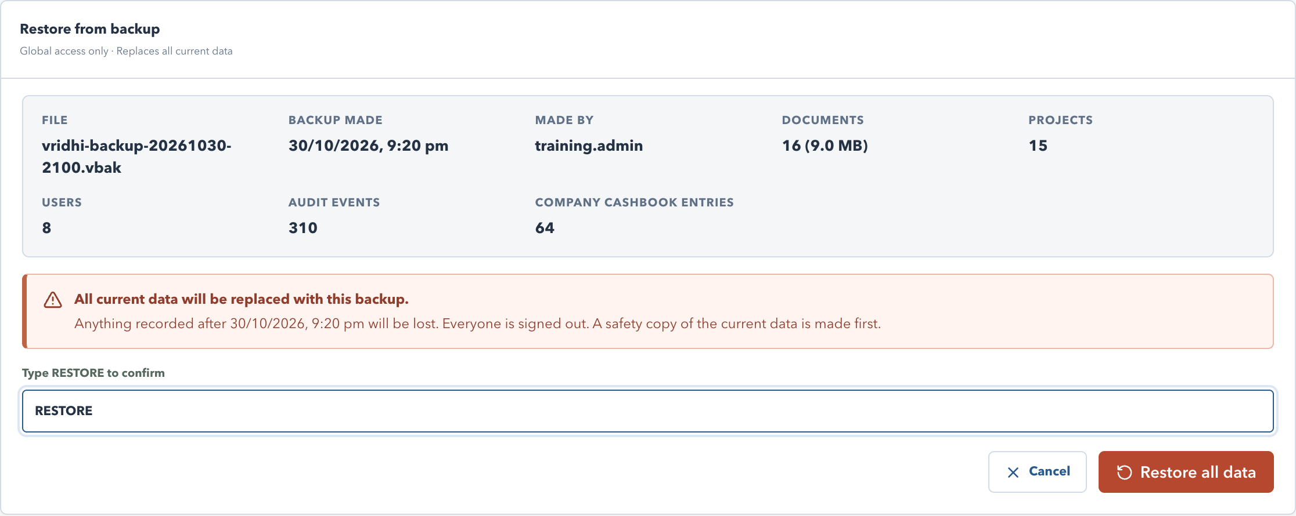
VRIDHI / CONSTRUCTIONS & DESIGNS
82 / 88 | USER TRAINING
BACKUP & RESTORE / VISUAL WALKTHROUGH
Restore: check the file, then confirm
Current application interface | Synthetic training data | No live records
WHAT TO NOTICE
Check backup
Choose the .vbak file and enter its
passphrase.
Review the summary
Date, creator, projects, users, audit
events, documents.
Type RESTORE
Required before Restore all data is
enabled.
Restore replaces all current data and signs everyone out. Global access only.
BACKUP & RESTORE UPDATE | 31 OCT 2026 | Companion: 14-backup-and-restore.md
82
Notes:
Restore: check the file, then confirm
Restore is available only to Global access users. The file is checked first and nothing changes until RESTORE is typed and confirmed. Anything recorded after the backup date is lost. After the restore, everyone signs in again with the accounts in the backup.
Sources: 14-backup-and-restore.md; 04-users-and-permissions.md; 07-data-and-persistence.md; 08-operations-and-troubleshooting.md
Screens use isolated synthetic API responses. No live database records were read or changed. Names, counts, files and dates are illustrative. Use an isolated training database. No credentials or real passphrases are included.

Slide 83
VRIDHI / CONSTRUCTIONS & DESIGNS
83 / 88 | USER TRAINING
BACKUP & RESTORE / FEATURE TRAINING
Restore safely
Several protections keep current data safe if something goes wrong.
Before and during
After and recovery
A safety copy of current data is saved.
Everyone is signed out; sign in again.
File is checked in a staging database first.
Safety copy: data/backups/safety.
Live data is swapped only after checks pass.
Older backups are upgraded automatically.
Others see a maintenance message meanwhile.
No start? Use scripts/backup.py restore.
A failed restore leaves current data unchanged and is recorded in the audit log.
BACKUP & RESTORE UPDATE | 31 OCT 2026 | Companion: 14-backup-and-restore.md
83
Notes:
Restore safely
The safety copy is named vridhi-before-restore and only the latest one is kept. A backup made by a newer application version is refused. The command line python3 scripts/backup.py create or restore FILE works when the app cannot start; restore requires the app to be closed.
Sources: 14-backup-and-restore.md; 04-users-and-permissions.md; 07-data-and-persistence.md; 08-operations-and-troubleshooting.md
Screens use isolated synthetic API responses. No live database records were read or changed. Names, counts, files and dates are illustrative. Use an isolated training database. No credentials or real passphrases are included.

Slide 84
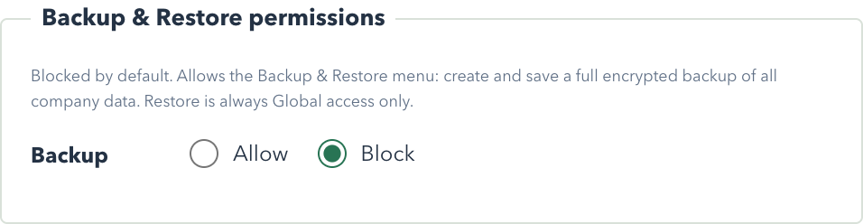
VRIDHI / CONSTRUCTIONS & DESIGNS
84 / 88 | USER TRAINING
BACKUP & RESTORE / VISUAL WALKTHROUGH
Who can back up and restore
Current application interface | Synthetic training data | No live records
WHAT TO NOTICE
Backup permission
Users page > Backup & Restore
permissions: Allow or Block.
Blocked by default
You can only grant what you have.
Restore
Always Global access only.
Daily settings and Restore cannot be granted to non-global users.
BACKUP & RESTORE UPDATE | 31 OCT 2026 | Companion: 14-backup-and-restore.md
84
Notes:
Who can back up and restore
A user with only the Backup permission needs no project assignment. Global access always includes Backup, daily settings and Restore.
Sources: 14-backup-and-restore.md; 04-users-and-permissions.md; 07-data-and-persistence.md; 08-operations-and-troubleshooting.md
Screens use isolated synthetic API responses. No live database records were read or changed. Names, counts, files and dates are illustrative. Use an isolated training database. No credentials or real passphrases are included.

Slide 85
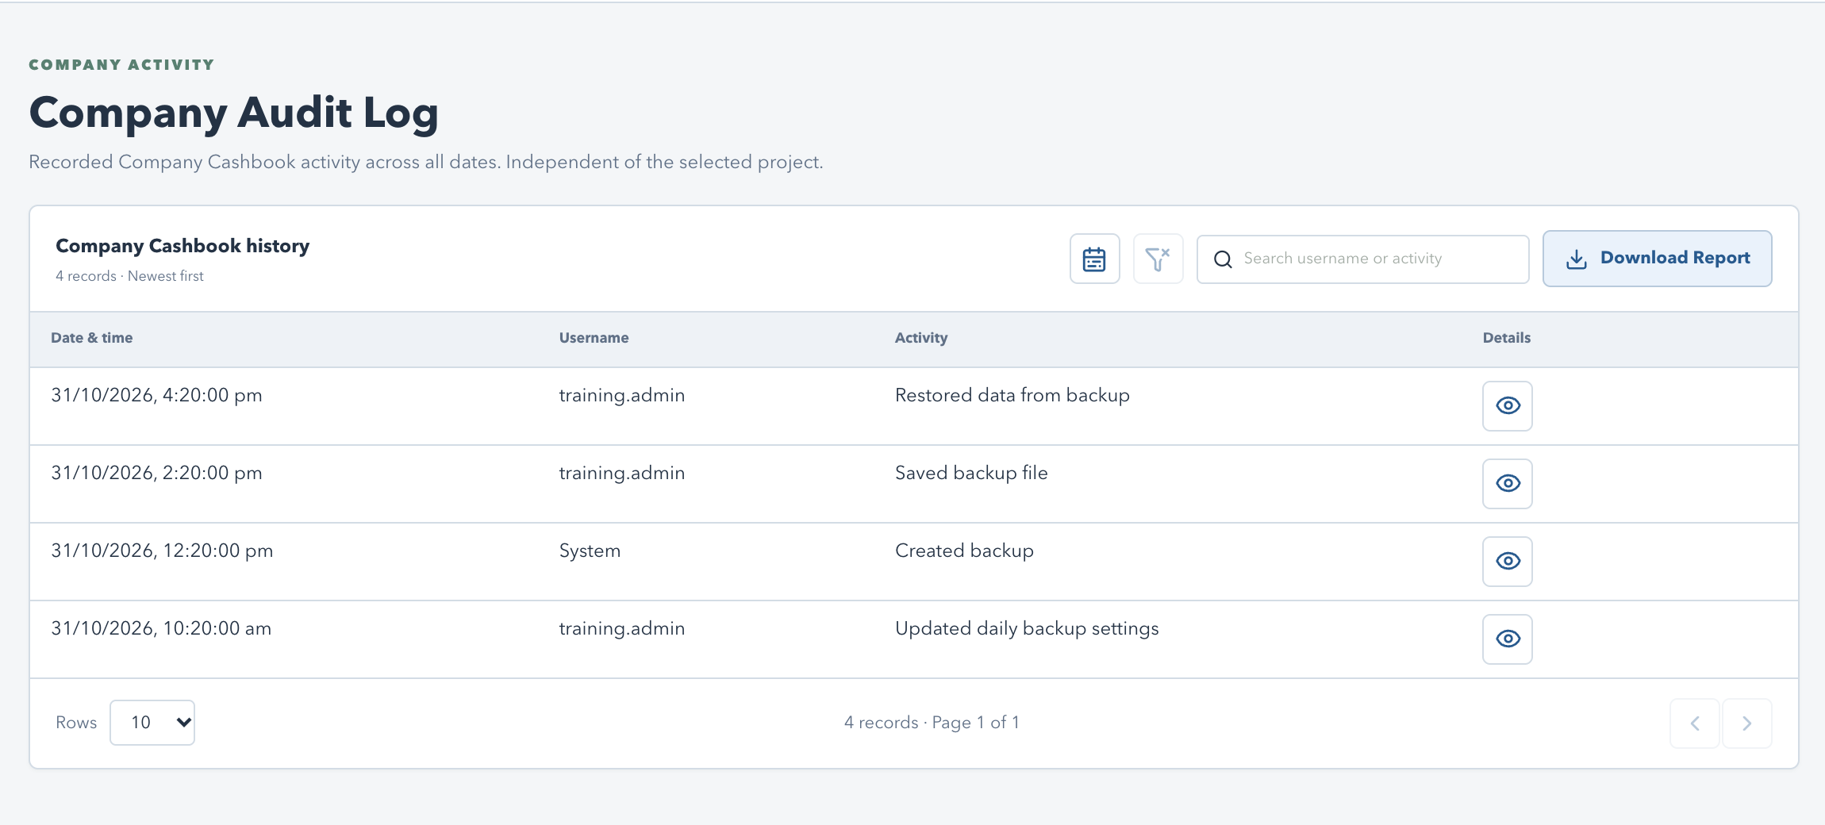
VRIDHI / CONSTRUCTIONS & DESIGNS
85 / 88 | USER TRAINING
BACKUP & RESTORE / VISUAL WALKTHROUGH
Every action is audited
Current application interface | Synthetic training data | No live records
WHAT TO NOTICE
Company Audit Log
Shows backups created and saved,
schedule changes and restores.
Daily backups
Appear with the actor System.
Failures
Failed and rejected restores are
recorded too.
Use the eye icon for details such as the file name and safety copy.
BACKUP & RESTORE UPDATE | 31 OCT 2026 | Companion: 14-backup-and-restore.md
85
Notes:
Every action is audited
Events: Created backup, Saved backup file, Backup failed, Updated daily backup settings, Restored data from backup, Restore failed and Restore rejected. They are included in the Company Audit Log and its Download Report.
Sources: 14-backup-and-restore.md; 04-users-and-permissions.md; 07-data-and-persistence.md; 08-operations-and-troubleshooting.md
Screens use isolated synthetic API responses. No live database records were read or changed. Names, counts, files and dates are illustrative. Use an isolated training database. No credentials or real passphrases are included.

Slide 86
VRIDHI / CONSTRUCTIONS & DESIGNS
86 / 88 | USER TRAINING
BACKUP & RESTORE / FEATURE TRAINING
Practice checklist and troubleshooting
Try this on a training database before relying on it.
Practice
If something goes wrong
Create a backup and save it to a folder.
Wrong passphrase or damaged file: re-download
the file.
Turn on Daily backup; set the time with the clock.
Newer version message: update the app first.
Check the file with Check backup; read the
summary.
Save dialog missing: use the Downloads file.
Cancel before typing RESTORE.
Banner keeps returning: use Save backup.
Never restore a live system for practice: it replaces all current data.
BACKUP & RESTORE UPDATE | 31 OCT 2026 | Companion: 14-backup-and-restore.md
86
Notes:
Practice checklist and troubleshooting
Companion guide: 14-backup-and-restore.md covers recovery on a new computer, the command line, Docker mode and the full troubleshooting table.
Sources: 14-backup-and-restore.md; 04-users-and-permissions.md; 07-data-and-persistence.md; 08-operations-and-troubleshooting.md
Screens use isolated synthetic API responses. No live database records were read or changed. Names, counts, files and dates are illustrative. Use an isolated training database. No credentials or real passphrases are included.

Slide 87
VRIDHI / CONSTRUCTIONS & DESIGNS
87 / 88 | USER TRAINING
WRAP-UP
Practice checklist and next steps
Use a training database, not live project records.
Practice the complete loop
Know where to look next
Create project -> update status with comment.
01 Getting started / 02 Module guide / 03
Workflows.
Create PO -> receive stock -> record use.
Record billing/receipt and direct work or contract
claim.
04 Permissions / 05 Reports and calculations.
06 Architecture / 07 Data / 08 Operations.
Review Audit Log and save one PDF report.
09 Evidence / 10 Presenter / 11-12 Cashbook
/ 13 Archive / 14 Backup & Restore.
Archive a finished project, then UnArchive it.
This source-reviewed guide explains current behavior; validate your operational release.
CURRENT SYSTEM | 16 DEC 2026 | Companion guide: docs/current_system_docs
87
Notes:
Practice checklist and next steps
Demonstrate a read-only account after the operational walkthrough to show permission differences. Confirm no real accounts or financial records are modified for training. Use the evidence checklist to plan UAT, restore drills and report reconciliation. Documentation must be refreshed when implementation changes; it is not a production-completeness estimate.
Companion documentation / source: 09-evidence-and-acceptance.md; 10-presentation-outline.md
Demonstrations should use a training database. Do not publish credentials.

Slide 88
VRIDHI / CONSTRUCTIONS & DESIGNS
88 / 88 | USER TRAINING
Thank you.
Building trust. Creating futures.
Thank you for your time and commitment to better ways of working.
Together, we turn clear records into confident business decisions.
WORK WITH CLARITY
GROW TOGETHER
BUILD CONFIDENCE
Keep every record clear and current.
Connect people, projects and purpose.
Review the numbers. Take the next step.
YOUR QUESTIONS. OUR NEXT STEPS. LET'S TALK.
ILLUSTRATED SYSTEM TRAINING | 16 DEC 2026
88

