Slide 1
JDBC Connector Example

Slide 2
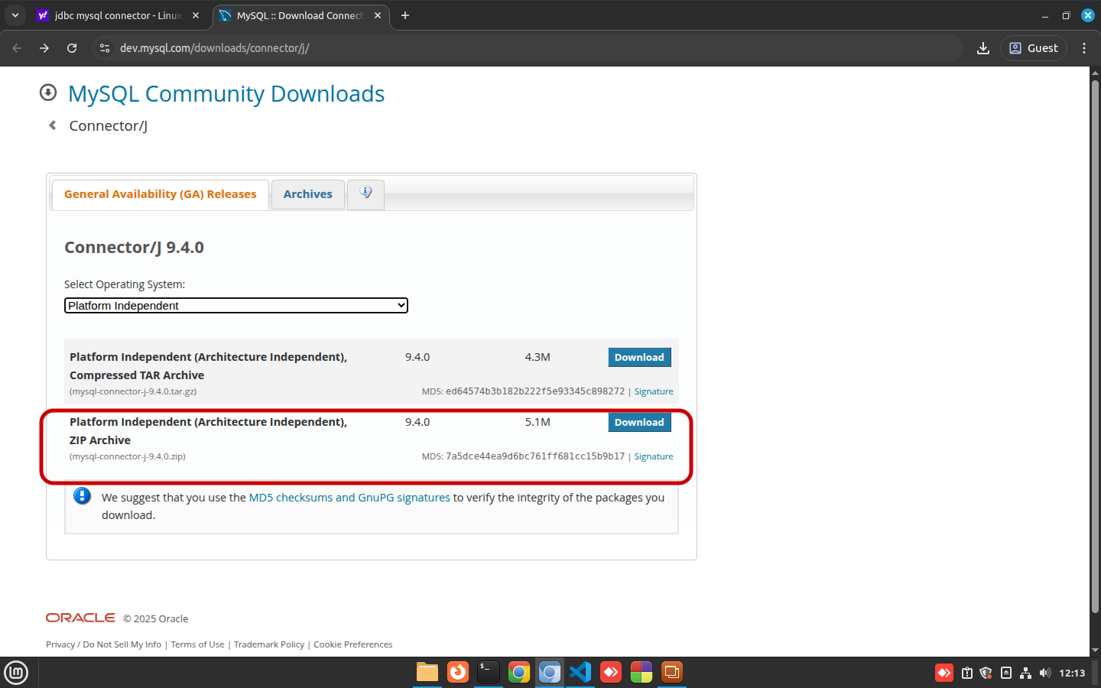
Downloading For Windows

Slide 3
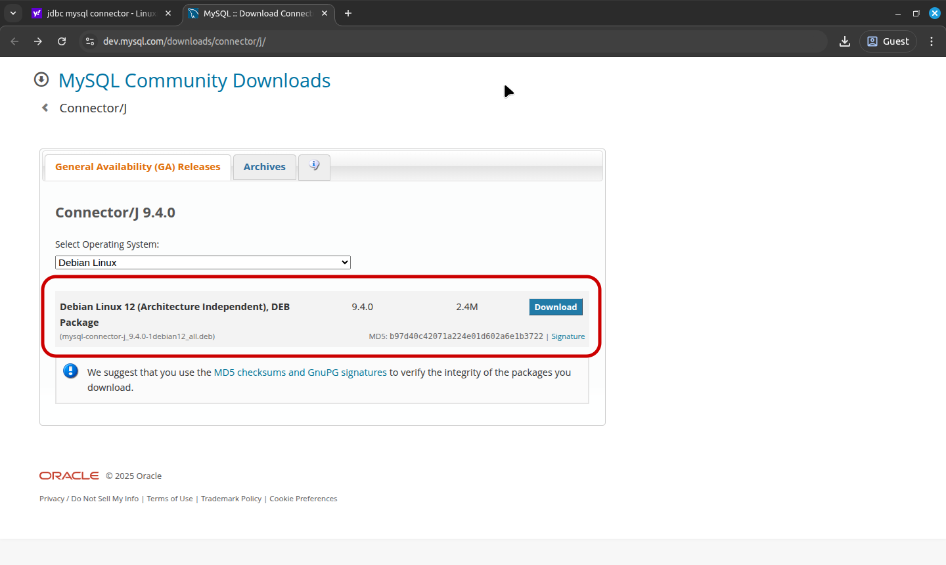
Downloading for MintOS Linux

Slide 4
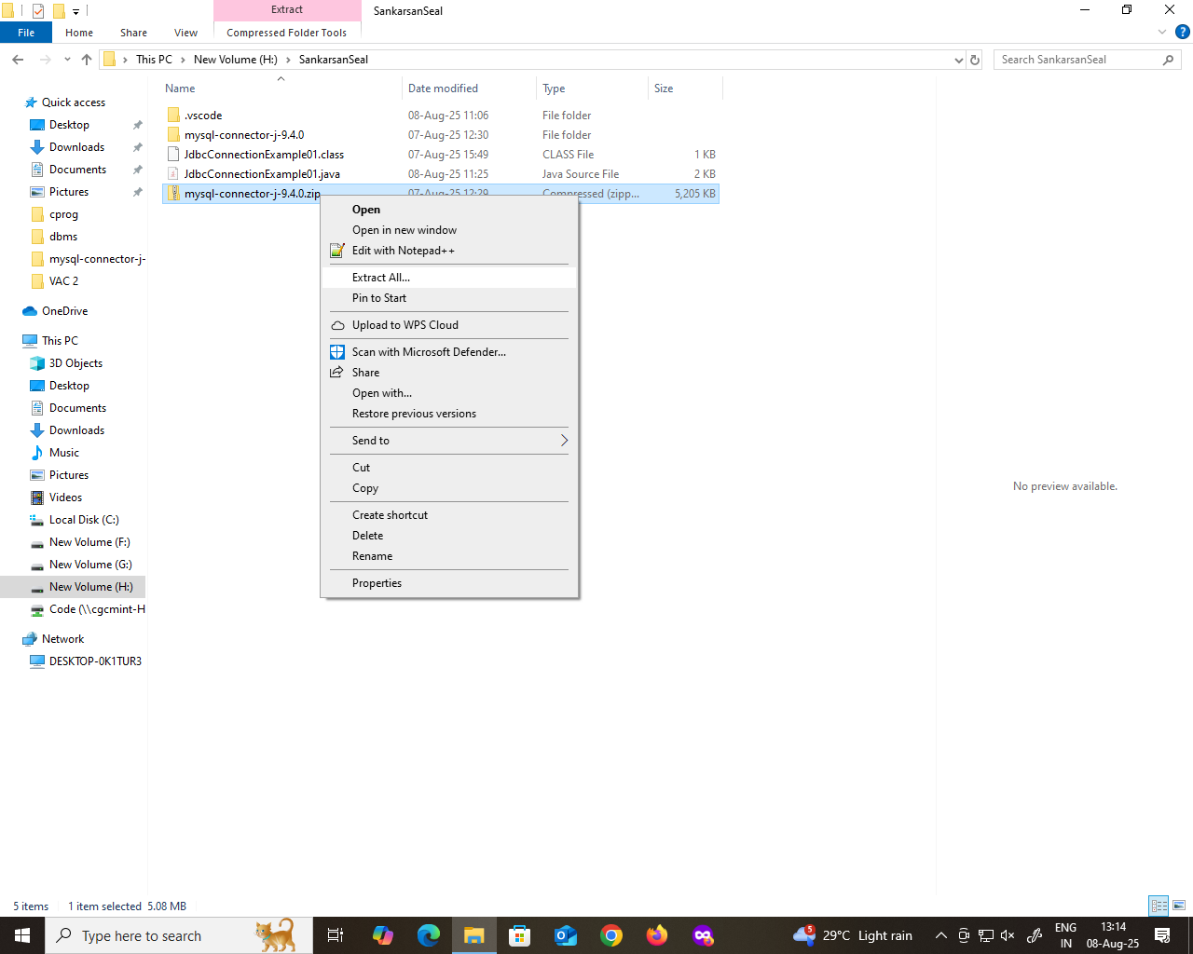
Setting CLASSPATH in Windows Unzipping the Downloaded Zip File

Slide 5
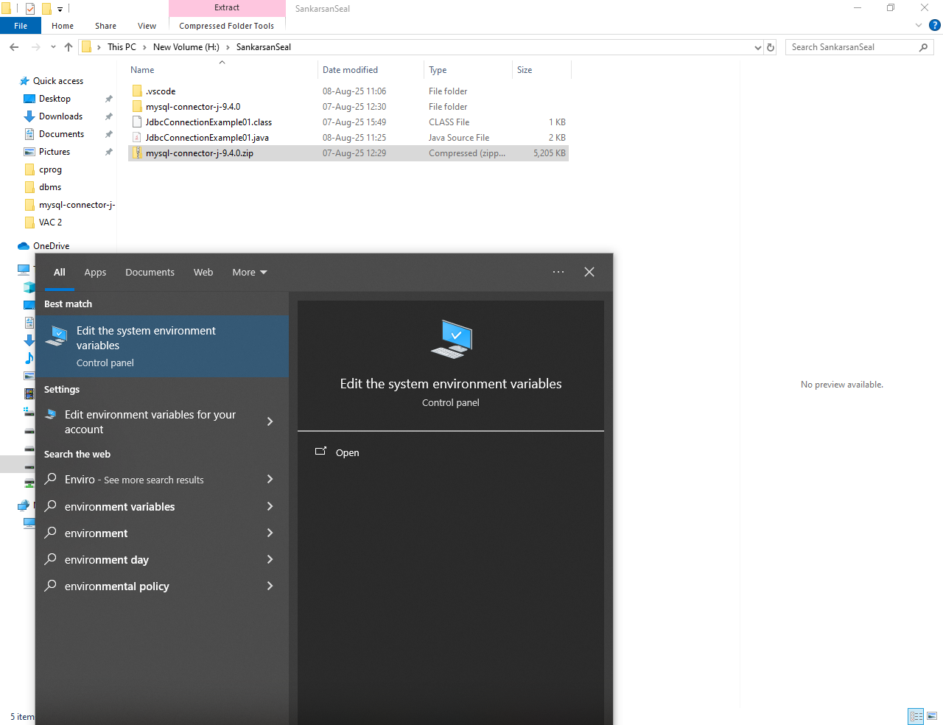
Editing Environment Variables in Windows Search with word “Environment Variable”

Slide 6
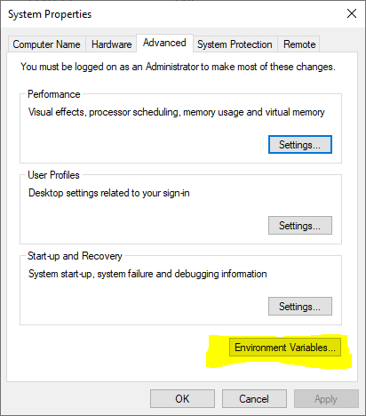
Opening Enviroment Variable Setting Panel Click “Environment Variable”

Slide 7
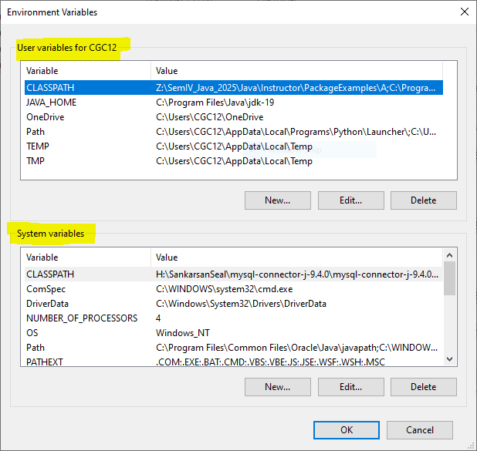
Setting CLASSPATH under “System Variable” Section

Slide 8
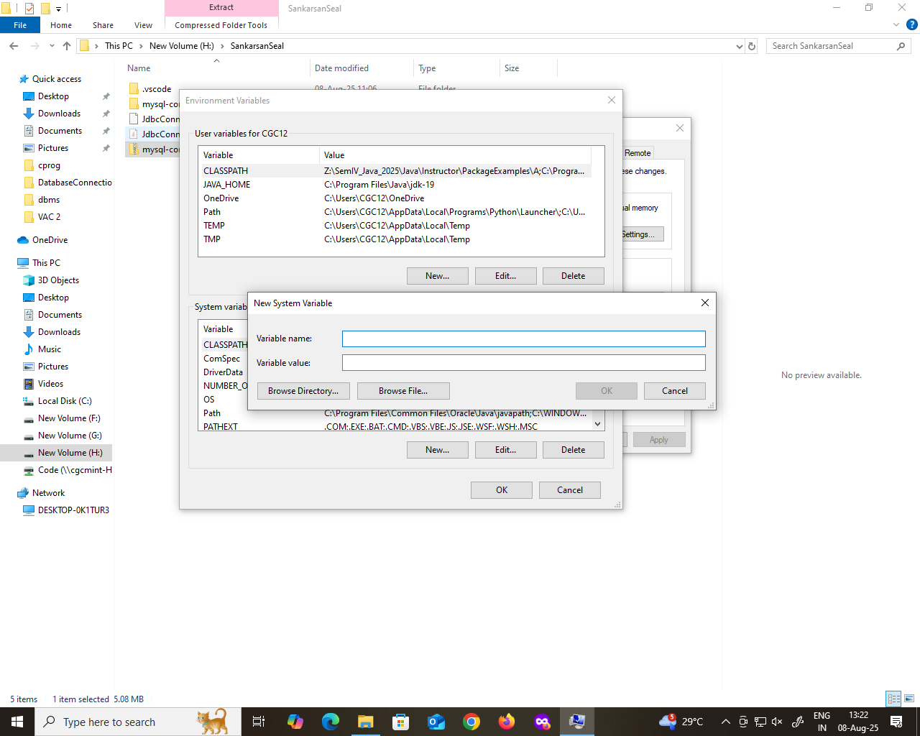
Click “New” to add the CLASSPATH

Slide 9
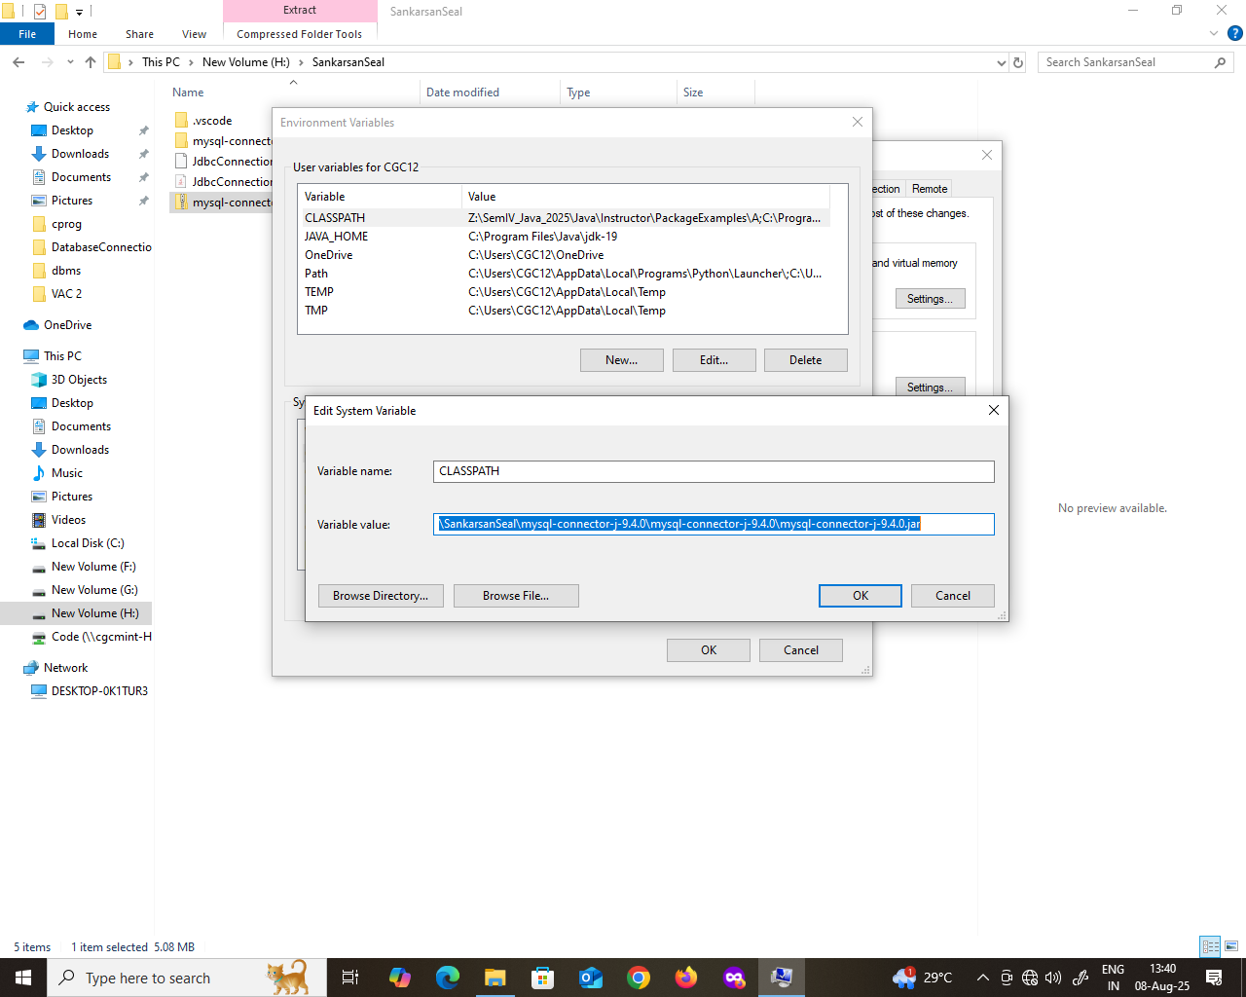
Adding the location to CLASSPATH Variable

Slide 10
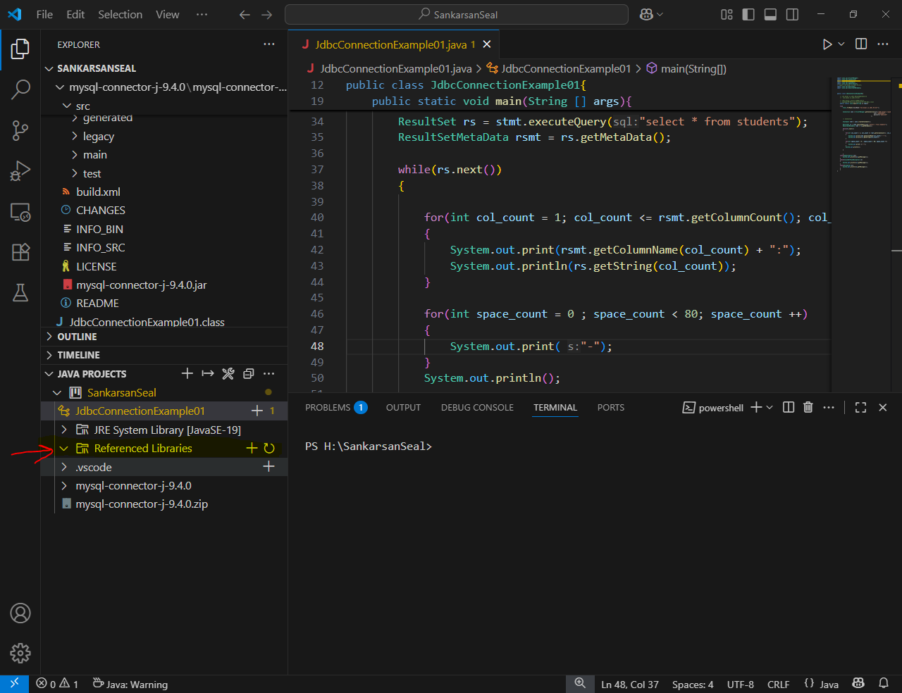
Adding the Jar File in VS Code Look for “Referenced Libraries” Under JAVA PROJECT

Slide 11
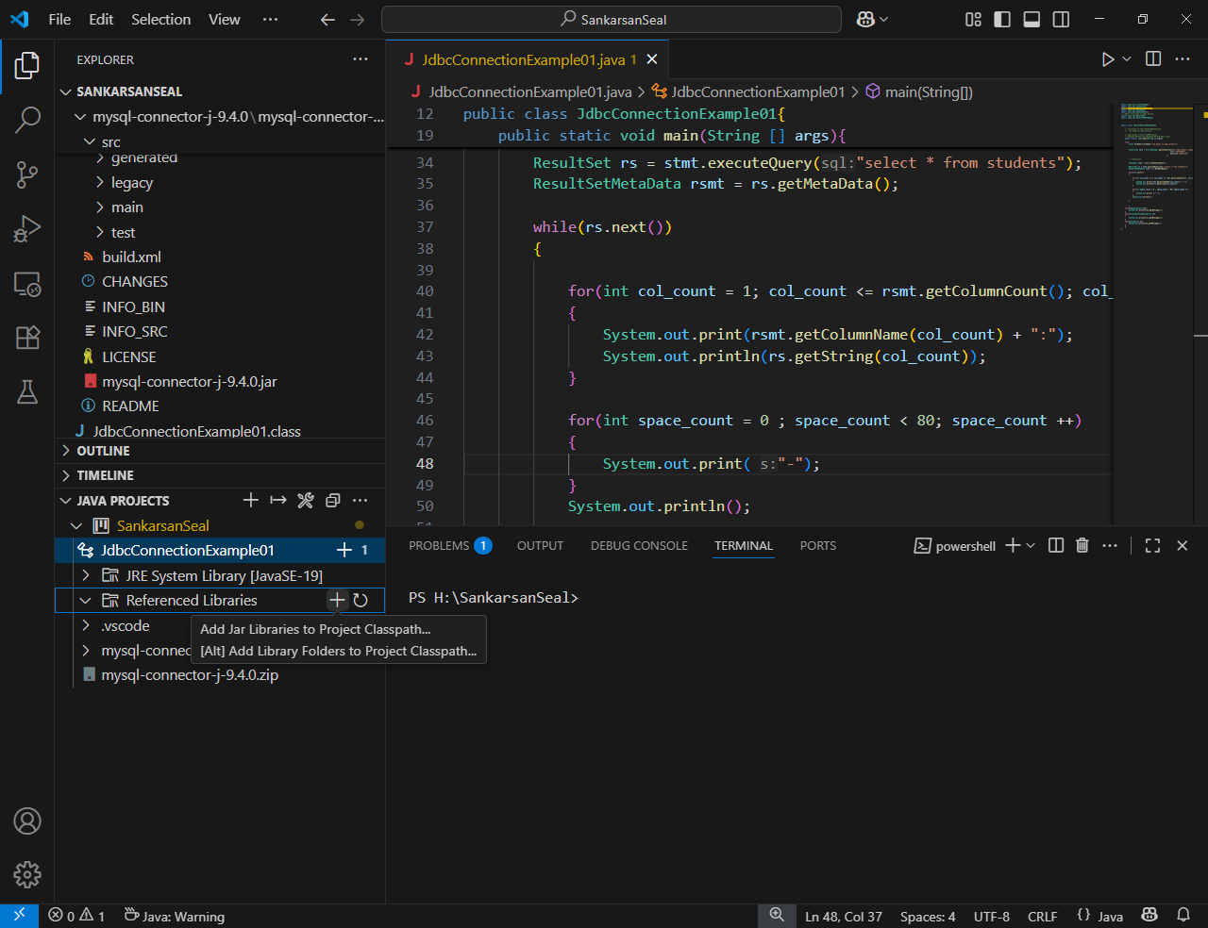
Adding the PATH to “Referenced Libraries”

Slide 12
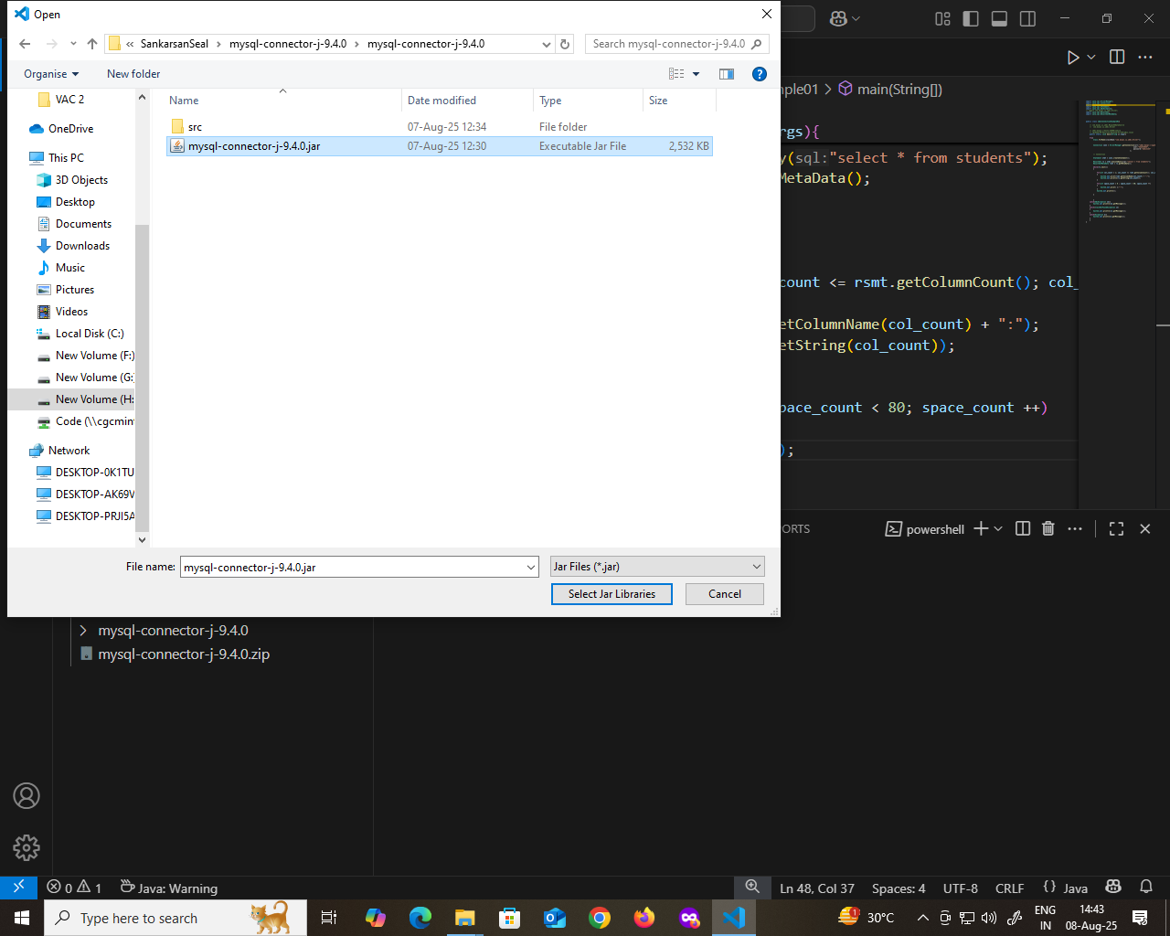
Go to the Location of Jar file

Slide 13
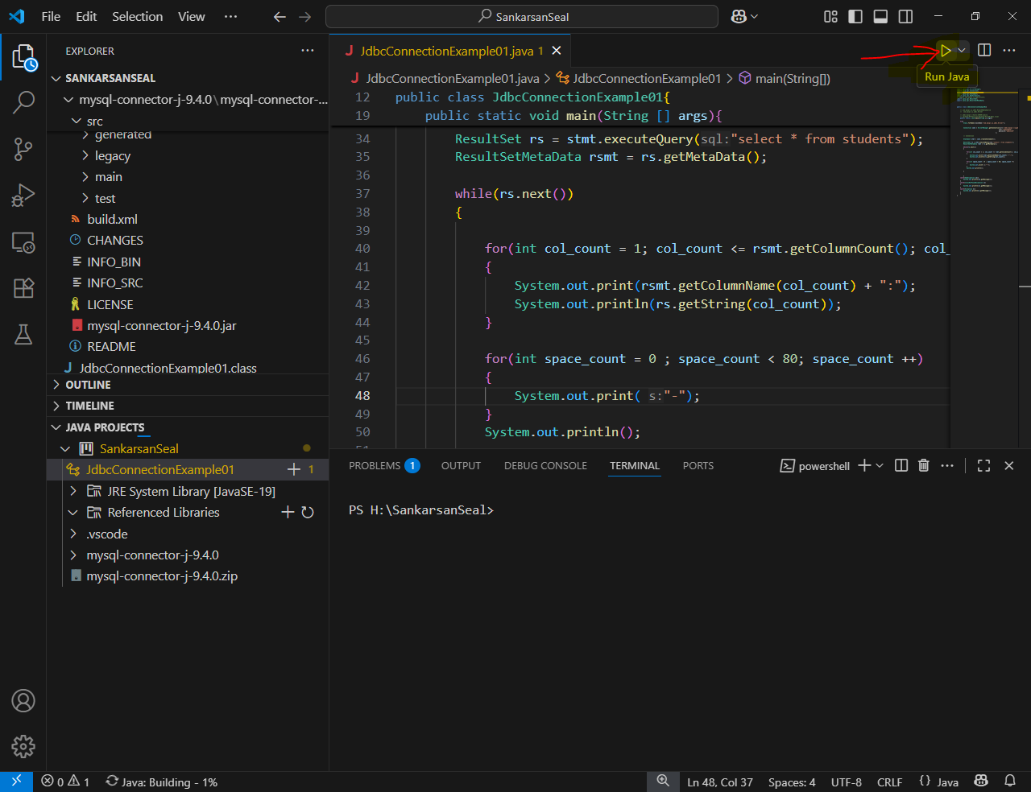
Run the code using “Run Java”

Slide 14
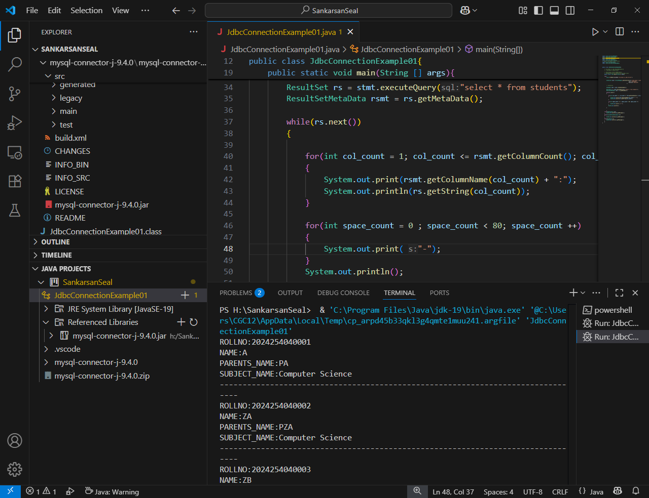
Output of JDBC Connection

Slide 15
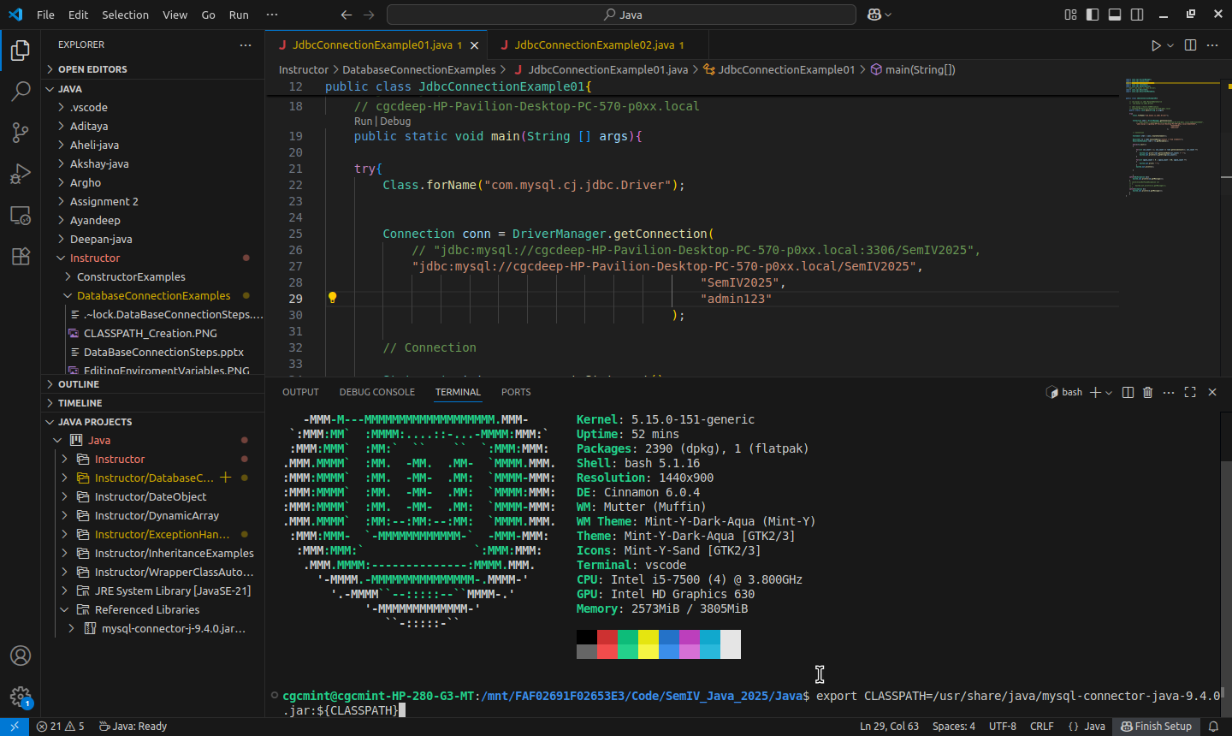
Setting CLASSPATH in Linux

Slide 16
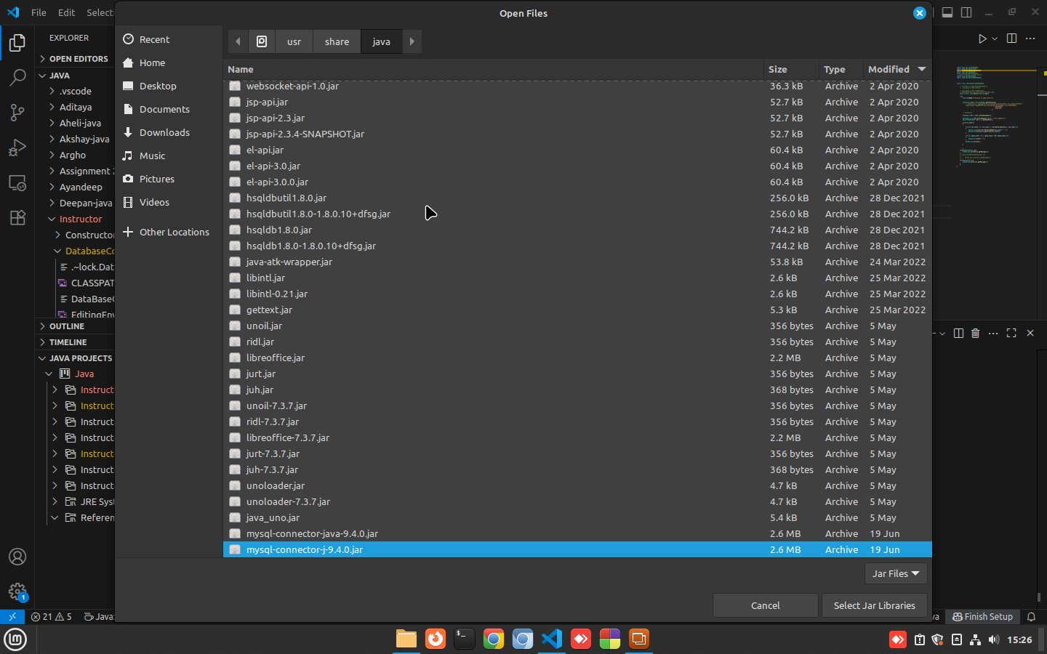
The Jar Location In Linux if Installed in Linux default location: /usr/share/java

