Slide 1
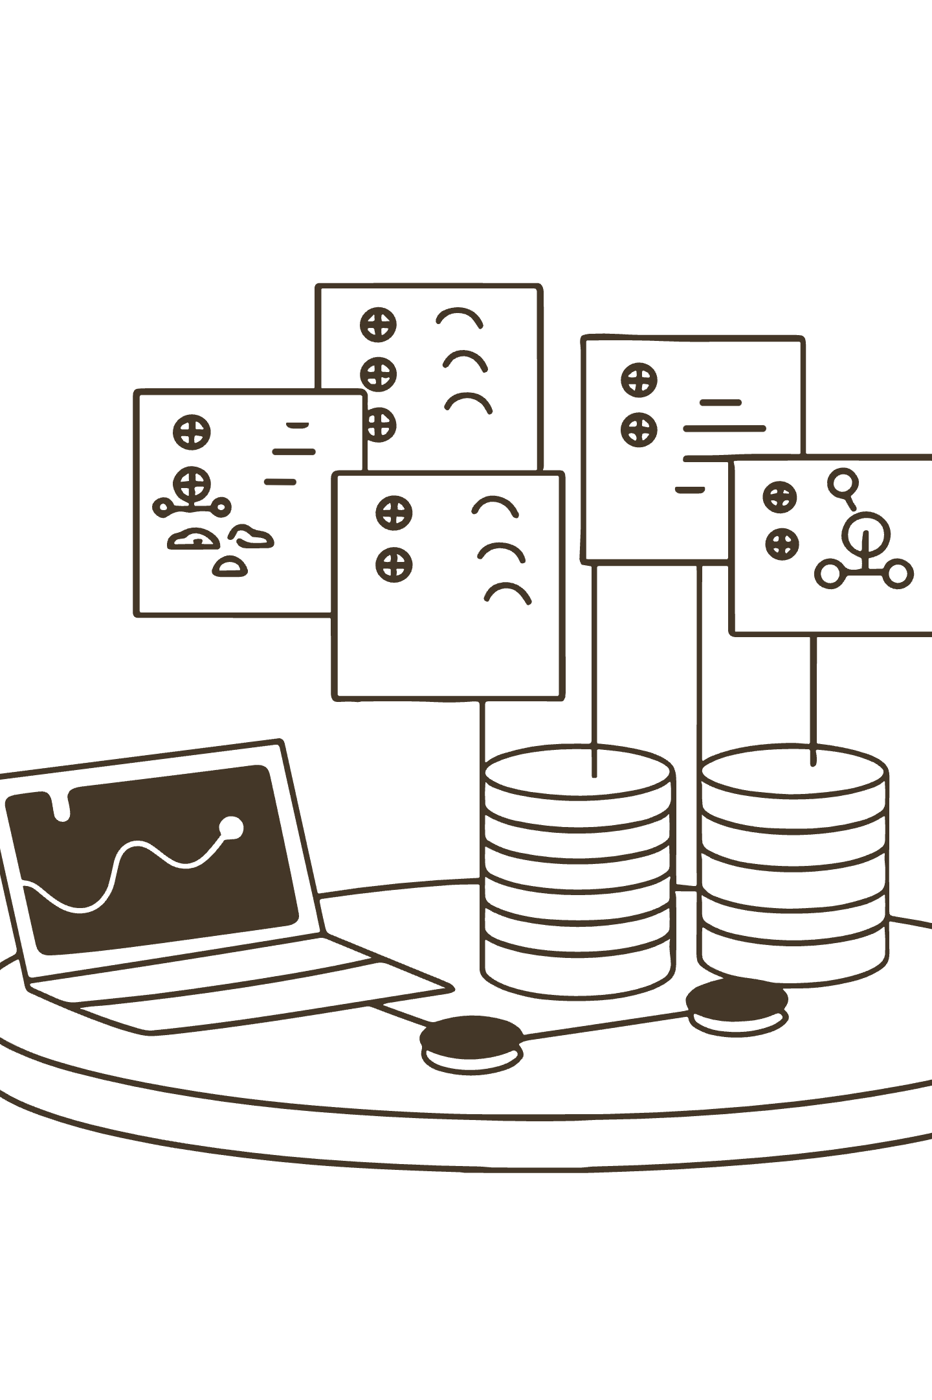
Comprehensive Digital Transformation: Empowering Our Lab's Future
An Interactive Solution for Enhanced Capability Management & Strategic Growth

Slide 2
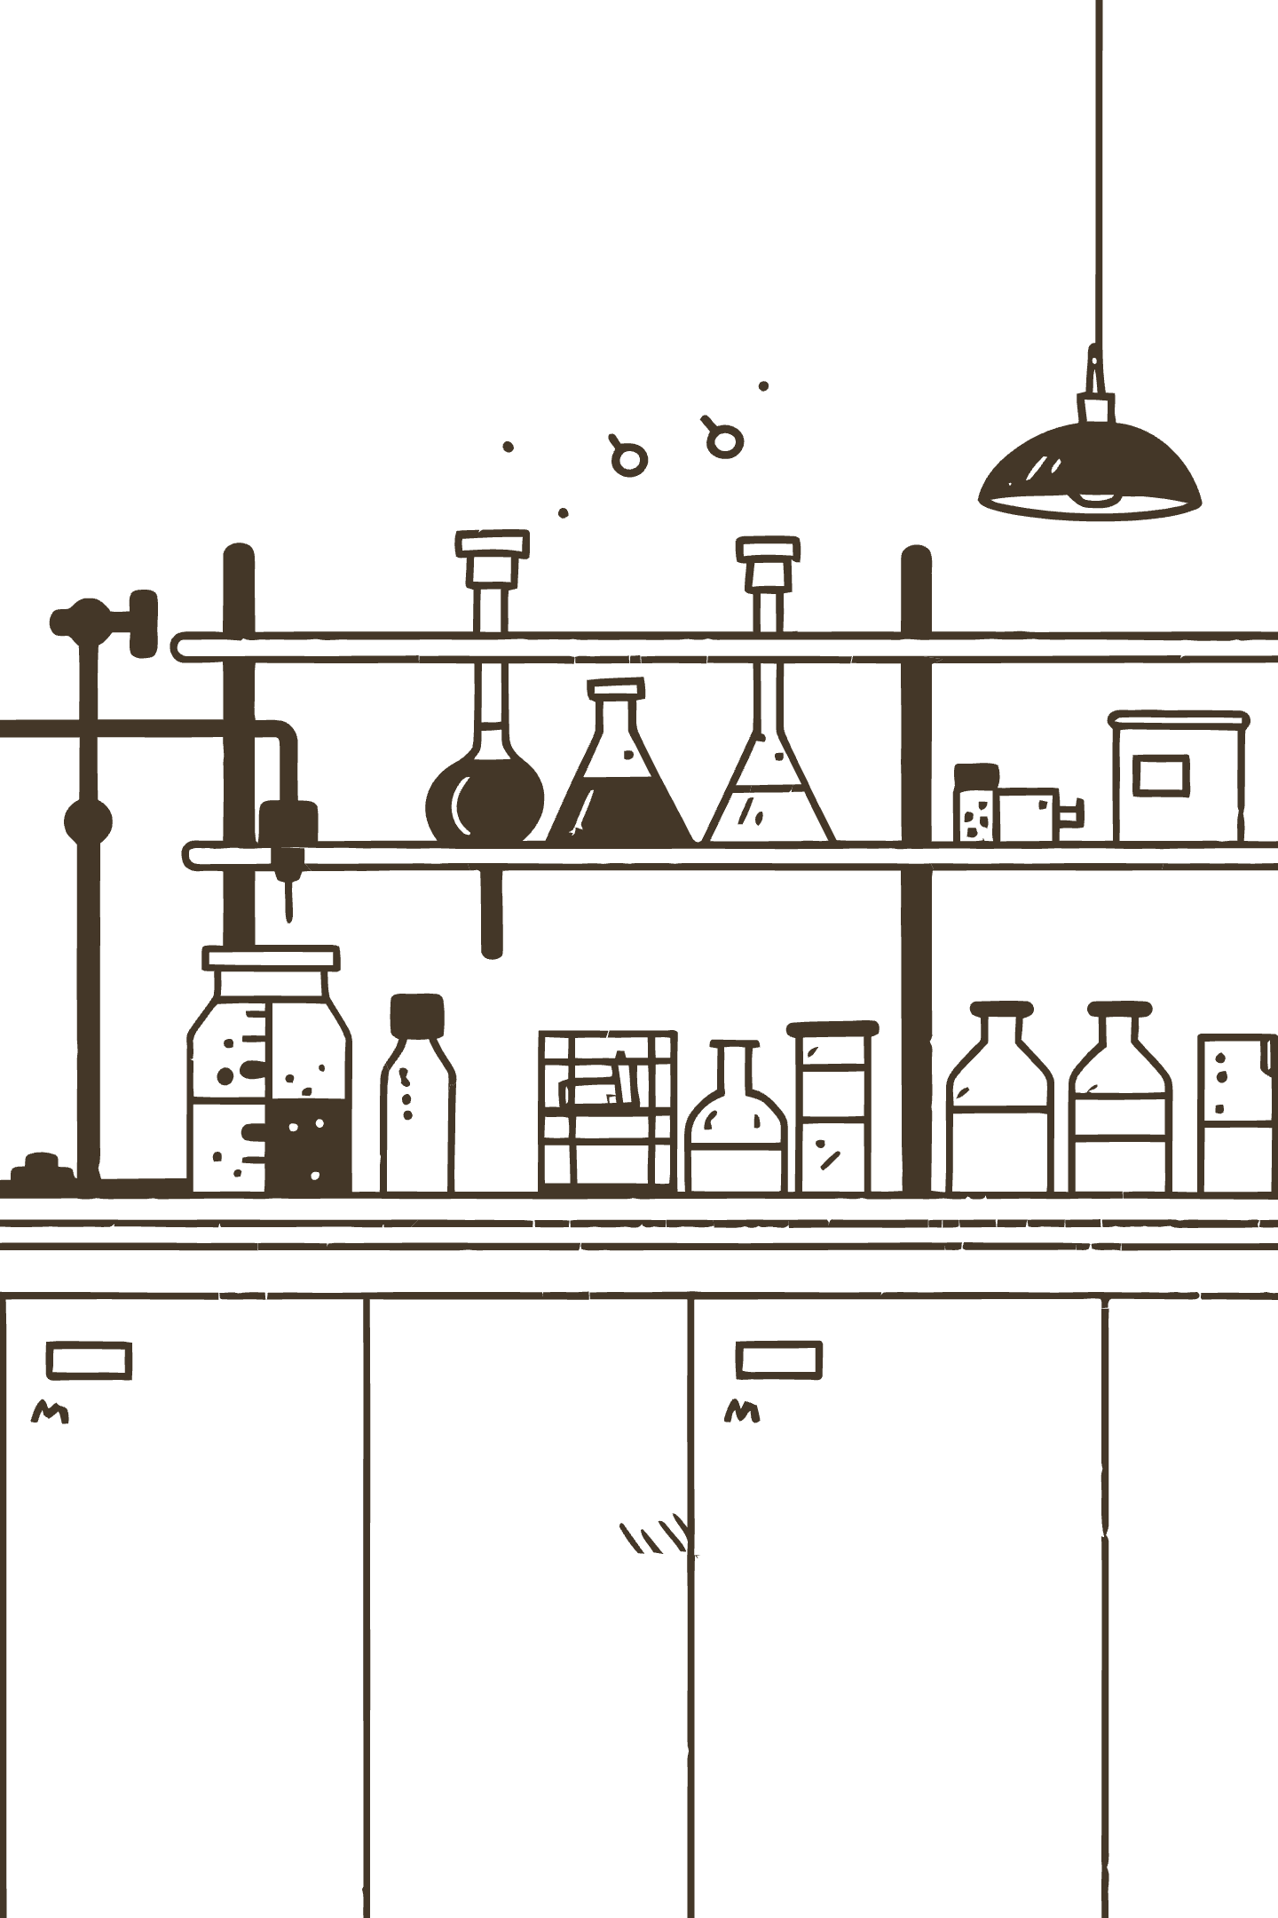
Our Lab's Foundation: High-Value Technical Resources & Process Development
Our lab operates numerous critical operation skids and test units, essential for complex process development. Maintaining high quality, efficiency, and strategic foresight is paramount for our scientific output.

Slide 3
The Hidden Costs of Our Current Approach: Fragmented Data & Manual Overheads
Inefficient Unit Fitness Testing & Lost Knowledge
Inconsistent Quality & Inventory
SharePoint's Fundamental Limitations
Manual Excel-based quality assessments lack standardization, and critical spares inventory has traceability issues, risking downtime.
Scattered technical details in SharePoint lead to time-intensive rework and difficulty leveraging past project learnings.
Its design lacks robust version control, immutable audit trails, and structured data enforcement, compromising data integrity and searchability.

Slide 4



The Imperative for Transformation: Addressing Bottlenecks & Seizing Opportunity
Time Loss & Rework
Lack of Data-Driven Insights
Competitive Imperative
Current inefficiencies result in significant time loss, rework, and frustration, impacting project timelines and scientific output.
Prevents optimal resource allocation and strategic investment in our process development infrastructure.
Industry leaders are rapidly adopting digital ecosystems, urging our lab to evolve and innovate.

Slide 5

How Can We Transform Our Lab into an Intelligent, Proactive Hub?
How can we centralize all critical unit, project, and inventory data for instant, reliable access and systematic evaluation?
How can we automate and standardize our quality assessments, enable predictive maintenance, and optimize resource allocation?
How can we leverage our data to create a capability mapping framework that identifies strategic investment opportunities?

Slide 6
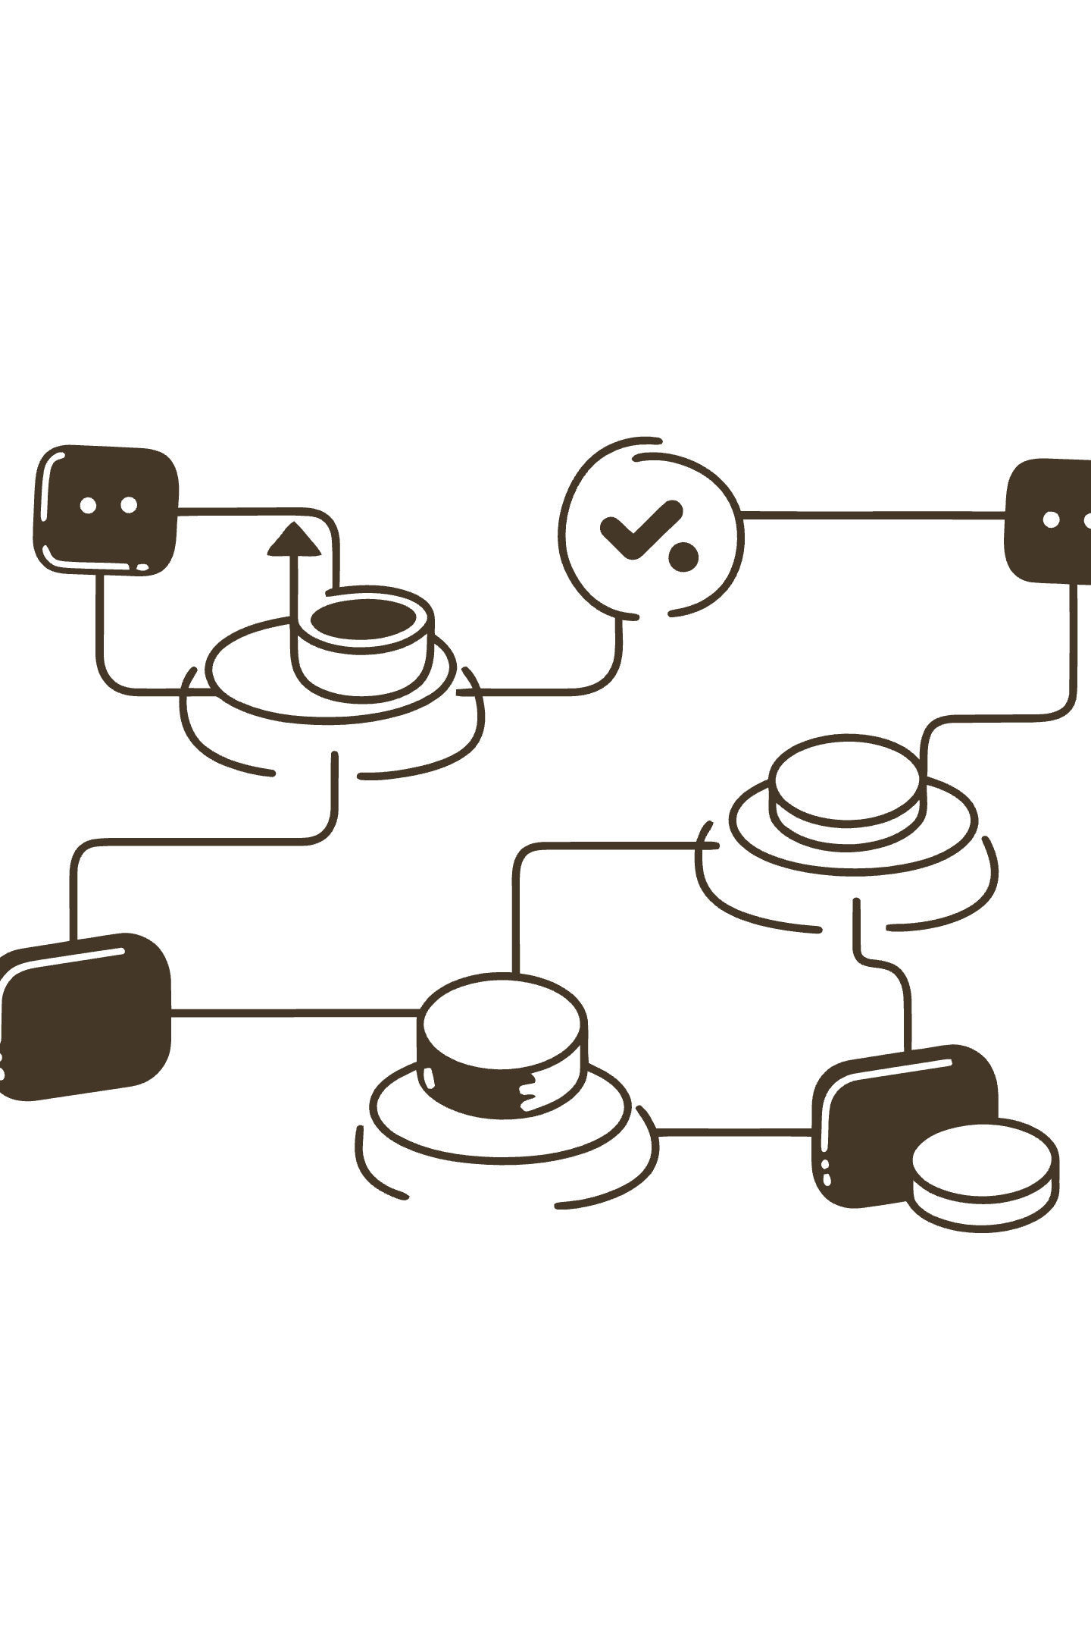
Our Solution: An Interactive Digital Application for Lab Capability Management
We will develop a custom, Python-based interactive application as a single, intelligent hub for all lab operations. This app will centralize unit technical details, project history, quality assessments, and critical spares inventory. It will integrate AI/ML for intelligent decision support, resource optimization, and strategic capability mapping.

Slide 7
Tangible Benefits: Driving Efficiency, Insight, & Strategic Growth
50%
60%
98%
—
Reduction in Project Fitness Testing Time
Reduction in Manual QA Effort
Inventory Accuracy
Optimized Resource Allocation & Strategic Investment
Automated workflows and real-time tracking minimize manual overhead and errors.
Instant access to comprehensive, accurate unit data and AI-driven recommendations.
Automated workflows and real-time tracking minimize manual overhead and errors.
Data-driven insights will guide effective utilization of technical resources and identify key infrastructure investment opportunities.

Slide 8


Our Roadmap: Phased Implementation & Leveraging Internal Expertise
Phased Approach
Industry Alignment
A structured 4-phase roadmap (Planning, Core Development, Advanced Features, Optimization) ensures incremental value delivery.
This approach mirrors successful digital transformations in leading research organizations.
Internal Expertise
My background in experimental science, Python, and VBA allows for cost-effective, tailored development and seamless data migration.

