Slide 1
API Automation Testing using RestAssured

Slide 2
AGENDA
Introduction to API
Concepts of API testing and its importance
Different tools available for API testing
Automating the API tests using RestAssured
Conclusion

Slide 3
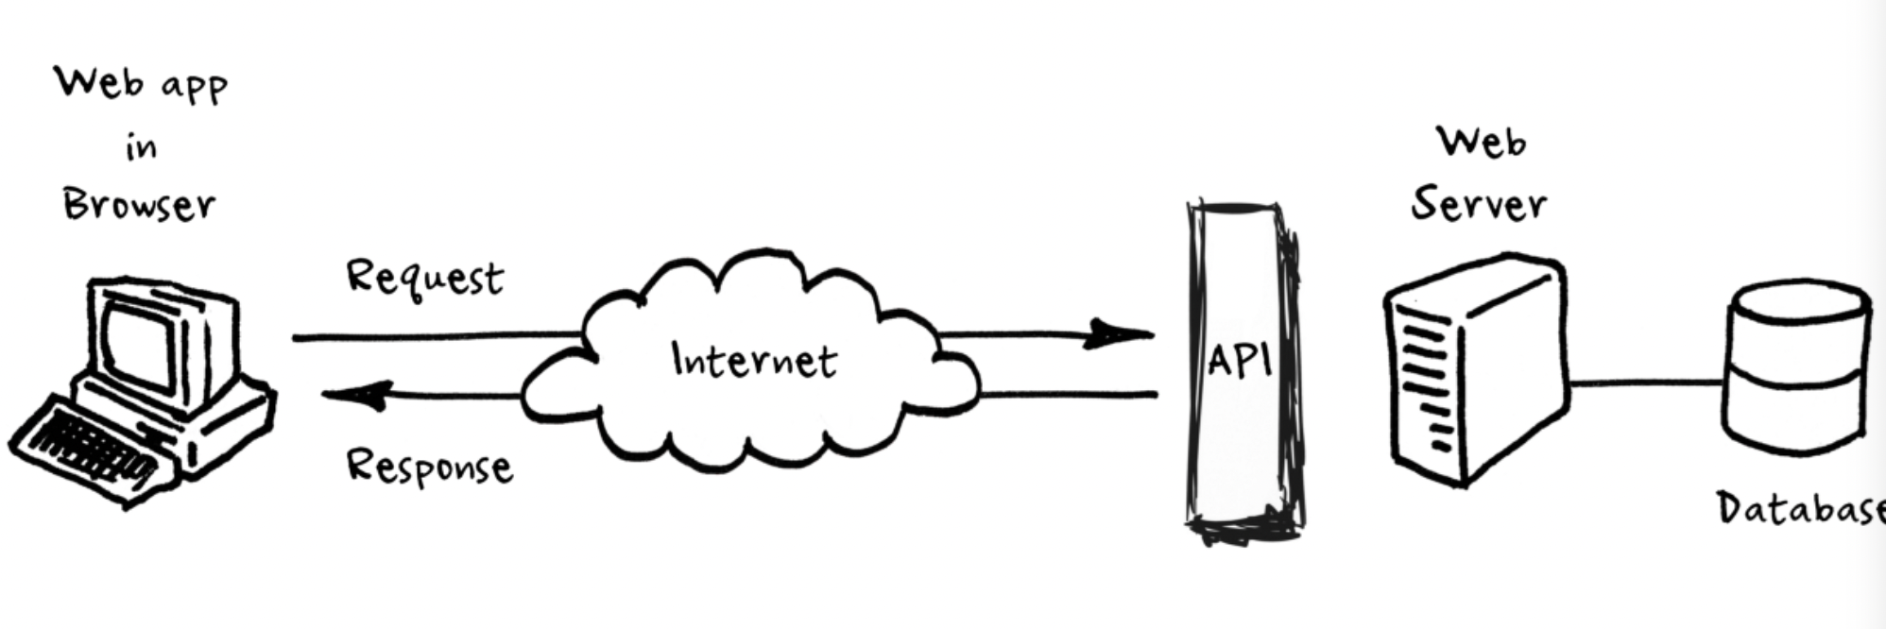
API - Introduction
API stands for Application Programming Interface
API is an interface to some data on a server typically stored in the DB, This interface allows the program to communicate and thus exchange data with the server, Without this interface the server would be in-accessible to the outside world

Slide 4

API testing and Importance
Instead of GUI testing business logic layer of the software.
API tests are faster to run and more isolated than UI tests, which makes it quicker and easier to identify and resolve bugs.
API testing allows developer operations, quality assurance, development, and other teams to begin testing an application’s core functionality before the user interface is ready.
API testing requires an application to interact with API, In order to test an API you will need to
Use Testing Tool to drive the API
Write our own code to test the API

Slide 5
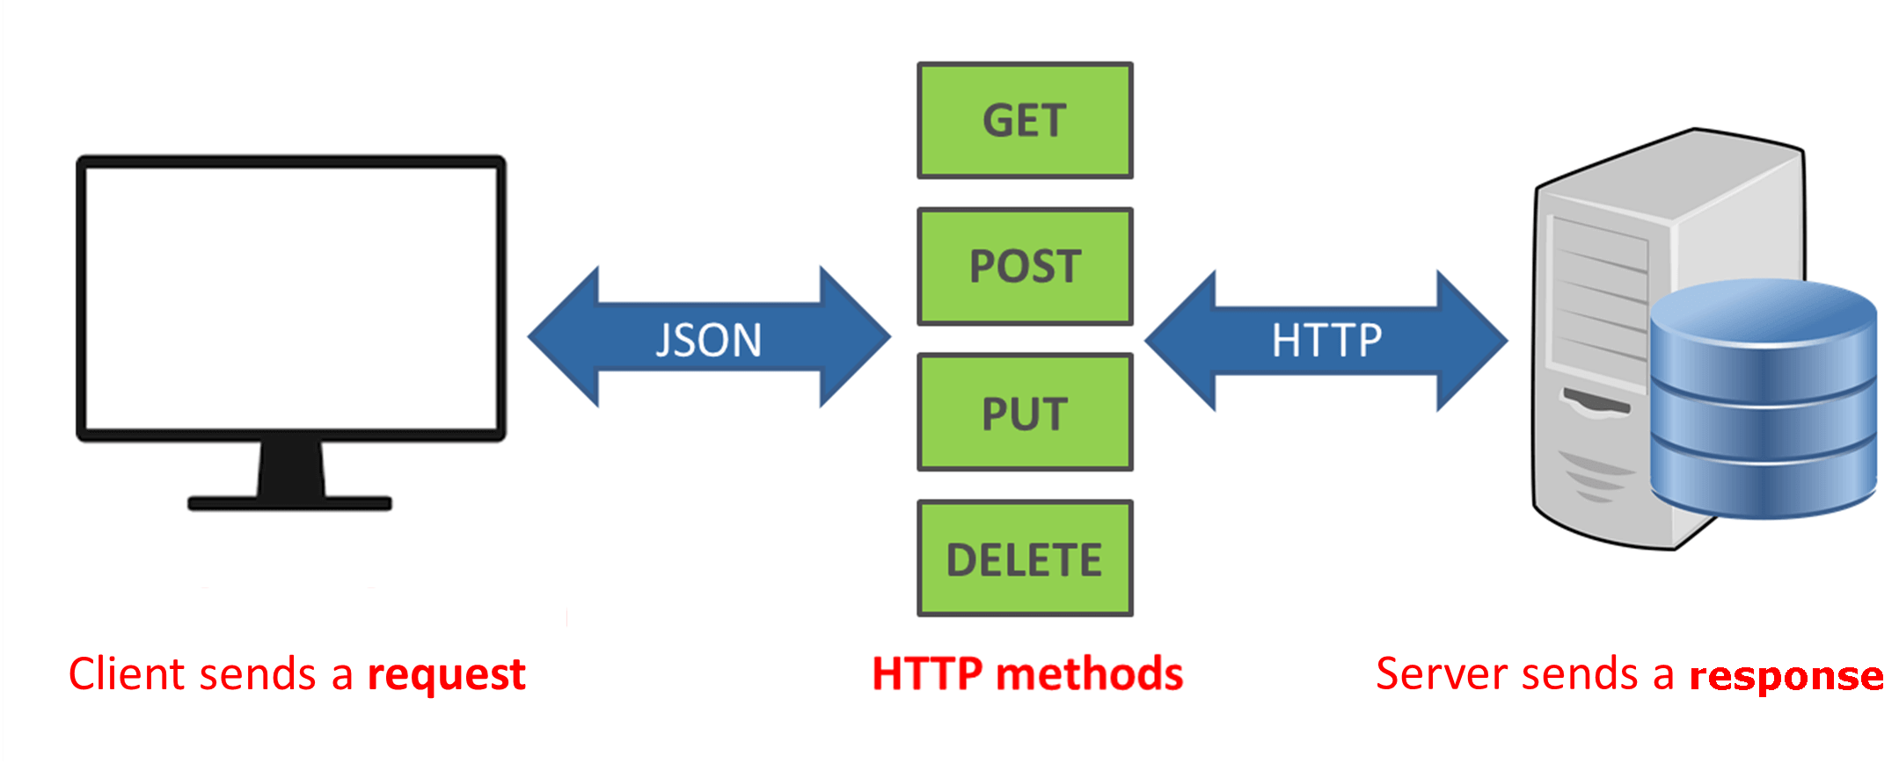
Overview of HTTP

Slide 6






API Testing Tools

