Slide 1
Testing the smart contracts
Chapter 10

Slide 2
Plan for the rest of the semester
Today: We’ll learn testing your smart contract using test.js scripts and test frameworks such as mocha
How can prepare for the exam?
There is no substitution for hard work. You must make it a habit to READ – read code, read books, read papers, read and read again. Read the chapters 4-10.
READ the lecture notes.

Slide 3
What this chapter covers
○ Seeing the importance of testing smart contracts
○ Writing test scripts in JavaScript
○ Using Truffle frameworks to support smart contract testing
○ Interpreting outputs from running test scripts
○ Developing test scripts for the counter, ballot, and blind auction smart contracts
We are using a JavaScript framework mocha

Slide 4
What are we going to do?
Writing test scripts requires specific knowledge of primitives such as beforeEach, it, and describe, as well and how and when to use them.
This chapter illustrates the development of test scripts with three different but familiar smart contracts: counter, ballot, and blind auction.
Thus, you are gradually moving from a simple test script to a more complex one.
You’ll also learn about using the Truffle suite of tools for running the test scripts and verifying that the tests pass (or fail) as you are developing and deploying the smart contracts.

Slide 5
Types of testing
Software testing takes many forms, depending on the granularity of tests and time of test execution during the development phases:
○ Unit testing—Testing of individual components such as a single function
○ Integration testing—Testing of the operation flow of the integrated system
○ System-level test-driven development—Testing done to verify the integrity of the system developed by different members of the team as functions are added and checked into repositories

Slide 6
Test scripts
Let’s learn unit testing that involves exhaustive testing of the smart contract functions and modifiers.
These tests are code scripts that simulate the execution of functions of the smart contract being tested.
With the support of the Truffle test framework, the passing and failing of a test can be visually verified by check (✔) and X marks.

Slide 7
Language for test scripts
Testers or test programs can be written in the same language as the main application to be tested.
In our case, you can write the tester itself as a smart contract in the Solidity language.
The Pet Shop example provided with the Truffle documentation illustrates tests written in Solidity (https://www.trufflesuite.com/tutorials/pet-shop).
But many smart contracts, such as Ballot, use the address data type for the chairperson and the voters. This causes a problem when another smart contract is used as a tester.
Because of this, we will use the alternative language supported by Truffle—JavaScript (JS)— for writing our tests.
Truffle supports both languages (Solidity and Javascript) and has tools to support JS-based testers, as well as JS test frameworks such as Mocha and Chai.

Slide 8
Let’s learn to write test scripts
Choosing these familiar Dapps helps you focus on the testing aspects.
Let’s explore testing:
○ The familiar smart contracts Counter.sol, Ballot.sol, and BlindAuction.sol
○ Test commands (it, describe) of the Mocha test framework
○ The Truffle assertion framework in Chai (assert)
○ Test commands with reverting conditions within a smart contract

Slide 9
Testing counter SC
Added two modifiers to the base code:
Only positive value allowed
contract Counter {
int value; //positive value counter
constructor() public{
value = 0; }
modifier checkIfLessThanValue(int n) {
require (n <= value, 'Counter cannot become negative');
_;
}
modifier checkIfNegative(int n) {
require (n > 0, 'Value must be greater than zero');
_;
}
Modifiers enforcing the rules
function get() view public returns (int){
return value; }
function initialize (int n) public checkIfNegative(n) {
value = n; }
function increment (int n) public checkIfNegative(n) {
value = value + n; }
function decrement (int n) public checkIfNegative(n) checkIfLessThanValue(n) {
value = value - n; }}

Slide 10
Writing the test scripts
Writing a test function script involves these three steps:
○ Identifying functions and modifiers to test
○ Writing the test script that will exercise each of the functions and ensure that these functions work as expected
○ Writing the test script for exercising each of the modifiers and making sure that they work

Slide 11
Useful test structures primitives /commands
beforeEach()—This function specifies the preconditions for other tests. It allows you to specify the code that will be executed before every test defined by it() and describe() test specifications.
The beforeEach() function initializes the contract and establishes the base condition for the execution of a test command.
○ it()—This function is a standalone test of a function; you can think of it as an independent test or a unit test.
○ describe()—This function is a composite test structure, and it specifies a group of related it() tests.

Slide 12
Inside the test functions (it, describe, and so on), you’ll also use a few other declarations:
– async()—Allows for the asynchronous execution of functions, especially because transactions on a blockchain takes variable run times
– await()—Waits for a callback from the function invoked using async() mode
– assert()—Specifies the condition to assert; typically, it helps match the actual result of a statement execution with expected results. If the match fails, the assertion fails.

Slide 13
Writing the counterTest.js
Step 1: Declare that you are using truffle assertions framework and that package is required.
Step 2: Define any string messages to be output.
Step 3: Write any initialization to be performed before every test: global initializations. This is the “beforeEach”
Step 4: In the case of the counter.sol, all the tests are “it” or independent tests, one for each function and one each for the modifiers.

Slide 14
Let’s study the code and run the test
Test.js you write will be
placed in the test directory.

Slide 15
Test.js for counter
Download the entire code the chapter from ublearns.
Let’s examine the “it” of the counter.sol, in its test.js
npm install
truffle test

Slide 16
contract('Ballot', function (accounts) {
let ballot
beforeEach('Setup contract for each test', async function () {
ballot = await Ballot.new(3)
});
it('Success on initialization to registration phase.',
async function(){
let state = await ballot.state()
assert.equal(state, 1) });
describe('Voter registration', function() {
it('Success on registration of voters by chairperson.',
async function () {...
it('Failure on registration of voters by non-chairperson entity.',
async function () { ...
it('Failure of registration of voters in invalid phase.',
async function () { ... });
Ballot test.js

Slide 17
describe('Voting', function() {
beforeEach() {}
it() { }
it() { }
it() { }
it() { }
it() { } });
describe('Phase change', function() {
it() { }
it() { }
it() { } });
describe('Requesting winner', function() {
beforeEach() {}
it() { }
it() { }
it() { }
it() { }
it() { } });
})
A describe() test with
beforeEach() and five
it()s for testing voting
A composite test
describe() with three it()s
for testing phase change
A describe() test with
beforeEach() and six it()s
for testing request winner

Slide 18
Output of running
test script.
Contract: Ballot
Success on initialization to registration phase. (SSms)
Voter registration
Success on registration of voters by chairperson.
Failure on registration of voters by non-chairperson entity. (69ms)
Failure on registration of voters in invalid phase.(281ms)
Voting
Success on vote. (189ms)
Failure on voting for invalid candidate. (155ms)
Failure on repeat vote. ( 195ms)
Failure on vote by an unregistered user. (56ms)
Failure on vote in invalid phase. (184ms)
Phase Change
Success on phase increment (99ms)
Failure on phase decrement. (Slms)
Failure on phase change by non-chairperson entity. (217ms)
Requesting winner
Success on query of winner with majority. (346ms)
Success on query for the winner by a non-chairperson entity. (357ms)
Success on tie-breaker when multiple candidates tied for the majority. (595ms)
Failure on request for winner with majority vote less than three. (281ms)
Failure on request for winner in invalid phase. ( 126ms)
17 passing (6s)

Slide 20
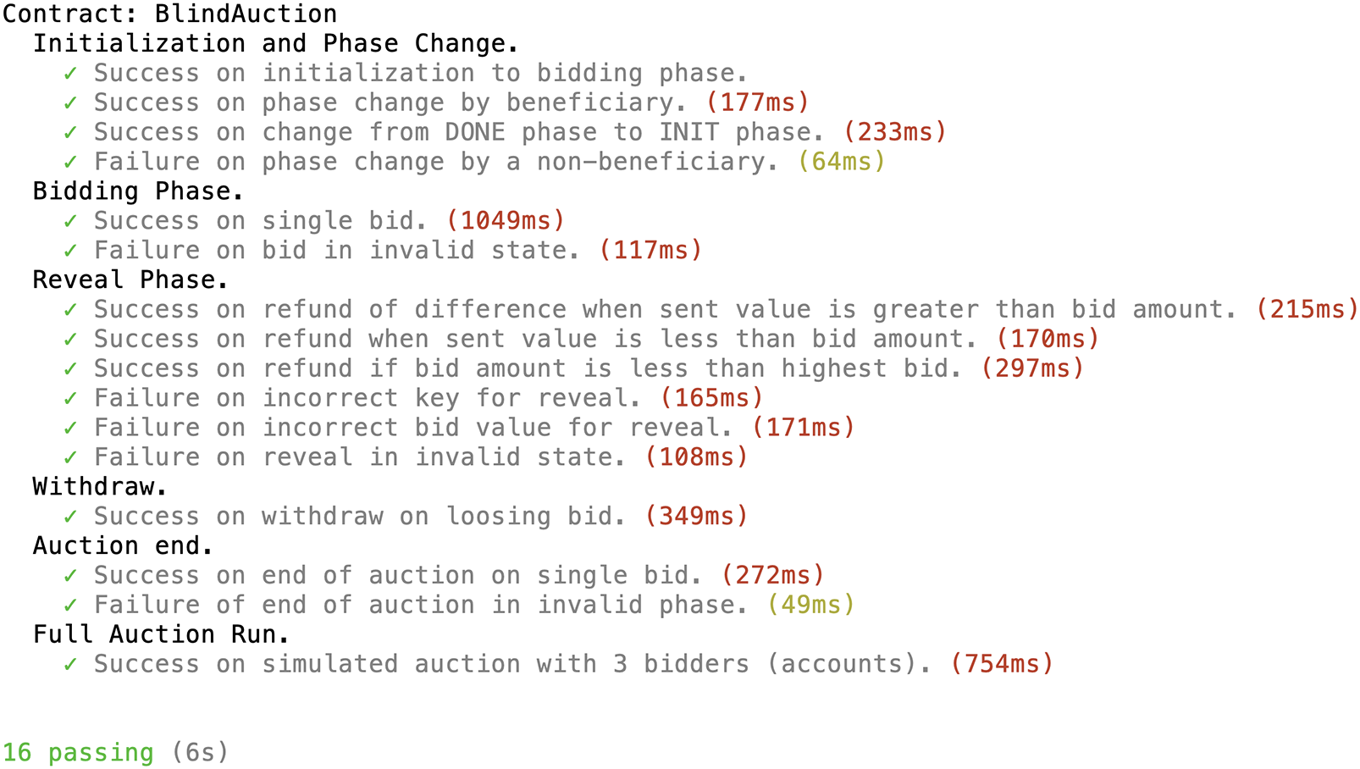

Slide 21
Best Practices
Testing is an important phase in the development of the blockchain-based decentralized
application. Here are some best practices:
○ Decide on the functions to be tested.
○ Decide on the modifiers to be tested.
○ Write positive test code that should be successful for correct inputs.
○ Write negative test code that fails or reverts (typically, on a modifier or require statement)
○ Use meaningful and concise descriptions for the tests and note that these descriptions are output during testing.
○ Use 'Success on' and 'Failure on' as prefixes for the positive and negative tests to identify the type of testing.
○ Use a standard naming convention for the test file (<name of the smart contract>Test.js).

Slide 22
Summary
Three test scripts discussed in this chapter—counterTest.js, ballotTest.js, and blindAuctionTest.js—illustrate how to write test scripts for smart contracts.
○ The main building blocks or coding elements for a test script are beforeEach(), it(), and describe().
○ The beforeEach() function is defined by code for establishing the preliminary conditions (before execution) of each test.
○ async(), await(), and assert() help in managing execution of functions during testing. The commands for completing the test setup are simple: initializing the Ganache test chain, installing the required modules using npm install, and executing the test code using truffle test.

