Slide 1
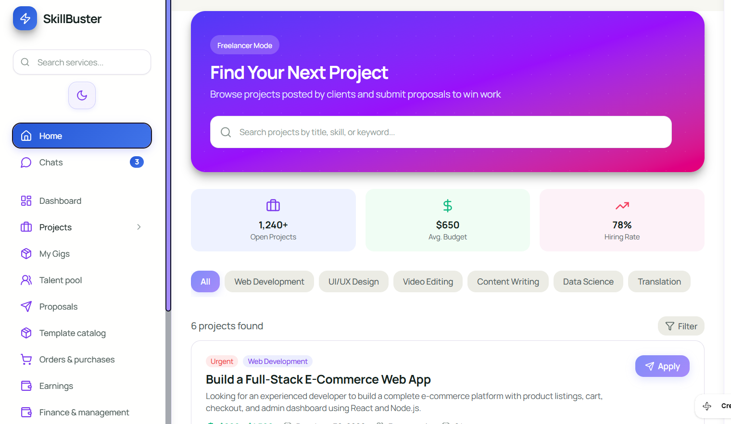
1
7
8
1. Main Project Search Card
2. Project Summary Cards Container
3. Reusable Summary Card
4. Project Category Filter Bar
5. Filter Button
6. Project Results Section
7. SkillBuster Brand Header
8. Project Search Bar
9. Home Navigation Item
10. Chats Navigation Item
11. Notification Badge
8
10
11
2
3
4
6
5

Slide 2
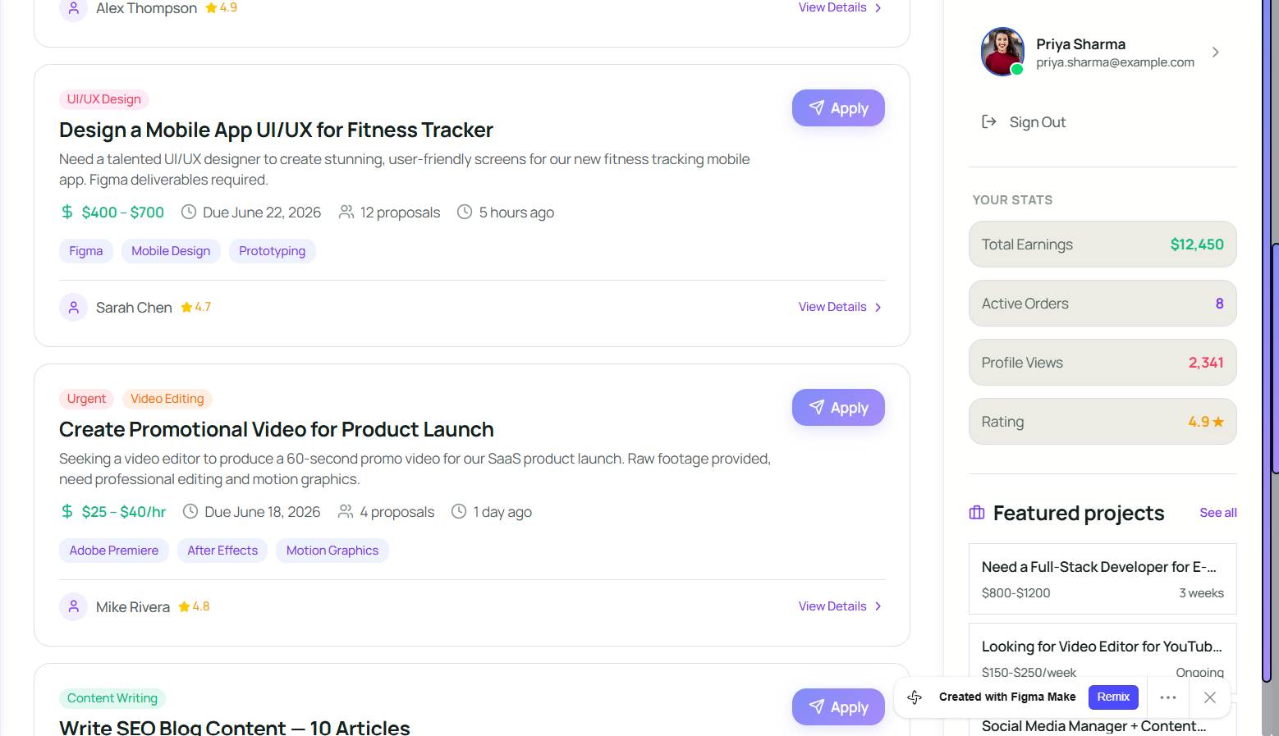
11
15
12
17
11. Project Results Container
12. Project Title and Description
13. Project Budget
14. Project Metadata
15. Client Profile Card
16. Apply Button
17. Freelancer Profile Header
18. Sign Out Button
19. Freelancer Statistics Container
20. Featured Project Card
16
13
18
19
14
20

Slide 3
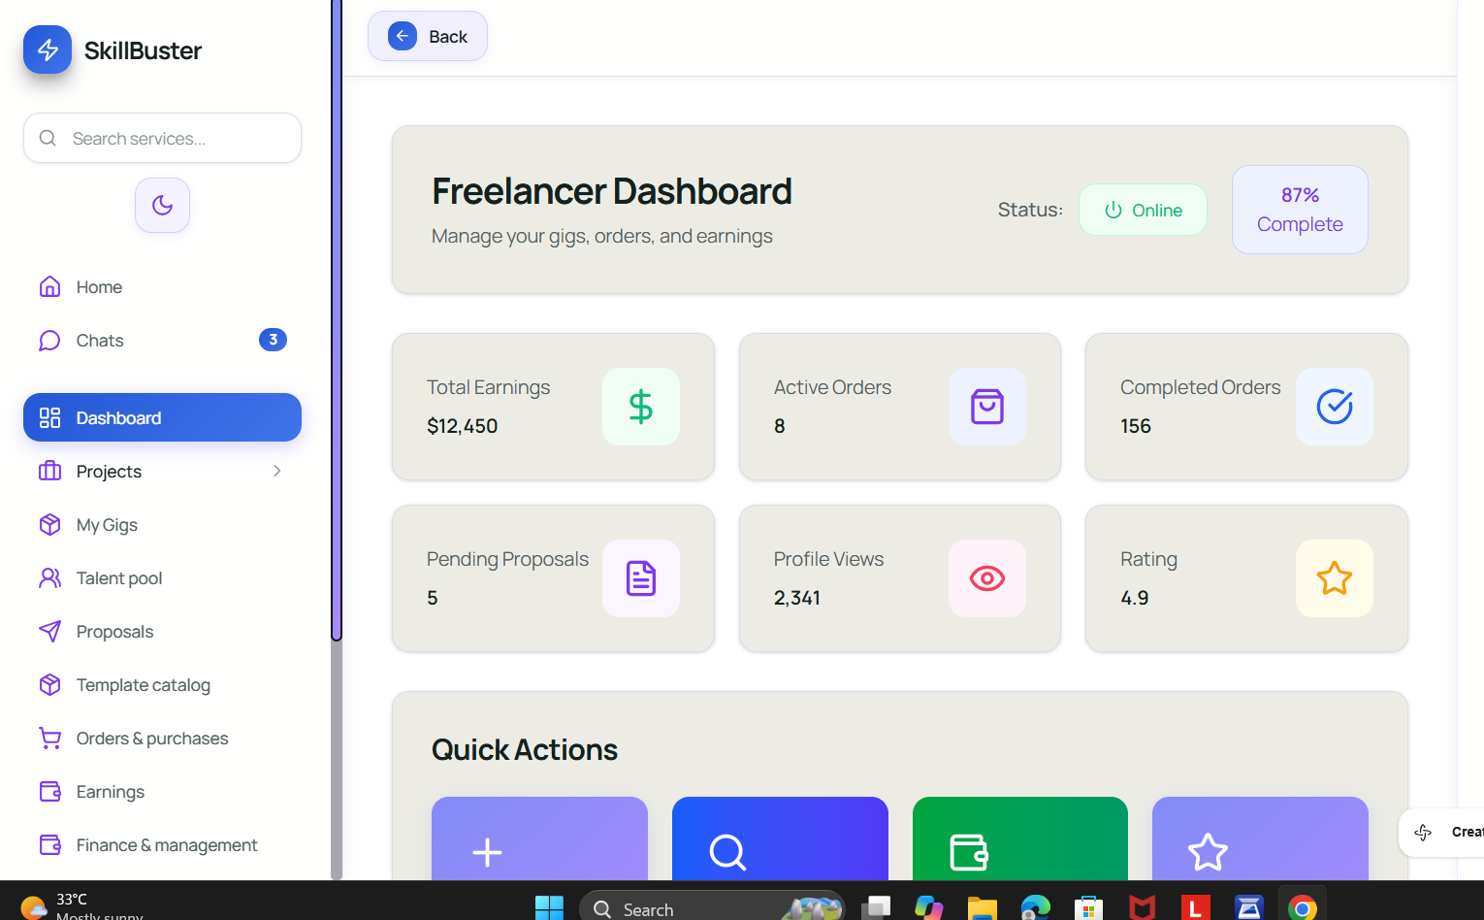
21
21. Dashboard Header Card
22. Online Status Indicator
23. Profile Completion Card
24. Earnings Summary Card
25. Active Orders Summary Card
26. Completed Orders Summary Card
27. Pending Proposals Card
28. Profile Views Summary Card
29. Rating Summary Card
30. Quick Actions Panel
31. Quick Action Button
32. Sidebar Navigation
33. Service Search Bar
34. Dashboard Navigation Item
33
22
23
32
24
25
34
26
27
29
28
31
30

Slide 4
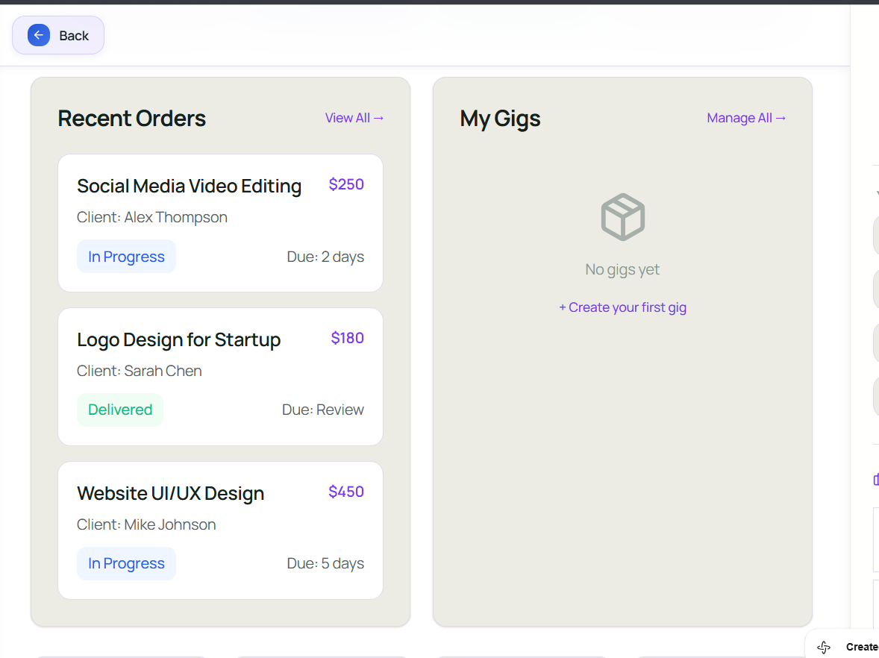
35. Recent Orders Container
36. Recent Orders Heading
37. View All Button
38. Order Card
39. Order Price
40. Order Status Badge
41. My Gigs Container
42. Manage All Button
43. Empty Gigs State
44. Create Gig Button
35
41
42
36
37
39
43
40
44

Slide 5
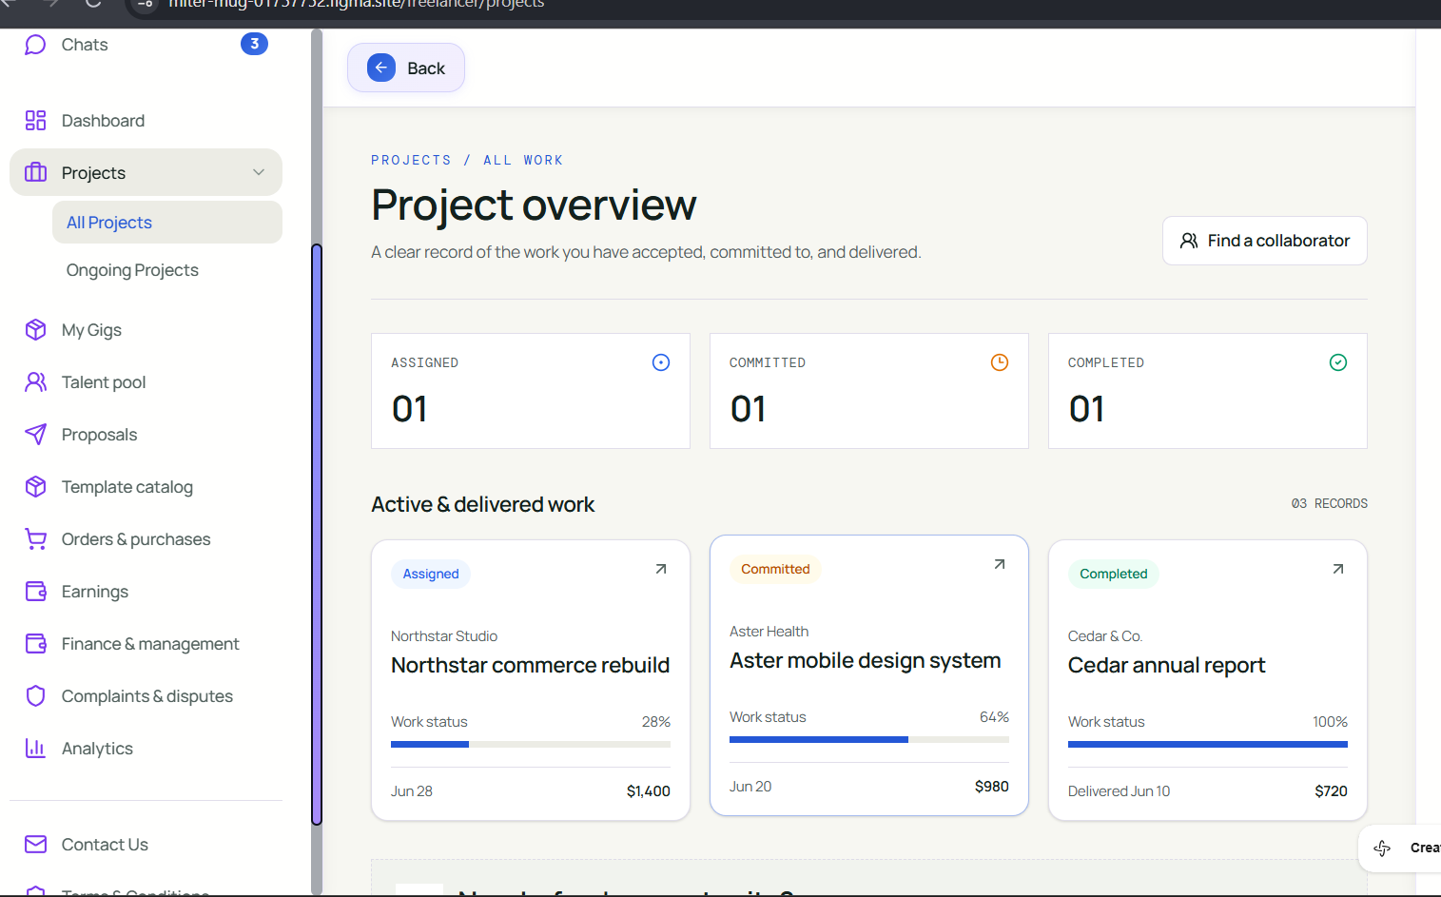
45
45. Back Button
46. Project Overview Header
47. Find a Collaborator Button
48. Project Statistics Container
49. Assigned Projects Card
50. Committed Projects Card
51. Completed Projects Card
52. Active and Delivered Work Section
53. Project Status Label
54. Projects Navigation Heading
55. Project Card
56. Project Status Badge
57. Project Budget
54
46
47
48
49
50
51
52
53
56.
57

Slide 6
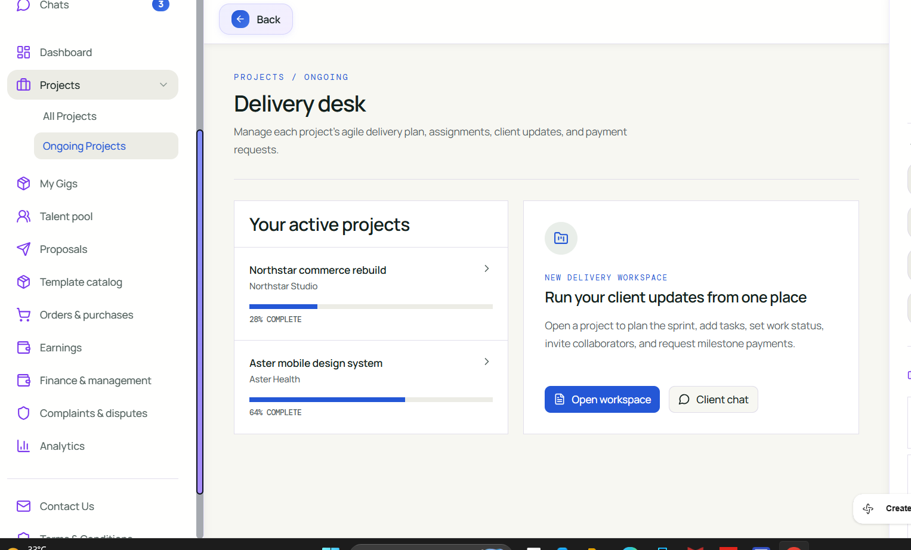
45
59
58. Back Button
59. Delivery Desk Header
60. Active Projects Container
61. Active Project Card
62. Project Progress Indicator
63. Delivery Workspace Card
64. Workspace Icon
65. Workspace Description
66. Open Workspace Button
67. Client Chat Button
61
60
64
62
63
65
66
67

Slide 7
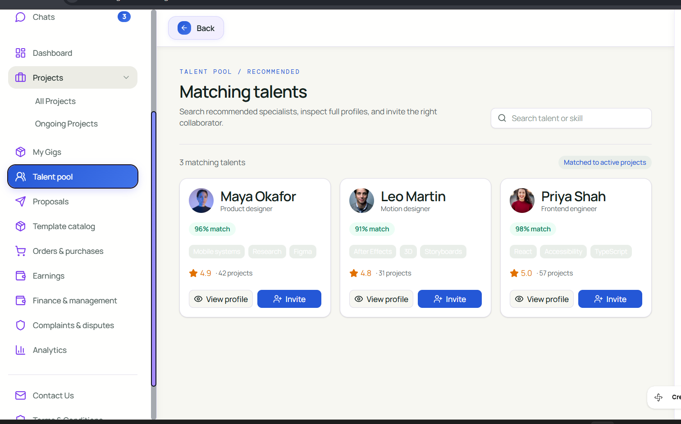
68. Talent Pool Header
69. Talent Search Bar
70. Matching Talent Count
71. Matched Projects Indicator
72. Talent Profile Card
73. Talent Name and Role
74. Talent Skills
75. View Profile Button
76. Invite Button
68
69
72
71
70
73
74
75
76

Slide 8
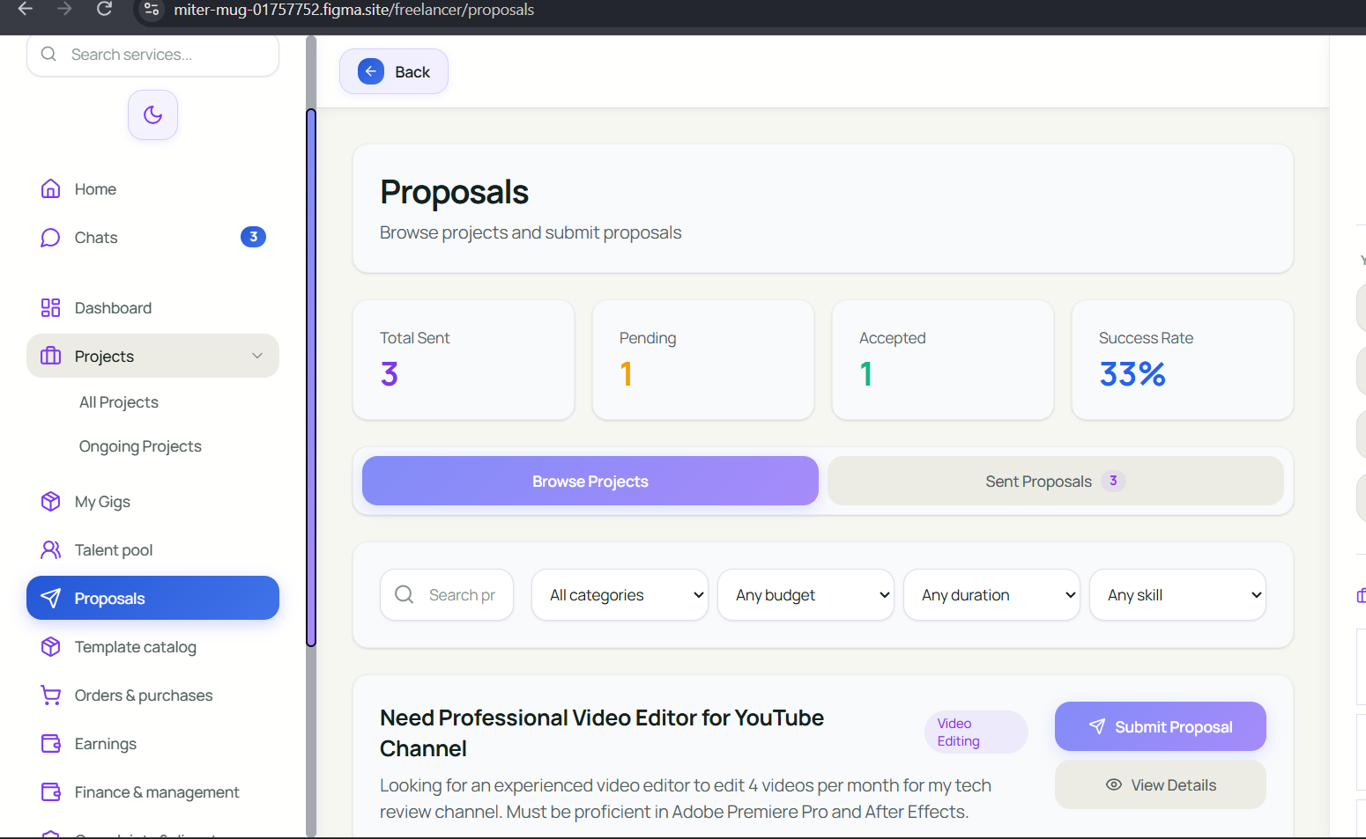
77
77. Back Button
78. Proposals Header Card
79. Proposal Statistics Container
80. Browse Projects Tab
81. Sent Proposals Tab
82. Proposal Filter Container
83. Proposal Search Field
84. Category Filter
85. Budget Filter
86. Skill Filter
87. Proposal Category Badge
88. Submit Proposal Button
89. View Details Button
90. Video Editing Category Badge
78
82
79
80
81
86
83
84
85
90
88
89

Slide 9
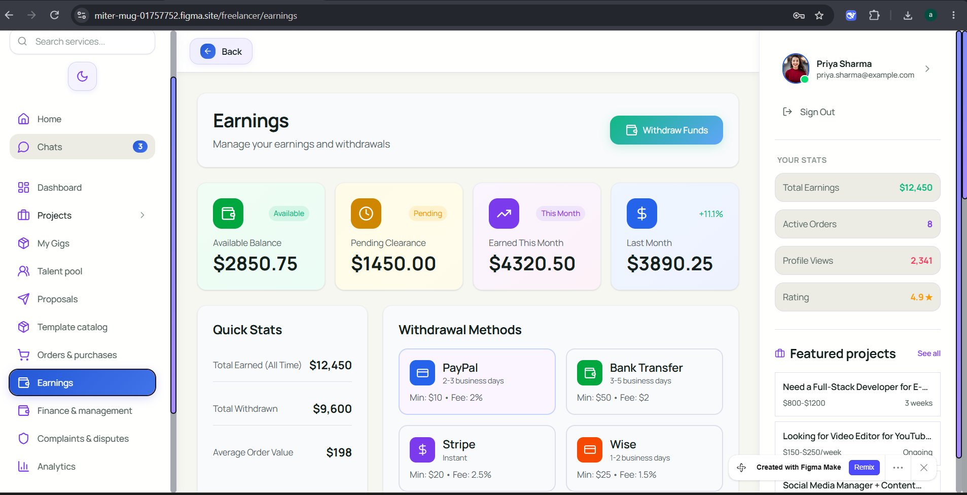
91.Left Navigation Sidebar
92. Back Button
93 Earnings Header Section
94 Withdraw Funds Button
95 Earnings Summary Cards Container
96 Available Balance Card
97 Pending Clearance Card
98 Earned This Month Card
99 Last Month Earnings Card
100 Quick Stats Section
101 Quick Stats Details Card
102 Withdrawal Methods Section
103 PayPal Payment Card
104 Bank Transfer Card
105 Stripe Payment Card
106. Wise Payment Card
17Right Profile Sidebar.
91
92
107
93
94
4
16
99
100
102
103
104
101
95
97
98
105
96

Slide 10
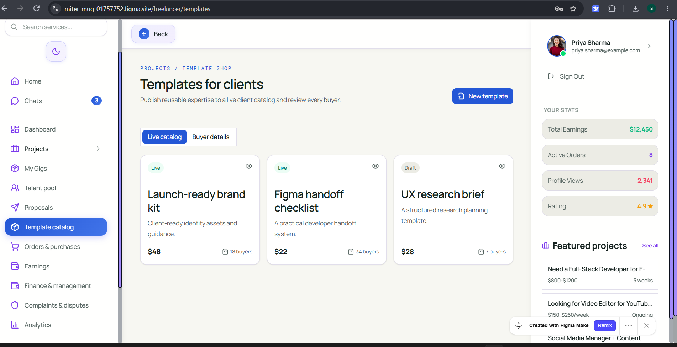
108. Navigation Sidebar
109. Template Catalog Header Section
110. New Template Button
111. Catalog Navigation Tabs
112. Live Catalog Tab
113. Buyer Details Tab
114. Template Cards Container
115. Launch-Ready Brand Kit Card
116. Figma Handoff Checklist Card
117. UX Research Brief Card
118. Profile Sidebar
119. Your Stats Section
17
107
108
109
19
112
112
114
115
116
113
111

