Slide 1
HealthcareBot
ChatBot that helps you for Healthcare queries

Slide 2
Aryan Tyagi
Sanket Raikwar
Swarup Deshmukh
Shivansh Saigal
Sohini Dutta
Team MediMinds

Slide 3
Case Study
Many individuals struggle to navigate the complexities of their health insurance plans, unfamiliar with medical jargon and overwhelmed by plan details, felt hesitant to contact her insurance company due to potential wait times and complex explanations.

Slide 4
Problem Statements
Navigating the complexities of health insurance plans can be overwhelming, particularly for individuals unfamiliar with medical terminology or specific plan details. Traditional methods like contacting insurance companies or healthcare providers often involve:
Long wait times
Limited accessibility
Difficulty understanding complex terms

Slide 5
Solution of Problem
A conversational AI (artificial intelligence) chatbot integrated into a health insurance platform or healthcare provider website. This chatbot will:
24/7 availability
User-friendly communication
Personalized responses
Simplify complex information
Answer a wide range of questions

Slide 6
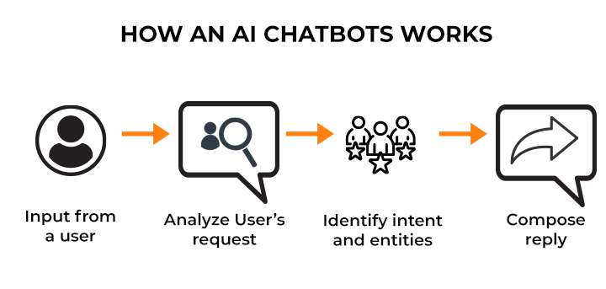

Slide 7
Benefits of our Proposed Solution
01
Reduced wait time
02
Simplified information
03
24/7 availability

Slide 8


Slide 9


