Slide 1
Exploring and Analyzing Conference Papers using Hadoop Ecosystems
Members: Sanket Patel
Saleh Albelwi

Slide 2
Introduction
Technology is growing faster and people are giving their contribution by trying new ideas, introducing work with others, discussing on ideas and solving it and so many other ways.
Conferences are held by many organizations such as IEEE, NIPS, CT-IETA, etc. for advancing innovation and technological excellence for the benefit of humanity.
So by analyzing this paper, one can know in what field technology is growing faster or slower.
Also one can find the similar papers to corresponding sample paper.

Slide 3
Introduction
All over the world approximately 10,000 GB of conference papers dataset is available.
Finding similarities between research papers is difficult and consuming-time.
Using Hadoop ecosystems tools it will be easy and less time consuming for analyzing this type of data.

Slide 4
Dataset
We are using Neural Information Processing Systems Conference (NIPS) 2015 papers.
Size of the dataset is 0.5 GB.
Over 403 papers are their in PDF formats.
Average number of pages for each paper is 10.
Link for dataset:
https://www.kaggle.com/benhamner/nips-2015-papers
Each paper contains a lot of information such as [ title of paper, author names, affiliations, abstracts, keywords, introduction, Related work, Results and Discussion, references, etc.]

Slide 5
Dataset
Also it contains Authors data in two files Authors.csv and PaperAuthors.csv containing author’s name, id, and papers id submitted by them in NIPS.

Slide 6
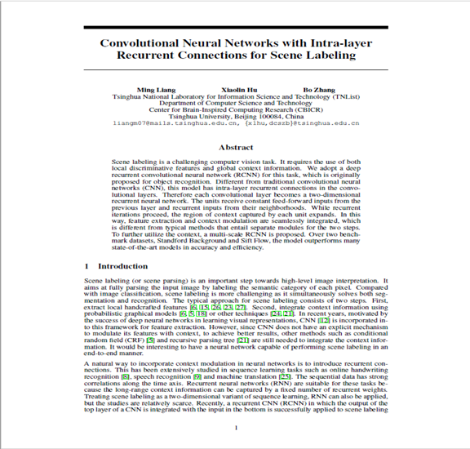
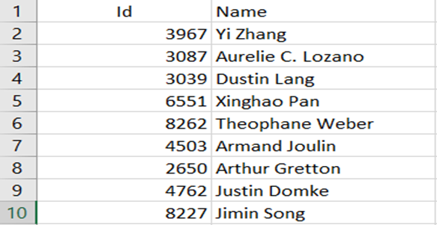
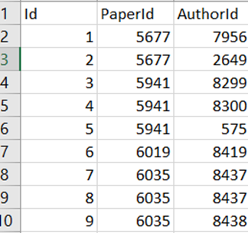
Dataset Files Sample
Sample Paper
Authors.csv
PaperAuthors.csv

Slide 7
Problem Definition 1
Finding Similar Papers
In this problem, we aim to find top 10 similar papers for given paper. This part is implemented by MapReduce program. It is implemented in 3 MapReduce programs as following :-
Find Top words by each paper.
Find Tf-Idf of top words in that paper.
Find top 10 similar papers for a given paper by using Jaccard index.

Slide 8
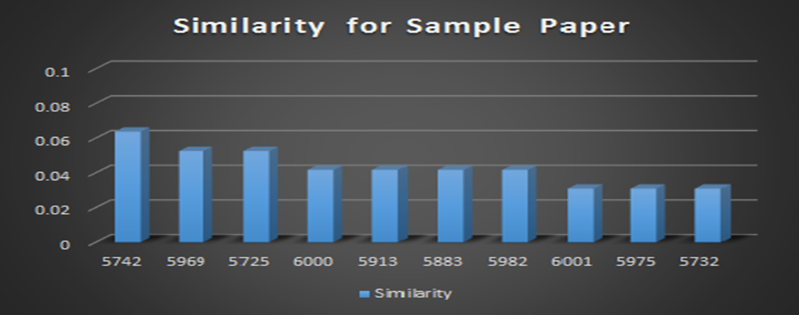
Similar Paper Result
Top 10 Similar Papers Corresponding to Sample Paper Id 5635

Slide 9
Problem Definition 2
2) Finding Number of Papers based on Country
In this problem, we are going to find the number of papers based on country using MapReduce.
And visualize the result on the world map.
MapReduce Function:
Mapper: map (byte offset, line text)
=Emit (Country,1) list
Reducer: Reduce (inter_country, 1)
= Emit (Country, sum)

Slide 10
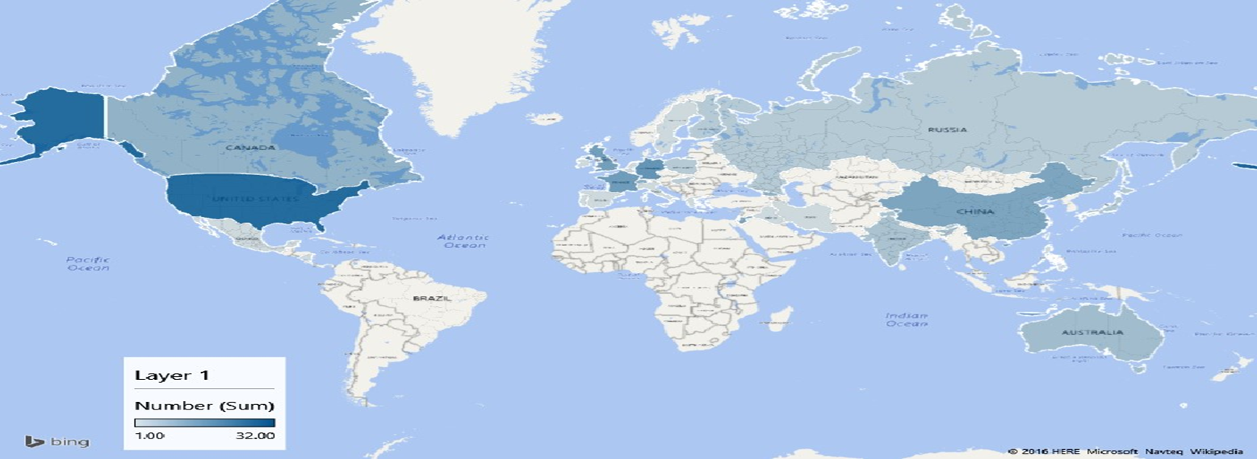
Number of Papers based on Country Result

Slide 11
Problem Definition 3
3) Finding Datasets Counts used in NIPS
In this problem, we are going to find datasets that are used in NIPS 2015 conference papers and number of papers using that dataset.
It is implemented in MapReduce.
So it will give result as number of papers used the specific dataset from list of datasets.

Slide 12
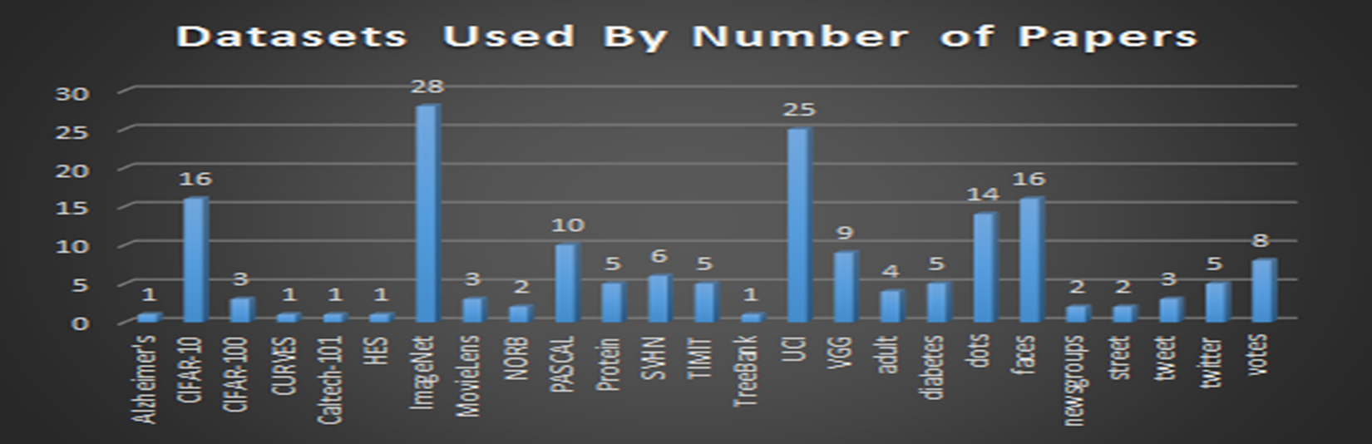
Datasets Counts Result

Slide 13
Problem Definition 4
4) Top Number of Authors
In this problem, we are using Author’s list containing the author’s name, id, and paper id’s which will be used to find the top authors who has published more number of papers in NIPS conference.
We are going to use Hive programming for this problem.

Slide 14
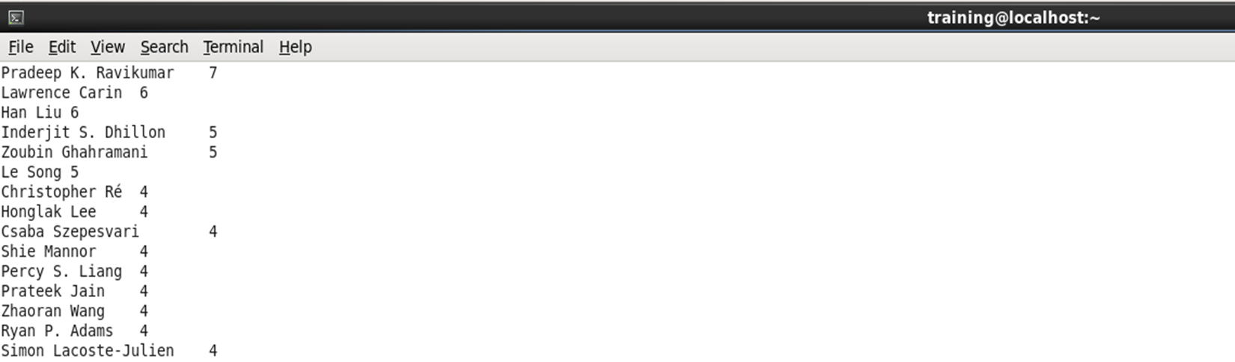
Top Number of Authors Result

Slide 15
Problem Definition 5
5) Clustering Papers Based on Titles
In this problem, we are going to cluster all the papers based on title using Spark and K-Means machine learning algorithm.
Because Spark contains libraries some machine learning algorithms library.
We have used only 50 papers to clustering.

Slide 16
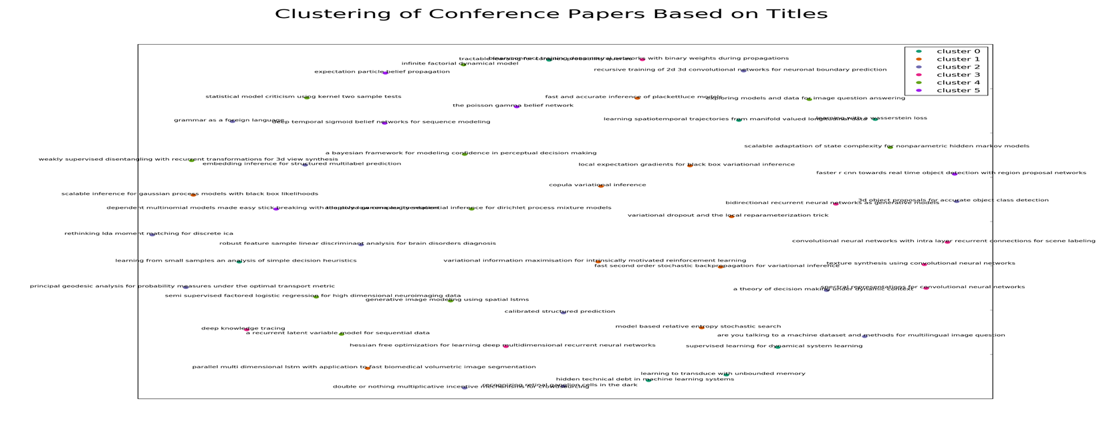
Clustering Papers Result

Slide 17
Conclusion
In this project, by using Hadoop Ecosystems such as MapReduce, Hive and Spark, one can find the result of the problem very quickly from Big data.
Also the task of finding similar papers corresponding to one sample paper from large dataset is difficult but through this Hadoop Ecosystem tools it can be done in less time than traditional tools.
The outputs of this project in many tasks are “Fact-sheet” about the conference which provides the deep insight analysis of this conference dataset.

Slide 18
Thank You..!!
Any Questions??

