Slide 1
Happyjourney.com
PROJECT WILL BE DONE BY-
1. DAKSH PARIKH (BT15CSE060)
2. KARTIK RAUT (BT15CSE067)
3. DHAWAL RENGE (BT15CSE069)
4. SAMAY SANGHVI (BT15CSE074)
5. SANKET GIRI (BT15CSE076)

Slide 2
Airline ticketing system
An Internet booking engine (IBE) is a website that allows consumers and travel agents to book flights, hotels, holiday packages, insurance and other services online.
An internet booking engine allows a customer to specify their travel requirements such as city of departure, destination, departure date, return date and class of travel. Once this information is received, the IBE will offer a list of available air tickets, hotels and excursions which the customer can then book.

Slide 3
Aim of this project!
To successfully make a website that offers people to book flight tickets and other flight related services.
Learn about the linking of database of flight details with the front end of website.
Making user-friendly interface.
To study details of presently working such type of websites like goibibo.com , makemytrip.com etc.
To explore different languages and learn different techniques of building a website in the world of Computer Science.

Slide 4
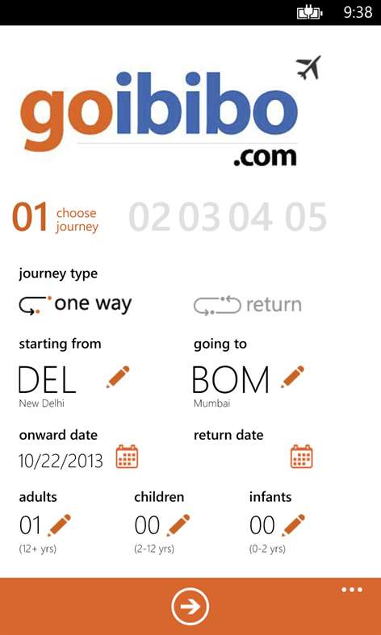
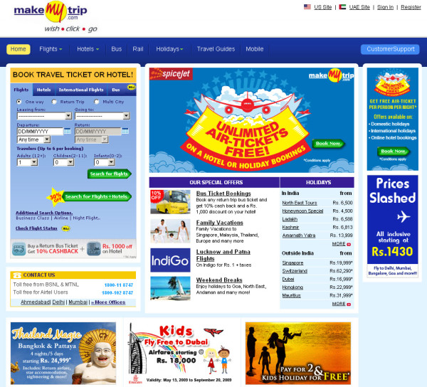
Some Examples Of Online Airline Ticketing Websites

Slide 5
Outcome of this Project
Building a fully working airline ticketing website named www.happyjourney.com.
Learning and understanding how back end and front end of a web site work.
Gaining knowledge about the working of different online ticketing websites.
And lastly feeling satisfied and proud to have successfully completed the project.
Future aim – To build an APP of the website – www.happyjourney.com

Slide 6
Happyjourney.com
Home Page Contents
Options about Flight:
From:
To:
Departure:
Return:
No. of persons:
Class:
SEARCH

Slide 7
LIST OF FLIGHTS:
NAME | DEPARTURE | ARRIVAL | PRICE
Air India | 4:00 | 6:00 | Rs.4000/-
Indigo | 11:20 | 14:00 | Rs. 3700/-
SpiceJet | 5:00 | 7:30 | Rs. 4500/-
SUBMIT

Slide 8
Details About Passengers:
First Name:
Last Name:
Mobile Number:
E-mail Address:
Proceed

Slide 9
CHOOSE PAYMENT MODE:
Credit / Debit Card
Net Banking
Mobile Wallet
Proceed To Pay

Slide 10
Thank you for using _______ Payment Mode!!!
You will be redirected to HappyJourney.com in some seconds…

Slide 11
ADMIN PANEL
Overview

Slide 12
Login to admin panel:
Admin will be logged in using login id and password.
The admin will have special permissions to make some changes which user is unable to do.

Slide 13
Powers to Admin:
Change seat allotment
Cancel tickets
Update site information
Access and Edit Database
Multiple Price Changing
Discounts / Offers

Slide 14
Extra Features of happy journey
Suggestion for next recent flight in case if any person has missed his/her flight.
Meals Inclusion
Discount offer
Cab booking
Extra Baggage and Fast forward service
Status Of Flights

Slide 15
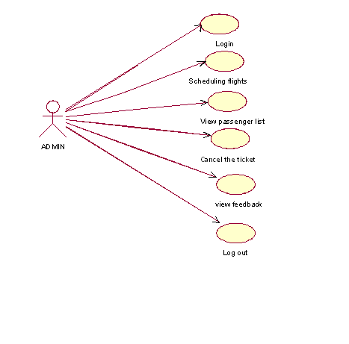

Slide 16
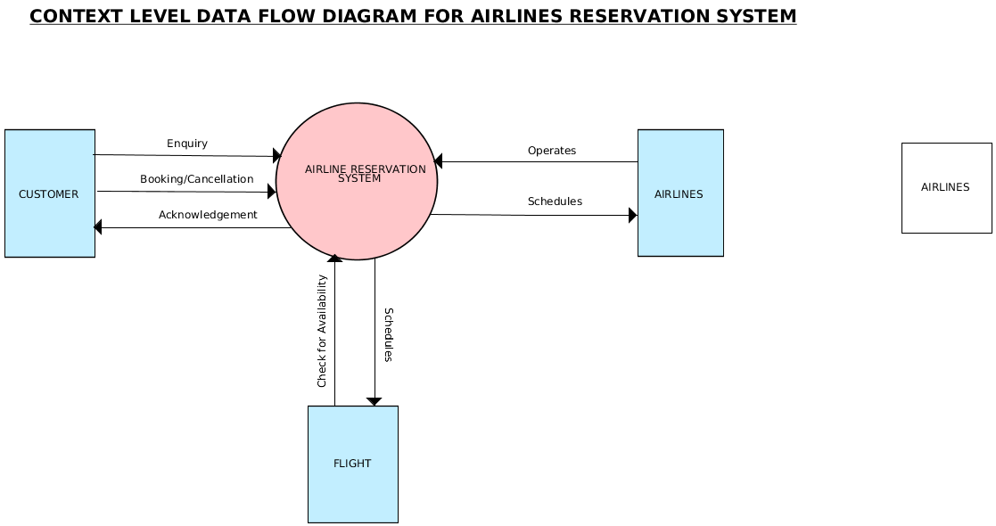


Slide 17
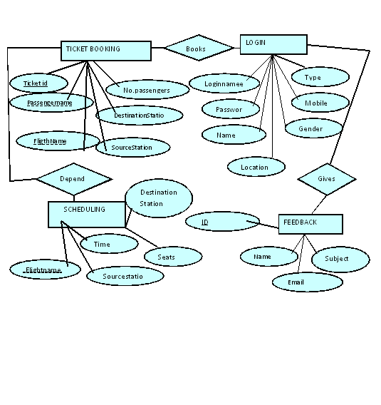

Slide 18
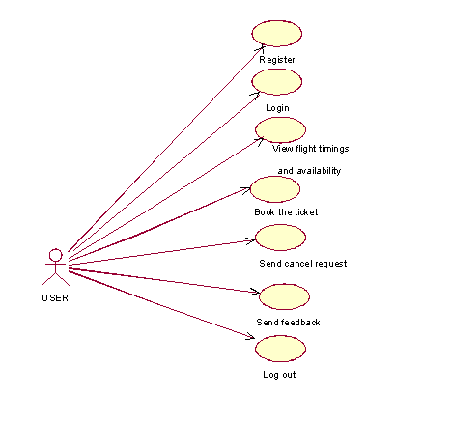

Slide 19
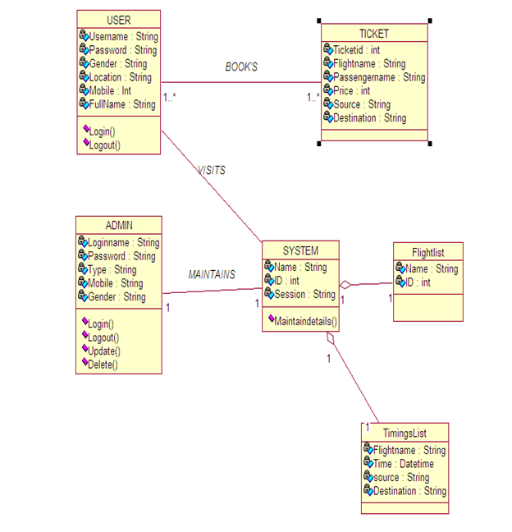

The online ticket booking application will follow three-tier architecture. In three-tier architecture application will run on three layer. User layer, application layer and data base layer. The client only displays the GUI and data but has no part in producing results.

Slide 20
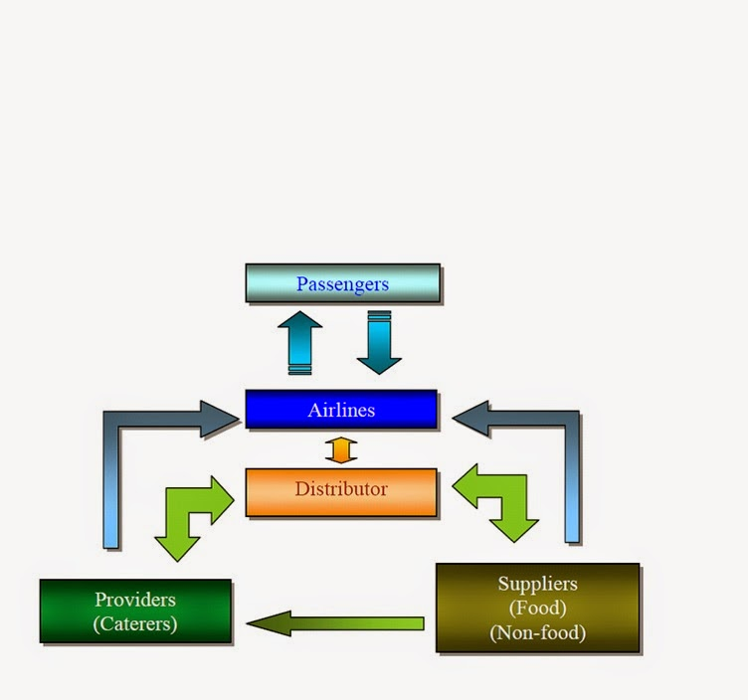

Slide 21
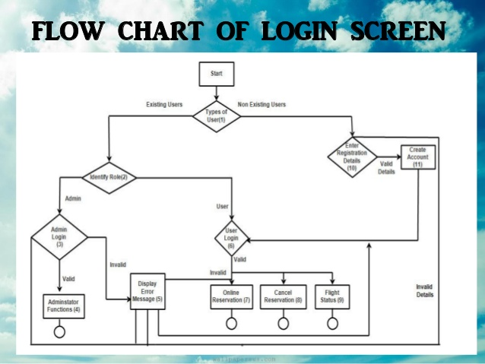

Slide 22
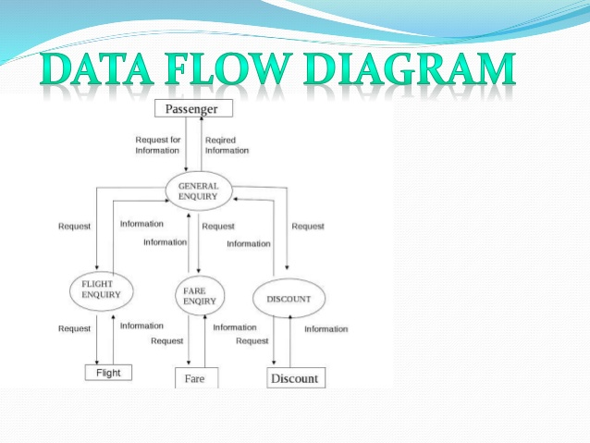

Slide 23
