Slide 1
Banking Application
Project Presentation
Name – Sanket Kumar
Emp Id – YM281

Slide 2
Contents
Project Overview
Prototype

Slide 3
Project Overview

Slide 4
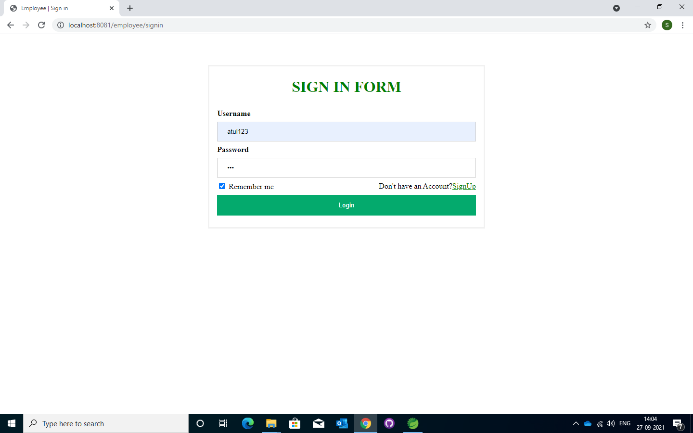
Prototype

Slide 5
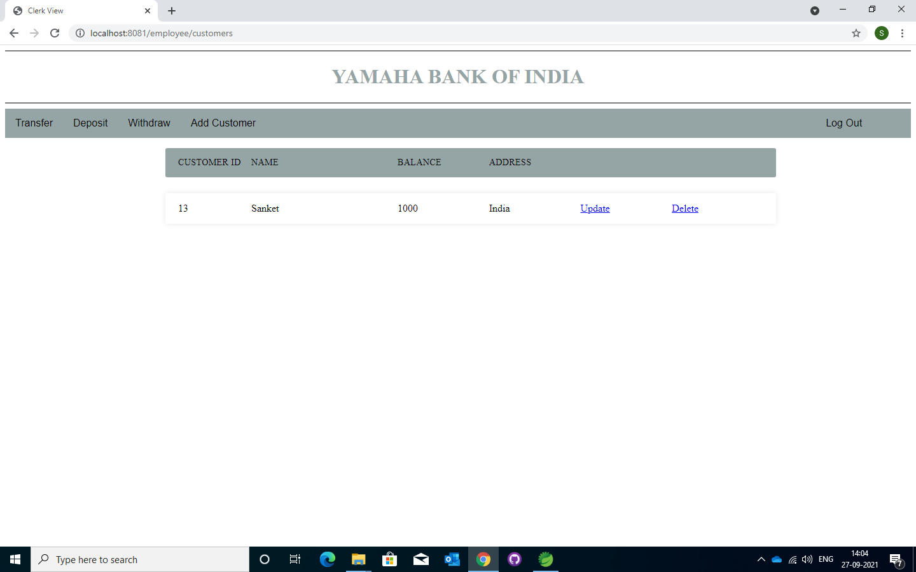
Prototype

Slide 6
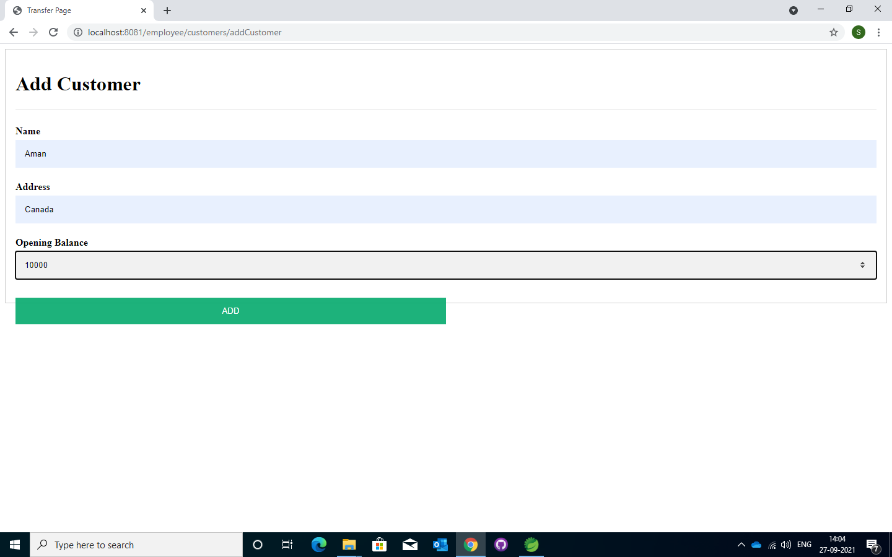
Prototype

Slide 7
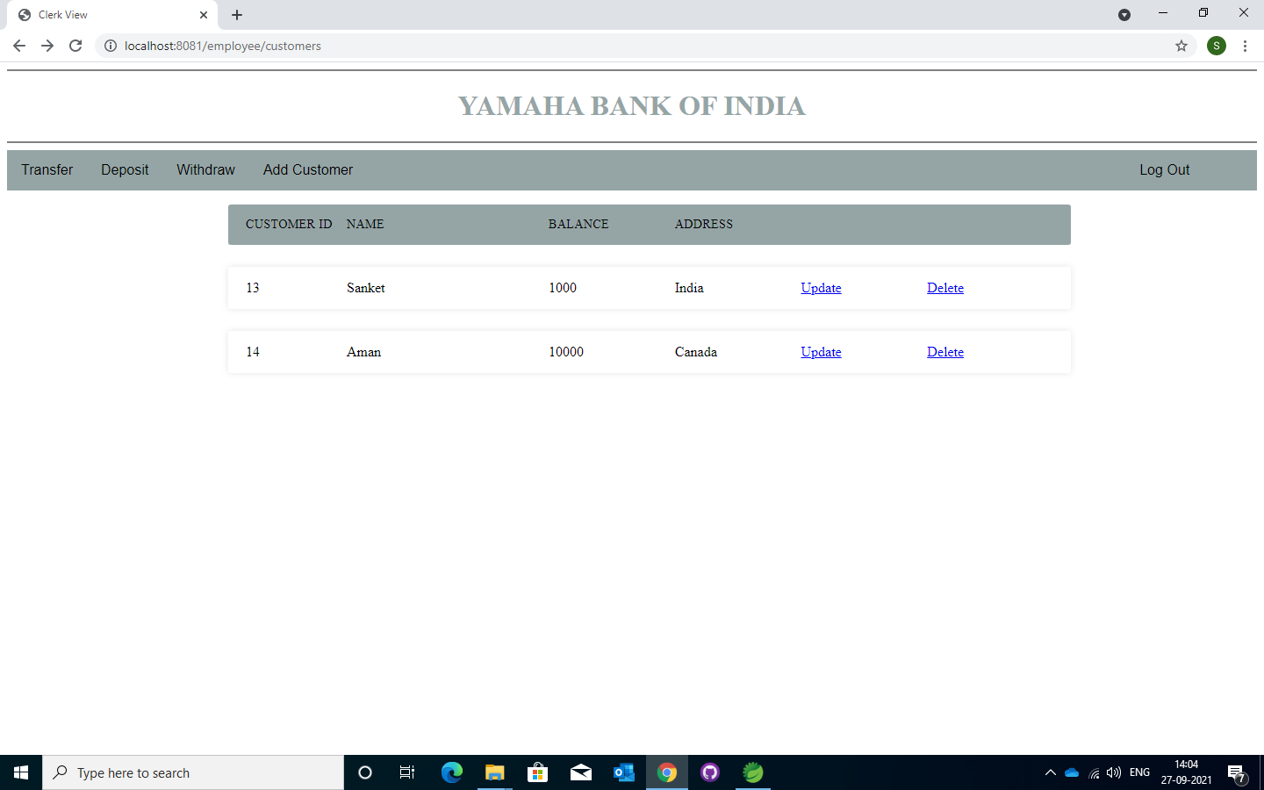
Prototype

Slide 8
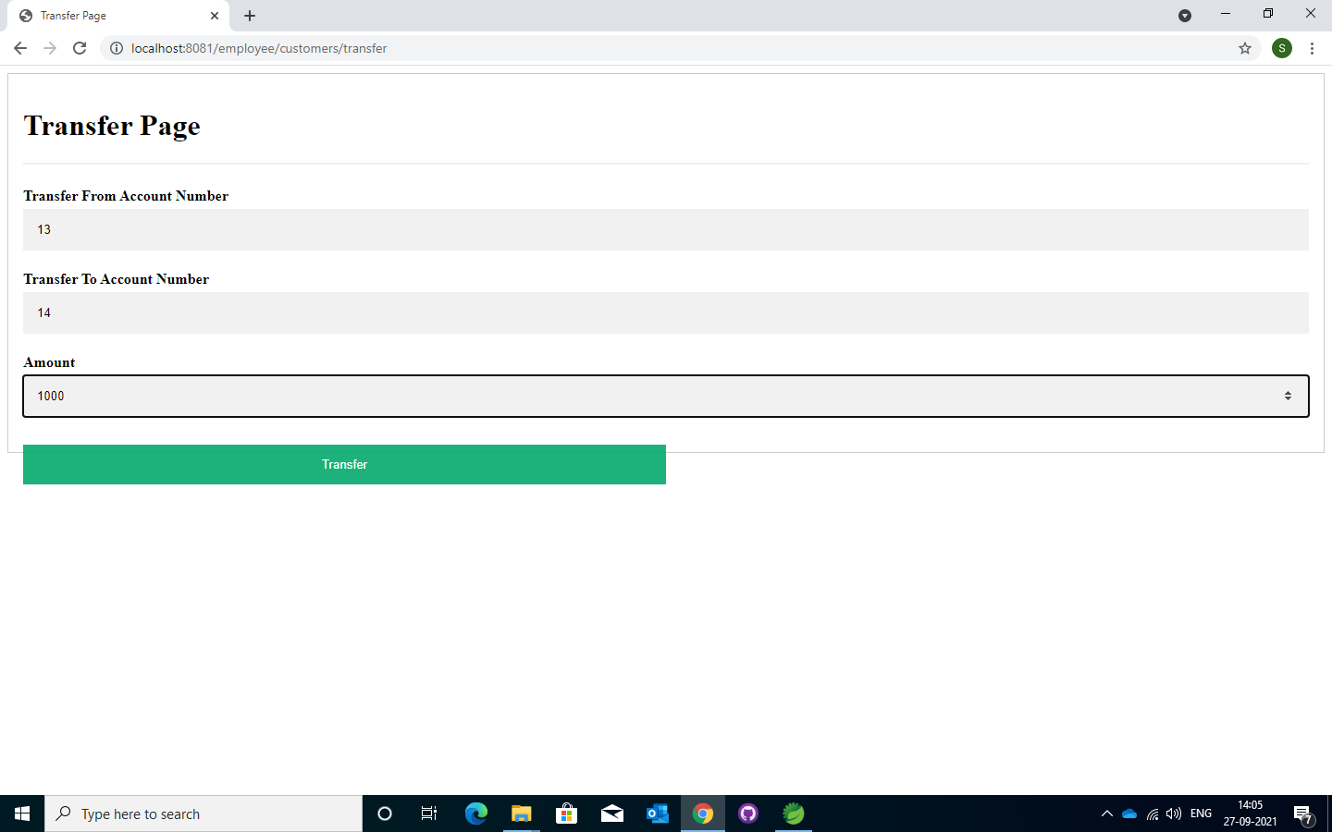
Prototype

Slide 9

Prototype

Slide 10
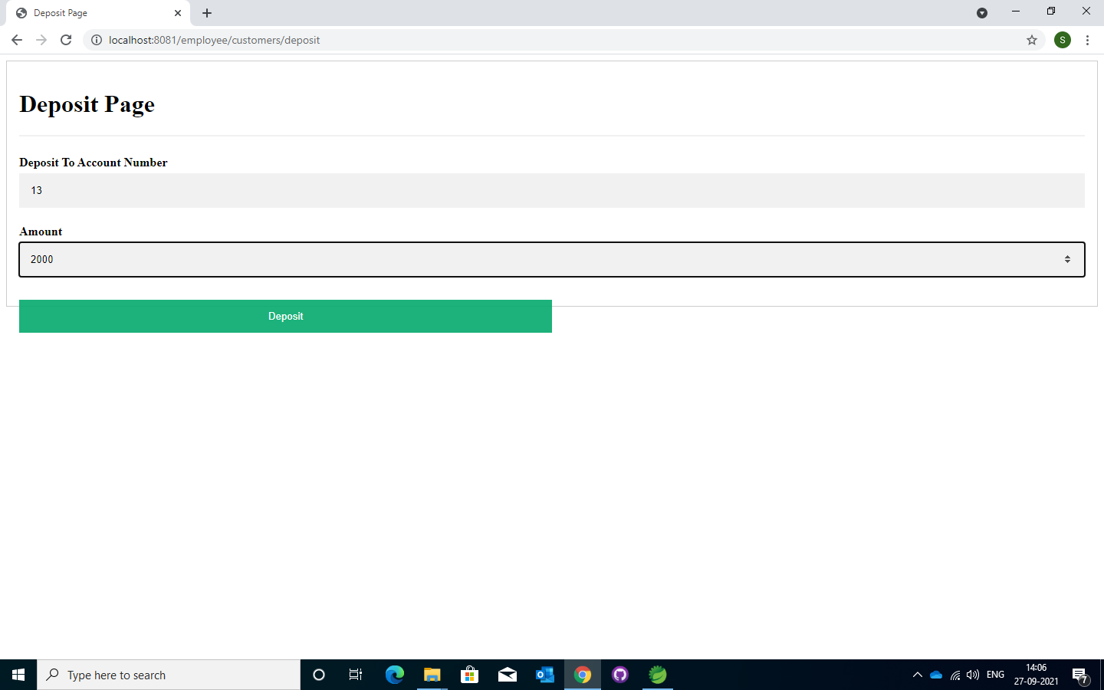
Prototype

Slide 11

Prototype

Slide 12
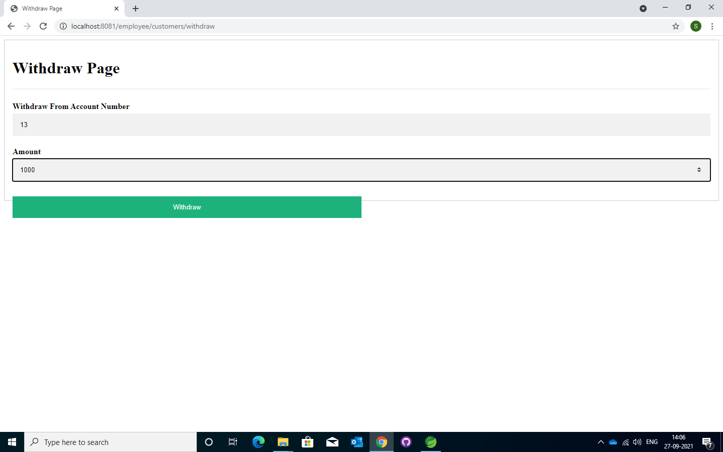
Prototype

Slide 13

Prototype

Slide 14
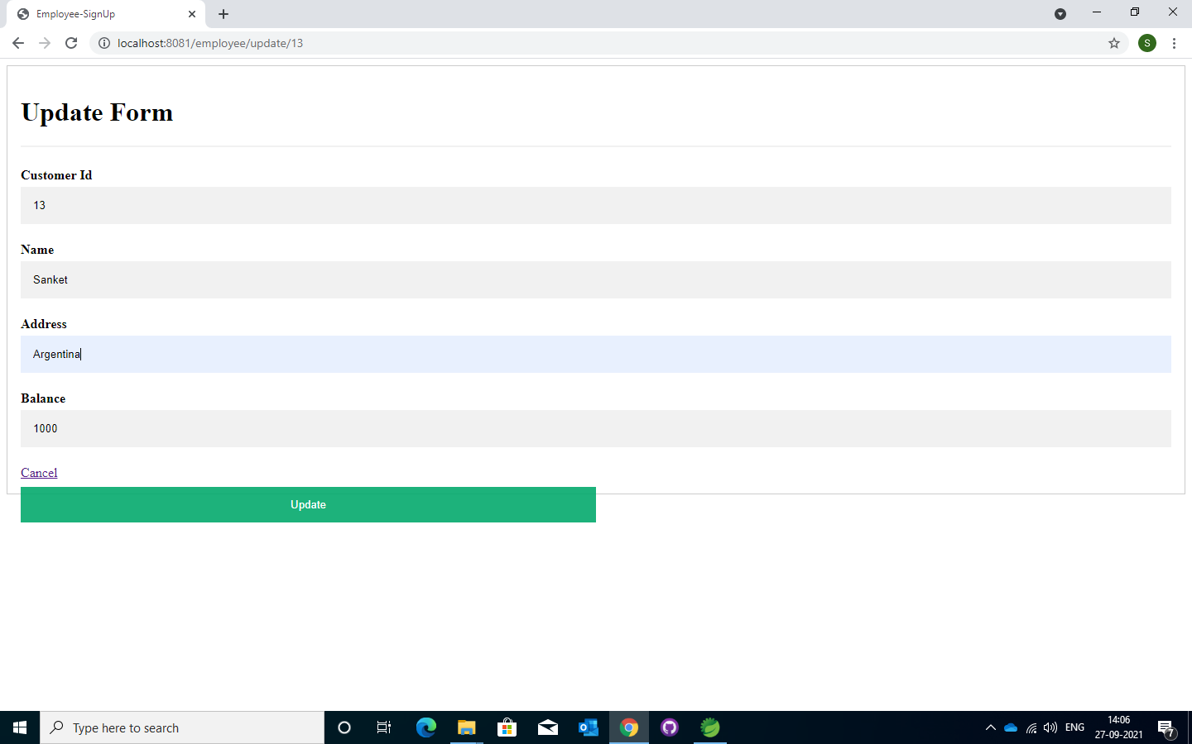
Prototype

Slide 15

Prototype

Slide 16

Prototype

Slide 17
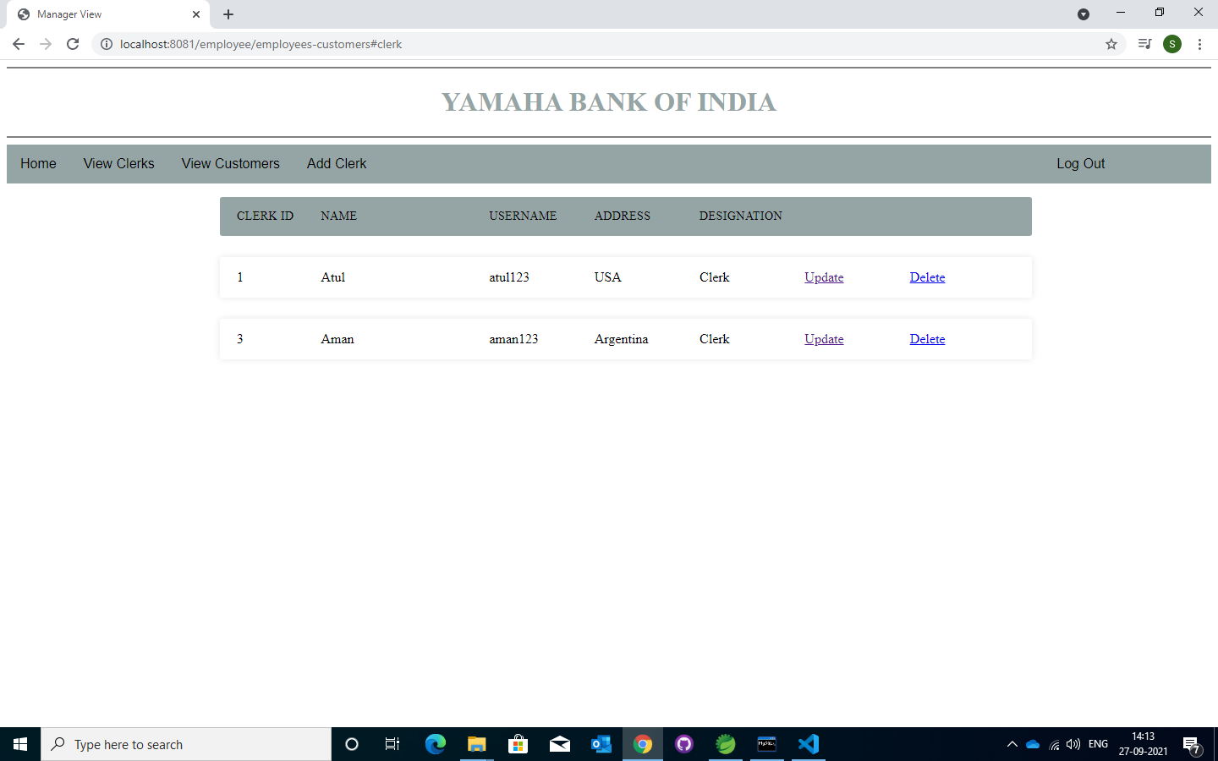
Prototype

Slide 18
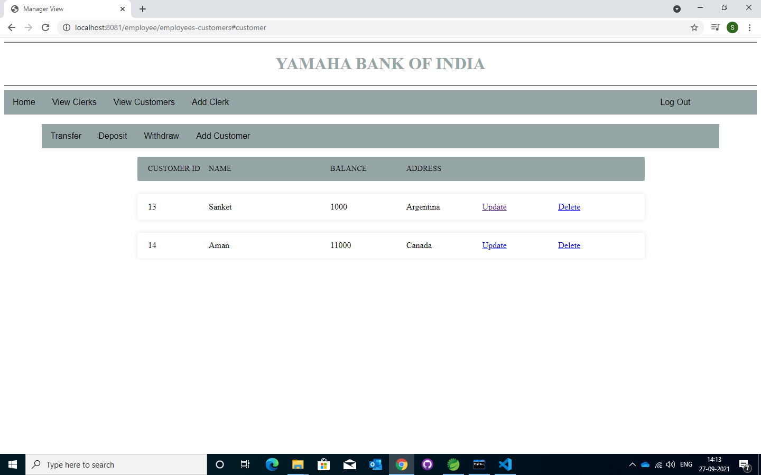
Prototype

Slide 19
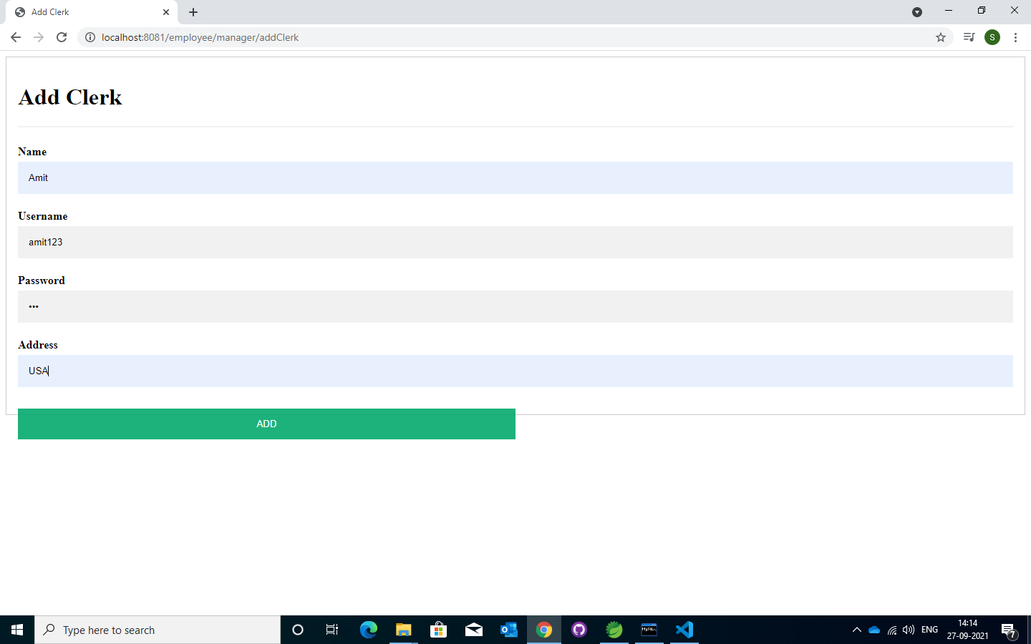
Prototype

Slide 20
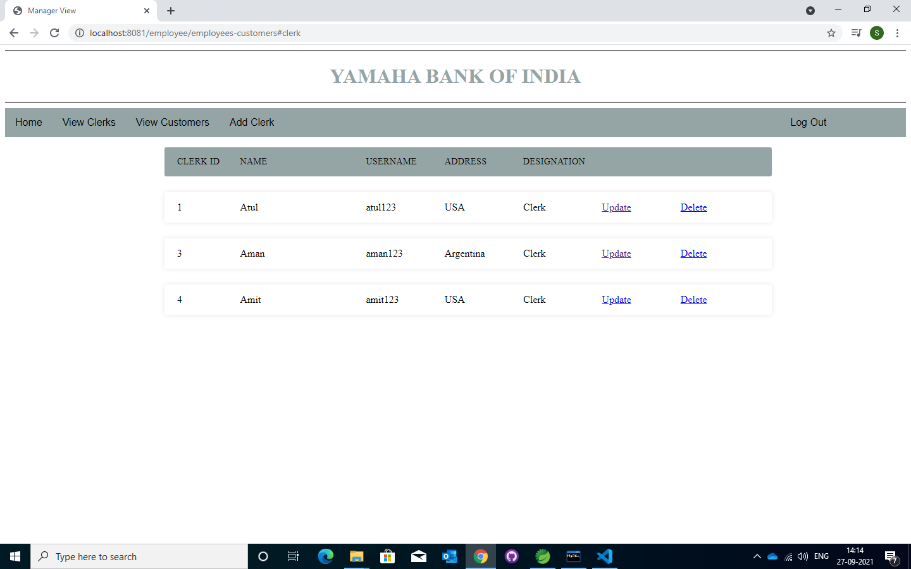
Prototype

Slide 21
Thanks !

