Slide 1
NodeJs & Web

Slide 2
Agenda
How HTML, CSS, Javascript renders on browser
How PHP Works
Node.js
Introduction
Single Threaded
Non-blocking I/O
Event Loop
JavaScript is Asynchronous
NPM (Node Package Manager)
How Node.Js works
Cluster
Real time chat application with Demo

Slide 3
DOM
Critical
Rendering
Path
JavaScript
CSSOM
Rendering Tree
Layout
Paint

Slide 4
Characters
<html><head><link href=“style.css”></link>
</head><body><p>Hey! Welcome </p></body></html> …
Tokens
StartTag: HTML
StartTag: head
Tag: link
Tokenizer
Tag: body
. . . . .
EndTag: body
. . .
HTML
Nodes
Body
Incremental Construction of DOM
Head
meta
Link
P
DOM
Hey! Welcome
Incremental Construction of DOM. Example - google.com

Slide 5
Characters
body{ font-size: 16px} p {font-weight: bold} span {color: red}
p span{display: none} img{float: right} …
body
Font-size: 16px
Tokens
p
img
Font-size: 16px color: red
span
Nodes
Font-size: 16px Font-weight: bold
span
Font-size: 16px Font-weight: bold
Display: none
CSSOM
Incremental Construction of CSSOM – NOT POSSIBLE (Thus CSS is render blocking)

Slide 6
HTML
DOM
Head
Body
meta
Link
P
Font-weight: bold
Hey! Welcome
Body
CSSOM
P
body
Font-size: 16px
p
Hey! Welcome
img
Font-size: 16px color: red
span
Font-size: 16px Font-weight: bold
Rendering Tree
Font-size: 16px Font-weight: bold
Display: none
span

Slide 7
How PHP Works
<?php class Controller_SuperAdmin_AccountManager extends Controller
{
function __construct(Request $request, Response $response)
{
$this->common_function = new CommonFunction;
}
function action_index()
{
echo ‘Hello ISS !’;
}
?>
Result :- Hello ISS !

Slide 8
Node.js
Ryan Dahl - Creator of Node.js
Built on top of Chrome’s v8 JavaScript Engine for building fast, scalable network application
Uses an Event Driven, non - blocking I/O model that makes it lightweight and efficient
Single threaded

Slide 9
Non-blocking I/O
All request temporarily saved on heap
To avoid blocking, Node makes use of the event driven nature of JS by attaching callbacks to I/O requests
Can support nearly 1 million concurrent connection
Script waiting on I/O waste no space because they get popped off the stack when their non-I/O related code finishes executing

Slide 10
Single Threaded
Most other web platform are multi-threaded, but JS has single thread One thread === One Call Stack === One thing at a time
When threads are bad :-
Hard to program
shared the state and locks
Deadlocks
Giant locks decrease concurrency
Context switching cases
When threads are good :-
Support Multi core CPUs
CPU - heavy work
Little or no shared state
Thread count == CPU core count

Slide 11
Event Loop
Instead of threads Node uses event loop with a stack
You already use callback and event loop
Ext.getStore(‘location_store’).on(‘load’, function(store, eOpts) {
// Some Code
});
or
$.ajax(. . . , function(...) {
console.log(‘Ajax Request!’);
});
Examples

Slide 12
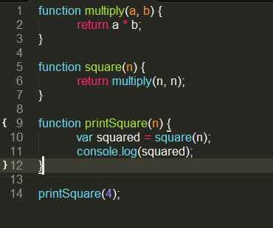
Stack
multiply(4, 4)
square(4)
printSquare(4)
main()

Slide 13
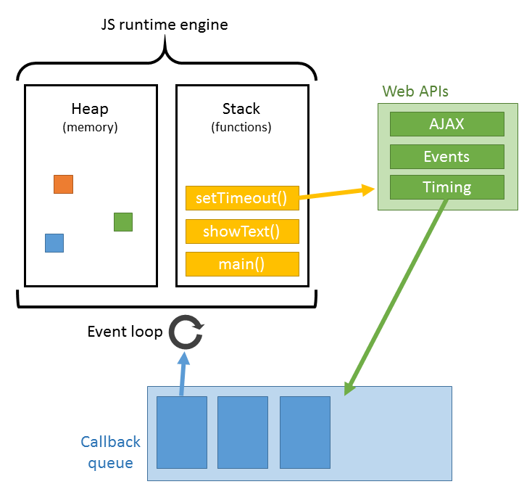
Here is real Concurrency

Slide 14
Event Loop Example
Demo I
Demo II

Slide 15
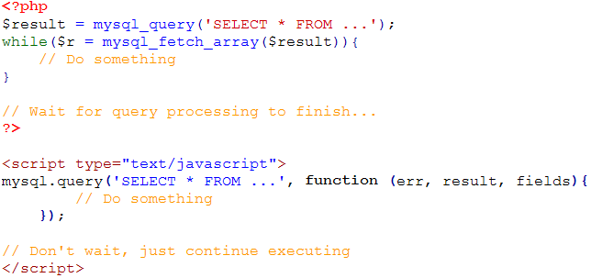
I/O Example

Slide 16
NPM (Node Package Manager)
Reusable components
NPM installs application dependencies locally, not globally
NPM handles multiple versions of the same module at the same time
It's really easy to publish your own module to the npm registry

Slide 17

Where is node.js ?
Single Threaded
Non-blocking I/O
Event Loop
JavaScript is Asynchronous
V8
NPM

Slide 18
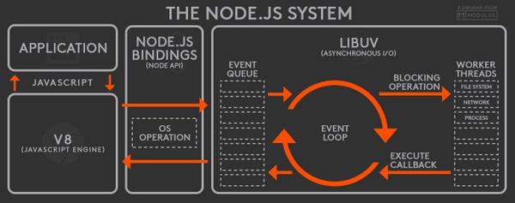

Slide 19
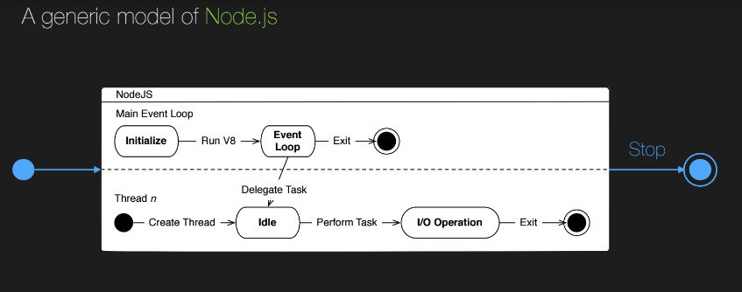
Node.js Working

Slide 20
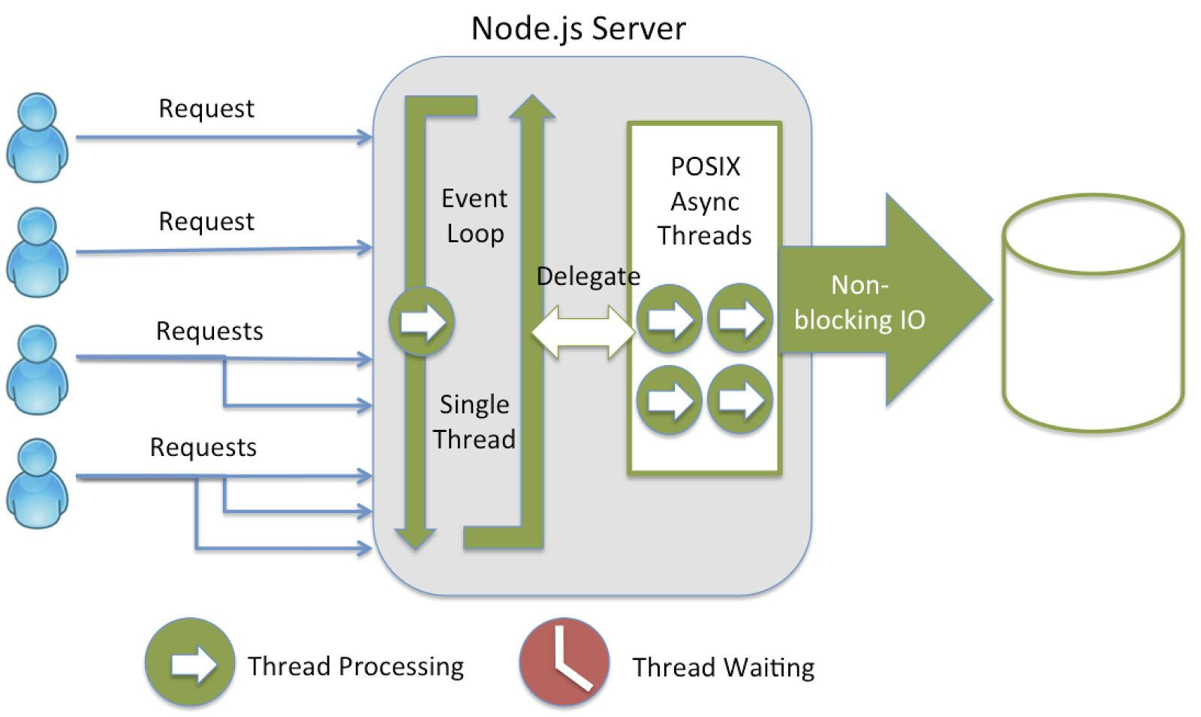
How Node.js Works

Slide 21
Which is better for my application ?
HTML
CSS
Javascript
php
node.js

Slide 22
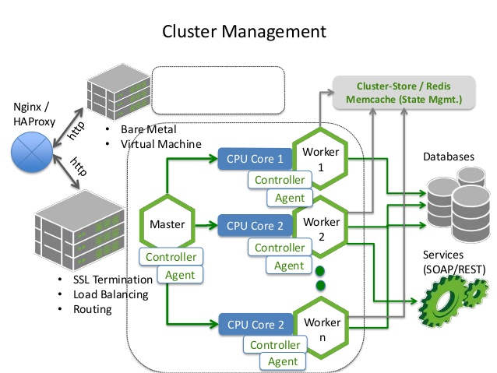
Cluster

Slide 23


Huge Success

Slide 24
Real time Chat Application
Enough theory!
Let’s create cool application using Node.JS
https://github.com/sanket876/chat-application.git

Slide 25
Thank You!

