Slide 1


Slide 2
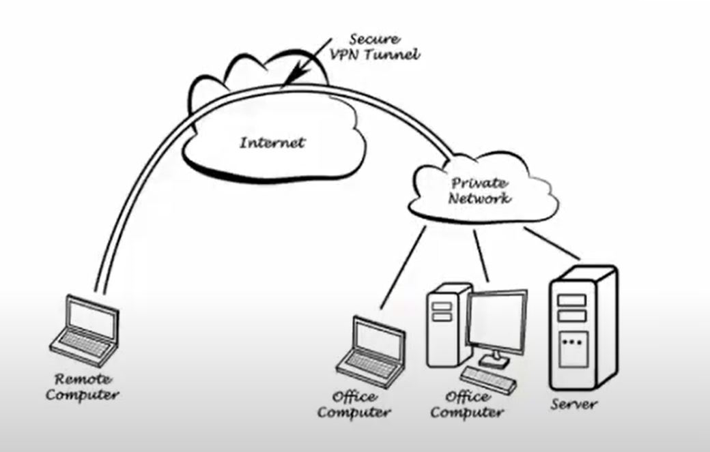

Slide 3
Electricity
Maintenance
Rent
Personal

Slide 4


HackJaipur
Team Name
IOTIANS
Project Title
Helping employee work from home via AWS EC2 Service

