Slide 1
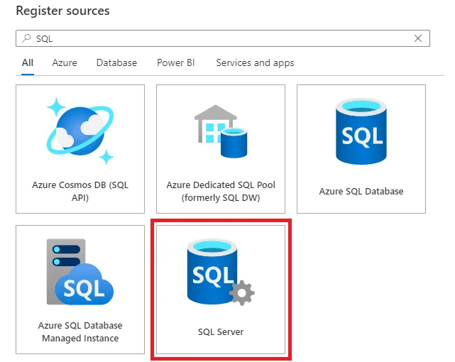




Azure Data Flowchart
Azure Data Factory
On Premise SQL
Azure Blob Storage
Power Bi

