Slide 1
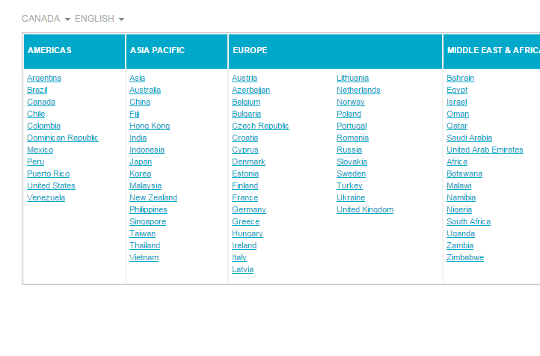
Country Selector
Description of Component Country Selector component is created for the users to select country from the available list and to view the different languages in which the web page is available for the users of a particular country.
Type of Component
New component
Version Compatibility
< 6>
Effort Saving (in man hrs)
Build hours – 34 hrs
Integration hours – 12 hrs
Plug-in effort – 2 hrs
Total Saving – 20 hrs

Slide 2
Country Selector
Disclaimer
Any sublicensing/distribution of the Asset by Accenture or any change of scope of use of the Asset, should be subject to review and clearance by legal based on the scope of new usage identified

