Slide 1

B.N.M. Institute of Technology
An Autonomous Institution under VTU
Approved by AICTE, Accredited as Grade A Institution by NAAC till 31.12.2026.
All Eligible UG branches – CSE, ECE, EEE, ISE & Mech. Engg. Accredited by NBA till 30.06.2025
Post box no. 7087, 27th cross, 12th Main, Banashankari 2nd Stage, Bengaluru- 560070, INDIA
Ph: 91-80- 26711780/81/82 Email: principal@bnmit.in, www.bnmit.org
PROBLEM SOLVING THROUGH C (22PSC125)
“MOVIE TICKET BOOKING SYSTEM”
H L SANKETH |  | AMAN SOUDAGAR
1BG22CS052 |  | 1BG22CS014
Under the guidance of
RAGHAVENDRA C K
Dept. of CSE, BNMIT

Slide 2
CONTENTS:
INTRODUCTION
PROBLEM STATEMENT
OBJECTIVES
METHODOLOGY
RESULTS
CONCLUSION
REFERENCES

Slide 3
INTRODUCTION:
The "Movie Ticket Booking System" project implemented in the C programming language offers a convenient and interactive solution for users seeking a streamlined way to book movie tickets. This project aims to provide a user-friendly console-based interface that allows individuals to choose from a selection of movies and showtimes. This project offers users a glimpse into the world of software development and showcases the essential aspects of building interactive applications.

Slide 4
PROBLEM STATEMENT:
MOVIE TICKET BOOKING SYSTEM
In traditional movie theatres, ticket booking processes often required patrons to visit physical counters, leading to long queues and potential inconvenience. As technology evolved, online ticket booking systems emerged, enabling users to book seats from the comfort of their homes. The project gives real life understanding of online movie ticket booking system and activities performed by various roles in the supply chain.

Slide 5
OBJECTIVES:
Design a user-friendly interface for movie selection, seat reservation, and interaction.
Implement the seat reservation mechanism, preventing multiple reservations for the same seat.
Develop functions to save and load seat reservation data to and from files.

Slide 6
METHODOLOGY:
The user is prompted to select a movie from the available options. The loop ensures the input is within the valid range of movie options.
Similarly, the user is prompted to select a showtime within the valid range of showtime options.
Users can choose to reserve a seat or exit the reservation process.
Once the user is done booking movies and showtimes, a thank you message is displayed, and the program ends.

Slide 7
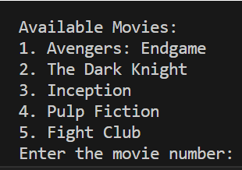
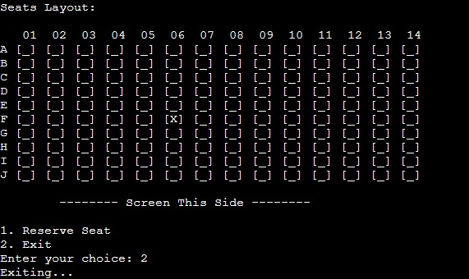
RESULTS:
User selects movie
Seat layout is displayed from which the user reserves the desired seat.

Slide 8
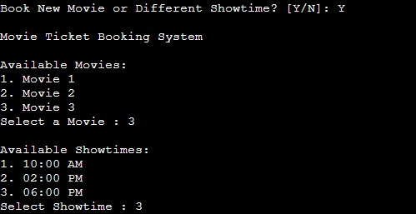

Same process is repeated.
The program is terminated with a thank you message.

Slide 9
CONCLUSION:
In conclusion, the development of the "Movie Ticket Booking System" using the C programming language has been a rewarding endeavour that underscores the significance of technology in simplifying and enhancing various aspects of our lives. Through this project, we have successfully demonstrated the feasibility and functionality of an efficient platform that facilitates the seamless booking of movie tickets.

Slide 10
REFERENCES:
Programming in ANSI C (Eight edition) by E. Balaguruswamy
Programming in C by Reema Thareja
Class notes given by Raghavendra C K
SOURCE CODE & PROJECTS
https://code-projects.org/c/languages/project/cprojects/
Interview Bit
https://www.interviewbit.com/blog/c-projects/

Slide 11
THANK YOU

