Slide 1
Flipkart Project
CSAT • Service Channels • Agent Performance • Response Time
EDA & Business Insights
Based on the submitted ML capstone notebook and its visual analysis
Submitted By: SANKETH S

Slide 2
Executive Summary
What the analysis says at a glance
Customer satisfaction
Channel concentration
Speed matters
CSAT 5 is the dominant rating, with 4 the next-largest group. The low-score segment remains an important improvement opportunity.
Inbound accounts for about 79.3% of interactions, making it the highest-impact channel for operational improvements.
The notebook reports a significant negative association between time difference and CSAT (rho ≈ -0.178).
People & shifts
Tenure effect
Data quality
CSAT varies by shift and manager, while staffing is concentrated in Morning and Evening shifts.
CSAT improves through the 61–90 tenure bucket, while the training group is the lowest in the displayed trend.
The dataset has 85,907 rows and 19 columns with no duplicate rows, but several fields contain substantial missingness.
Flipkart Project • Customer Support Analytics

Slide 3
Dataset & Data Quality
Structure observed in the notebook
Rows
Columns
Duplicate rows
Channels
85,907
19
0
3
Categories
Sub-categories
Managers
Tenure buckets
12
57
6
5
Missing-value hotspots
Pre-processing visible in notebook
Order_id: 18,232 missing
order_date_time: 68,693 missing
Product_category: 68,711 missing
Customer Remarks were filled with “No Remarks”; Item_price missing values were filled with the median; Customer_City and connected_handling_time were dropped; response_time was engineered.
Flipkart Project • Customer Support Analytics

Slide 4
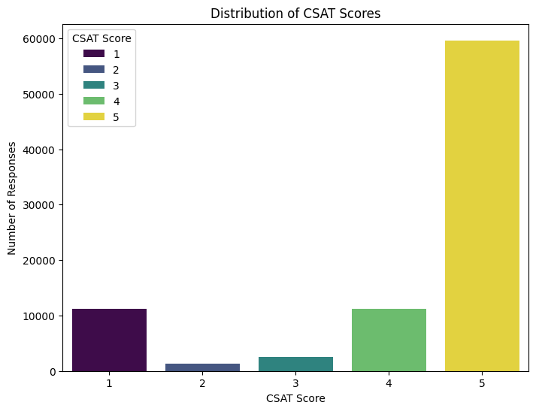
CSAT Score Distribution
Why this chart?
A count plot is appropriate for showing the frequency of each discrete CSAT rating.
Key insight
CSAT 5 is the dominant rating, followed by 4. Lower ratings are much less frequent, but the visible 1-score group is large enough to warrant attention.
Business impact
Protect the strong satisfaction base while investigating the drivers of low scores. Reducing the 1-score segment can improve overall service quality.
Flipkart Project • Customer Support Analytics

Slide 5
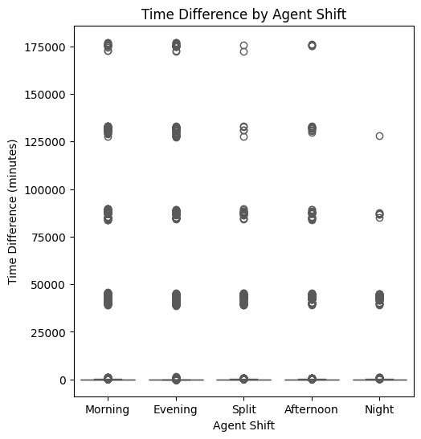
Response/Time Difference by Agent Shift
Why this chart?
A box plot compares the distribution and spread of response/time differences across shifts.
Key insight
All shifts show extreme high-value outliers, indicating occasional very long delays or possible data-quality anomalies.
Business impact
Shift-level monitoring and validation of extreme delay records can help identify operational bottlenecks and improve response consistency.
Flipkart Project • Customer Support Analytics

Slide 6
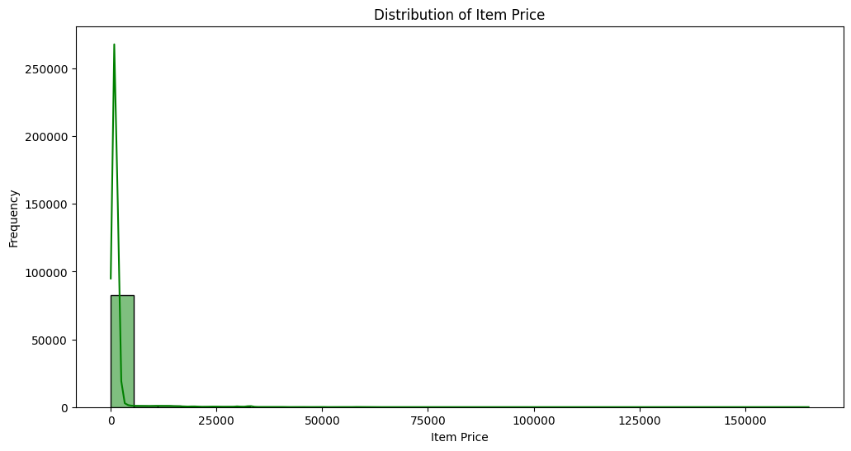
Item Price Distribution
Why this chart?
A histogram shows how item prices are distributed and whether the variable is concentrated or skewed.
Key insight
Item prices are heavily concentrated at lower values with a long right tail, showing a small number of much higher-priced observations.
Business impact
Segmenting service cases by order value may help prioritize high-value customers without ignoring the larger volume of lower-value interactions.
Flipkart Project • Customer Support Analytics

Slide 7
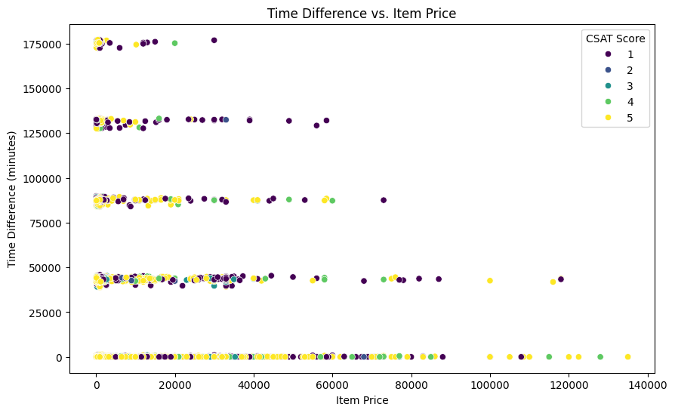
Time Difference vs. Item Price
Why this chart?
A scatter plot tests whether service delay varies systematically with item price, with CSAT shown as an additional dimension.
Key insight
The points are widely dispersed across item prices, so there is no strong visual evidence that item price alone explains time difference.
Business impact
Operational response time should not be optimized only around order value; staffing, workflow and case complexity should also be considered.
Flipkart Project • Customer Support Analytics

Slide 8
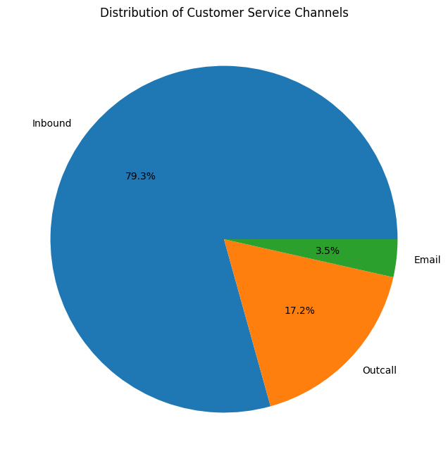
Customer Service Channel Mix
Why this chart?
A pie chart is useful for showing the share of interactions handled through each channel.
Key insight
Inbound represents about 79.3% of interactions, Outcall about 17.2%, and Email about 3.5%.
Business impact
Inbound is the primary service channel, so improvements to inbound handling can have the largest operational impact.
Flipkart Project • Customer Support Analytics

Slide 9
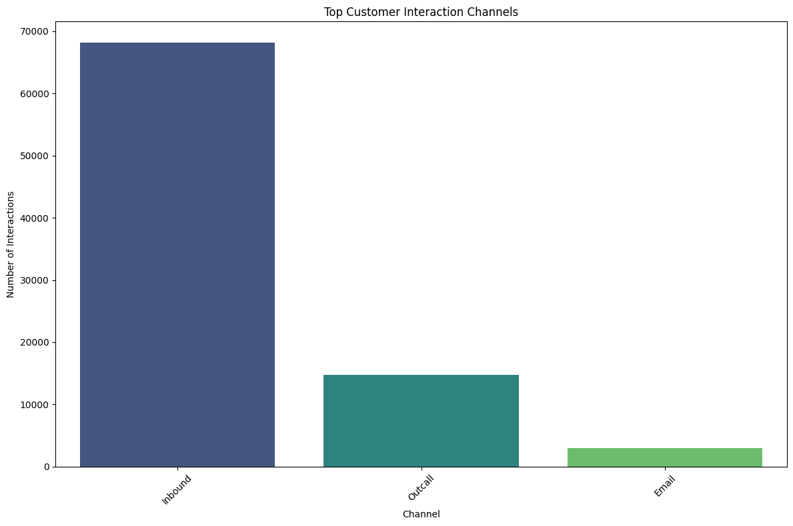
Top Customer Interaction Channels
Why this chart?
A bar chart makes it easy to compare the volume handled by each channel.
Key insight
Inbound has by far the highest interaction volume, followed by Outcall and then Email.
Business impact
Resource allocation should reflect actual channel demand, especially the much larger inbound workload.
Flipkart Project • Customer Support Analytics

Slide 10
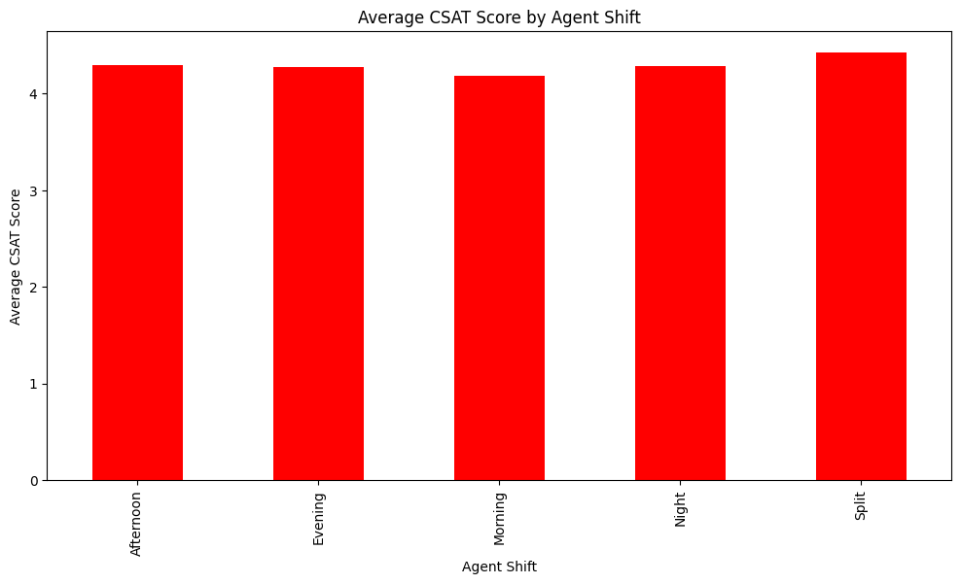
Average CSAT by Agent Shift
Why this chart?
A bar chart compares average customer satisfaction across operational shifts.
Key insight
Average CSAT is relatively close across shifts, with the Split shift appearing lower and Night/Morning among the stronger groups.
Business impact
The relatively small gap suggests that broad shift-based changes should be targeted carefully; focus on the lower-performing shift rather than applying the same intervention everywhere.
Flipkart Project • Customer Support Analytics

Slide 11
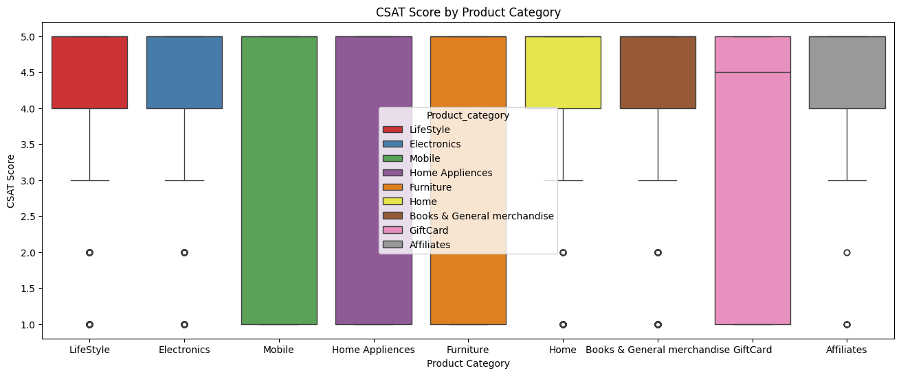
CSAT by Product Category
Why this chart?
Box plots compare CSAT distributions across product categories and highlight medians, spread and outliers.
Key insight
Customer satisfaction differs across product categories, with some categories showing wider variation and more low-score observations.
Business impact
Category-specific issue handling and targeted process improvements can address inconsistent customer experiences.
Flipkart Project • Customer Support Analytics

Slide 12
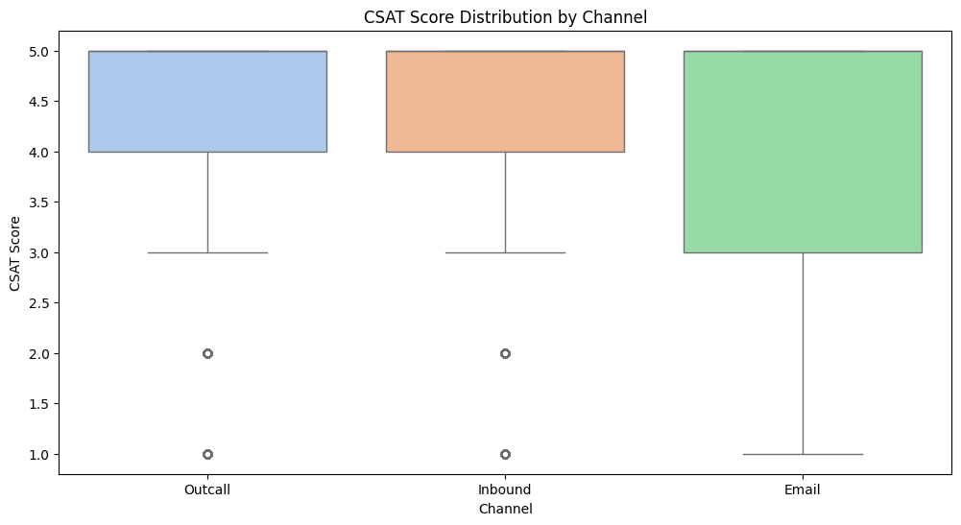
CSAT Distribution by Channel
Why this chart?
A box plot compares the distribution of CSAT scores for each support channel.
Key insight
Inbound and Email show high central CSAT levels, while Outcall has a lower central level and visible low-score observations.
Business impact
Channel-specific service standards and coaching can improve the weaker channel without disrupting stronger channels.
Flipkart Project • Customer Support Analytics

Slide 13
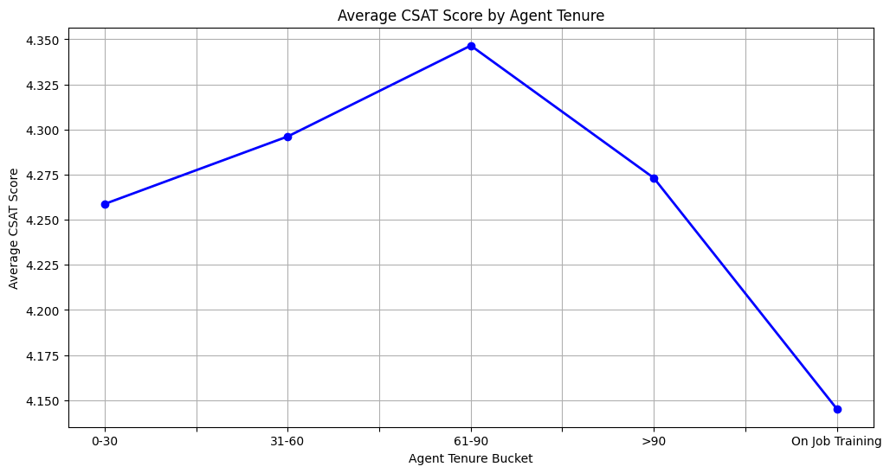
Average CSAT by Agent Tenure
Why this chart?
A line chart shows how average CSAT changes across ordered tenure buckets.
Key insight
Average CSAT rises from early tenure to the 61–90 bucket, then falls for the 90+ bucket; the 'On Job Training' group is lowest.
Business impact
Structured onboarding and targeted coaching for new/training agents can help lift satisfaction, while experienced-agent practices can be reviewed for consistency.
Flipkart Project • Customer Support Analytics

Slide 14
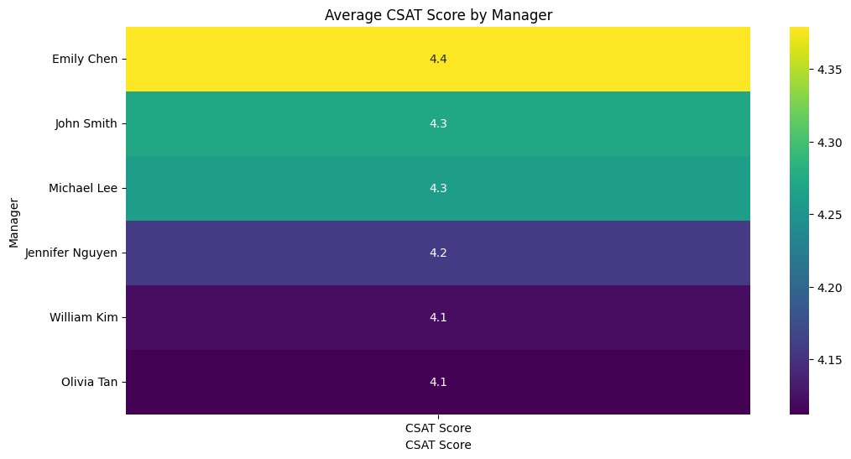
Average CSAT by Manager
Why this chart?
A heatmap provides a compact comparison of average CSAT across managers.
Key insight
Manager-level averages range roughly from 4.1 to 4.4, with Emily Chen highest in the displayed analysis and William Kim/Olivia Tan among the lower values.
Business impact
Manager-level benchmarking can identify practices worth sharing and teams that may benefit from additional coaching or process support.
Flipkart Project • Customer Support Analytics

Slide 15
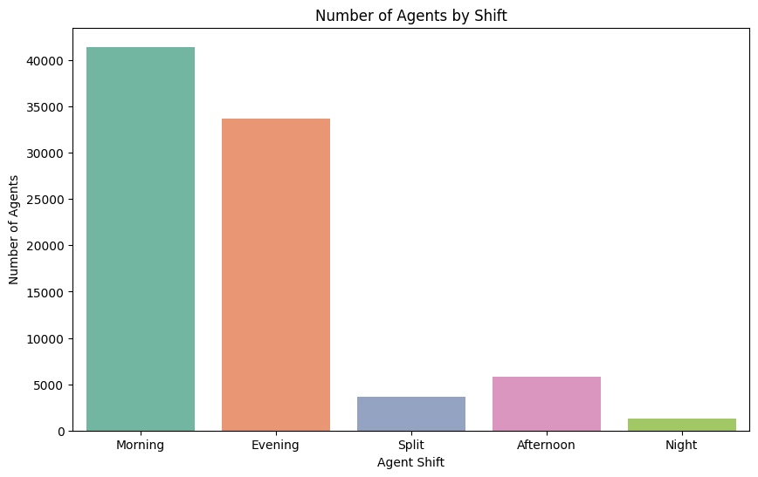
Number of Agents by Shift
Why this chart?
A count plot compares staffing volume across shifts.
Key insight
Morning has the largest agent count, followed by Evening. Afternoon, Split and Night have much smaller staffing levels.
Business impact
Staffing should be checked against the interaction-volume profile so that capacity is aligned with demand and peak periods.
Flipkart Project • Customer Support Analytics

Slide 16
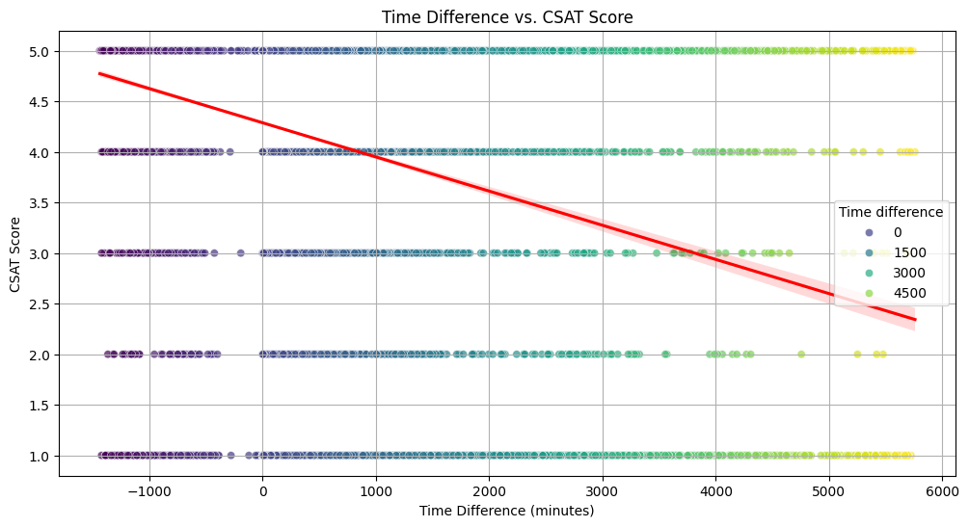
Time Difference vs. CSAT Score
Why this chart?
A scatter plot with a trend line tests the relationship between service delay and customer satisfaction.
Key insight
The fitted trend slopes downward, indicating that longer time differences are associated with lower CSAT. The notebook's Spearman test also reports rho = -0.1776 with p < 0.001.
Business impact
Reducing avoidable response delays is a clear improvement opportunity because faster resolution is associated with better customer satisfaction.
Flipkart Project • Customer Support Analytics

Slide 17
Hypothesis Testing
Statistical checks included in the notebook
Time difference ↔ CSAT
Spearman rho = -0.1776; p = 0.0 in notebook output
Significant negative relationship.
Agent shift ↔ CSAT
Kruskal–Wallis H = 151.58; p = 9.34×10⁻³²
Significant difference among shifts.
Item price ↔ CSAT
Spearman rho = -0.03395; p = 2.46×10⁻²³
Statistically significant but very weak negative association.
Flipkart Project • Customer Support Analytics

Slide 18
Business Recommendations
Actions directly supported by the observed patterns
• Prioritize response-time reduction: the notebook shows a significant negative relationship between delay and CSAT.
• Strengthen inbound support operations because inbound represents the overwhelming majority of interactions.
• Review low-CSAT cases by channel, product category, shift and manager rather than relying only on overall averages.
• Use structured onboarding and coaching for agents in training / early tenure, while sharing practices from stronger tenure groups.
• Benchmark manager-level performance to identify teams with repeatable service practices and teams needing support.
• Validate extreme time-difference records before using them for operational KPIs or automated decisions.
Flipkart Project • Customer Support Analytics

Slide 19
Submission Note
Important scope point from the supplied notebook
EDA is populated
ML section is still templated
The supplied notebook contains the dataset exploration, data preparation, 13 required visual analyses, and three hypothesis tests used in this deck.
The Model 1/2/3 sections in the supplied notebook contain placeholder implementation/evaluation cells rather than completed model results. No ML accuracy or final-model claim has been invented here.
Best practice
Before final submission, ensure the notebook's ML section is either completed or intentionally marked as not applicable, depending on your assignment requirement. This deck intentionally stays faithful to the provided source.
Flipkart Project • Customer Support Analytics

Slide 20
Conclusion
The analysis shows a generally strong customer-satisfaction profile, but the business still has clear opportunities to reduce low-score experiences. Inbound interactions dominate demand, response delay is negatively associated with CSAT, and performance varies across shifts, tenure groups, channels and managers. The strongest improvement path is therefore operational: reduce avoidable delays, align staffing with demand, target weaker teams and channels, and use low-CSAT cases for focused root-cause analysis.
Overall objective: improve service consistency while protecting the existing high-CSAT base.
Flipkart Project • Customer Support Analytics

