Slide 1
STRAVA FITNESS DATA ANALYTICS
EDA Case Study | Python • Pandas • Matplotlib • Seaborn
Executive focus
Understand activity behaviour, improve engagement, and identify opportunities to encourage premium adoption.
Submitted By : SANKETH S

Slide 2
1. Business Objective
What the analysis is designed to answer
• Identify activity trends that can attract new users and increase app usage.
• Understand behaviour patterns that can support subscription and premium conversion.
• Study activity, distance, steps and calorie relationships to improve user engagement.
• Use customer activity patterns to inform campaigns, challenges and rewards.
Data scope
The notebook combines daily activity, calories, intensities, steps, sleep and weight-related datasets before EDA.
Analysis approach
Data preparation → exploratory analysis → visual storytelling → business recommendations.
2

Slide 3
2. Data Preparation & Quality
A consolidated activity dataset was prepared for analysis
• Multiple Strava datasets were merged using date-based matching.
• The notebook reports 1,004 rows and 39 columns after consolidation.
• Duplicate records were checked and duplicate IDs were removed.
• Missing values were handled to make the dataset analysis-ready.
• The notebook notes that replacing missing BMI, weight and sleep values with 0 can introduce unrealistic values; this is a data-quality limitation.
Key quality note
Missing-value treatment should be revisited before production use; 'Missing' is more appropriate for categorical fields.
Why it matters
Cleaner and more consistent activity records improve the reliability of engagement insights and future personalization.
3

Slide 4
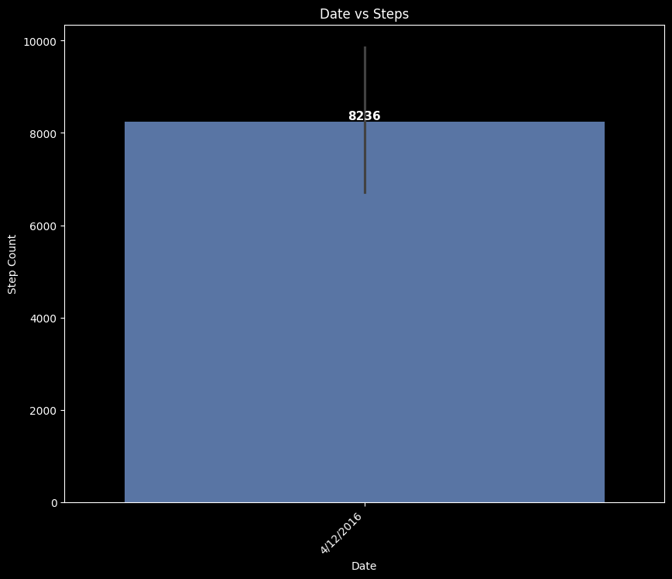
3. Activity Trend: Daily Steps
Daily activity varies across the observation period
Insight
The notebook highlights an example daily total of 8,236 steps and indicates that users show recurring walking/activity behaviour.
Business implication
Use step-based challenges, streaks and milestone notifications to reinforce consistent activity.
4

Slide 5
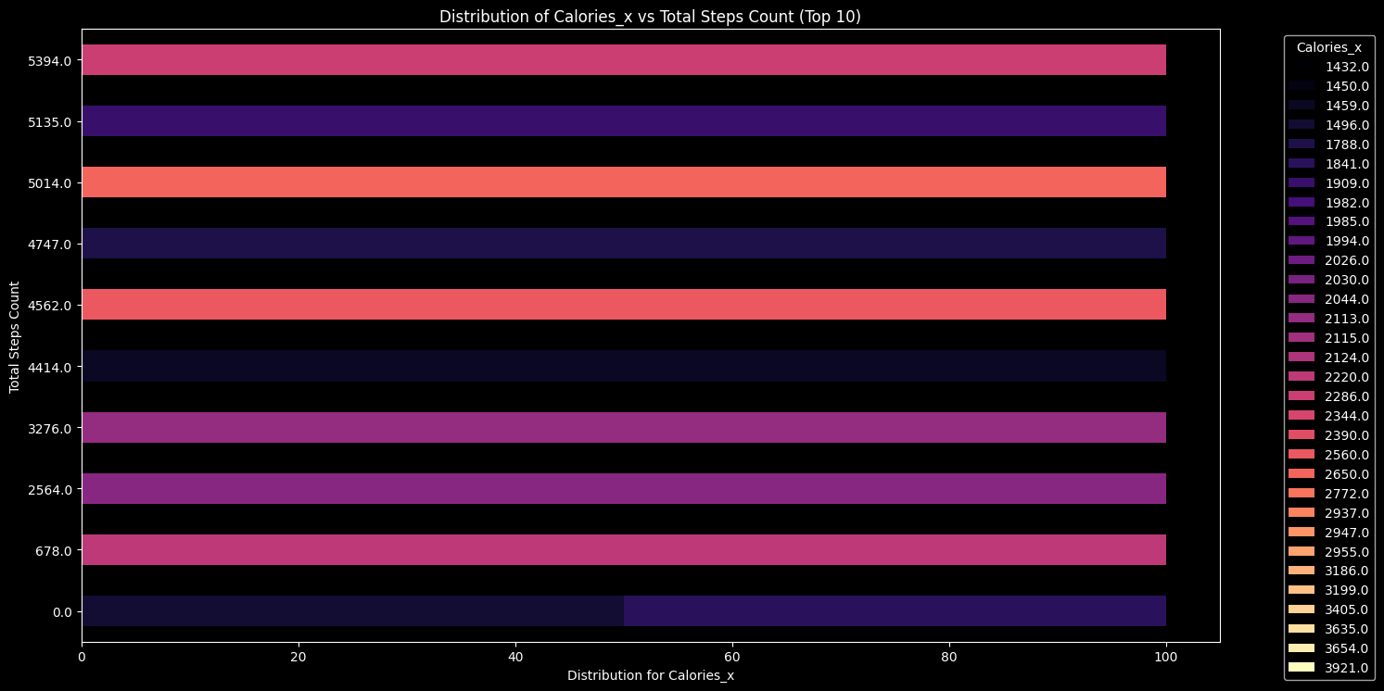
4. Steps & Calories: A Useful Engagement Signal
Higher activity is generally associated with greater calorie expenditure
Insight
The EDA states that calorie expenditure varies across step counts, with higher activity levels generally associated with more calories burned.
Product opportunity
Create personalized step and calorie targets, then connect milestone completion to rewards or premium benefits.
5

Slide 6
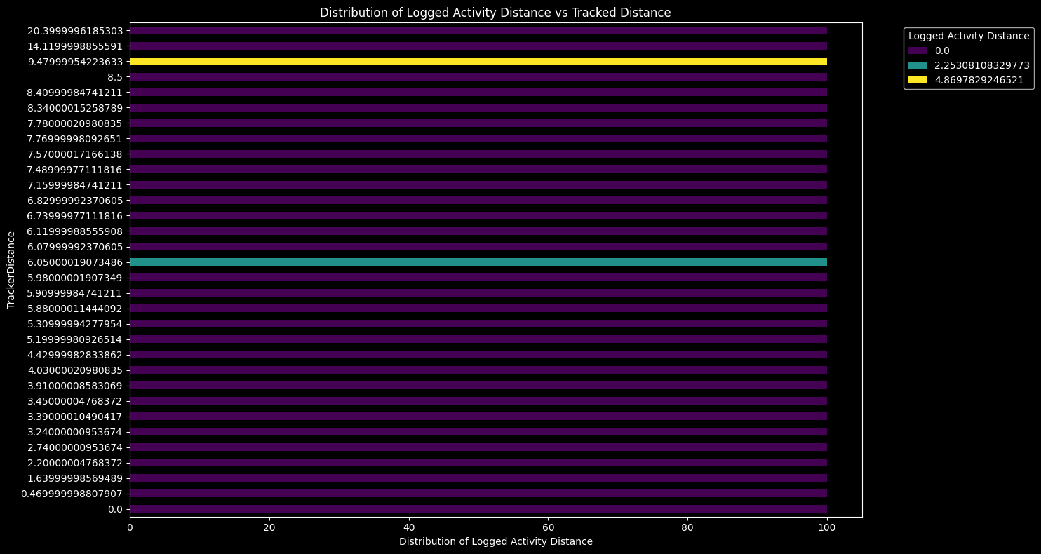
5. Activity Tracking Behaviour
Tracked distance and logged activity do not always align
Insight
The notebook identifies variation between tracked distance and logged activity, suggesting differences in how consistently users record activities.
Business implication
Improve logging prompts and make activity capture frictionless so users build a more complete fitness history.
6

Slide 7
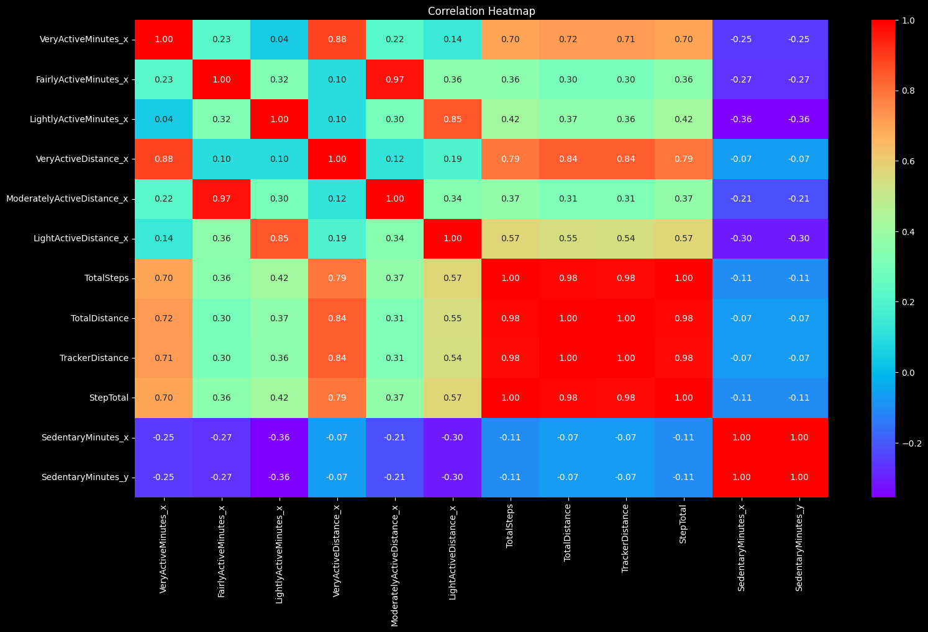
6. Correlation Analysis
Activity metrics move together in meaningful ways
Key relationship
The notebook specifically notes a strong positive relationship between steps and distance: more steps generally correspond to greater distance.
Why it matters
These relationships can support smarter goal setting, progress tracking and personalized nudges.
7

Slide 8
7. Business Recommendations
Turn the EDA into engagement and subscription actions
• Encourage users to track and log daily distance alongside steps for more complete activity records.
• Run fitness campaigns, challenges, webinars and reward programmes to increase participation.
• Use achievement-based offers or discounts to connect fitness milestones with premium membership.
• Use highly active dates and recurring activity patterns to design targeted challenges and rewards.
• Improve activity logging consistency to strengthen the quality of future personalization.
Expected impact
Higher engagement • stronger retention • better activity data • more opportunities for premium conversion
8

Slide 9
8. Executive Takeaways
The analysis points to a simple growth loop
1 — Engage
Use challenges, streaks and milestones to keep users active.
2 — Personalize
Use steps, distance and calorie relationships to tailor goals and nudges.
3 — Convert
Link fitness achievements with premium benefits to encourage subscription.
• The core opportunity is not simply collecting more activity data — it is turning activity behaviour into repeat engagement.
• The supplied EDA supports a strategy centred on consistent tracking, motivation and reward-led premium conversion.
• Data-quality improvements should accompany these initiatives so future decisions are based on more reliable records.
9

Slide 10
References & Submission Context
• Primary analysis source: supplied Strava_EDA.ipynb.
• Case-study framing and submission requirements: supplied STRAVA FITNESS APP.pptx.
• The notebook includes the EDA workflow, chart outputs, business objectives, recommendations and conclusion.
• This presentation intentionally uses a focused set of the notebook's charts rather than reproducing every visualization.
10

