Slide 1
UBER SUPPLY DEMAND GAP
Data Analytics / Business Analytics — EDA
Exploratory analysis of demand, trip outcomes, pickup locations and service availability
Sanketh S | Individual Project

Slide 2
Business Objective
Identify demand patterns and unsuccessful trip outcomes so that vehicle supply, driver allocation and operational planning can be improved where customers are most affected.
Focus areas
• Demand concentration by pickup point
• Completed vs cancelled vs no-car requests
• Location-specific operational gaps
• Time-based demand patterns
• Practical actions to improve successful-trip conversion
2

Slide 3
Dataset Snapshot
Columns
Request ID
Pickup point
Driver ID
Status
Request timestamp
Drop timestamp
Data preparation
Missing Driver ID and Drop timestamp values were handled as “Not Available” in the analysis.
6,745 records
6 columns
No duplicate records
3

Slide 4
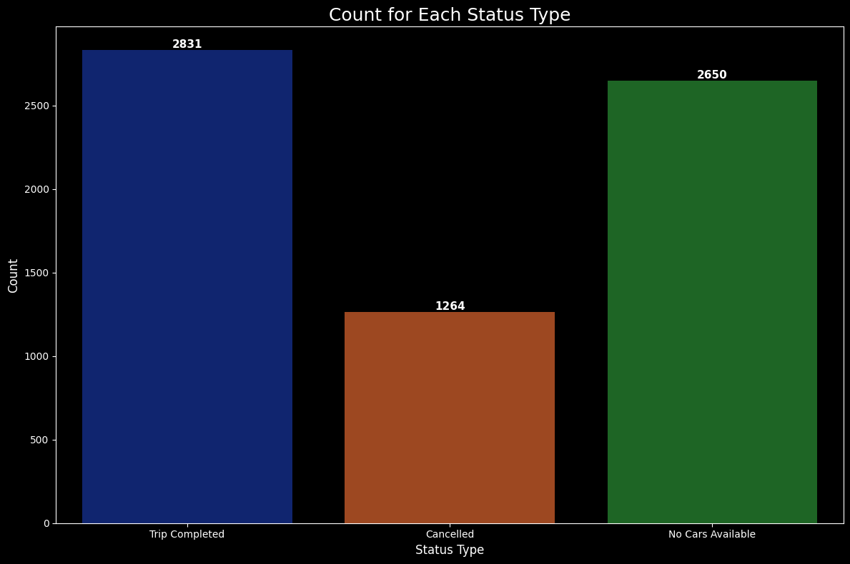
Overall Trip Status
Actual chart output from the submitted Jupyter notebook
INSIGHT
2,831 completed, 1,264 cancelled and 2,650 no-car requests. A large share of demand does not become a completed trip.
ACTION
Reduce cancellation and vehicle-unavailability cases.
4

Slide 5
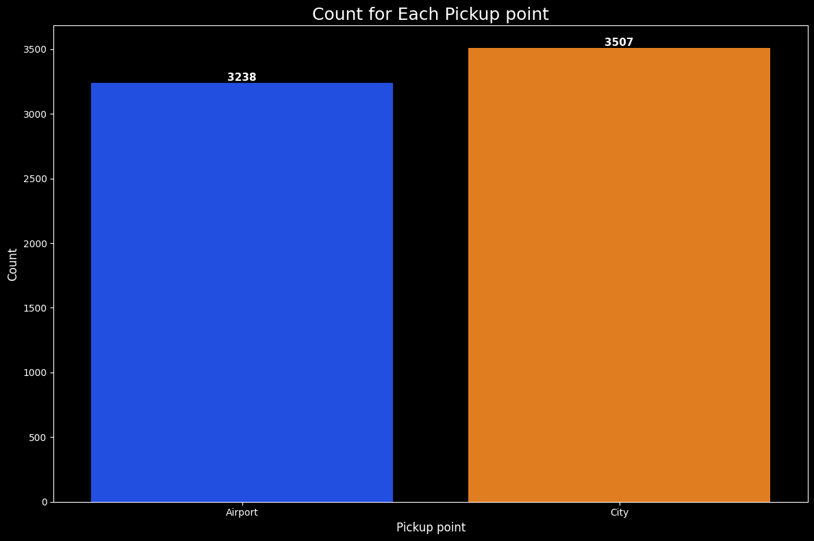
Pickup Point Demand
Where requests are concentrated
INSIGHT
City has 3,507 requests versus 3,238 at Airport, so demand is high at both locations.
ACTION
Use pickup demand to guide driver positioning.
5

Slide 6
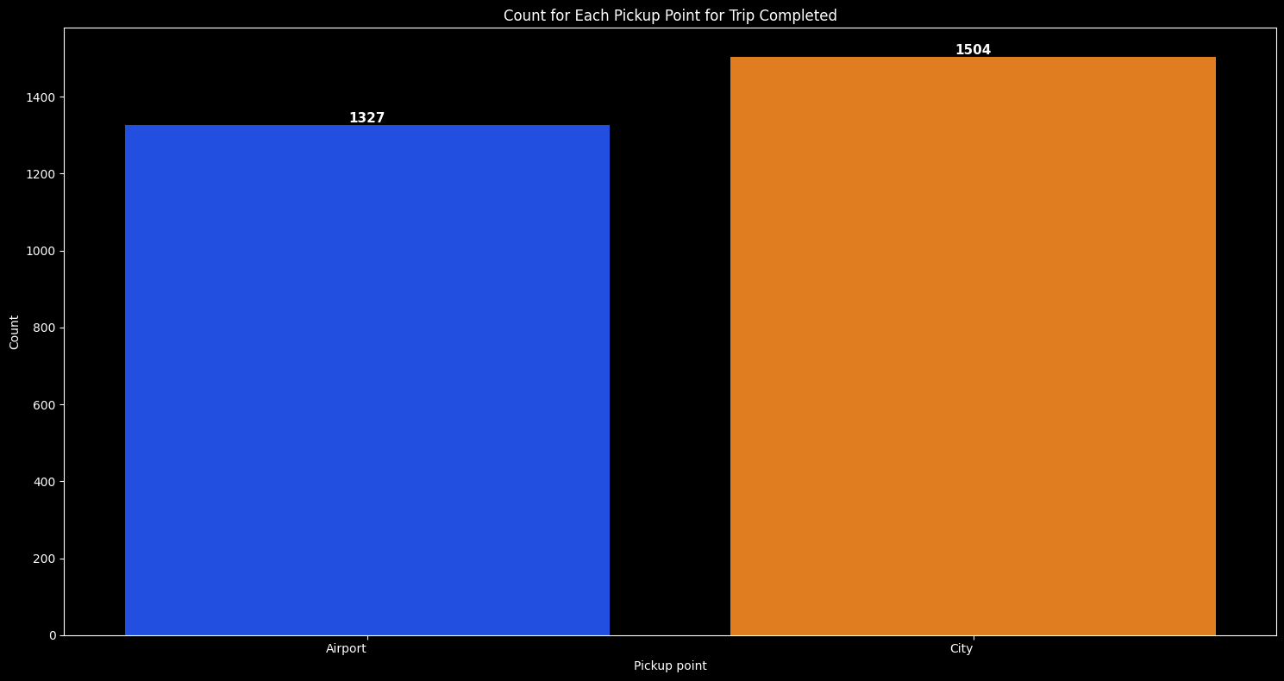
Successful Trip Completion
Completed trips by pickup point
INSIGHT
City records 1,504 completed trips compared with 1,327 at Airport.
ACTION
Compare completion with unsuccessful outcomes by location.
6

Slide 7
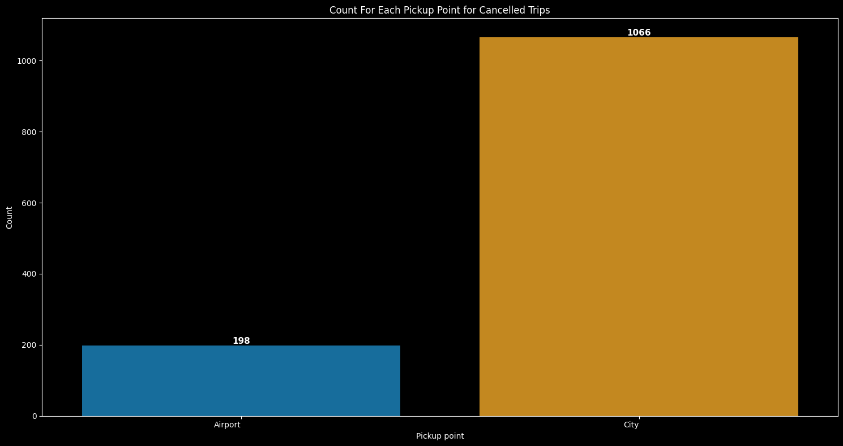
Cancellation Pattern
Where requests are lost after booking
INSIGHT
Airport has 1,066 cancellations versus 198 in City, making cancellation a major Airport issue.
ACTION
Investigate waiting time, driver assignment and availability around Airport requests.
7

Slide 8
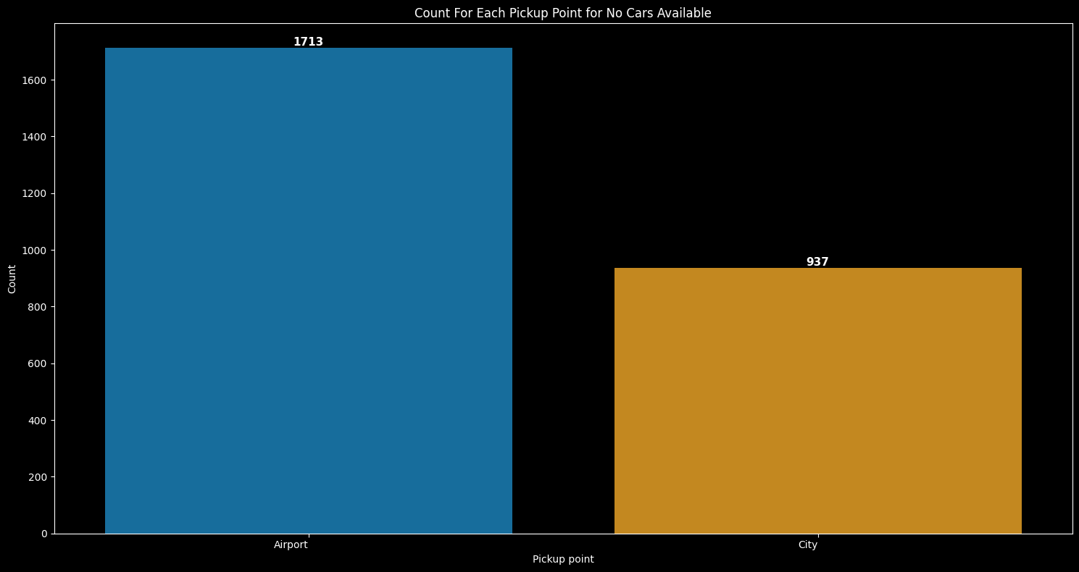
Vehicle Availability Gap
Requests that could not obtain a vehicle
INSIGHT
City has 1,804 no-car cases versus 846 at Airport, indicating a stronger supply shortage in City.
ACTION
Reposition or increase supply during high-demand City periods.
8

Slide 9
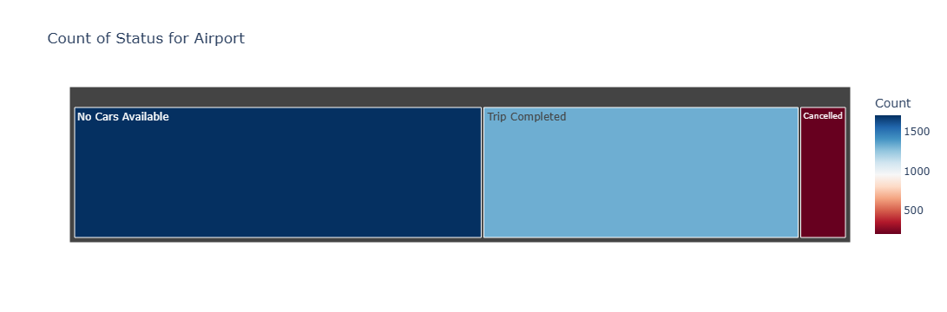
Location-Specific Status
Airport and City show different operational patterns
Airport
City
The same supply strategy should not automatically be applied to both pickup points.
9

Slide 10
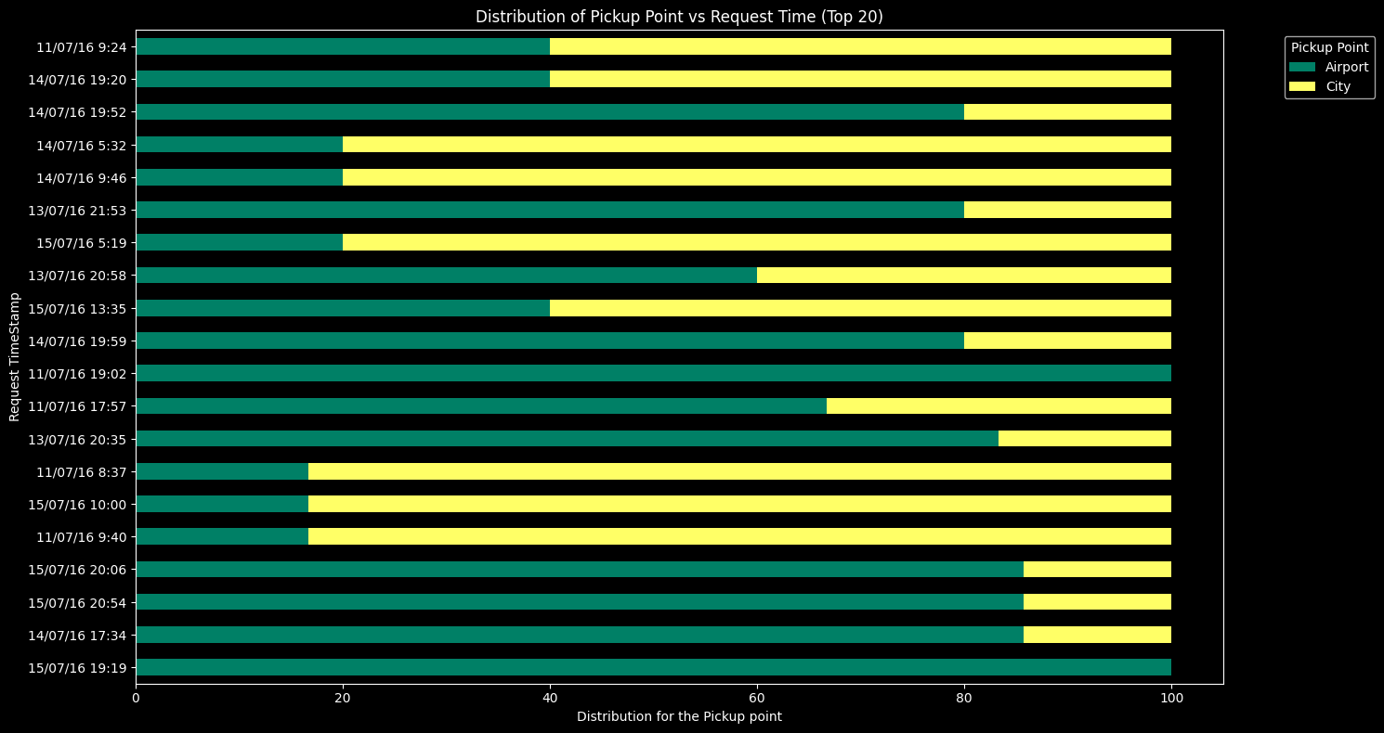
Time-Based Demand View
Pickup-point mix across request timestamps
INSIGHT
Request activity varies over time and the Airport/City mix is not identical at every timestamp.
ACTION
Use time patterns for shift planning and targeted driver incentives.
10

Slide 11
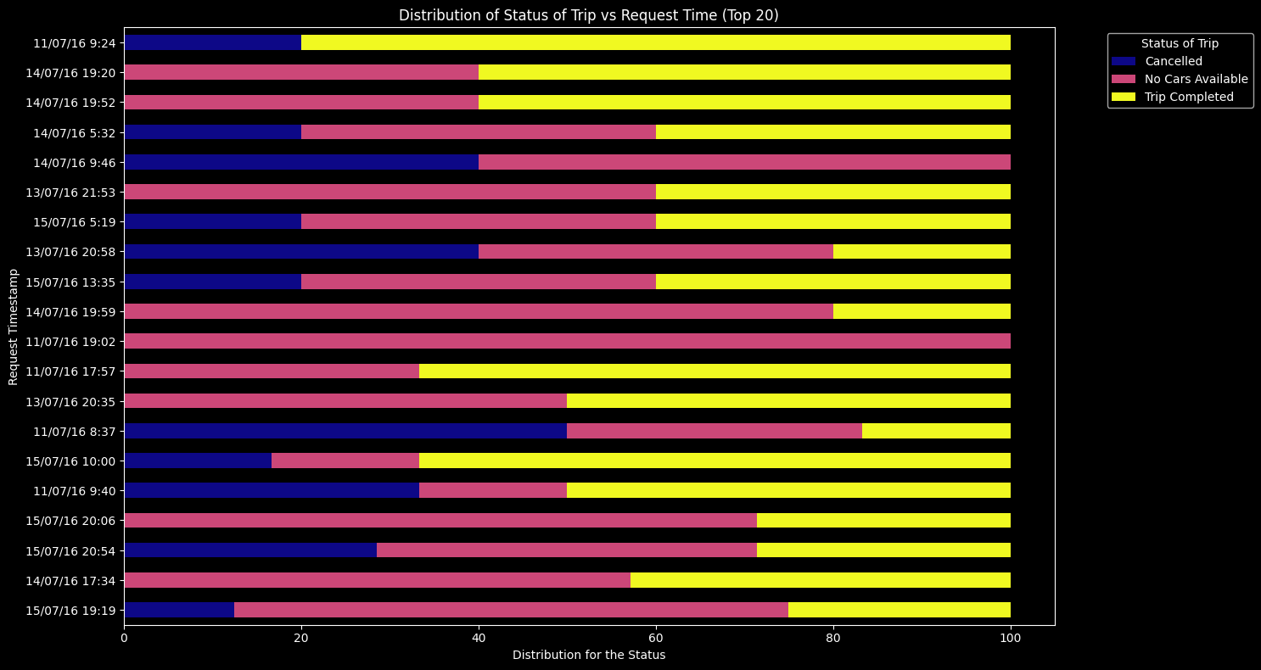
Status Distribution by Request Time
Where unsuccessful outcomes appear across timestamps
INSIGHT
Status composition changes across request timestamps, making time a useful operational planning dimension.
ACTION
Combine time and status to target periods with the highest service gap.
11

Slide 12
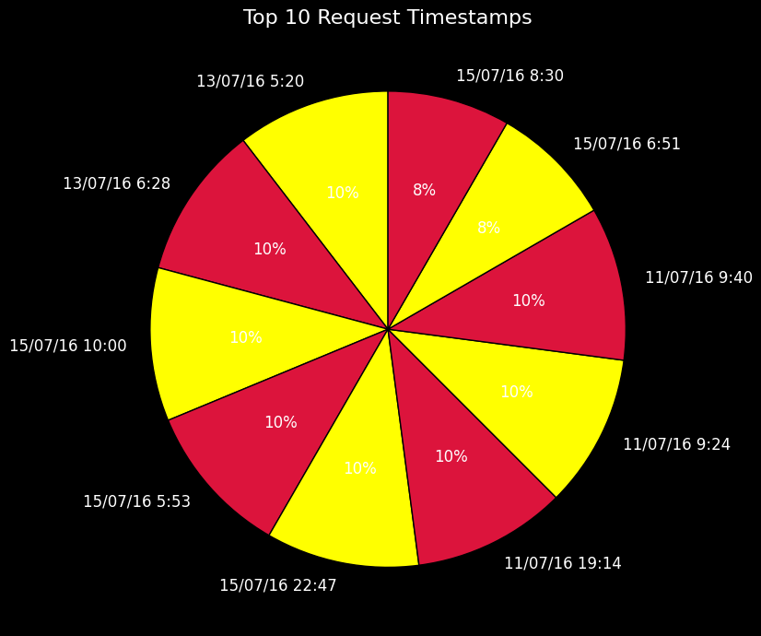
Peak Request Timestamps
Top request timestamps identified in the notebook
INSIGHT
Demand is concentrated among a limited set of timestamps rather than being evenly distributed.
ACTION
Prepare supply before expected peaks instead of reacting after shortages occur.
12

Slide 13
Recommended Business Actions
1. Balance supply with demand — position vehicles using pickup-point and time-based request patterns.
2. Reduce vehicle-unavailability — prioritize locations and periods with large no-car counts.
3. Investigate cancellations — especially the unusually high Airport cancellation volume.
4. Plan by location — City and Airport need different operational strategies.
5. Prepare for peaks — use request-time patterns to schedule drivers before demand rises.
6. Measure improvement — track completed, cancelled and no-car counts after interventions.
14

Slide 14
Conclusion
The EDA shows that Uber's request outcomes are strongly connected to service availability and location-specific operating conditions.
City has slightly higher overall demand and a larger no-car problem, while Airport has a much higher cancellation count.
The clearest business opportunities are to improve vehicle availability, reduce cancellations and use time-based demand patterns for proactive driver allocation.
Key message: plan supply based on BOTH where and when customers request rides.
15

