Slide 1
Testing

Slide 2
Software Testing
Software Testing is a method to check whether the actual software product matches expected requirements and to ensure that software product is Defect free.
It involves execution of software/system components using manual or automated tools to evaluate one or more properties of interest.
The purpose of software testing is to identify errors, gaps or missing requirements in contrast to actual requirements.

Slide 3
Benefits Of Software Testing
Cost-Effective: It is one of the important advantages of software testing.
Testing any IT project on time helps you to save your money for the long term.
In case if the bugs caught in the earlier stage of software testing, it costs less to fix.
Security: It is the most vulnerable and sensitive benefit of software testing.
People are looking for trusted products.
It helps in removing risks and problems earlier.
Product quality: It is an essential requirement of any software product.
Testing ensures a quality product is delivered to customers.
Customer Satisfaction: The main aim of any product is to give satisfaction to their customers.
UI/UX Testing ensures the best user experience.

Slide 4
Types of software testing
Software Testing Type is a classification of different testing activities into categories, each having, a defined test objective, test strategy, and test deliverables.
The goal of having a testing type is to validate the Application Under Test(AUT) for the defined Test Objective.
Nearly about 150 testing types are present.
Agile Testing: Software testing practice that follows the principles of the agile manifesto, emphasizing testing from the perspective of customers who will utilize the system.
It is usually performed by the QA teams.
Automated Testing: Testing technique that uses Automation Testing tools to control the environment set-up, test execution and results reporting.
It is performed by a computer and is used inside the testing teams.

Slide 5
Benefits of Automated Testing
70% faster than the manual testing
Wider test coverage of application features
Reliable in results
Ensure Consistency
Saves Time and Cost
Improves accuracy
Human Intervention is not required while execution
Increases Efficiency
Better speed in executing tests
Re-usable test scripts
Test Frequently and thoroughly
More cycle of execution can be achieved through automation
Early time to market

Slide 6
Types of Automated Testing
Smoke Testing
Unit Testing
Integration Testing
Functional Testing
Keyword Testing
Regression Testing
Data Driven Testing
Black Box Testing

Slide 7
Fundamentals of Unit Testing
UNIT TESTING is a type of software testing where individual units or components of a software are tested.
The purpose is to validate that each unit of the software code performs as expected.
Unit Testing is done during the development (coding phase) of an application by the developers.
Unit Tests isolate a section of code and verify its correctness.
A unit may be an individual function, method, procedure, module, or object.

Slide 8
Unit Testing Tools
NUnit: is widely used unit-testing framework use for all .net languages.
It is an open source tool which allows writing scripts manually.
It supports data-driven tests which can run in parallel.
2. xUnit.net : is a free, open source, community-focused unit testing tool for the .NET Framework.
Written by the original inventor of NUnit v2, xUnit.net is the latest technology for unit testing C#, F#, VB.NET and other .NET languages.
xUnit.net works with ReSharper, CodeRush, TestDriven.NET and Xamarin.
It is part of the .NET Foundation, and operates under their code of conduct.
It is licensed under Apache 2 (an OSI approved license).

Slide 9
Unit Testing Tools
MSTest is one type of framework that provides the facility to test the code without using any third-party tool.
It helps in writing effective unit tests using MSTest framework to test software applications.
MSTest is a number-one open-source test framework that is shipped along with the Visual Studio IDE.
It is also referred to as the Unit Testing Framework.
However, MSTest is the same within the developer community.

Slide 10
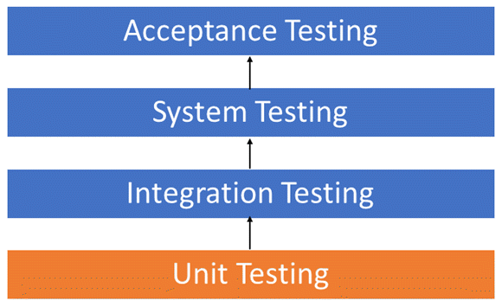
Unit Testing

Slide 11
Unit Testing
Unit testing breaks the program down into the smallest bit of code, usually function-level, and ensures that the function returns the value one expects.
By using a unit testing framework, the unit tests become a separate entity which can then run automated tests on the program as it is being built.
The purpose of unit testing is to isolate individual parts of the program and show that individually these parts are functional.
This type of testing is usually done by programmers.

Slide 12
Unit Tests
To create unit tests, small sections of code are selected that need to be tested.
The test site should generally be less than class.
In most cases, a single class method or even part of the functions of a method is tested.
When testing, it is important to isolate the code under test from the rest of the program with which it interacts, so that you can clearly identify the possibility of errors in this isolated code.
The creation of unit tests for small sections of code leads to the fact that the number of these unit tests becomes very large.
If the process of obtaining results and conducting tests is not automated, this can lead to a waste of working time and lower productivity.
Therefore, it is important that the results of unit tests be a simple solution; either the test is passed or not.

Slide 13
Structural Technique
Another type of software testing technique is Structural testing, which is used to test the internal design of the software or structure of the coding for the particular software.
In this testing, the development team members are included in the testing team to execute the software's internal design.
The working of structural testing is opposite to Behavioral testing.
In other words, we can say that structural testing tests the different features of an application based on its types.
Structural testing is also known as white-box testing, glass box testing, and clear-box testing.
Developers mostly implement it to identify the issue and fix them quickly.

Slide 14
Structural Technique
The structural testing process requires an in-depth knowledge of the programming language and is opposite to Functional Testing.
The knowledge of the code's internal executions and how the software is implemented is a necessity for the test engineer to implement the structural testing.
Throughout the structural testing, the test engineer intends on how the software performs, and it can be used at all levels of testing.

Slide 15
Functional Testing
It is a type of software testing which is used to verify the functionality of the software application, whether the function is working according to the requirement specification.
In functional testing, each function tested by giving the value, determining the output, and verifying the actual output with the expected value.
Functional testing performed as black-box testing which is presented to confirm that the functionality of an application or system behaves as we are expecting.
It is done to verify the functionality of the application.
Functional testing also called as black-box testing, because it focuses on application specification rather than actual code.
Tester has to test only the program rather than the system.

Slide 16
Error Based Techniques
Error guessing is a technique in which there is no specific method for identifying the error.
It is based on the experience of the test analyst, where the tester uses the experience to guess the problematic areas of the software.
It is a type of black box testing technique which does not have any defined structure to find the error.
In this approach, every test engineer will derive the values or inputs based on their understanding or assumption of the requirements, and we do not follow any kind of rules to perform error guessing technique.
The accomplishment of the error guessing technique is dependent on the ability and product knowledge of the tester because a good test engineer knows where the bugs are most likely to be, which helps to save lots of time.

Slide 17
Mocking Frameworks
Mocking Frameworks (Moq, NSubstitute, Rhino Mocks, FakeItEasy, and NMock3) are used to create fake objects.
We can stub, i.e., completely replace the body of member and function.
It is used to isolate each dependency and help developers in performing unit testing in a concise, quick, and reliable way.
Creating mock objects manually is very difficult and time-consuming.
So, to increase your productivity, you can go for the automatic generation of mock objects by using a Mocking Framework.
A developer can build his/her unit test by using any of the NUnit, MbUnit, MSTest, xUnit etc. unit test frameworks.

Slide 18
SOLID principles
SOLID principles are the design principles that enable us to manage most of the software design problems.
Robert C. Martin compiled these principles in the 1990s.
These principles provide us with ways to move from tightly coupled code and little encapsulation to the desired results of loosely coupled and encapsulated real needs of a business properly.

Slide 19
SOLID principles
SOLID is an acronym of the following.
S: Single Responsibility Principle (SRP)
O: Open closed Principle (OCP)
L: Liskov substitution Principle (LSP)
I: Interface Segregation Principle (ISP)
D: Dependency Inversion Principle (DIP)

Slide 20
Single Responsibility Principle
The Single Responsibility Principle states that “Each software module or class should have only one reason to change“.
In other words, we can say that each module or class should have only one responsibility to do.
That does not mean your class should contain only one method or property, you can have multiple members (methods or properties) as long as they are related to a single responsibility or functionality.
So, with the help of SRP, the classes become smaller and cleaner and thus easier to maintain.

Slide 21
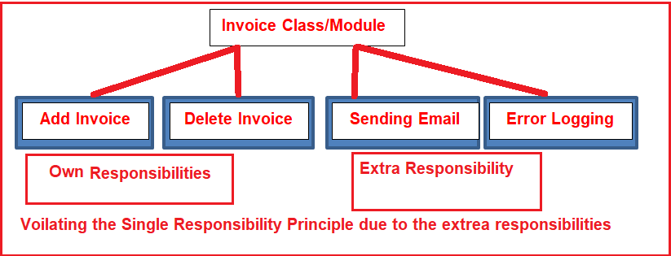
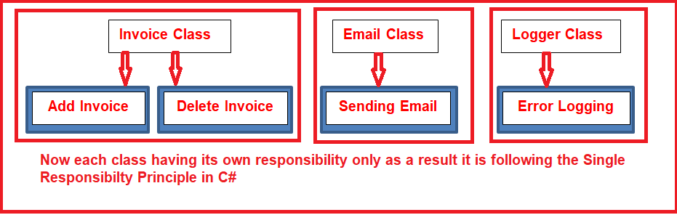
Single Responsibility Principle

Slide 22
Open-Closed Principle
The Open-Closed Principle states that “software entities such as modules, classes, functions, etc. should be open for extension, but closed for modification“.
The Open for extension means we need to design the software modules/classes in such a way that the new responsibilities or functionalities should be added easily when new requirements come.
On the other hand, Closed for modification means, we should not modify the class/module until we find some bugs.

Slide 23
Open-Closed Principle
The easiest way to implement the Open-Closed Principle in C# is to add the new functionalities by creating new derived classes which should be inherited from the original base class.
Another way is to allow the client to access the original class with an abstract interface.
So, at any given point of time when there is a change in requirement or any new requirement comes then instead of touching the existing functionality, it’s always better and suggested to create new derived classes and leave the original class implementation as it is.

Slide 24
Liskov Substitution Principle
The Liskov Substitution Principle is a Substitutability principle in object-oriented programming Language.
This principle states that, if S is a subtype of T, then objects of type T should be replaced with the objects of type S.
In other words, we can say that objects in an application should be replaceable with the instances of their subtypes without modifying the correctness of that application.
For example, a father is a teacher whereas his son is a doctor.
So here, in this case, the son can’t simply replace his father even though both belong to the same family.

Slide 25
Interface Segregation Principle
The Interface Segregation Principle states that “Clients should not be forced to implement any methods they don’t use.
Rather than one fat interface, numerous little interfaces are preferred based on groups of methods with each interface serving one submodule“.
First, no class should be forced to implement any method(s) of an interface they don’t use.
Secondly, instead of creating large or you can say fat interfaces, create multiple smaller interfaces with the aim that the clients should only think about the methods that are of interest to them.

Slide 26
Interface Segregation Principle
As per the Single Responsibility Principle of SOLID, like classes, interfaces also should have a single responsibility.
That means we shouldn’t force any class to implement any method(s) which they don’t require.

Slide 27
Dependency Inversion Principle
The Dependency Inversion Principle (DIP) states that high-level modules/classes should not depend on low-level modules/classes.
Both should depend upon abstractions.
Secondly, abstractions should not depend upon details. Details should depend upon abstractions.
The most important point that you need to remember while developing real-time applications, always to try to keep the High-level module and Low-level module as loosely coupled as possible.
When a class knows about the design and implementation of another class, it raises the risk that if we do any changes to one class will break the other class.

Slide 28
Dependency Inversion Principle
So we must keep these high-level and low-level modules/classes loosely coupled as much as possible.
To do that, we need to make both of them dependent on abstractions instead of knowing each other.

Slide 29
Advantages
Maintainability
Maintaining software is very important for organizations.
Day by day the business may grow for the organization and you may need to enhance the software with new changes.
So you need to design the software in such a way that it should accept future changes without any problem.
Testability
Test-Driven Development (TDD) is one of the most important key aspects nowadays when you need to design and develop a large-scale application.

Slide 30
Advantages
Flexibility and Extensibility
Nowadays flexibility and extensibility both are very much required for enterprise applications.
So we should design the application in such a way that it should be flexible so that it can be adapted to work in different ways and extensible so that we can add new features easily with minimum modifications.
Parallel Development:
The Parallel Development of an application is one of the most important key aspects.
As we know it is not possible to have the entire development team will work on the same module at the same time.
So we need to design the software in such a way that different teams can work on different modules.

Slide 31
Dependency Injection

Slide 32
Dependency Injection
Dependency Injection (DI) is a software pattern.
DI is a technique whereby one object supplies the dependencies of another object.
With the help of DI, we can write loosely coupled code.
A loosely-coupled code is a code where all your classes can work independently without relying on each other.

Slide 33
Types of DI
There are four types of DI in C#
Constructor Injection
Setter or property Injection
Method Injection
Service Locator Injection

Slide 34
Constructor injection
Constructor injection is nothing but the process of injecting dependent class object through the constructor.
public interface IAccount
{
void PrintData();
}
public class SavingAccount : IAccount
{
public void PrintData()
{
Console.WriteLine("Saving account data.");
}
}

Slide 35
Constructor injection
public class CurrentAccount : IAccount
{
public void PrintData()
{
Console.WriteLine("Current account data.");
}
}

Slide 36
Constructor injection
public void PrintAccounts()
{
account.PrintData();
}
}
public class Account
{
private IAccount account;
//Passing IAccount interface as parameter to Account constructor
public Account(IAccount account)
{
this.account = account;
}

Slide 37
Constructor injection
class Program
{
static void Main()
{
//If you want to call the SavingAccount class PrintAccounts() method, just create the object of SavingAccount() and pass as parameter to Account constructor.
IAccount savingAccount = new SavingAccount();
Account account = new Account(savingAccount);
account.PrintAccounts();
//Similar approach for current account class as well.
Console.ReadLine();
}
}

Slide 38
DI using Setter or Property Injection
Setter or property injection is injecting dependent class object through the property.
public interface IAccount
{
void PrintData();
}
//Implemented the IAccount interface in SavingAccount class
public class SavingAccount : IAccount
{
public void PrintData()
{
Console.WriteLine("Saving account data.");
}
}

Slide 39
DI using Setter or Property Injection
public class CurrentAccount : IAccount
{
public void PrintData()
{
Console.WriteLine("Current account data.");
}
}
public class Account
{
//Here my account property is of type IAccount interface
public IAccount account { get; set; }
public void PrintAccounts()
{
account.PrintData();
}
}
class Program
{
static void Main()
{
Account savingAccount = new Account();
savingAccount.account = new SavingAccount();
savingAccount.PrintAccounts();
Console.ReadLine(); } }

Slide 40
DI using Method Injection
Method Injection is injecting dependent class object through a class method.
public interface IAccount
{
void PrintData();
}

Slide 41
DI using Method Injection
public class SavingAccount : IAccount
{
public void PrintData()
{
Console.WriteLine("Saving account data.");
}
}

Slide 42
DI using Method Injection
public class CurrentAccount : IAccount
{
public void PrintData()
{
Console.WriteLine("Current account data.");
}
}
public class Account
{
//Passing "IAccount" as parameter to PrintAccounts() method
public void PrintAccounts(IAccount account)
{
account.PrintData();
}
}

Slide 43
DI using Method Injection
class Program
{
static void Main()
{
Account savingAccount = new Account();
savingAccount.PrintAccounts(new SavingAccount());
Account currentAccount = new Account();
currentAccount.PrintAccounts(new CurrentAccount());
Console.ReadLine();
}
}

Slide 44
TestFixtureSetUp and TestFixtureTearDown
Two very important concepts of NUnit testing are Test Setup and Teardown.
In the Calculator.Test, we are creating objects of the SUT Calculator in both tests.
This is not the right practice.
We should create all the objects required for the test before execution of any test. Other scenarios could be:
1. Create a database connection before execution of the first test
2. Create an instance of a particular object before execution of the first test
3. Delete all connection to the database after execution of all the tests

Slide 45
TestFixtureSetUp and TestFixtureTearDown
4. Delete a particular file from the system before execution of any test
We can solve the above scenarios using the TestFixtureSetUp and the TestFixtureTearDown.
TestFixtureSetUp is a code which gets executed before the execution of any test, and the TestFixtureTearDown is a piece of code which gets executed after execution of all the tests.

Slide 46
Mocking in Unit Testing
Mock is an object to simulates the behavior of a real method/object in a controlled environment for unit testing.
A developer learns mocking as a skillset and uses mock frameworks as a tool during unit testing.
Mock objects help to isolate the component being tested from the components it depends on by applying mock objects effectively.
Mocking is an important part of test-driven development (TDD).
Although you can run your unit tests without use of mocking but it will drastically slow down the executing time of unit tests and also will be dependent on external resources.

Slide 47
Mocking in Unit Testing
Mocking helps to improve unit tests by removing the outside dependencies which results in better, faster, independent unit tests.
Mock objects allow you to mimic the behavior of classes and interfaces, letting the code in the test interact with them as if they were real.
This isolates the code you’re testing, ensuring that it works on its own and that no other code will make the tests fail.
With mocks, you can set up the object, including giving parameters and return values on method calls and setting properties.
You can also verify that the methods you set up are being called in the tested code.
This ensures that the flow of the program is as expected.

Slide 48
Isolation Framework
An isolation framework is a set of programmable APIs that makes creating fake objects much simpler, faster, and shorter than hand-coding them.
Isolation frameworks, when designed well, can save the developer from the need to write repetitive code to assert or simulate object interactions, and if they’re designed very well, they can make tests last many years without making the developer come back to fix them on every little production code change.

Slide 49
Isolation Framework
Isolation frameworks exist for most languages that have a unit testing framework associated with them.
For example, C++ has mockpp and other frameworks, and Java has jMock and PowerMock, among others.
.NET has several well-known ones including Moq, FakeItEasy, NSubstitute, Typemock Isolator, and JustMock.

Slide 50
Isolation Framework
A dynamic fake object is any stub or mock that’s created at runtime without needing to use a handwritten (hardcoded) implementation of that object.
A stub can replace an object in the unit testing world.
For example I have implemented one function to send mail that is half functional or not yet functional.
So, I can implement one stub to reflect the non-functional mail sending function.
And if it needs to return “true” always to continue unit test the application, I can implement a stub to reflect the mail sending functionality that will return true always.

Slide 51
Code Coverage
Code coverage measurements tell you which lines of code your test suite executes and which lines it doesn’t.
Firstly, the benefit of using a code coverage tool to help you learn more about your application and the way that it works.
Secondly, how that added benefit of a set of unit tests coupled with a code coverage tool can yield increased levels of confidence in your application's testing strategy.
Of course, prior to code coverage tools being automated, the simplest form of code coverage was the debugger.

Slide 52
Code Coverage Tools
Default Visual Studio Code Coverage
ReSharper’s dotCover
Ncover
OpenCover
NCrunch

Slide 53
TDD
Test-Driven Development (TDD) is additionally called test-driven design.
TDD may be a method of software development during which ASCII text file is tested over and once again (unit testing).
Test-driven development may be a balanced approach for the programming perfectly blended with tightly interwoven three activities: coding, testing (writing unit tests), and designing (refactoring)first goal of correcting specification instead of the validation first.
In other words, TDD may be a smart approach to know and streamline the wants before writing the functional code within the line of Agile principles.

Slide 54
Advantages of TDD
You only write code that’s needed
More modular design
Easier to maintain
Easier to refactor
High test coverage
Less debugging

Slide 55
Tests Coverage
Test coverage is defined as a metric in Software Testing that measures the amount of testing performed by a set of test.
It will include gathering information about which parts of a program are executed when running the test suite to determine which branches of conditional statements have been taken.
In simple terms, it is a technique to ensure that your tests are testing your code or how much of your code you exercised by running the test.

Slide 56
Role of Test Coverage
Finding the area of a requirement not implemented by a set of test cases
Helps to create additional test cases to increase coverage
Identifying a quantitative measure of test coverage, which is an indirect method for quality check
Identifying meaningless test cases that do not increase coverage

Slide 57
Tests Coverage
Test coverage can be done by exercising the static review techniques like peer reviews, inspections, and walkthrough
By transforming the ad-hoc defects into executable test cases
At code level or unit test level, test coverage can be achieved by availing the automated code coverage or unit test coverage tools
Functional test coverage can be done with the help of proper test management tools

Slide 58
Tests Coverage
Example 1:
For example, if "knife" is an Item that you want to test.
Then you need to focus on checking if it cuts the vegetables or fruits accurately or not.
However, there are other aspects to look for like the user should able to handle it comfortably.
Example 2:
For example, if you want to check the notepad application.
Then checking it's essential features is a must thing.
However, you need to cover other aspects as notepad application responds expectedly while using other applications, the user understands the use of the application, not crash when the user tries to do something unusual, etc.

