Slide 1

MOVIE RECOMMENDATION SYSTEM WITH PYTHON
Machine Learning Project
DONE BY:
1. Vipul Jhala
2. Kundan Pandey
3. Basava Sanketh
4. Shefali Pandey
5. Mohamad Yasir
6. P.Bhargavi
UNDER THE GUIDANCE OF :
Ganesh Sir

Slide 2
Aim :- Build a movie recommendation system based on ‘Movies’ dataset.
Generate random movie list from database
User can choose the movie they can prefer
Recommend another movie they might like

Slide 3

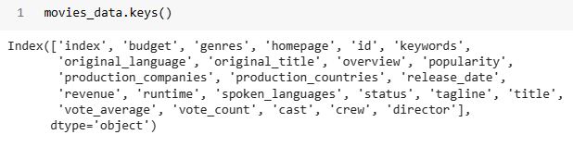
DataSet
Movie dataset contains (4803 rows and 24 columns)
These are the Columns present in the dataset

Slide 4
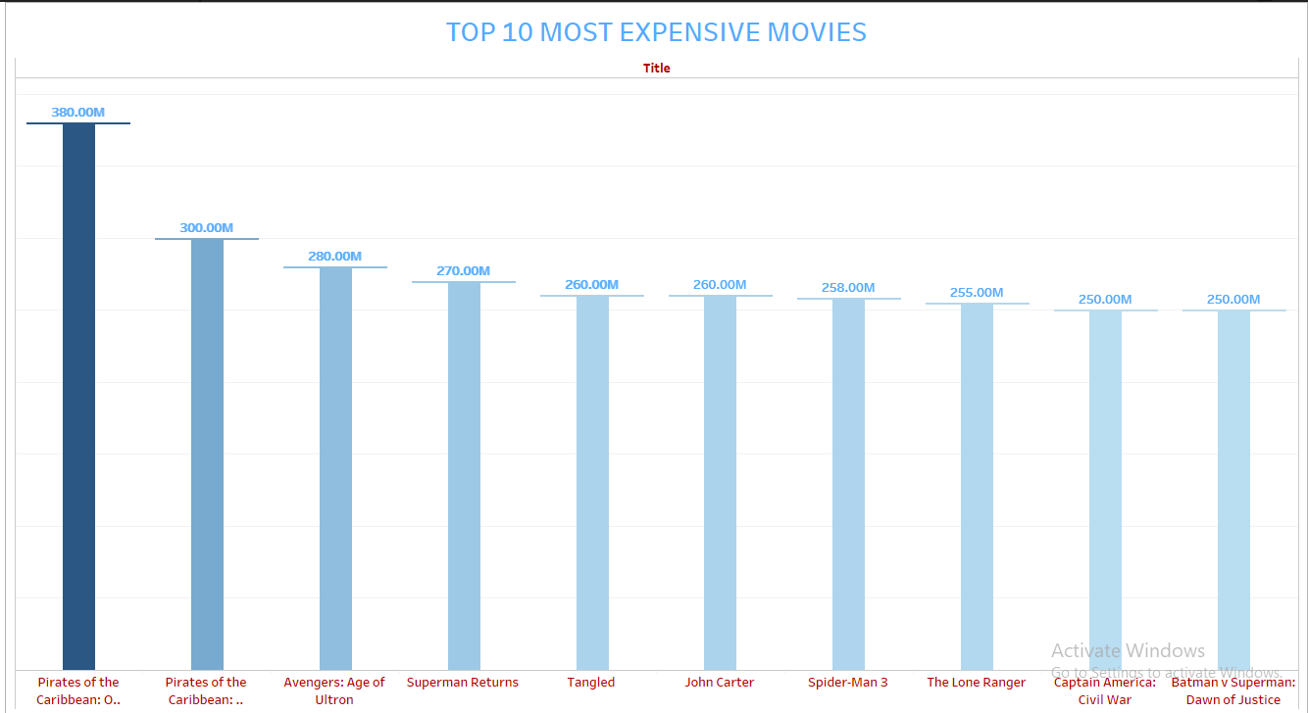
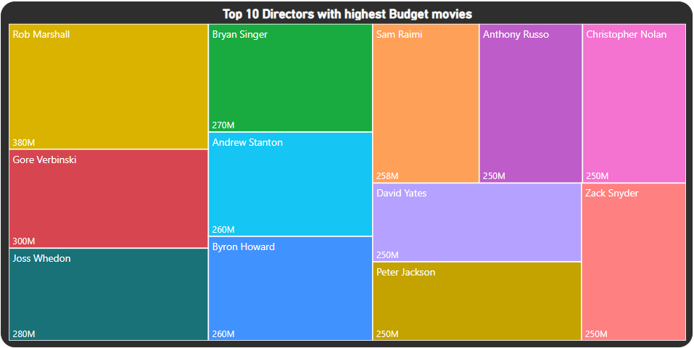
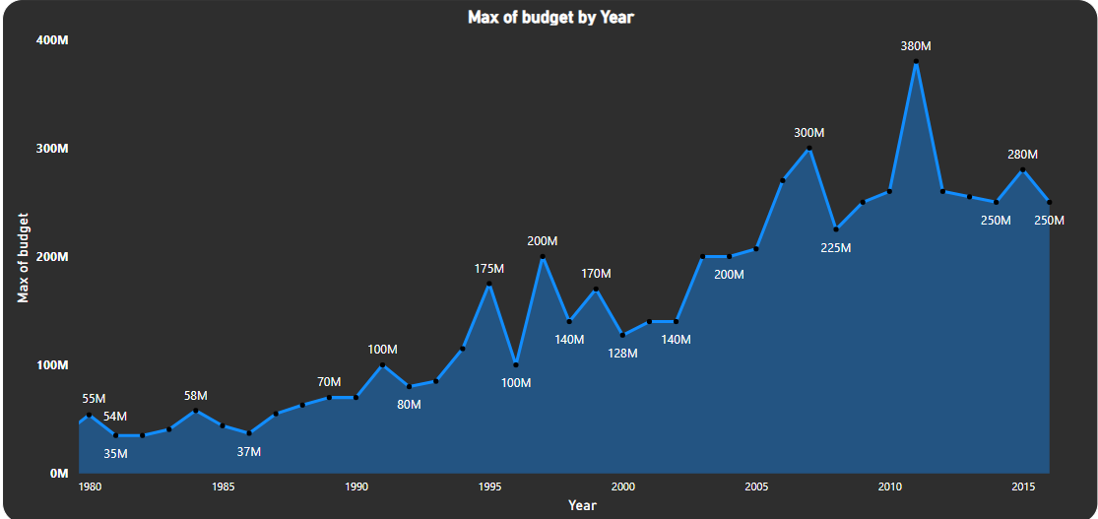
Data Analysis :

Slide 5
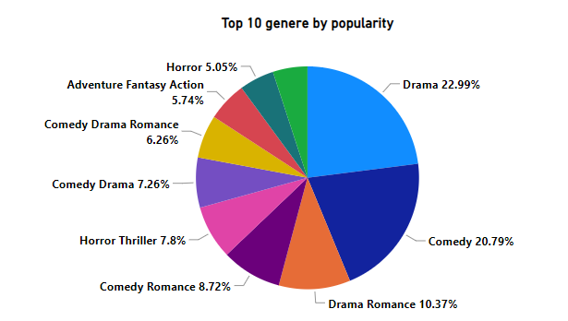
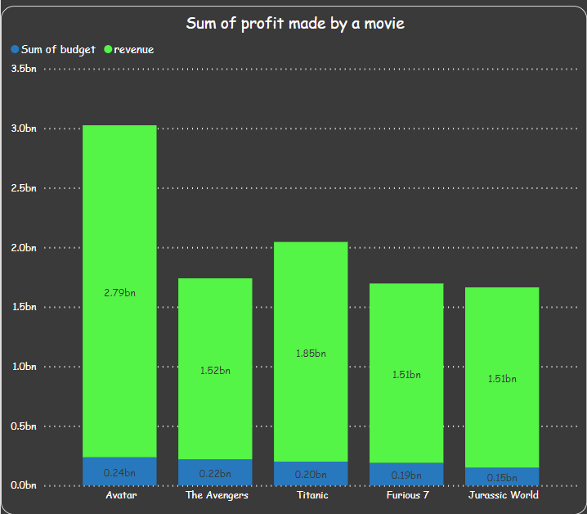
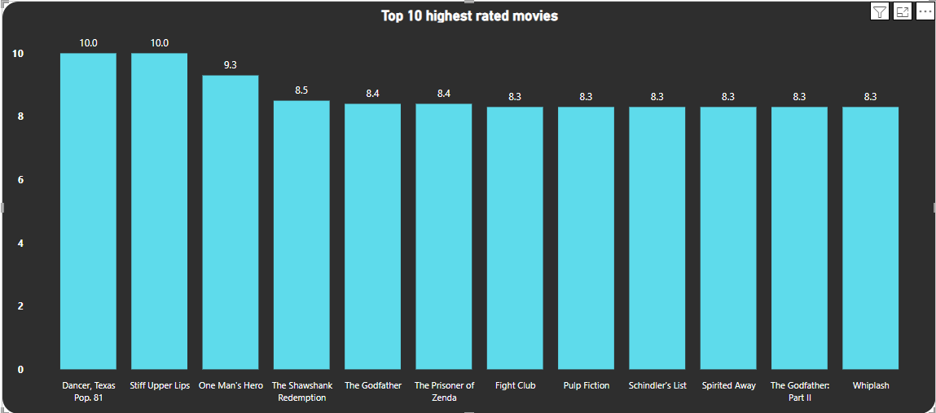
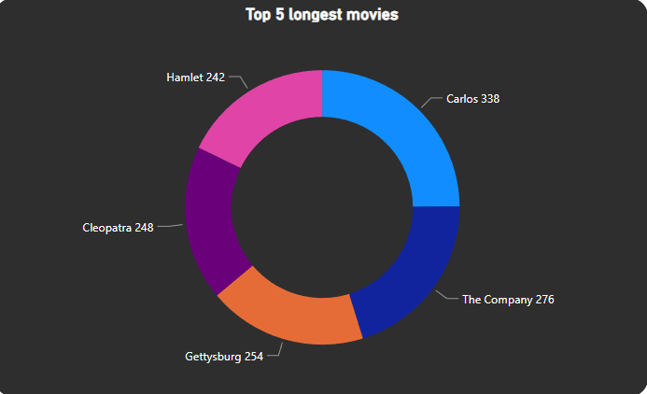

Slide 6
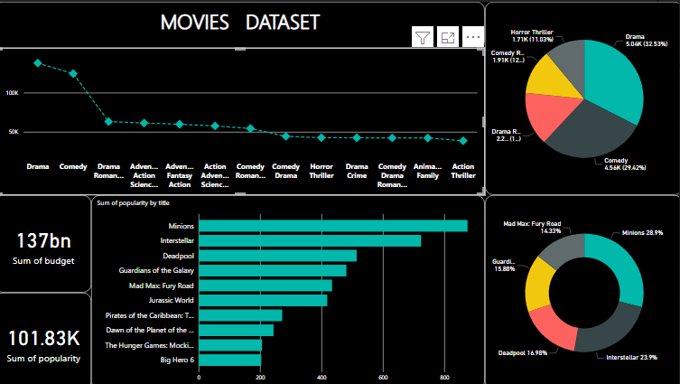

Slide 7
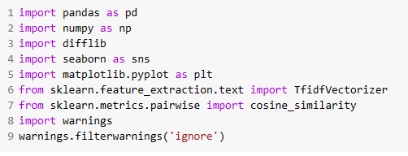
Model Building
Imported Libraries which we will use in our Model

Slide 8
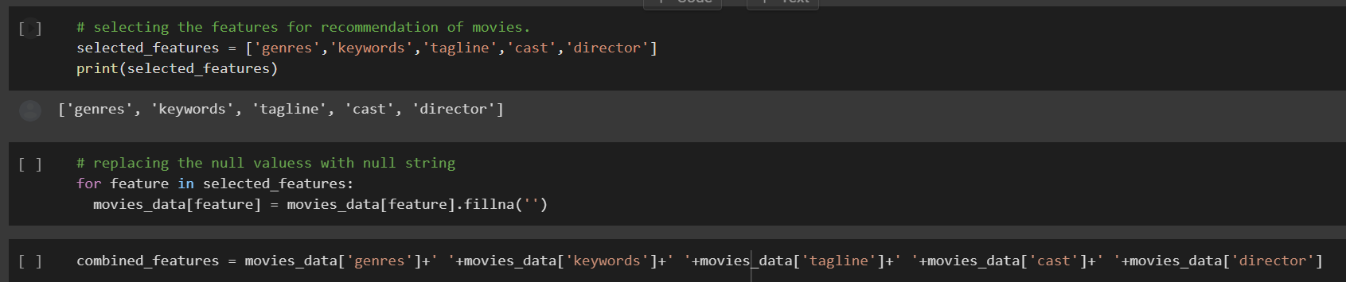
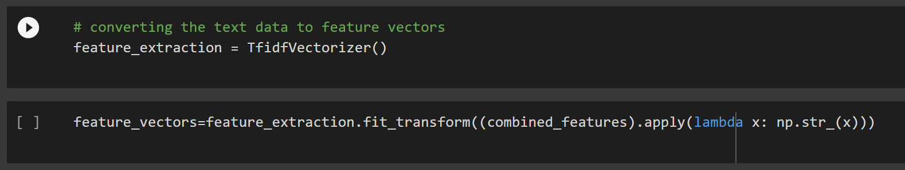
Selecting the features for the recommendation of movies and converting the text data to feature vectors

Slide 9
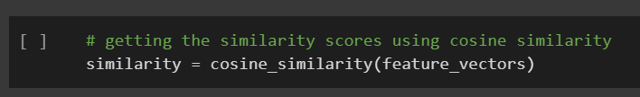
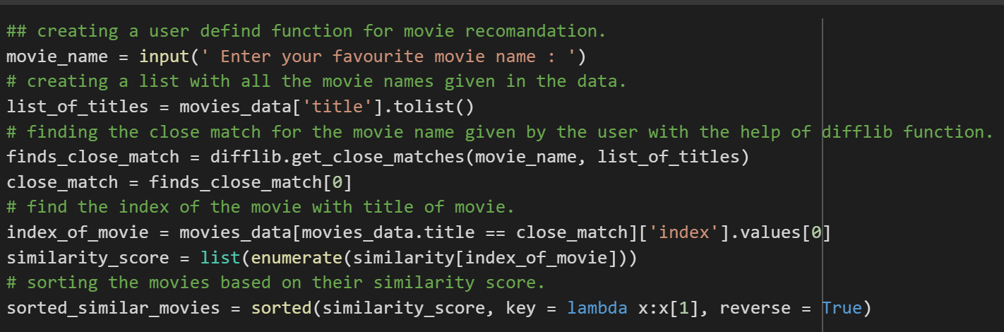
Using Cosine Similarity to measure the similarities between the two vectors

Slide 10
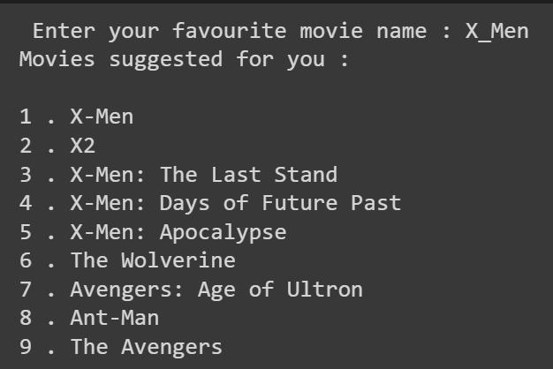
Model Output

Slide 11
Thank You!

