Slide 1
HACKATHON PRESENTATION · OCTOBER 2026
stockpilot.
Supply disrupted.
01
Plan
Understand the goal
Recovery, verified.
02
Approve
An AI operations workspace that turns urgent
Keep purchasing accountable
order goals into approved, executed outcomes.
03
Act + verify
Prove the business outcome
LIVE GEMINI + MONGODB ATLAS
Agentic supply recovery • Live Gemini execution verified
01 / 15
Notes:
Opening: StockPilot is an agentic supply recovery workspace for small and medium businesses. When inventory runs short or supplier availability changes, it turns an operations goal into a plan, approved business actions and a verified result. The key promise is recovery with evidence, rather than another chat answer.

Slide 2
THE PROBLEM
Urgent orders turn into a coordination problem.
For operations managers, inventory coordinators and purchasing approvers.
Inventory is short
Suppliers change
Decisions need control
Orders need 30 units.
Price, stock and lead time
Budgets, deadlines and
Only 8 are on hand.
can change while a purchase
approvals must stay
The shortfall must be
is waiting for approval.
consistent with the latest
sourced.
business state.
The gap: one accountable workflow across inventory, procurement and verification.
StockPilot • Hackathon pitch
02 / 15
Notes:
Explain the business problem using the demo inputs: two urgent orders need thirty sensor units, but inventory has only eight. The manager needs to compare suppliers, respect the deadline and budget, obtain approval and avoid buying against a stale quote. These are coordinated business decisions, not simply a question-answering task. Do not invent time savings or market-size statistics.

Slide 3
THE SOLUTION
One goal in. A verified recovery plan out.
“Recover both urgent sensor orders within four days. Reserve available
stock,
purchase only the shortfall, verify allocations and publish a report.”
SCOPE: TWO ORDERS
BUDGET: $1,500
DEADLINE: 4 DAYS
Understand
Plan
Act
Prove
Read current records
Delegate specialist work
Use controlled tools
Verify and report
The goal guides planning. Explicit scope, budget and deadline remain authoritative.
StockPilot • Hackathon pitch
03 / 15
Notes:
Describe the input: a natural-language goal plus explicit order scope, maximum budget and deadline. Gemini interprets the goal and plans specialist work. The backend keeps those constraints authoritative. The output is an executed and verified allocation plan with evidence. In this MVP, purchasing changes an internal sandbox ledger; it does not place an external supplier order or send a payment.

Slide 4
AGENTIC ARCHITECTURE
Six roles. One coordinated workflow.
Orchestrator
Interprets the goal • Delegates • Revises the plan
Research
Analysis
Execution
Verification
Communication
Read inventory,
Compare cost,
Reserve, purchase
Check evidence
Publish the final
orders, suppliers
availability and
and allocate within
and block invalid
operations report.
and memory.
arrival feasibility.
policy.
completion.
Scoped Gemini invocations + structured contracts + durable, sequential handoffs.
StockPilot • Hackathon pitch
04 / 15
Notes:
These are six scoped agent roles coordinated by one durable engine, not six separate servers. The orchestrator plans; research reads; analysis compares; execution proposes domain mutations; verification checks evidence; communication publishes the report. Every role has an explicit structured contract and limited tools. The handoffs are sequential so business mutations remain consistent and auditable.

Slide 5
HOW IT WORKS
From goal to action — with a recovery loop.
01
02
03
04
Set the goal
Create a plan
Run real tools
Pause for approval
Orders, budget and deadline
Delegate scoped specialist
Read, reserve and compare
Bind the exact purchase
steps
request
08
07
06
05
Publish evidence
Verify the outcome
Revise the plan
Observe a change
Report, audit and completion
Allocations, spend and arrival
Use current state and memory
Stale supplier quote is rejected
Changed-state failures feed fresh observations into a new plan; committed actions persist.
StockPilot • Hackathon pitch
05 / 15
Notes:
Walk through the loop. The user sets the goal and constraints. The orchestrator produces a plan, specialists execute real tools, and a high-risk purchase pauses for approval. In the recovery demo, stock changes before approval. Quote-version checks reject the stale request. That observation and supplier-failure memory drive a new plan. The system preserves existing reservations, buys only the remaining shortfall, verifies the result and publishes evidence. A supplier change is a demonstrated recovery branch, not mandatory in every workflow.

Slide 6
TECHNICAL ARCHITECTURE
AI reasoning meets a durable execution engine.
React workspace
Express API
MongoDB Atlas
Persistent memory
Vite • MUI • live polling
JWT • tenant-scoped REST
Ledger • approvals • evidence
Plans • verified supplier failures
Workflow engine
Gemini + roles
Policy gateway
Domain tools
Leases • retries • plan history
Structured plans and actions
Schema • scope • approvals
Atomic business mutations
Tool observations → bounded recovery → revised plan
StockPilot • Hackathon pitch
06 / 15
Notes:
The frontend reads real persisted state through authenticated REST endpoints. One Express process runs the API and a leased workflow worker. Gemini produces structured plans and actions, validated by full Zod schemas and tool contracts. The policy gateway enforces permissions and business rules before tools mutate Atlas. Task state, approvals, executions, audit and memory are persistent. Optional native OpenAI support exists, but the verified run uses Gemini 3.5 Flash Lite. There is no runtime fixture fallback.

Slide 7
CONTROLLED AUTONOMY
AI proposes. The backend enforces.
Role + scope permissions
Structured input validation
Agents receive only approved tools and
Exact tool schemas and grounded memory
owned order/SKU scope.
IDs are checked before execution.
Exact-action approvals
Fresh business invariants
Cumulative purchasing above $250 pauses
Quote version, budget, uncovered demand
for a persisted decision.
and deadline are rechecked.
JWT + tenant ownership Backend-only keys Atomic writes + replay receipts
StockPilot • Hackathon pitch
07 / 15
Notes:
The model cannot grant itself permission. Every action crosses a backend boundary: permitted role, strict input schema, owned scope and current workflow state. Cumulative purchases above two hundred fifty dollars require approval, preventing split-purchase bypass. The saved approval binds the exact validated request. Execution still rechecks fresh quotes, budget, remaining demand and deadline. Atomic ledger updates and replay receipts prevent duplicate effects after interruptions. Keys remain on the backend.

Slide 8
LIVE RECOVERY SCENARIO
The demo: recover when the supplier changes.
30 NEEDED
8 ON HAND
22 TO SOURCE
4-DAY DEADLINE
Plan A: supplier A
Quote changed
Plan B: supplier B
22 × $30 = $660
Supplier stock is
22 × $36 = $792
2-day lead time
withdrawn.
3-day lead time
Purchase awaits approval.
The approved stale quote
Fresh approval → commit.
fails: QUOTE_CHANGED.
8 reserved + 22 scheduled = 30 allocated units. Budget and deadline checks pass.
Source: docs/LIVE_ACCEPTANCE.md • Actual Gemini + Atlas • Sandbox business ledger
08 / 15
Notes:
This is the strongest demo moment. After reserving eight units, supplier A initially appears feasible at six hundred sixty dollars. While the purchase waits for approval, the acceptance script withdraws its real sandbox stock. The stale approved request fails quote-version validation. The model replans using current data and memory, then proposes twenty-two units from supplier B for seven hundred ninety-two dollars. A second exact approval allows purchase commitment and allocations. Supplier C is cheaper but its nine-day lead time misses the four-day deadline. CLI approvals used explicit --approve-sandbox consent; do not present those as human clicks in a recorded walkthrough.

Slide 9
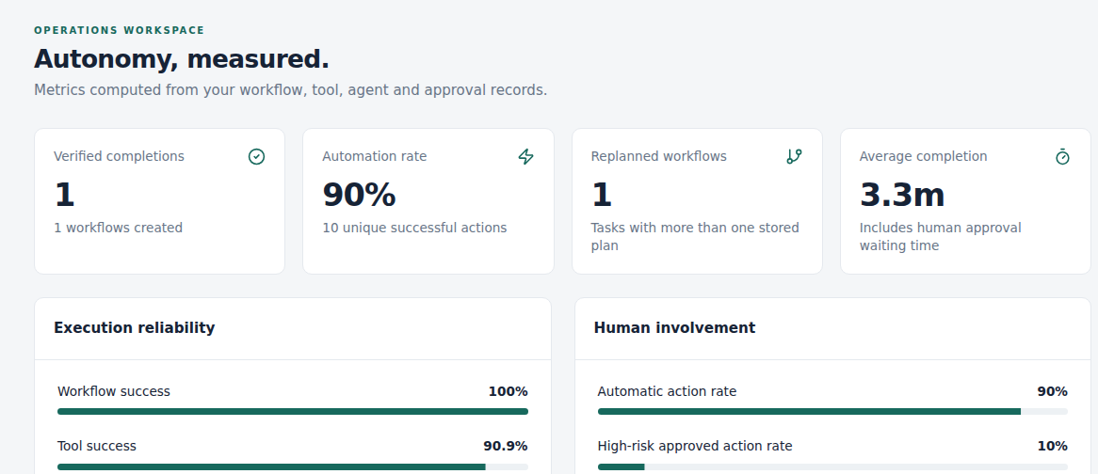
ACCEPTANCE RESULTS
Measured execution. A verified outcome.
30 / 30
$792
3m 15.7s
2
Units allocated
Within $1,500 budget
Actual wall-clock time
Accepted plan revisions
The acceptance proved
Real plans and tool mutations
Two persisted approvals
Stale-quote recovery
Independent checks + final report
37 BACKEND TESTS
2 UI TESTS
Live API-derived analytics
Source: LIVE_ACCEPTANCE.md + VERIFICATION.md • One controlled live scenario, not a population benchmark
09 / 15
Notes:
The real Gemini and Atlas workflow completed in exactly 195,706 milliseconds: three minutes and 15.706 seconds. All thirty requested units were allocated, and the commitment was seven hundred ninety-two dollars within the fifteen-hundred-dollar budget. Two accepted plan revisions and two persisted approval decisions are in the evidence. Analytics report ninety percent automation and ninety point nine percent tool success for this isolated account: ten successful tool attempts and one genuine induced stale-quote failure. These are single-run measurements, not generalized performance claims. Thirty-seven backend tests and two fixture-backed desktop/mobile browser tests also passed. Completion is scheduled/allocated fulfillment, not delivery.

Slide 10
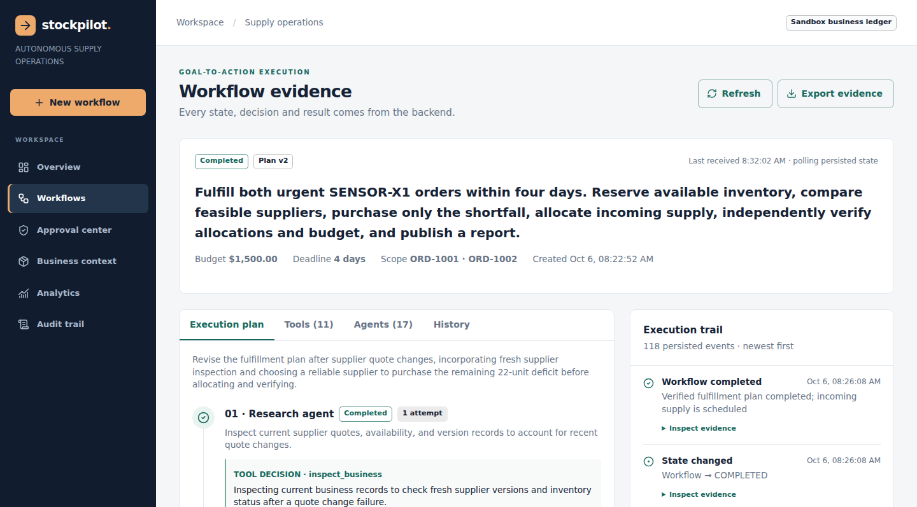
THE CONNECTED PRODUCT
Every decision leaves visible evidence.
Plans + history
Inspect revisions and handoffs.
Actions + approvals
See exact inputs and results.
Audit + exports
Trace and export the outcome.
Actual screenshot: docs/screenshots/workflow-live-gemini.png • Completed Gemini/Atlas task
10 / 15
Notes:
This image comes from the normal React application reading the actual completed live task from Atlas, not a mockup or fixture screenshot. Show the completed status and plan version two, then explain the tool and agent tabs, approval center, history and execution trail. The product also includes business context, analytics, audit and JSON evidence export. During a live demo, open localhost port 5173 and use a fresh account so earlier allocations do not remove the deficit.

Slide 11
BUSINESS VALUE + NEXT STEPS
Less coordination. More accountability.
Operations
Purchasing
Audit
Coordinate stock, quotes
Keep high-risk
Trace model decisions to
and allocation in one live
commitments bound to an
actual actions and verified
workflow.
exact decision.
outcomes.
Roadmap
NEXT
THEN
LATER
Public deployment
Supplier / ERP adapters
Multi-SKU planning
Hosted verification + demo video
External notifications
Organization approvals + scaling
StockPilot • Hackathon pitch
11 / 15
Notes:
The intended value is less fragmented coordination and clearer accountability. Operations gets a shared live workflow, purchasing gets exact-action control, and audit gets evidence connecting decisions to mutations and checks. These are product benefits, not measured ROI claims. The current verified scope is a local frontend/API connected to hosted Atlas and real Gemini, executing a sandbox ledger. Next come public Render/Vercel deployment, production configuration checks and a recorded human-clicked demo. Then supplier/ERP and notification adapters, multi-SKU planning, organizational roles and high-volume scaling.

Slide 12
THE PITCH
stockpilot.
Give the system a goal.
Get an outcome you can prove.
Plans adapt. Purchases stay accountable.
Business outcomes are independently verified.
GOAL
APPROVED ACTIONS
VERIFIED RESULT
Local demo: http://localhost:5173 • Evidence: docs/LIVE_ACCEPTANCE.md
12 / 15
Notes:
Close: StockPilot turns goals into accountable business actions. It plans, delegates, obtains approval, adapts when a supplier changes and proves the final result. Invite the judges to inspect the live workflow, actual model/tool records and exported evidence. Transition to the application demo or questions; backup slides follow.

Slide 13
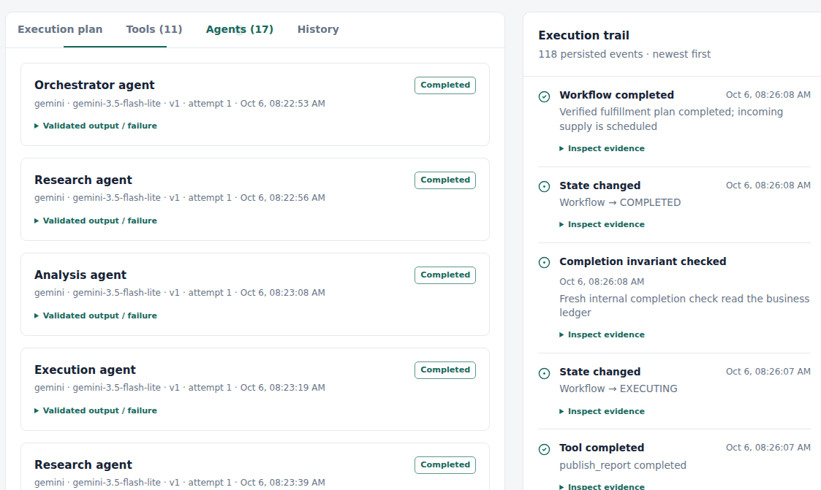
EVIDENCE FOR JUDGES
Backup: actual Gemini invocation records.
Separate scoped calls
Provider, model, role, revision,
attempts and validated output
are persisted.
Failures remain visible
Correction and recovery records
are retained rather than
replaced by success-only history.
Actual screenshot: agents-live-gemini.png • Native @google/genai • gemini-3.5-flash-lite
BACKUP · 13 / 15
Notes:
Use this slide if judges ask whether the agents are real. These are actual native Gemini invocation records displayed by the connected app. They include role, provider/model, plan revision and attempts. Failed semantic proposals can be corrected before any tool runs; their invocation records remain visible. The runtime provider factory selects native Gemini or optional native OpenAI from trusted configuration. Fixtures are loaded only by tests and visibly labeled TEST_FIXTURE_NOT_AI. Full evidence is retained in Atlas and privately exported.

Slide 14
TECHNICAL DETAIL
Backup: eight tools and persistent proof.
Inspect +
Reserve +
Allocate + verify
Notify + publish
compare
commit
inspect_business
reserve_inventory
allocate_purchase
notify_operations
compare_supply
place_purchase
verify_fulfillment
publish_report
Eight purposeful MongoDB entities
User · Task · AgentExecution · ToolExecution · Approval
WorkflowEvent · BusinessState · Memory
Sources: backend/src/tools/registry.js • backend/src/models/index.js • ARCHITECTURE.md
BACKUP · 14 / 15
Notes:
The eight tools are actual backend functions with input/output schemas, roles and risk. Inspect business reads scoped records; compare supply calculates feasibility and memory-adjusted ranking; reserve inventory allocates on-hand stock; place purchase commits sandbox incoming supply; allocate purchase allocates it to orders; verify fulfillment reads actual ledger checks; notify operations persists in-app notifications; publish report persists an evidence-grounded report. MongoDB records users, tasks, agent/tool executions, approvals, events, domain state and memory. Quote versions, atomic CAS and receipts enforce concurrency and replay safety.

Slide 15
JUDGE Q&A
Backup: answers to the hard questions.
Why agentic AI?
What does “completed” mean?
Goal-driven plans and tool choices adapt to
All requested supply is reserved or scheduled
observed state. The backend handles
and allocated; checks and a report pass. Not
arithmetic and policy.
physical delivery.
Can the model bypass approval?
What remains to ship?
No. Exact approval binding and independent
Public deployment, hosted verification, demo
backend permissions remain authoritative.
video, external integrations and broader live
evaluation.
StockPilot • Hackathon pitch
BACKUP · 15 / 15
Notes:
Additional answers: planning is model-generated, not a hardcoded workflow template. Tools are allowlisted and cannot execute arbitrary code, network requests or database queries. A changed supplier quote fails even after approval because approval does not override fresh business invariants. Restart recovery uses leases, persisted state and idempotent receipts. Supplier-failure memory influences later rankings but never changes permissions. The workflow owner currently approves actions; separate organizational roles are future work. One measured successful scenario does not establish universal model reliability.

