Slide 1
Internship
Sanketh Prabhu
PSB4KOR
college: KLE TECH HUBLI

Slide 2
Technologies:
Angular 8
UI5-Webcomponents.

Slide 3
Project
Fraud detection for payment anomalies in a fi-module
Objectives:
Deliverable:
Design an alert system to notify users about fraud and to create investigate for the same
UI (front–end)

Slide 4
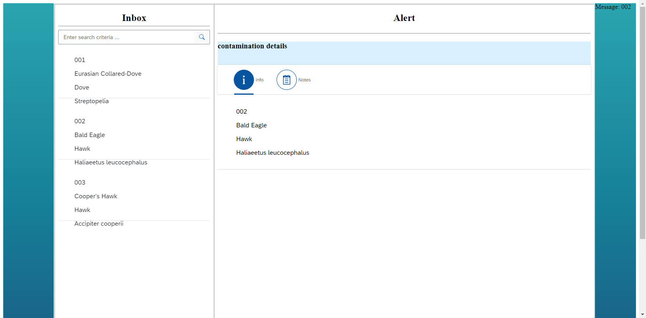
Progress

Slide 5
