Slide 1



TWITTER SENTIMENT
ANALYSIS
IBM HACK CHALLENGE 2020
CODEPLAY
Sanket Jangale
Kunal Kotkar
Manoj Ayyappan
Shreyas Udupa

Slide 2
PROBLEM STATEMENT
The sentiment analysis of Indians after the extension of lockdown announcements to be analyzed with the relevant #tags on twitter and build a predictive analytics model to understand the behavior of people if the lockdown is further extended.
Also develop a dashboard with visualization of people reaction to the govt announcements on lockdown extension

Slide 3
STAGES
Data Collection
Data Pre-processing
Data Modelling and Plotting
UI and Deployment

Slide 4

DATA COLLECTION
Importing the essential libraries :

Slide 5
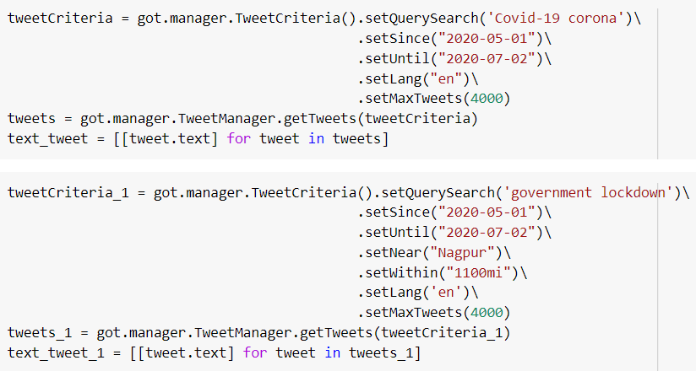
Getting the Tweets using Query Search :

Slide 6
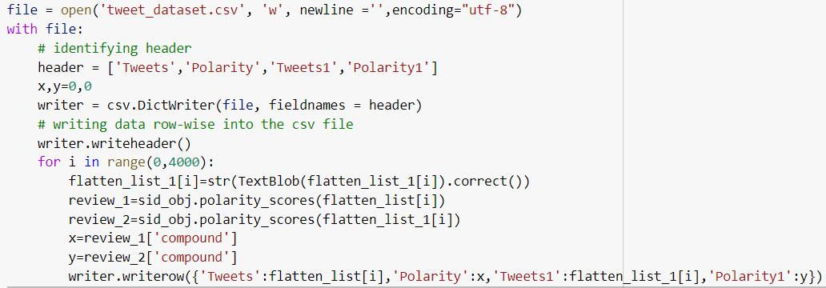
Writing the contents into a csv file :

Slide 7
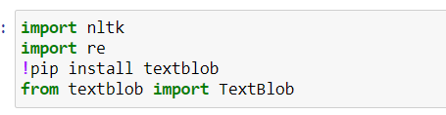
DATA PREPROCESSING
Notes:
Data preprocessing is the process of converting data to something a computer can understand.
NLTK is a python library which is widely used in language processing. It contains all the features that is required to perform natural language processing
Re is a python library which is used to work with regular expressions
TextBlob is a Python library for processing textual data. It provides a simple API to perform simple NLP tasks such as noun phrase extraction, sentiment analysis, classification, translation, and more.
Textblob has a few attributes which makes our language processing simplified and less tedious.

Slide 8
DATA CLEANING
Next objective is to clean the data viz. removing unwanted data that would decrease the accuracy of our model.
Used the .correct attribute of TextBlob to get rid of the spelling mistakes.
Executed during data collection
Notes:
We have made slight alteration while implementing this as executing the .correct attribute while running the code took a lot of processing time.
It took approximately 2 hrs to compile the corrected data in our dataset of 4000 tweets

Slide 9
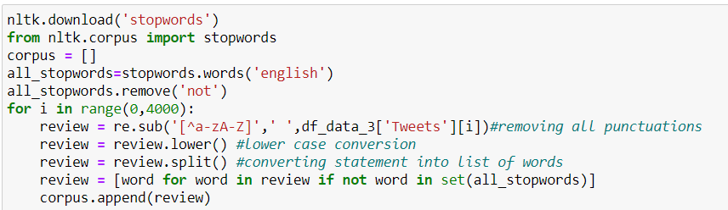
Notes:
After we get our dataset, first we have to remove the stopwords from it. Stopwords are the commonly used words (such as “the”, “a”, “an”, “in”) which dont contribute to the sentence and end up taking precious processing time. Python already has a list of words termed as stopwords.
As you can see we have made an exception for the word “not” in the stopwords. We have done this so that the bag of words contain negative phrases as well.
In the first statement under the for loop we have removed all the punctuations from the sentences as we want only words to be present in our final output.
In the next line we have converted all the words into lower case for simplification of the output after which we have split the sentences into individual words
Lastly we have appended the words present in review which are not part of the stopwords in our empty list “Corpus”.
After this process , the output that we get is called ‘bag of words’ which basically contains all the sentences in the dataset split into words excluding the stopwords.

Slide 10
DATA MODELLING/ANALYSIS
Measure polarity.
Analyse counts of polarity.
Divide them into positive/negative/neutral.
Analyse emotions from the cleaned data .

Slide 11


MEASURE POLARITY
Measure polarity using Vader .
Vader -a lexicon and rule-based sentiment analysis tool that is specifically attuned to sentiments expressed in social media.

Slide 12
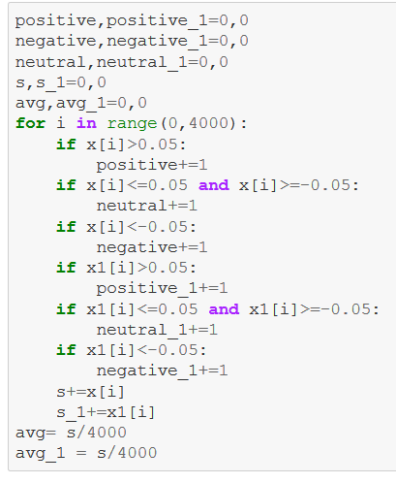
ANALYSE SENTIMENT COUNTS
Set a criteria for positive/negative/neutral tweet.
Take total count.

Slide 13
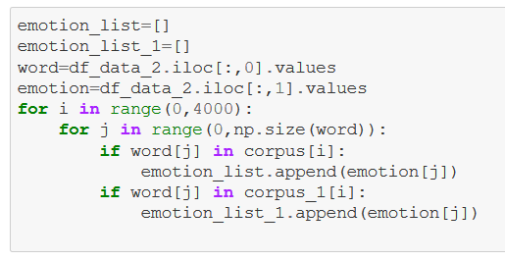
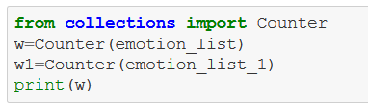
ANALYSE EMOTIONS
Load Cleaned data into corpus.
Match the keywords from dataset
(emotion.csv).
Count number of emotions.
Convert into a Dictionary.

Slide 14
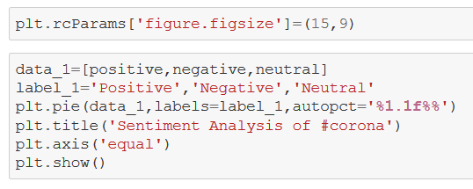
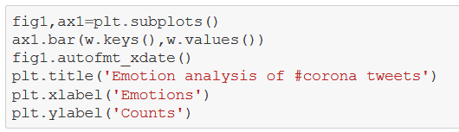
DATA PLOTTING
Import matplotlib
Plot pie charts for polarity
Plot bar graphs for emotions

Slide 15
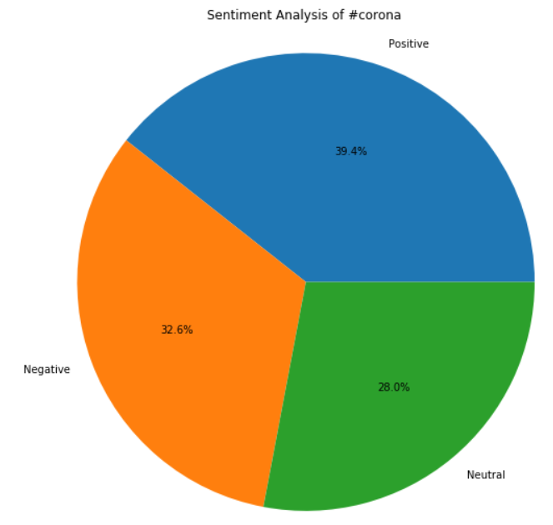
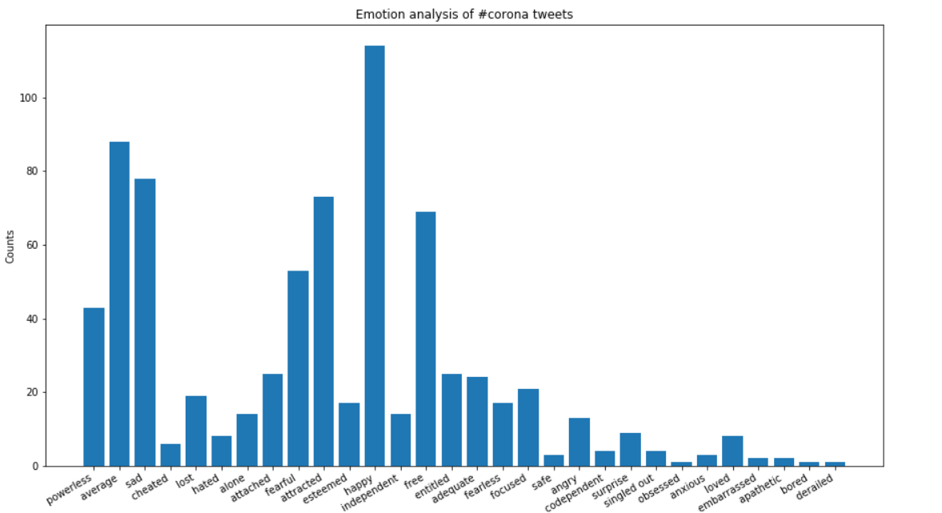
SAMPLE GRAPHS

Slide 16
DEVELOPING USER INTERFACE
The design and execution of the User Interface was done by using Node-Red and IBM Cloud Services.
A website was developed which consists of 5 tabs.
The Tabs are:
Homepage
COVID Tweets Analysis
Lockdown Tweets Analysis
Live Analysis
Check Your Own Sentiment & COVID India Tracker
Notes:
Displaying the output of our model in a user friendly way was one of our biggest priorities.
To achieve this, we developed a website using Node Red and IBM Cloud services.

Slide 17
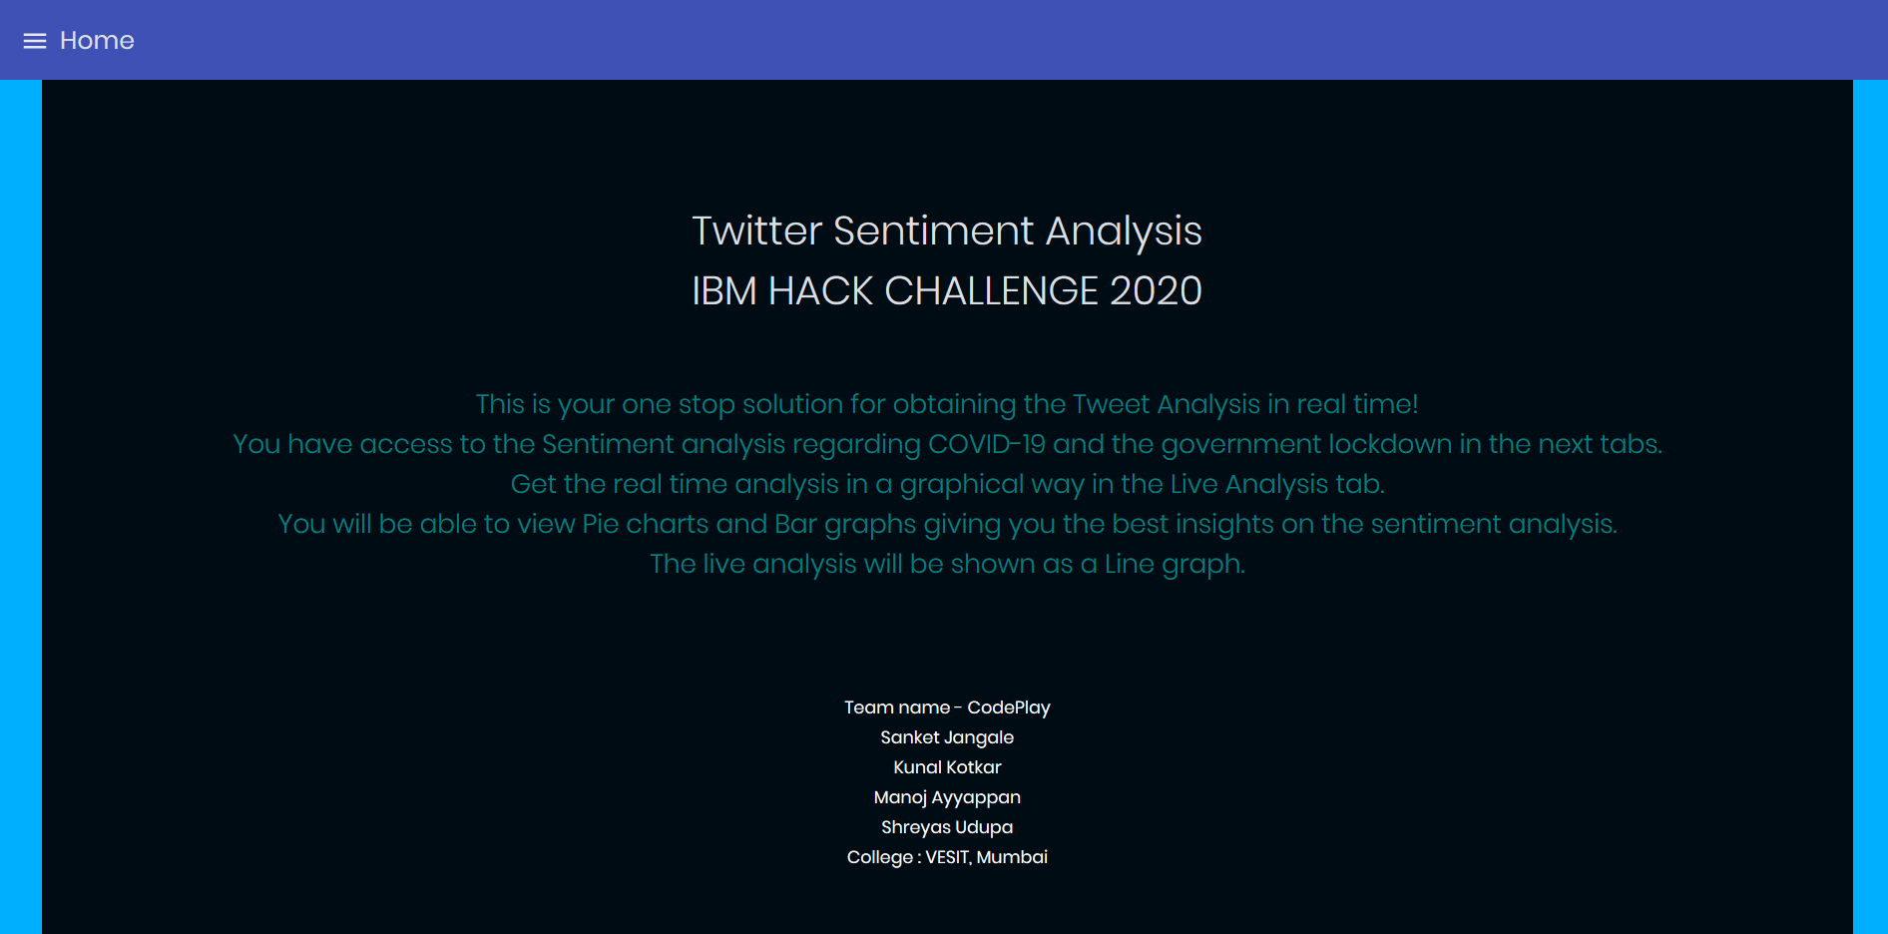

HOMEPAGE
The Homepage Tab gives us the basic idea of what the website is capable of.
The bottom half of the tab displays the Team Name and the Team Members.
This tab was created using the “template” node from Node-Red.
Languages used : HTML and CSS.
Notes:
The first and introductory tab of our website is the Homepage. It gives us a basic idea of our website and our project.

Slide 18
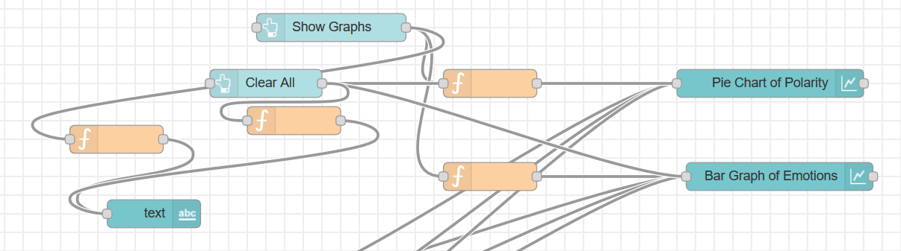
COVID TWEETS ANALYSIS
“Chart” nodes are used to display the Pie Chart and Bar Graph shown in the website.
A “function” node is used to input the data.
Two buttons “Show Graphs” and “Clear All” are used to display the graphs and clear them respectively.
Notes:
The COVID and Lockdown Tweet Analysis Tabs display the outputs of our Machine Learning Model

Slide 19
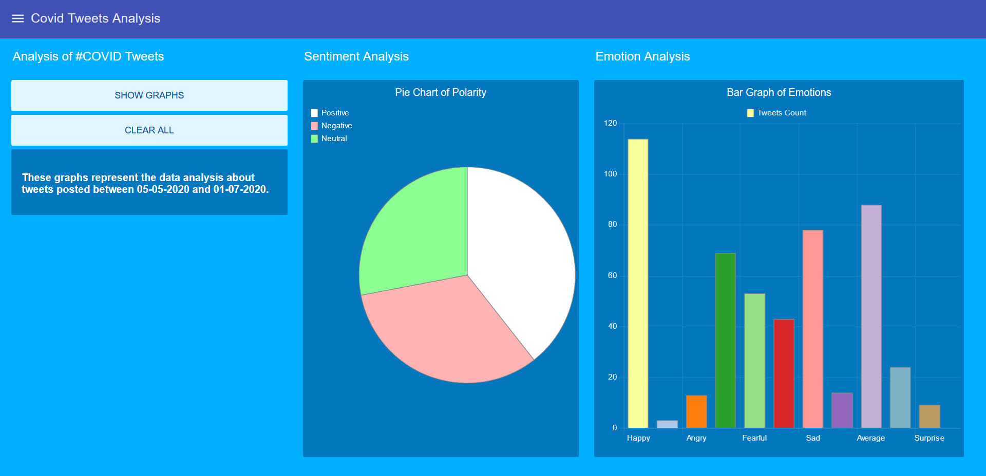
Notes:
Speak about the percentage of polarity and bar graph features.
Positive - 39.4
Negative - 32.6

Slide 20
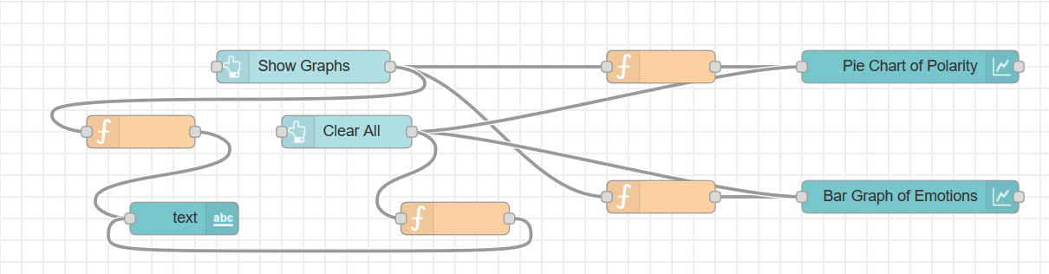
LOCKDOWN TWEETS ANALYSIS
Follows the same procedure as the COVID Tweets Analysis Tab.
Notes:
The lockdown tweet analysis tabs was made in the Similar way as we did the previous one.

Slide 21
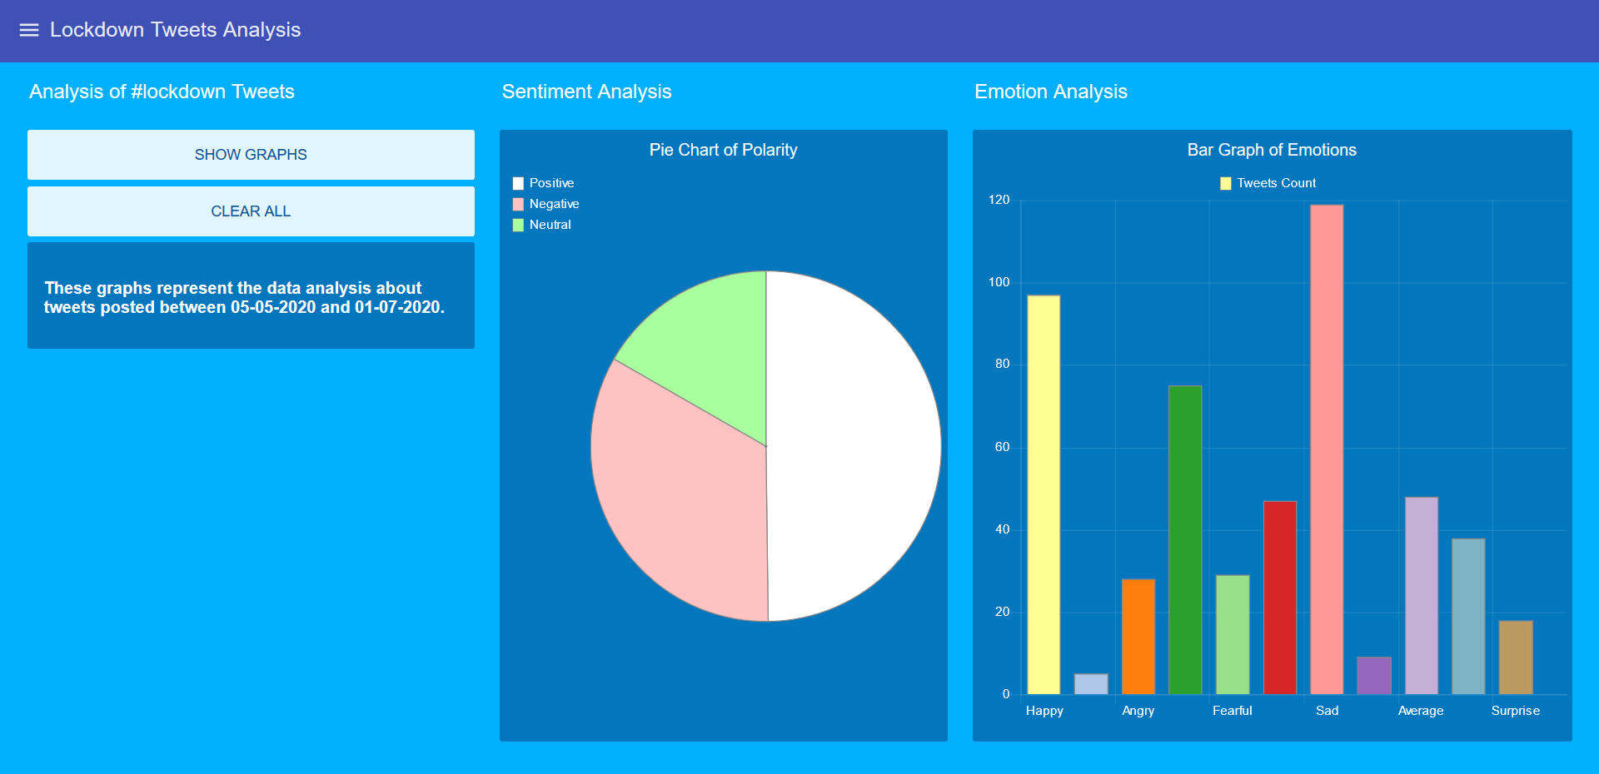
Notes:
Speak about the percentage of polarity and bar graph features.
Positive - 49.8
Negative - 33.5
Sad Feeling - 119

Slide 22
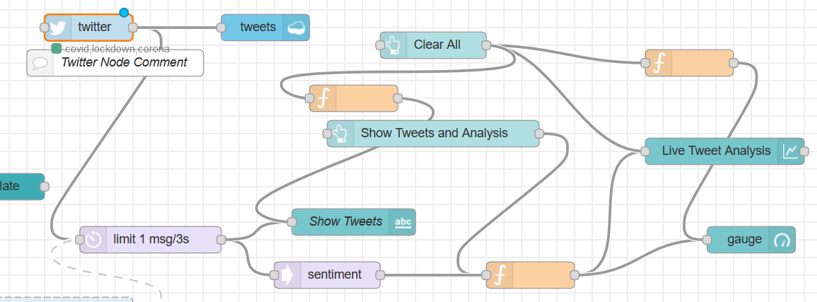
LIVE ANALYSIS
Twitter API extracts the tweets which include the keywords - covid, lockdown, corona.
Extracted at the rate of ‘1 tweet per 3 seconds’.
Stored in the Cloudant database.
The “sentiment” node analyses the polarity of each text.
Notes:
One of the interesting tabs of our website is the Live Analysis. The Twitter node extracts the tweets.
Talk about delay node too.

Slide 23
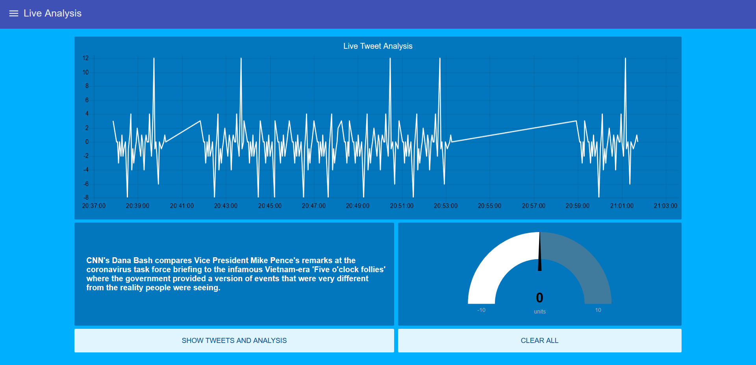
A line chart displays the polarity of the tweets taken at a particular time.
The text box on the bottom left displays the latest tweet.
The gauge displays the polarity of the corresponding tweet.
Notes:
Line chart and gauge.

Slide 24
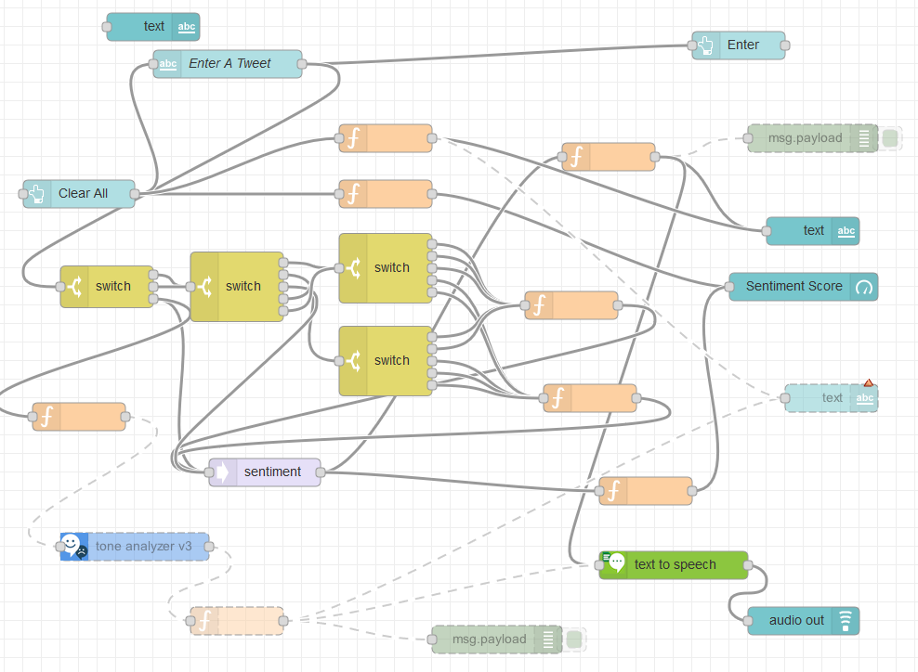
CHECK YOUR OWN SENTIMENT
Custom text input from the user
“Switch” nodes + “sentiment” node
Final output score
Final sentiment output in the form of visual and audio format
Notes:
Talk about switch nodes using keywords corona and covid.
Talk about text to speech to text node

Slide 25
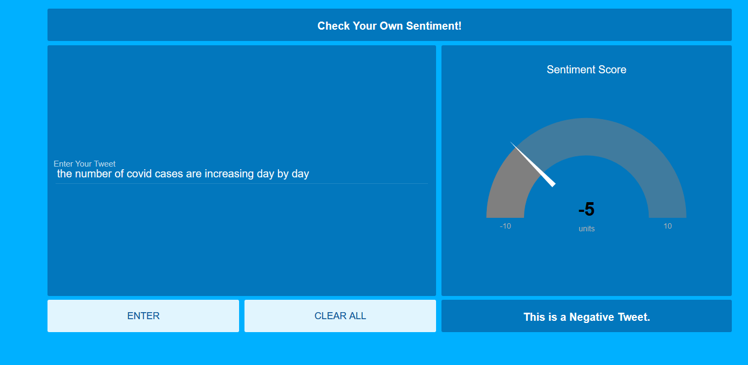
User text input in the text box on the left
Bottom right text box displays the polarity
Gauge displays the polarity score
Notes:
Talk about polarity score extreme left and right show extreme emotions.

Slide 26
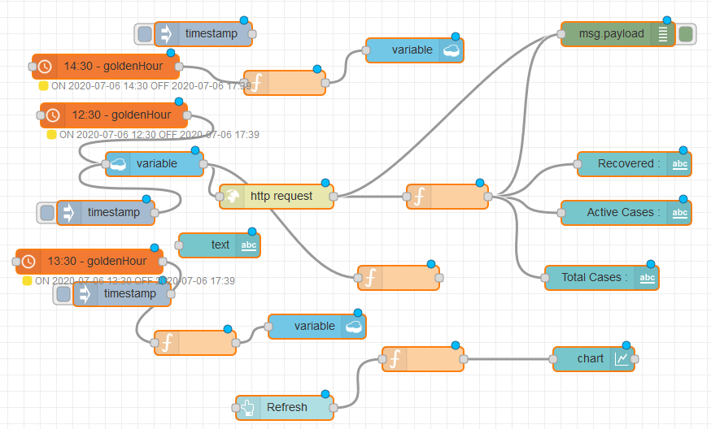
COVID INDIA TRACKER
“HTTP request” node extracts the live covid data from the API.
“Schedex” nodes are used to refresh the data on a regular basis.
Notes:
Talk about https://api.covid19api.com/total/country/india - API Website
Cloudant storing the data id for the present day and works with schedex.

Slide 27
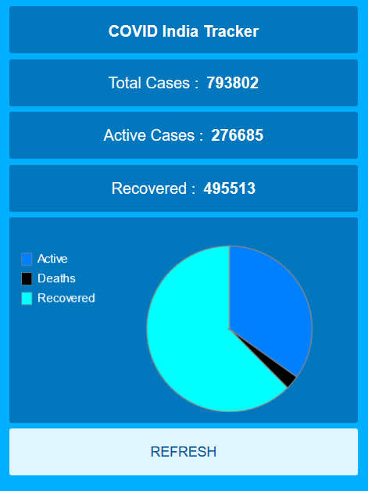

Slide 28
Thank You

