Slide 1


Department of Electronics and Communication Engineering
SENIOR DESIGN PROJECT
“ Design And Analysis of a Low-Power 6T SRAM Cell ”
SL.NO. | NAME | USN | ROLL NO.
01 | Sakshi More | 02FE22BEC075 | 08
02 | Sejal Jadhav | 02FE22BEC086 | 18
03 | Sanket Kammar | 02FE23BEC406 | 58
04 | Aditya Donk | 02FE23BEC409 | 61
Under the Guidance of
Prof : Rashmi P
Dr : Swati M

Slide 2
Problem Statement
Modern VLSI systems require fast, low-power, and area-efficient memory with stable performance across PVT variations. An optimized 6T SRAM cell can meet these requirements by ensuring reliable operation and reduced power consumption in advanced CMOS technologies.
Need Statement
Modern portable and embedded electronic systems demand on-chip memories that consume extremely low power without sacrificing data stability. There is a critical need to design a low-power 6T SRAM cell that can reduce both leakage power during standby and dynamic power during read/write operations, while ensuring sufficient noise margins, reliable operation across PVT variations, and minimal impact on silicon area.

Slide 3
Introduction
This project focuses on the design and comparative analysis of a low-power 6T SRAM cell at 180nm, 90nm, and 45nm technology nodes using Cadence Virtuoso. The 6T SRAM cell is widely used in high-speed memory applications due to its simple structure, fast access time, and low power consumption. As technology scales down, transistors become smaller and faster, reducing dynamic power but introducing issues like increased leakage current, process variability, and reduced stability. Through simulation and analysis, this work evaluates how scaling affects SRAM performance parameters such as speed, power efficiency, and area, aiming to achieve an optimal balance between performance and reliability in advanced VLSI designs.

Slide 4
Why Choose 6T SRAM?
Compact Cell Size: Only 6 transistors per cell, saving area
Low Power Consumption: Ideal for portable, battery-powered devices
Fast Access: Quick read/write performance
Stable & Reliable: Good data retention and noise margins

Slide 5
Literature Review
Sl No. | Paper title | Objectives | Methods/Techniques/Algorithm used | Limitations /Disadvantages
1. | Design and Optimization of 6T SRAM Cell at Different Technology Nodes using CMOS for Low Power and High Speed | To design and optimize 6T SRAM cells at various CMOS technology nodes (45 nm & 22 nm) for reduced leakage, high stability, and low delay. | Cadence Virtuoso design and simulation; transistor sizing optimization; supply voltage scaling; delay and leakage measurement under different node sizes. | Requires precise sizing to maintain write stability; scaling reduces delay but increases leakage power.
2. | Design and Performance Analysis of 6T SRAM Cell on 90 nm Technology | To analyze read delay, write delay, power consumption, and RSNM of 6T SRAM at 90 nm. | Cadence simulations for performance metrics. | Area overhead due to extra circuitry; trade-off between power saving and access speed.
3. | Performance Analysis of Low Power 6T SRAM Cell in 180 nm and 90 nm | To compare power, delay, and stability of 6T SRAM cells at 180 nm and 90 nm technology nodes. | Cadence Virtuoso schematic & layout; wordline and bitline capacitance extraction; DRC/LVS verification. | Smaller node reduces power but may cause read stability issues under voltage fluctuations.

Slide 6
Sl No. | Paper title | Objectives | Methods/Techniques/Algorithm used | Limitations /Disadvantages
4. | Design and Performance Analysis of 6T SRAM Cell on Different CMOS Technologies | To evaluate write delay, read delay, and power dissipation across multiple technology nodes (90 nm, 70 nm, 50 nm). | Technology scaling analysis; Cadence simulation for timing and power,transistor sizing for stability. | Scaling improves speed and reduces power but increases susceptibility to process variation.
5. | Design, Modeling and Comparative Analysis of SRAM Performance under Subthreshold Operation | To analyze 6T SRAM in 180 nm, 90 nm, and 45 nm under subthreshold regime for low-power operation. | Cadence Virtuoso simulation; delay, leakage and stability analysis. | Higher sensitivity to temperature and process variations; lower noise margin in subthreshold operation.

Slide 7
Gantt Chart
 | August |  |  |  | September |  |  |  | October |  |  |  | November
Task | Week 01 | Week 02 | Week 03 | Week 04 | Week 01 | Week 02 | Week 03 | Week 04 | Week 01 | Week 02 | Week 03 | Week 04 | Week 01 | Week 02
Literature Survey
Problem & Need Statemenr
Schematic Design
Simulation & Analysis
Layout Design
DRC
LVS
P-EX
Final Docum-entation

Slide 8
Work Breakdown Structure
“ Design And Analysis of a Low-Power 6T SRAM Cell ”
Project Initiation
Planning and Analysis
Design
Implementation
Testing & Optimization
Documentation & Presentation
Problem & Objectives
Technology & Tool Selection
Schematic Design
Setting up EDA Tools
Functional Simulation
Report making
Literature Survey
Requirement Analysis
Simulation Setup
Running Simulations
Power & Performance Analysis
Final Presentation Preparation
Defining Software Scope
Schedule & Task Allocation
Design Optimization
Layout Design
Layout vs Schematic Checks
Documentation Compilation
Identifying Software Deliverables
Prepare Gantt Chart & WBS
Post-Layout Simulation
LVS & DRC Verification
Parasitic Extraction
Final Review

Slide 9
Methodology :
Selection of Technology Nodes:
6T SRAM cell designed using 180nm, 90nm, and 45nm CMOS technologies to study scaling effects on area, power, and delay.
2. Schematic Design:
Implemented a standard 6T SRAM cell using two cross-coupled inverters and two access transistors in Cadence Virtuoso with appropriate PDK/BSIM models.
3. Transistor Sizing and Simulation Setup:
Optimized transistor ratios (pull-up, pull-down, access) for stable read/write operations.
Performed simulations in Cadence Virtuoso ADE L – Waveform Calculator (Spectre Simulation) to measure read/write delay and power consumption (static and dynamic).
4. Layout Design and Verification:
Created layouts for all three technology nodes.
Verified layouts through DRC and LVS checks.
Conducted Parasitic Extraction (PEX) for accurate post-layout simulations.
5. Performance Evaluation:
Evaluated area, power dissipation, and propagation delay from extracted layouts.
Compared results across 180nm, 90nm, and 45nm to assess improvements due to scaling.
6. Result Analysis:
Found that with smaller technology nodes, area reduces, speed improves, but leakage current and power consumption increases.

Slide 10
Mathematical and Physical model of a system
1. Mathematical Model :
Power Consumption
  Dynamic power : P_{dyn} = α *C_{L}*V_{DD} ²
  Static power :(leakage):P_{static}=I_{leak}*V_{DD}P
Delay (Read/Write delay)
  Dynamic power : Pdyn = α CL*VDD2
  Static power :(leakage):Pstatic=Ileak*VDDP
2. Physical Model :
MOSFET equations :
  Linear region : I_{ds}=μ*C_{ox}*(W/L)*[(V_{gs}−V_{th})V_{ds}−V_{ds} ²/2]
  Saturation region : I_{ds}=1/2*μ*C_{ox}*(W/L)*(V_{gs}−V_{th})²
  Physical parameters to consider:
  Threshold voltage V_{th}
  Oxide thickness t_{ox}
  Mobility μ
  Scaling of W/L

Slide 11
Functional Block Diagram
Technology Selection
Schematic Design
Simulation
Layout Designing
Testing & Verification
Result & Analysis

Slide 12
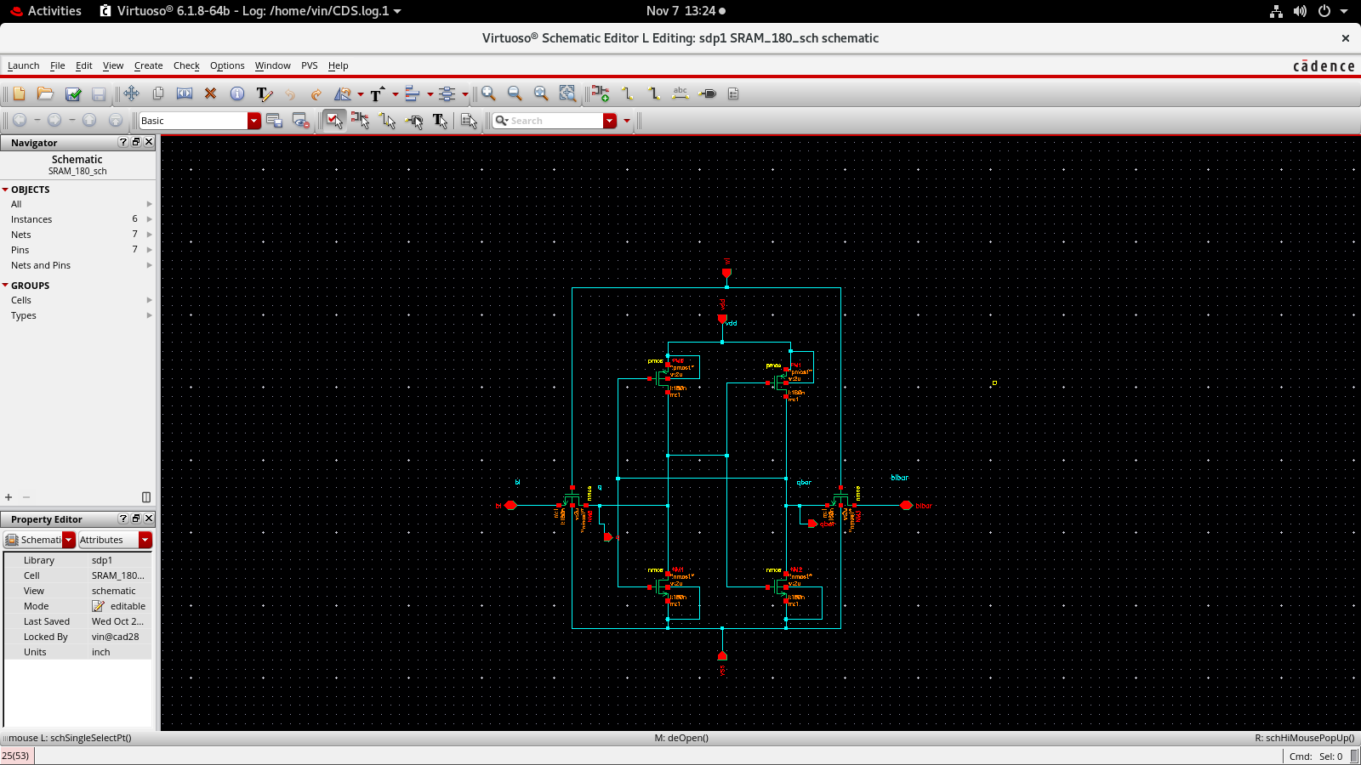
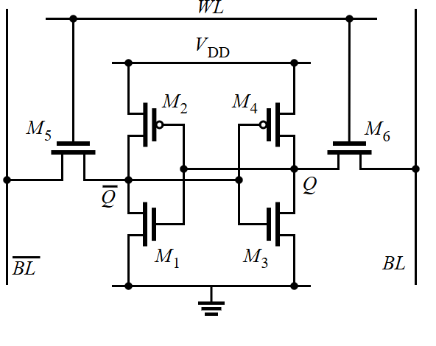
Circuit Diagram

Slide 13
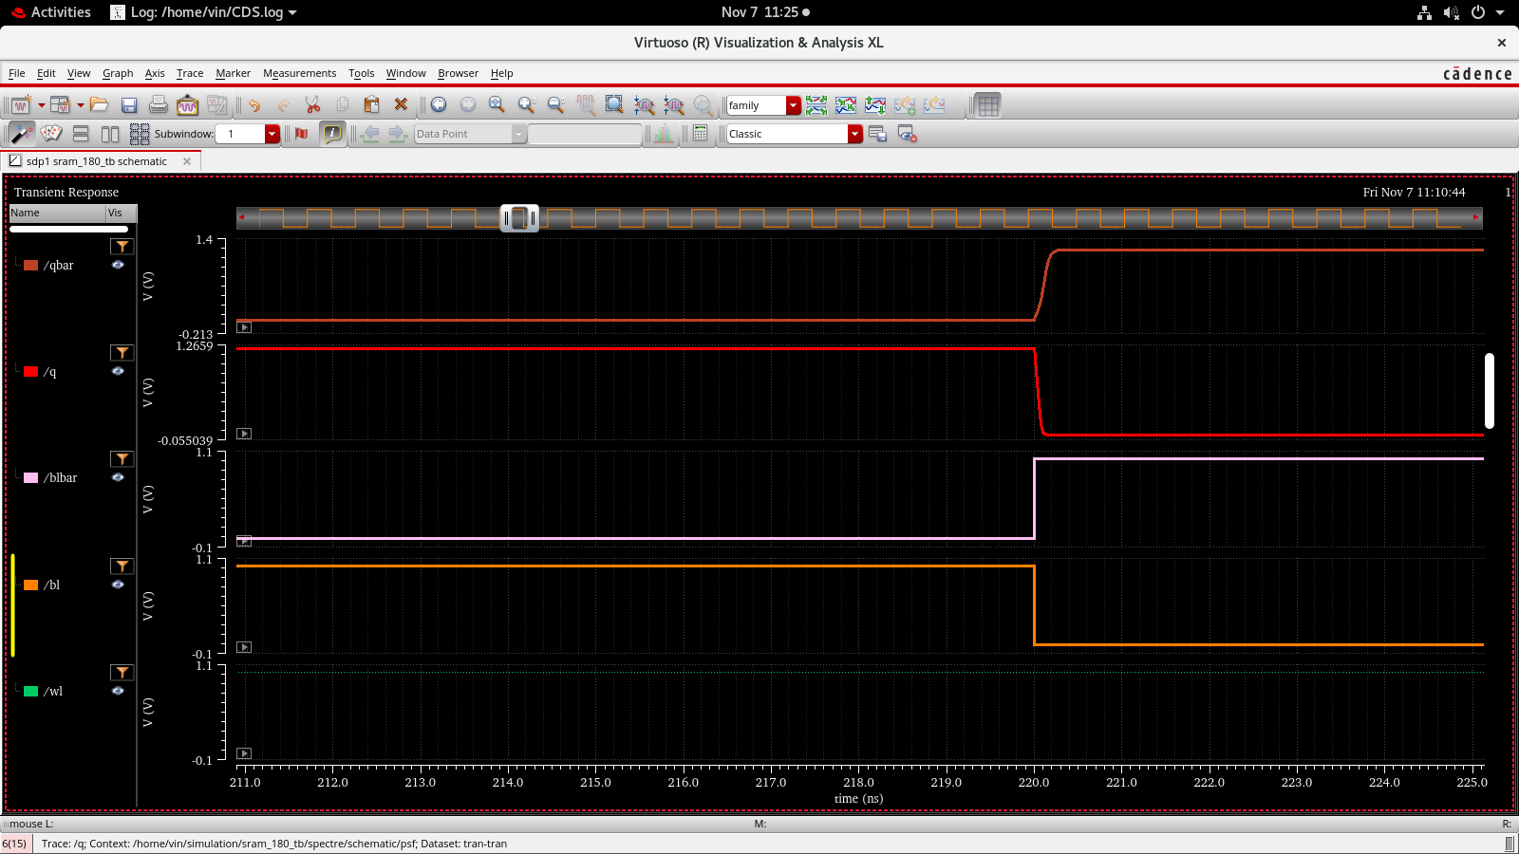
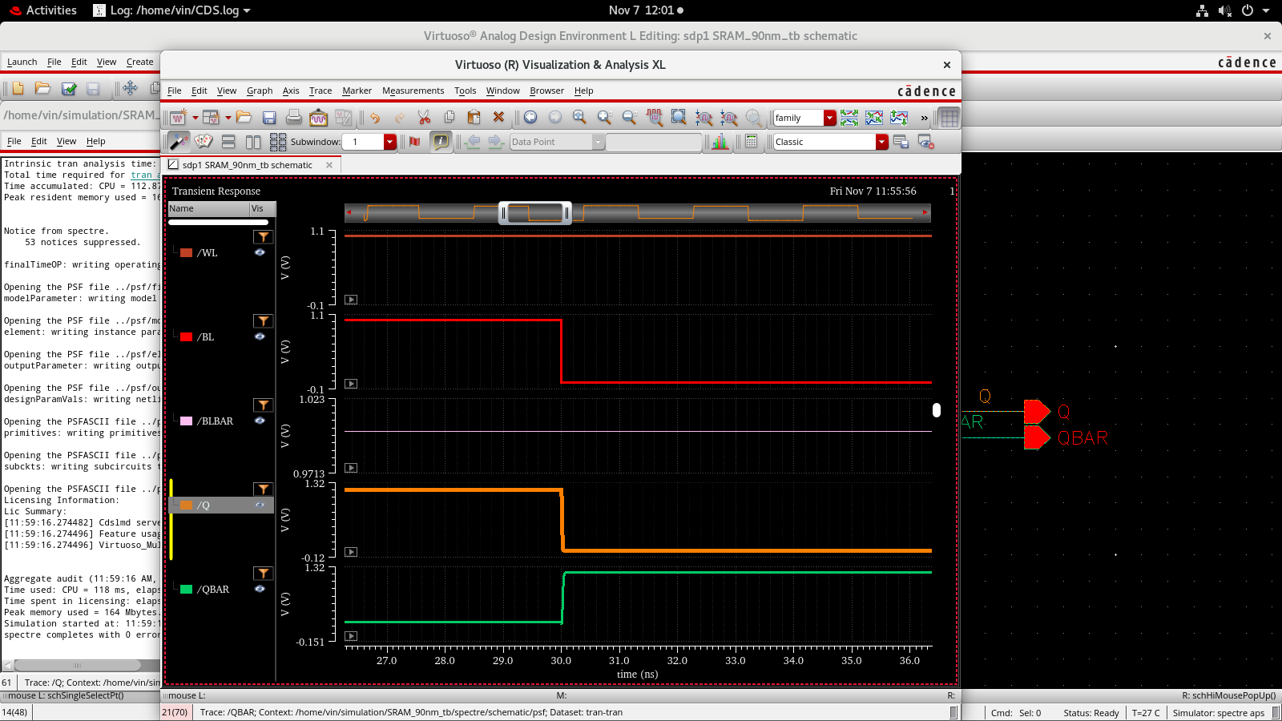
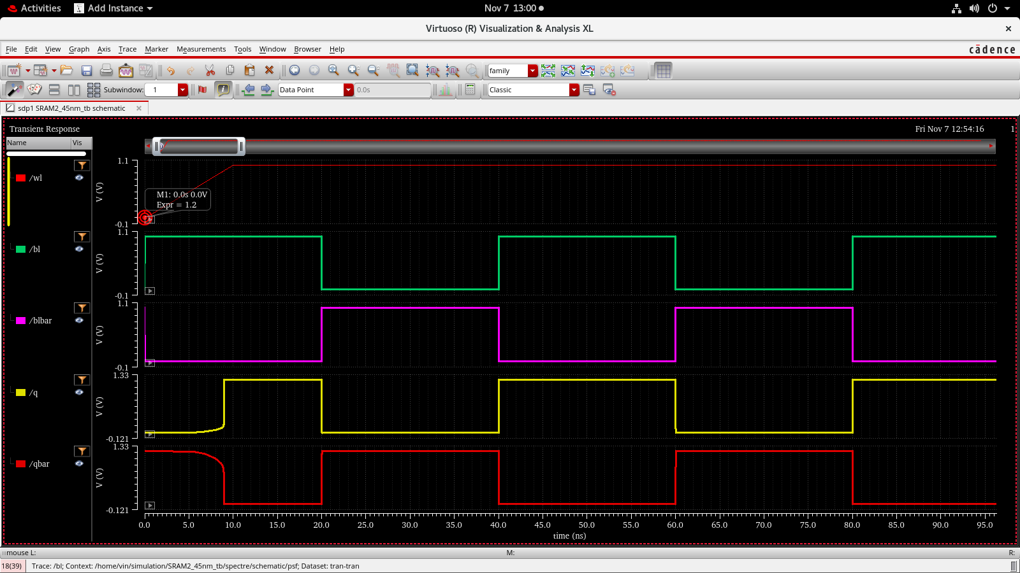
Transient Analysis at 180,90 &45 nM technology
180 nM technology :
90 nM technology :
45 nM technology :

Slide 14
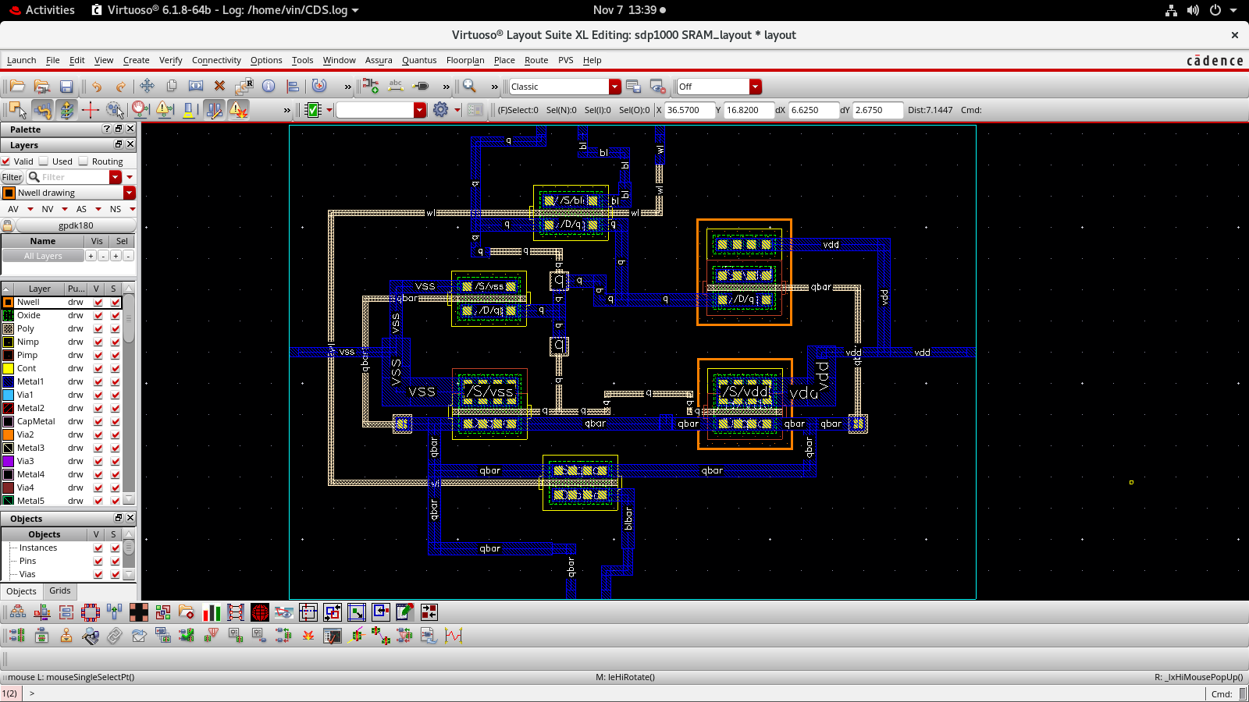
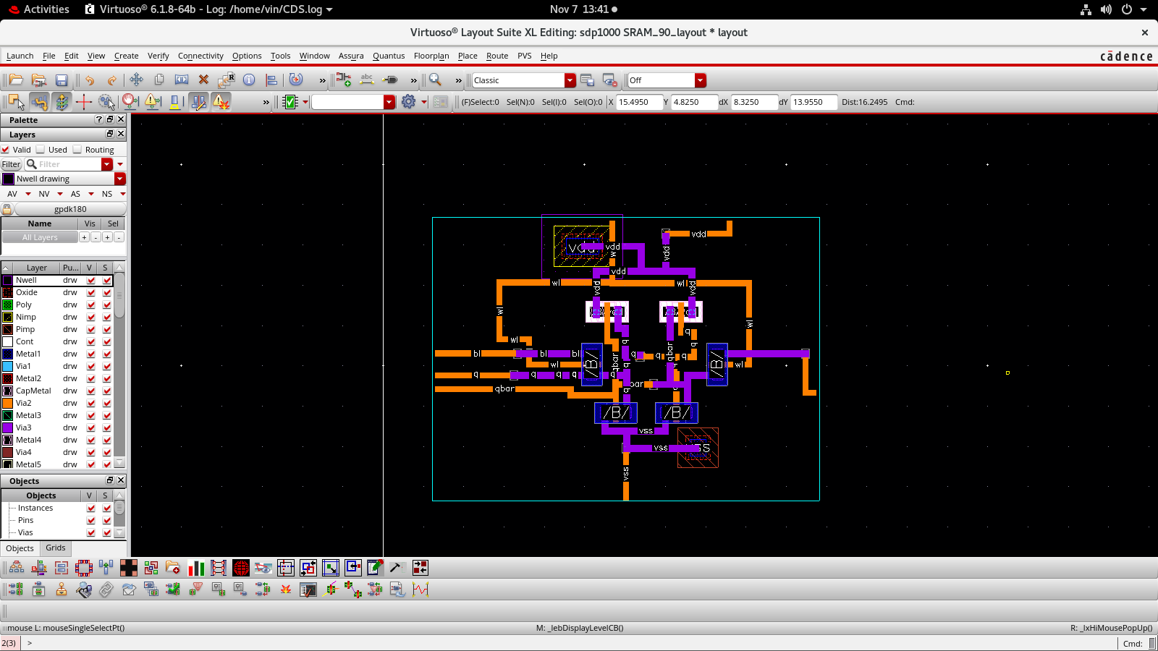
Layout Design of 180nM and 90nM :
180 nM technology :
90 nM technology :

Slide 15
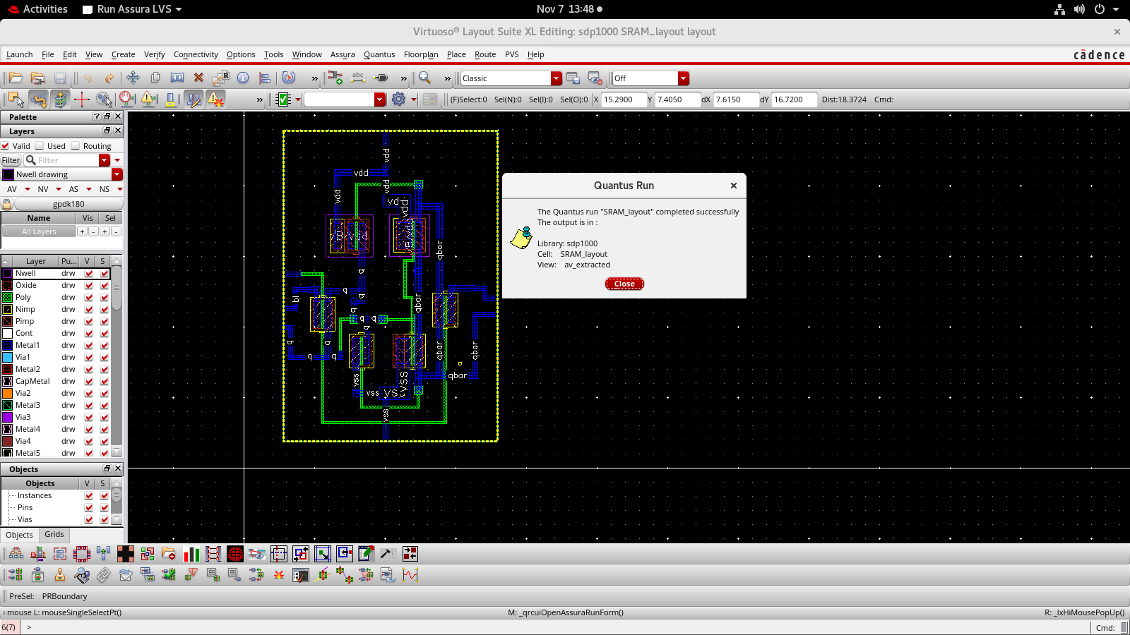
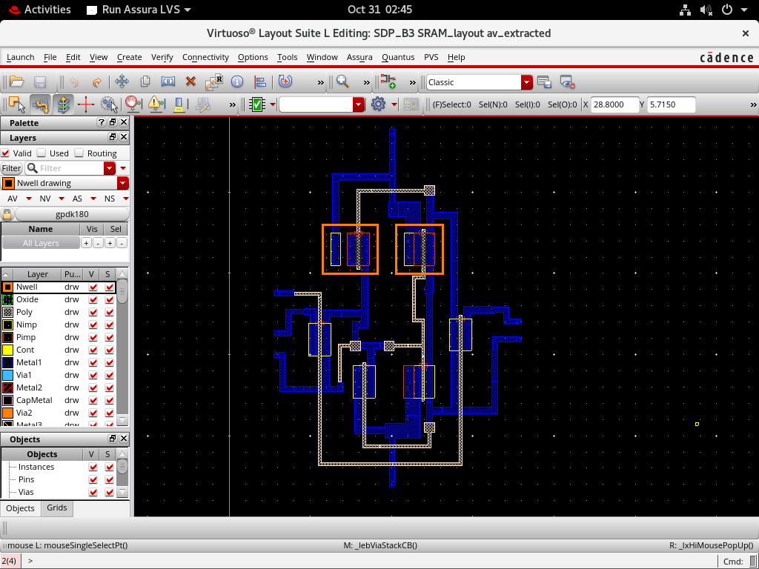
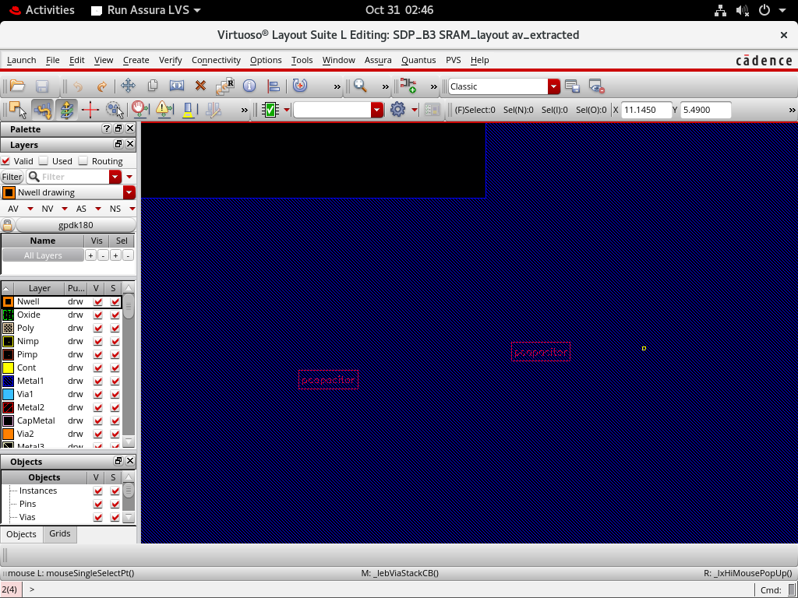
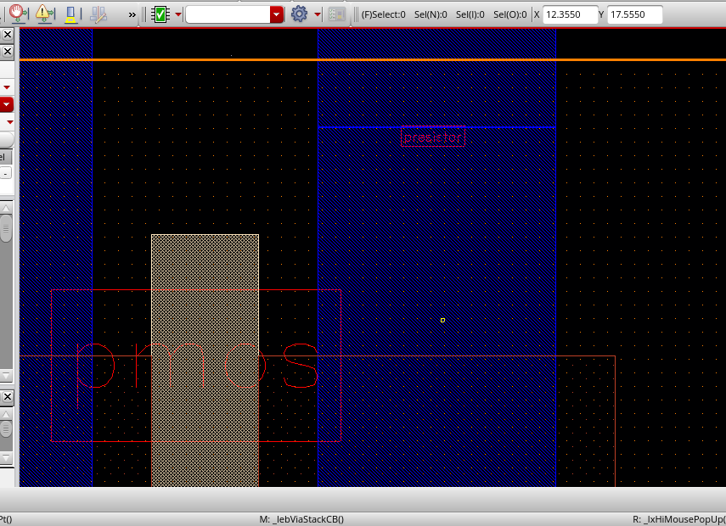
Parasitic Extraction of 180nM and 90nM :
AV Extracted
Parasitic Capacitors
Parasitic Resistors

Slide 16
Write Delay and Power Comparison of 6T SRAM Across Technology Nodes :
180 nM Technology Node :
VDD | Comparison of Literature paper v/s Practical values | Rising to Falling 1→0 Delay (ns) | Falling to Rising 0→1 Delay (ns) | Avg Power at VDD=1.2V
1.0V | Dataset | 0.255 | 0.500 | -
1.0V | Practical | 0.240 | 0.410 | -
1.2V | Dataset | 0.166 | 0.358 | -
1.2V | Practical | 0.180 | 0.340 | -
1.2V | Avg Power | - | - | Q: 0.599mW Qbar: 0.598mW
2. 90 nM Technology Node :
VDD | Comparison of Literature paper v/s Practical values | Rising to Falling 1→0 Delay (ns) | Falling to Rising 0→1 Delay (ns) | Avg Power at VDD=1.2V
1.0V | Dataset | 0.0912 | 0.1403 | -
1.0V | Practical | 0.098 | 0.100 | -
1.2V | Dataset | 0.067 | 0.119 | -
1.2V | Practical | 0.039 | 0.100 | -
1.2V | Avg Power | - | - | Q: 0.625mW Qbar: 0.403mW

Slide 17
3. 45 nM Technology Node :
VDD | Comparison of Literature paper v/s Practical values | Rising to Falling 1→0 Delay (ns) | Falling to Rising 0→1 Delay (ns) | Avg Power at VDD=1.2V
1.0V | Dataset | 0.062 | 0.082 | -
1.0V | Practical | 0.019 | 0.020 | -
1.2V | Dataset | 0.0378 | 0.0477 | -
1.2V | Practical | 0.011 | 0.020 | -
1.2V | Avg Power | - | - | Q: 0.586mW Qbar: 0.610mW

Slide 18
Limitations & Sources of Error
Limitations: Reduced noise margin and increased leakage at smaller technology nodes.
Sources of error: Process variation, simulation tool limitations, and parasitic effects in layout.
Limitation: Temperature dependence of stability in SRAM operation.
Error source: Human errors in schematic or layout creation leading to incorrect results.

Slide 19
Conclusion
The project successfully demonstrates that technology scaling plays a vital role in improving SRAM efficiency. The 45 nm technology offers better performance in terms of speed and power consumption, making it ideal for low-power and high-speed applications. The 90 nm node provides a balanced trade-off between stability and power, while 180 nm offers higher noise immunity with larger area and delay. Thus, optimized transistor sizing and design techniques are essential to ensure reliable and energy-efficient SRAM operation in advanced VLSI systems.

