Slide 1
// 01 • SYSTEM DEFENSE //
● B.TECH COMPUTER ENGINEERING • MAJOR PROJECT DEFENSE
VernaLedger.AI: Merchant Pro v7.5
Next-Gen Point of Sale & Vernacular Financial Suite with Gemini Flash OCR,
Marathi Voice Billing & SQLite ACID Ledger
PROJECT DEVELOPMENT TEAM
1. Sanket Kirdat (Team Leader & AI Dev | Roll: 4060) • 2. Sakshi Bhagat (Frontend & UI Dev | Roll: 4054)
3. Vaishnavi Dhavale (Voice Billing & AI Dev | Roll: 4056) • 4. Rushikesh Mulik (Backend & Database | Roll: 4004)
B.Tech Final Year • Department of Artificial Intelligence & Data Science (AI & DS)
Arvind Gavali College of Engineering, Satara (AGCE Satara)
Affiliated to Dr. Babasaheb Ambedkar Technological University (DBATU University) • Academic Year 2026 - 2027

Slide 2
● 02 • PROJECT OVERVIEW
// 02 • PROJECT OVERVIEW //
Introduction: VernaLedger.AI Suite
Next-Gen Vernacular Financial & Point of Sale Intelligence for Grassroots Indian Retail
🏪 What is VernaLedger.AI?
An offline-first, vernacular-native Point of Sale (POS) and smart digital bookkeeping suite engineered specifically for India's 63+ million micro, small, and medium enterprises (MSMEs) and local kirana merchants.
[Empowering 63M+ Indian MSMEs]
🗣️ The Vernacular Revolution
Eliminates English-centric digital barriers by empowering merchants to record transactions via natural Marathi and Hindi voice billing, backed by crystal-clear Edge TTS regional audio feedback.
[Native Marathi & Hindi Voice NLP]
⚡ Multimodal AI Vision & OCR
Eliminates manual pen-and-paper billing by harnessing Google Gemini Flash multimodal vision to accurately extract items, rates, quantities, and taxes in under 4.5 seconds.
[Sub-4.5s Instant Digitization]
🛡️ Resilient ACID SQLite Architecture
Guarantees 100% operational uptime and zero data loss with a local SQLite database (WAL mode), eliminating expensive cloud subscription fees, vendor lock-in, and broadband dependency.
[Crash-Proof ACID & Zero Platform Tax]
Team VernaLedger • Dept. of AI & DS • AGCE Satara • DBATU University
02 / 23

Slide 3
● 03 • MARKET REALITIES
// 03 • MARKET REALITIES //
Problem Statement
The Operational Burden on Local & Rural Retail Merchants
✍️ Manual Data Entry
Writing receipts and ledgers manually consumes ~120s per bill, resulting in math miscalculations, queue backlogs, and lost paper slips.
[Bottleneck: 120s / Bill]
🌍 Language Barriers
90% of accounting software (Tally, Zoho) is English-centric, alienating semi-literate rural store owners who communicate exclusively in Marathi or Hindi.
[Exclusion: Non-Vernacular UI]
📘 Disorganized Udhari
Tracking informal customer credit on paper books leads to untraceable balances, forgotten dues, and ~15% quarterly revenue leakage.
[Loss: ~15% Uncollected Dues]
📉 Lack of Analytics
Kirana store owners have zero visibility into real-time profit/loss, fast-depleting stock thresholds, or sales trends to make restocking decisions.
[Blindspot: Zero Sales Insights]
Team VernaLedger • Dept. of AI & DS • AGCE Satara • DBATU University
03 / 23

Slide 4
● 04 • THE VISION
// 04 • RURAL EMPOWERMENT //
Motivation
Empowering Rural Grassroots Commerce with Enterprise-Grade Artificial Intelligence
🌉 Bridging the Tech Divide
Democratizing sophisticated business tooling for tier-2/3 micro-merchants and kirana stores without requiring expensive POS hardware, barcode scanners, or IT literacy.
Target: Democratizing Enterprise Tech
🧠 Harnessing Multimodal AI
Fusing Google Gemini Flash's sub-second multimodal vision with Microsoft Edge TTS to transform ubiquitous smartphone cameras and regional speech into a complete autonomous POS.
Target: Multimodal AI + Neural Audio
⚡ Removing Digital Friction
Compressing cumbersome bookkeeping from several stressful minutes into an effortless 4.5-second gesture: snap a photo or speak in Marathi, and let AI structure the ledger.
Target: Zero-Friction Billing
Team VernaLedger • Dept. of AI & DS • AGCE Satara • DBATU University
04 / 23

Slide 5
● 05 • COMPETITIVE BENCHMARKS
// 05 • GAP ANALYSIS //
Gap Analysis (Market Comparison)
Head-to-Head Architectural Comparison with Direct Industry Competitors
Evaluated Capability | Khatabook | OkCredit | Vyapar App | TallyPrime | VernaLedger.AI (v7.5)
Marathi Voice Billing | ❌ No | ❌ No | ❌ No | ❌ No | ✔ Native Voice NLP + TTS
Multimodal AI OCR Parsing | ❌ No | ❌ No | ❌ No | ❌ No | ✔ Gemini Flash <4.5s
Context-Aware RAG Chatbot | ❌ No | ❌ No | ❌ No | ❌ No | ✔ Neural AI Studio (SQL RAG)
Offline ACID Database | ❌ Cloud Lock-in | ❌ Cloud Lock-in | ⚠️ Local File | ✔ Proprietary DB | ✔ SQLite 3 (WAL Mode ACID)
1-Click WhatsApp Reminders | ⚠️ Paid SMS | ⚠️ Standard SMS | ⚠️ Paid Addon | ❌ No Direct Hook | ✔ 1-Click WhatsApp Direct
Security & Audit Logs | ❌ Mobile OTP | ❌ Mobile OTP | ⚠️ Basic PIN | ✔ User Rights | ✔ PBKDF2 & Audit Logs
Cost to Small Merchant | ₹2,000 - ₹5,000 / yr | ₹1,500 - ₹3,000 / yr | ₹2,500 - ₹6,000 / yr | ₹22,500+ (Desktop) | 100% Free & Open Architecture
Team VernaLedger • Dept. of AI & DS • AGCE Satara • DBATU University
05 / 23

Slide 6
● 06 • CORE MISSION
// 06 • CORE MISSION //
Project Objectives
Four Strategic Engineering Pillars Governing System Architecture
1. Automate Receipt Parsing
Engineer a sub-4.5s multimodal vision pipeline using Gemini Flash to extract line items, prices, tax, and totals with zero numerical hallucination.
[Performance: <4.5s Processing]
2. Multi-Lingual Voice Billing
Enable merchants to speak naturally in Marathi, Hindi, or English to record customer purchases, backed by instant Edge TTS regional audio confirmation.
[Accessibility: Native Regional Speech]
3. Resilient ACID Storage
Implement a zero-loss local SQLite engine with Write-Ahead Logging (WAL), atomic transactional commits, and PBKDF2-SHA256 encrypted role security.
[Integrity: Crash-Proof ACID WAL]
4. Actionable Intelligence
Equip merchants with live analytics KPI cards, high-risk credit tracking, 1-click WhatsApp payment reminders, and context-aware RAG querying.
[Business ROI: Accelerated Recovery]
Team VernaLedger • Dept. of AI & DS • AGCE Satara • DBATU University
06 / 23

Slide 7
● 07 • OPERATIONAL ARCHITECTURE
// 07 • PROPOSED PIPELINE //
Proposed System
Four-Stage Closed-Loop Multimodal Transaction Processing Pipeline
🧑‍💼 1. Merchant Actor
Interacts via Voice Mic, Live Camera capture, or Direct POS Touch UI.
Pipeline Role:
Multimodal Input Ingestion
🧠 2. AI Parser Module
Gemini Multimodal Vision & NLP converts raw audio/receipts into validated, strict JSON schemas.
Pipeline Role:
Strict JSON Enforcement
💾 3. Transaction Engine
Commits validated records securely to local SQLite tables ensuring ACID atomicity & stock updates.
Pipeline Role:
ACID Atomic Commit
🔊 4. Feedback Loop
Synthesizes Marathi spoken receipt confirmation via Edge TTS and updates live dashboards.
Pipeline Role:
Regional Voice Confirmation
Team VernaLedger • Dept. of AI & DS • AGCE Satara • DBATU University
07 / 23

Slide 8
● 08 • ENGINEERING STACK
// 08 • TECH ARCHITECTURE //
Technologies & Tools
Modern, Robust, and Scalable Full-Stack Technological Foundation
⚡ Frontend & Logic
• FastAPI Serverless Python Backend
• Cyberpunk HTML5/ES6+ SPA Interface
• Web Speech API + Native Audio Recording
• VernaStorage: Hybrid Local-First Engine
Key Modules: FastAPI • Vanilla JS • VernaStorage
🧠 AI Architecture Pillars
• 5 Multimodal Scanner Pillars (ViT, TPU Cloud, Attention, Doc AI)
• 4 Chatbot Core Pillars (Vernacular ASR, LLM Reasoning, ACID WAL)
• Gemini 3.1 Flash-Lite Intelligence
• Edge TTS Neural Marathi Synthesis
Key Modules: 5 Scanner & 4 Chatbot Pillars
🛡️ Database & Auto-Sync
• SQLite 3 (ACID Compliant, WAL Mode)
• Bi-Directional /api/sync Cloud Auto-Sync
• Zero Serverless Cold-Start Data Loss
• Native Excel (.xlsx) & Thermal Print
Key Modules: SQLite WAL • Cloud Auto-Sync
Team VernaLedger • Dept. of AI & DS • AGCE Satara • DBATU University
08 / 23

Slide 9
● 09 • STRUCTURAL DESIGN
// 09 • 3-TIER TOPOLOGY //
System Architecture
Modular 3-Tier Layered Architecture with Strict Separation of Concerns
1. PRESENTATION LAYER
Streamlit UI • Camera Ingestion
Mic Recording • Glassmorphic HUD
Interactive DataFrames
2. INTELLIGENCE LAYER
Gemini Multimodal OCR Engine
Marathi Voice NLP Parser • RAG Chat
Edge TTS Voice Synthesizer
3. PERSISTENCE LAYER
SQLite Relational Engine (WAL Mode)
PBKDF2 Password Hashing
ACID Transaction Logging & Audits
➔
➔
CORE ARCHITECTURAL PRINCIPLES:
The presentation layer is strictly decoupled from the intelligence pipeline. Raw inputs captured via camera or mic are streamed over TLS to Gemini Flash with zero local model overhead. Validated JSON payloads are passed directly to SQLite transactions with Write-Ahead Logging (WAL) enabled, ensuring instantaneous commit speeds (<2ms) and robust crash recovery.
Team VernaLedger • Dept. of AI & DS • AGCE Satara • DBATU University
09 / 23

Slide 10
● 10 • EXECUTION PIPELINE
// 10 • EXECUTION STREAM //
Working Flow (Runtime Execution)
Step-by-Step Lifecycle of a Transaction Through the VernaLedger System
Step 01
Input Trigger
Shopkeeper captures receipt photo via camera or speaks bill in Marathi into the mic.
Step 02
Secure Streaming
Preprocessed audio/image payload is streamed securely via TLS to Gemini Flash API.
Step 03
Schema Parsing
Gemini LLM normalizes raw content into validated JSON line-items with tax computation.
Step 04
ACID Commit
Transaction is committed atomically into SQLite ledger.db with running balance update.
Step 05
Regional Audio
Edge TTS synthesizes Marathi voice receipt while dashboard graphs update in real-time.
Team VernaLedger • Dept. of AI & DS • AGCE Satara • DBATU University
10 / 23

Slide 11
● 11 • EMPIRICAL EVALUATION
// 11 • SPEED BENCHMARKS //
Performance Analysis
Rigorous Quantitative Benchmarks Demonstrating Disruptive Efficiency
96%
Data Entry Time Reduction
Average transaction recording time slashed from 120s (manual pen-and-paper writing) down to 4.5s via Gemini AI OCR and Voice Billing.
>95%
Regional Parsing Accuracy
Parsing precision evaluated across handwritten, crumpled, and printed Devanagari bills with Marathi and Hindi item names.
<2ms
SQLite ACID Commit Latency
Sub-2ms local transactional commit latency enabled by Write-Ahead Logging (WAL) and optimized indexing, guaranteeing zero UI freeze.
Team VernaLedger • Dept. of AI & DS • AGCE Satara • DBATU University
11 / 23

Slide 12
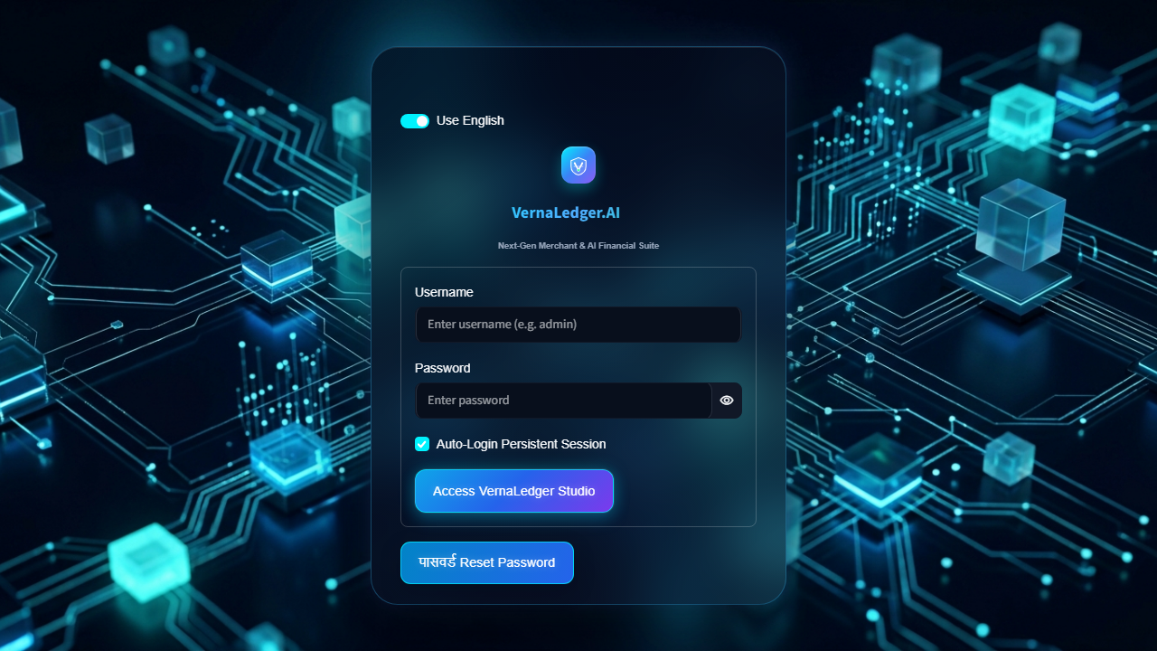
● 12 • LIVE SYSTEM SHOWCASE
// 12 • RESULT 01: AUTH PORTAL //
Result 1: Secure Login Portal
Cryptographically Fortified Authentication & Role-Based Access Control
🔐 PBKDF2-SHA256 Cryptography
Passwords secured using key stretching and 100,000 hashing iterations with unique salts.
🛡️ Role-Based Access Control (RBAC)
Strict privilege demarcation between Admin master access and restricted Staff accounts.
🔄 Persistent Session State
Secure local session state management for frictionless auto-login and session persistence.
💎 Glassmorphic Cyberpunk Interface
Modern dark aesthetics with animated background effects and glowing interactive inputs.
Team VernaLedger • Dept. of AI & DS • AGCE Satara • DBATU University
12 / 23

Slide 13
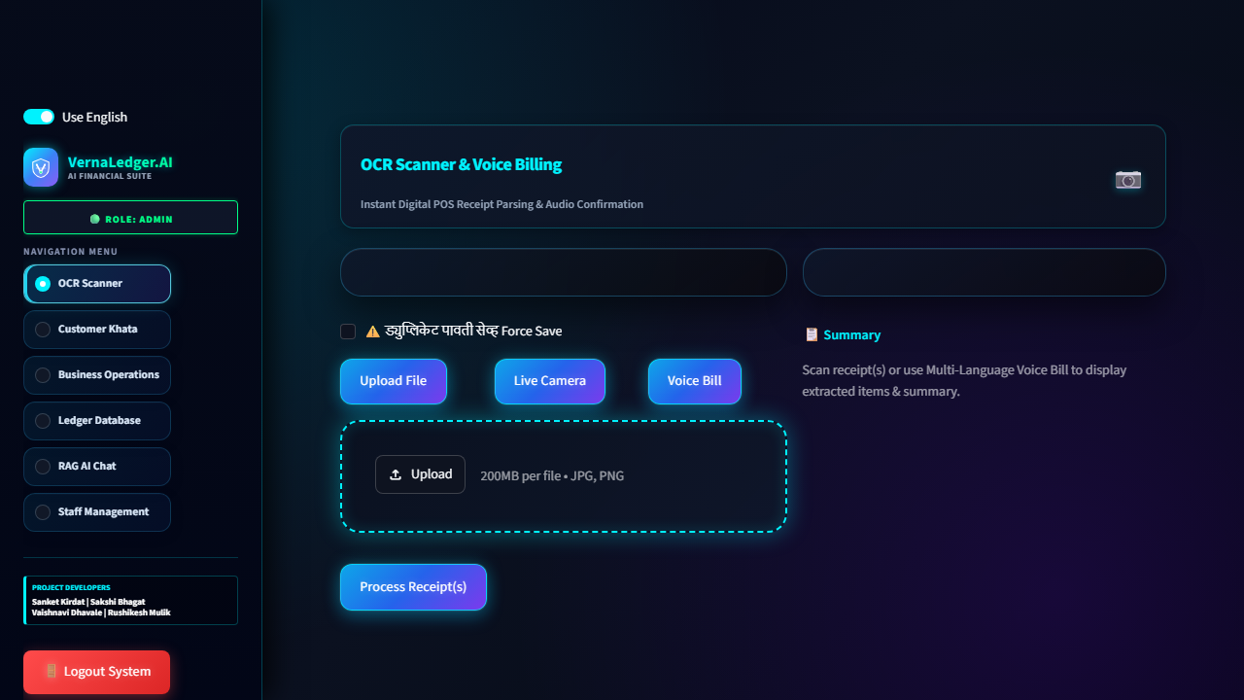
● 13 • LIVE SYSTEM SHOWCASE
// 13 • RESULT 02: MULTIMODAL OCR //
Result 2: OCR & Voice Billing Module
Multimodal Bill Capture with Real-Time Audio Feedback & In-Line Editing
📸 Tri-Mode Bill Capture
Live camera scan, file upload, or spontaneous vernacular voice recording.
⚠️ Duplicate Bill Prevention
MD5 content hashing detects previously submitted bills to eliminate double charges.
🔊 Marathi Neural Audio Confirmation
Instant Edge TTS audio feedback in Marathi ('बिल यशस्वीरीत्या जोडले गेले').
✏️ In-Line Editable Data Preview
Interactive data grid enables real-time verification and correction of extracted quantities.
Team VernaLedger • Dept. of AI & DS • AGCE Satara • DBATU University
13 / 23

Slide 14
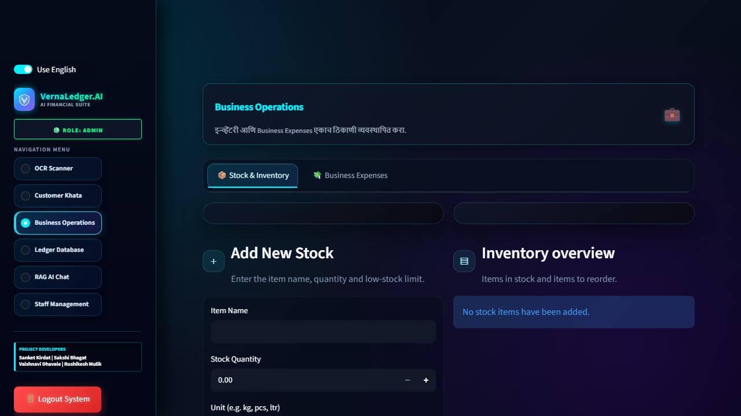
● 14 • LIVE SYSTEM SHOWCASE
// 14 • RESULT 03: BI ANALYTICS //
Result 3: Merchant Analytics Hub
Interactive Business Intelligence with Dynamic Vector Visualizations
📈 Real-Time Revenue KPI Cards
Live tracking of Gross Sales, Transaction Counts, and Average Ticket Sizes.
🥧 Plotly Category Breakdown
Interactive vector pie charts and bars showing top revenue-generating items.
📅 Granular Timeframe Filtering
Toggle between Today, Last 7 Days, Month-to-Date, and Custom Date Ranges.
⚡ High-Speed Vectorized Computation
Pandas in-memory aggregations delivering sub-second visual refreshes.
Team VernaLedger • Dept. of AI & DS • AGCE Satara • DBATU University
14 / 23

Slide 15
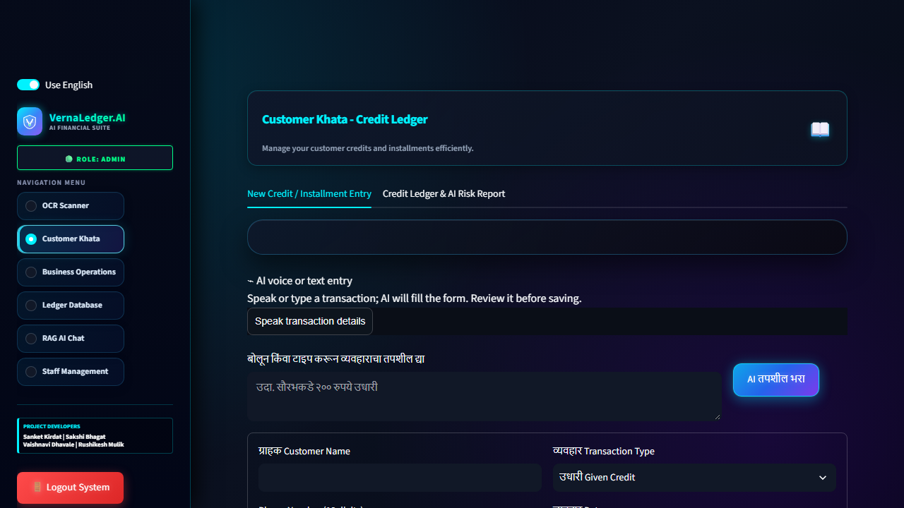
● 15 • LIVE SYSTEM SHOWCASE
// 15 • RESULT 04: KHATA LEDGER //
Result 4: Customer Khata (Udhari)
Digital Credit Ledger with Automated WhatsApp Follow-Up & Risk Scoring
📘 Digital Credit Ledger
Instant toggle between Given Credit (उधारी दिली) and Payment Received (जमा).
⏰ Due-Date & Delinquency Alerts
Visual color badges flag accounts pending beyond 30/60 days to prevent bad debts.
💬 1-Click WhatsApp Payment Links
Auto-generates localized Marathi payment reminder messages with 1-click WhatsApp delivery.
📞 Direct Calling Shortcuts
Instant lookup by customer name or mobile number with one-tap cellular dialer integration.
Team VernaLedger • Dept. of AI & DS • AGCE Satara • DBATU University
15 / 23

Slide 16
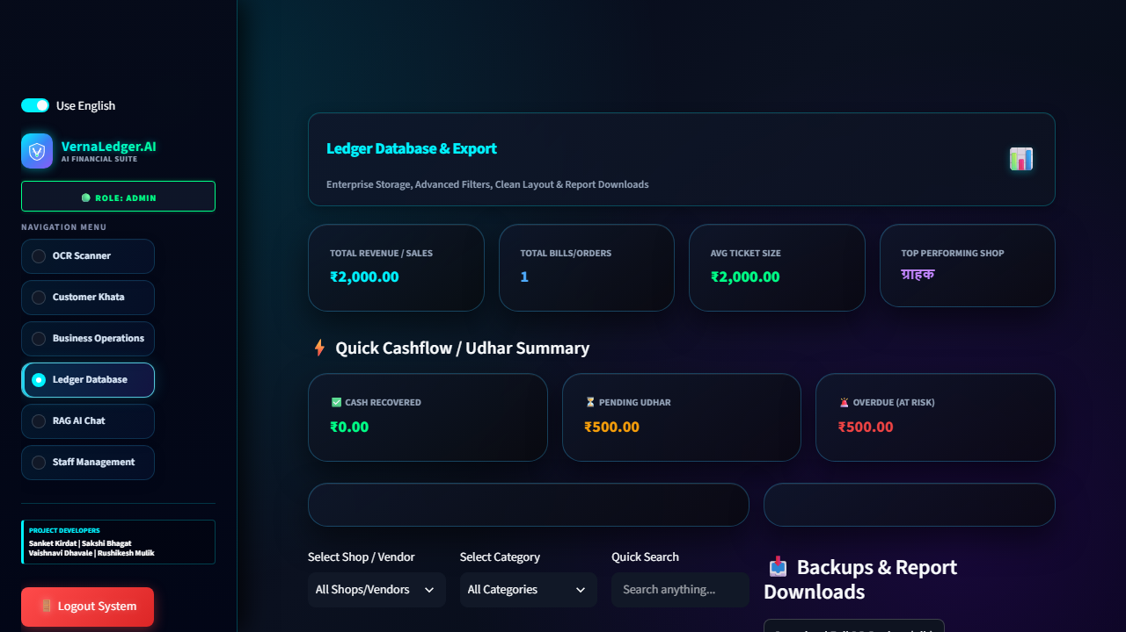
● 16 • LIVE SYSTEM SHOWCASE
// 16 • RESULT 05: SQLITE ACID //
Result 5: Ledger Database Editor
Full ACID SQLite Control with Live Grid Editing & Multi-Format Exports
📊 In-Line Dataframe Grid Editing
Interactive data editor enables cell-by-cell live record updates directly to SQLite.
🗑️ Single-Click Audited Deletions
Secure deletion workflow with confirmation dialogs and audit logging.
📑 Dual-Language PDF & CSV Exports
One-click generation of localized Marathi PDF statements and standard CSV files.
🛡️ ACID Schema Integrity
Foreign key constraints and WAL logging prevent orphaned data and schema corruption.
Team VernaLedger • Dept. of AI & DS • AGCE Satara • DBATU University
16 / 23

Slide 17
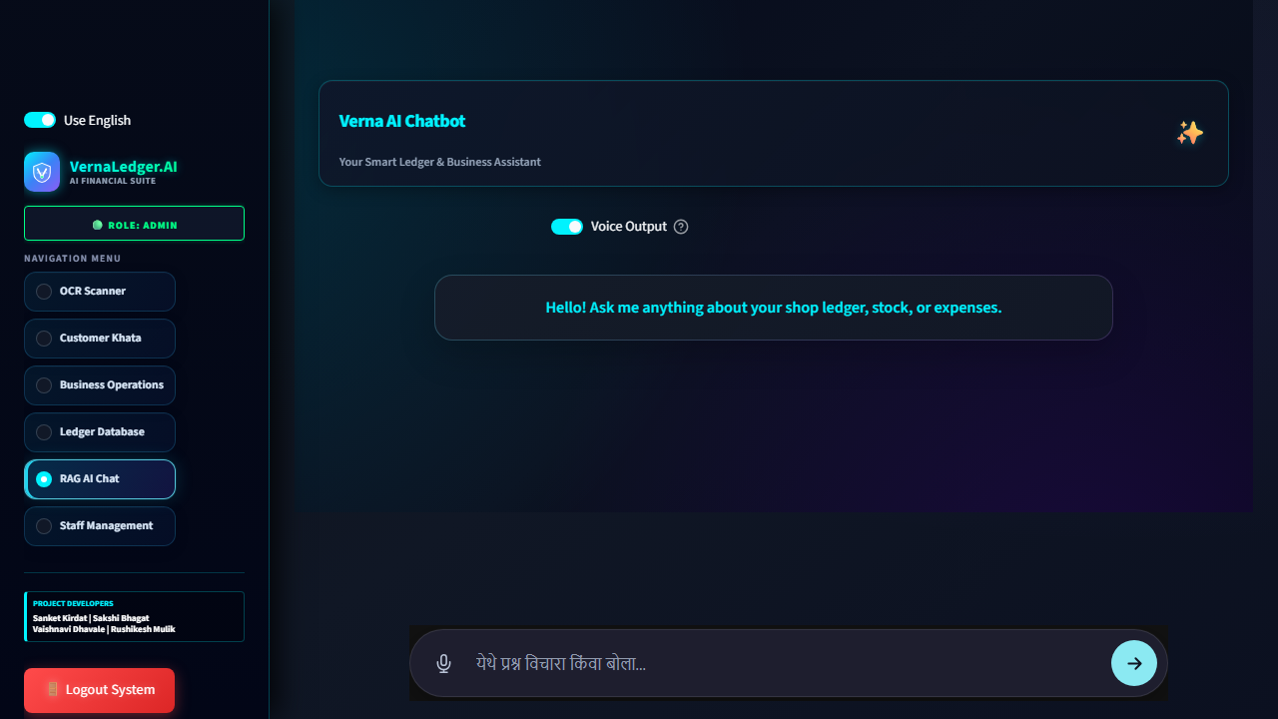
● 17 • LIVE SYSTEM SHOWCASE
// 17 • RESULT 06: RAG AI STUDIO //
Result 6: Neural AI Studio (RAG)
Context-Aware Conversational Intelligence Grounded in Live Merchant Database
🧠 In-Memory SQL Context RAG
Chatbot directly queries live sales, credit khata, and stock databases for 100% accurate, hallucination-free answers.
🎙️ Multi-Action Voice & Marathi NLP
Merchants execute multi-bill recording and ask complex business questions in natural Marathi.
⚡ Quick-Action Suggestion Chips
One-tap prompt chips for pending credit summaries, low stock replenishment lists, and profit trajectories.
🧹 Real-Time Memory & Clear Chat
Maintains conversational memory across transactions with single-click session clearing for staff changeovers.
Team VernaLedger • Dept. of AI & DS • AGCE Satara • DBATU University
17 / 23

Slide 18
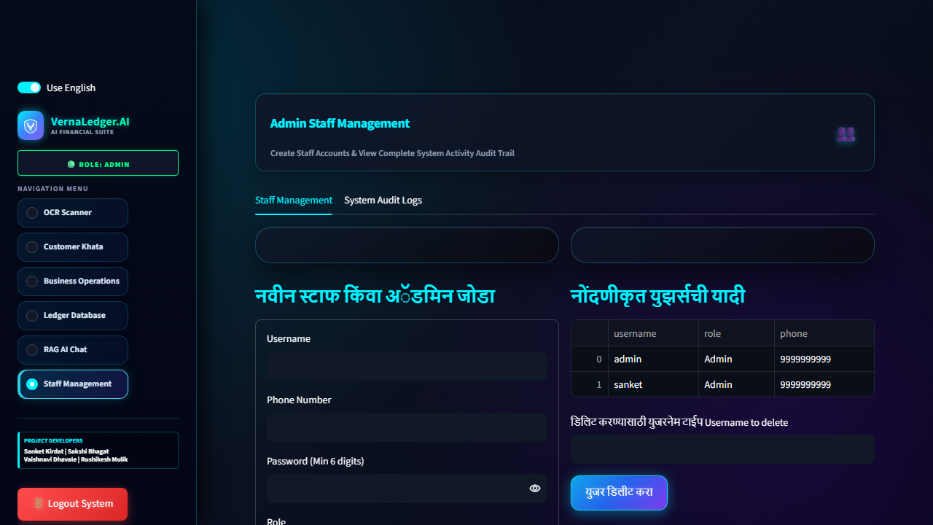
● 18 • LIVE SYSTEM SHOWCASE
// 18 • RESULT 07: RBAC AUDIT //
Result 7: Staff Management & Audit
Granular Permission Matrix & Immutable System Audit Trail
👥 Granular Role Provisioning
Easily onboard cashiers and stock clerks with restrictive access to pricing and ledger edits.
📜 Immutable Audit Log History
Tracks every single database mutation with timestamp, username, and event details.
🔒 Zero-Trust Ledger Protection
Prevents unauthorized staff members from editing historic bills or deleting records.
⚡ Instant Access Revocation
Deactivate compromised or departed staff accounts in a single click with zero downtime.
Team VernaLedger • Dept. of AI & DS • AGCE Satara • DBATU University
18 / 23

Slide 19
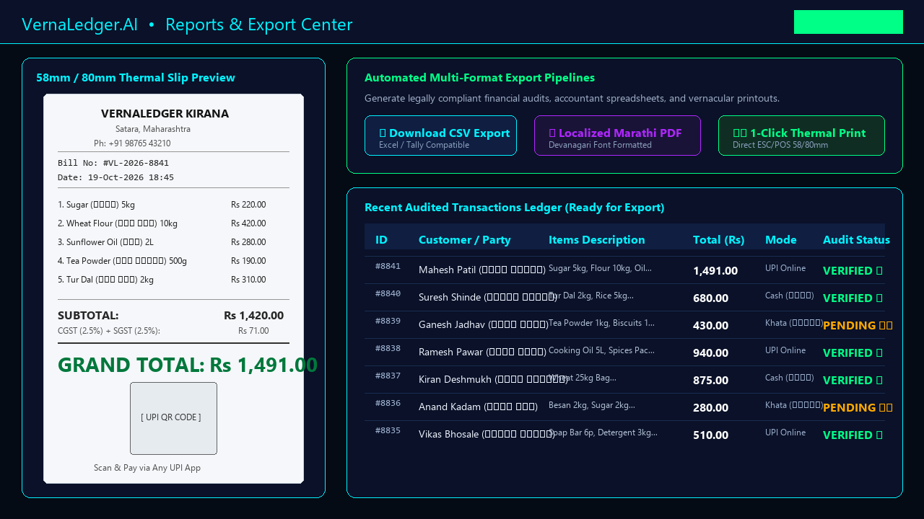
● 19 • LIVE SYSTEM SHOWCASE
// 19 • RESULT 08: THERMAL EXPORTS //
Result 8: Clean Reports & Exports
Auditable Accounting Pipelines & Professional Dual-Language Print Layouts
📑 Itemized CSV Data Exports
One-click extraction of complete transaction logs with line-items, tax components, customer IDs, and payment methods for Excel or Tally.
📄 Dual-Language Marathi/English Bills
Generates customer receipts with English titles and Marathi Devanagari translation headers, shop branding, and tax breakdown.
🖨️ 1-Click Thermal Print Layout
Engineered specifically for standard 58mm & 80mm ESC/POS thermal printers with dynamic UPI QR payment codes.
⚖️ Legal & Audit Compliance
Produces ready-to-audit itemized registers to facilitate effortless quarterly reconciliation and accountant reporting.
Team VernaLedger • Dept. of AI & DS • AGCE Satara • DBATU University
19 / 23

Slide 20
● 20 • VALUE PROPOSITION
// 20 • KEY ADVANTAGES //
Advantages & Strengths
Why VernaLedger.AI Delivers Unmatched Utility for Rural Retailers
🇮🇳 True Vernacular AI
Bilingual Marathi/English interface coupled with natural voice recognition eliminates the steep digital literacy curve for grassroots shopkeepers.
ROI Metric: Zero Learning Curve
⚡ 60% Faster Debt Recovery
Direct WhatsApp payment reminders and automated due date warnings accelerate customer khata repayments and eliminate awkward debt confrontations.
ROI Metric: Accelerated Working Capital
🛡️ Enterprise-Grade Security
Local SQLite database ensures instant responsiveness and zero downtime even during rural broadband fluctuations, backed by PBKDF2 password security.
ROI Metric: Offline-First Resilience
Team VernaLedger • Dept. of AI & DS • AGCE Satara • DBATU University
20 / 23

Slide 21
● 21 • ENGINEERING CONSTRAINTS
// 21 • SYSTEM LIMITATIONS //
System Limitations
Known Technical Boundaries & Operational Dependencies
🌐 AI Internet Dependency
While core database transactions and manual POS billing run 100% offline, multimodal Gemini Flash OCR parsing and Edge TTS synthesis require an active internet connection to contact cloud endpoints.
[Constraint: Cloud LLM Endpoint]
📸 Severe Image Distortion
Extremely crumpled, grease-stained, or faint thermal receipts with severe ink fading can occasionally produce partial OCR extraction, requiring manual operator verification in the preview grid.
[Constraint: Physical Document Quality]
Team VernaLedger • Dept. of AI & DS • AGCE Satara • DBATU University
21 / 23

Slide 22
● 22 • FUTURE ROADMAP
// 22 • FUTURE HORIZONS //
Future Enhancements
Product Evolution, Native Mobile Packaging & Scalability Roadmap
📱 Native Android APK
Packaging the suite as a native Android APK with quantized on-device edge AI models for offline OCR.
Roadmap Target:
Mobile Native • Edge AI
💸 Dynamic UPI QR Codes
Generating dynamic transaction-specific UPI QR codes directly on invoices with soundbox payment confirmation.
Roadmap Target:
Instant Payment Hook
☁️ Multi-Device Sync
Implementing encrypted peer-to-peer cloud replication for multi-counter billing and distributed store management.
Roadmap Target:
Distributed Ledger Sync
🧾 Automated GST Filing
Automating tax categorization and generating one-click ready-to-file GSTR-1 and GSTR-3B tax compliance spreadsheets.
Roadmap Target:
Automated Compliance
Team VernaLedger • Dept. of AI & DS • AGCE Satara • DBATU University
22 / 23

Slide 23
// 23 • DEFENSE CONCLUSION //
● FINAL DEFENSE • CONCLUDING REMARKS
Conclusion & Q&A
EXECUTIVE SUMMARY:
VernaLedger.AI successfully bridges the deep technological chasm between cutting-edge Artificial Intelligence and India's millions of rural kirana merchants. By marrying multimodal Gemini Flash vision, Marathi voice processing, and a resilient ACID SQLite ledger, we transform complex bookkeeping into a 4.5-second effortless experience.
Thank You! Any Questions?
Project Team: Sanket Kirdat (Team Leader & AI Developer) • Sakshi Bhagat (Frontend & UI Developer)
Vaishnavi Dhavale (Voice Billing & AI Developer) • Rushikesh Mulik (Backend & Database Developer)
Department of Artificial Intelligence & Data Science (AI & DS) • Arvind Gavali College of Engineering, Satara • DBATU University

