Slide 1
VernaLedger.AI: Merchant Pro v7.5
The Ultimate AI-Powered Ledger System

Slide 2

Result: Secure Login Portal
Access Management
• Authentication Security: PBKDF2 with SHA-256.
• Role-Based Access (RBAC): Admin vs. Staff.
• Persistent Sessions: Auto-login functionality.

Slide 3
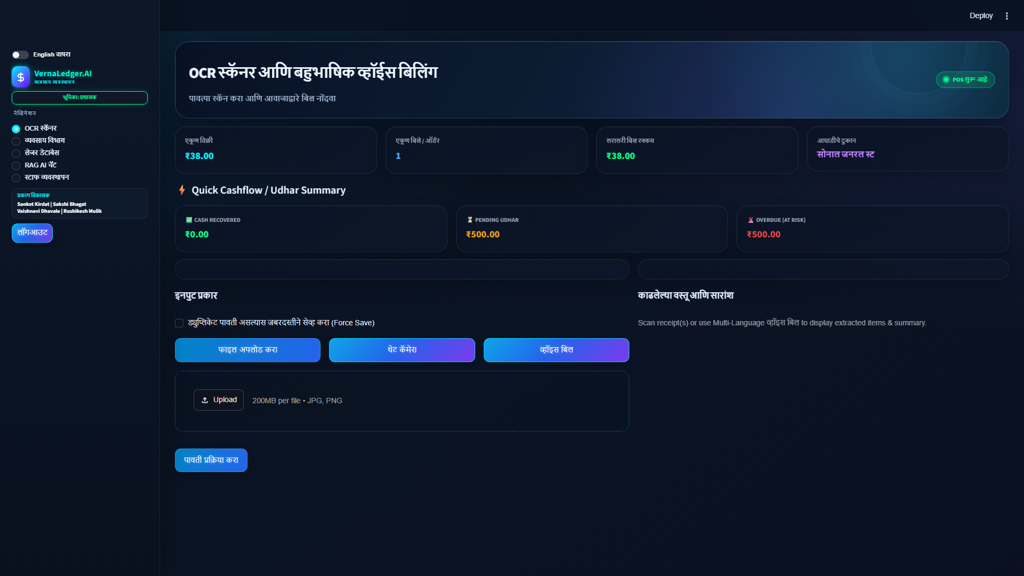
Result: OCR & Voice Billing Module
Core Engine Showcase
• Multimodal Bill Capture: File Upload, Camera, Voice.
• Duplicate Prevention: Automatic warnings.
• Audio Confirmation: Edge TTS in Marathi.

Slide 4
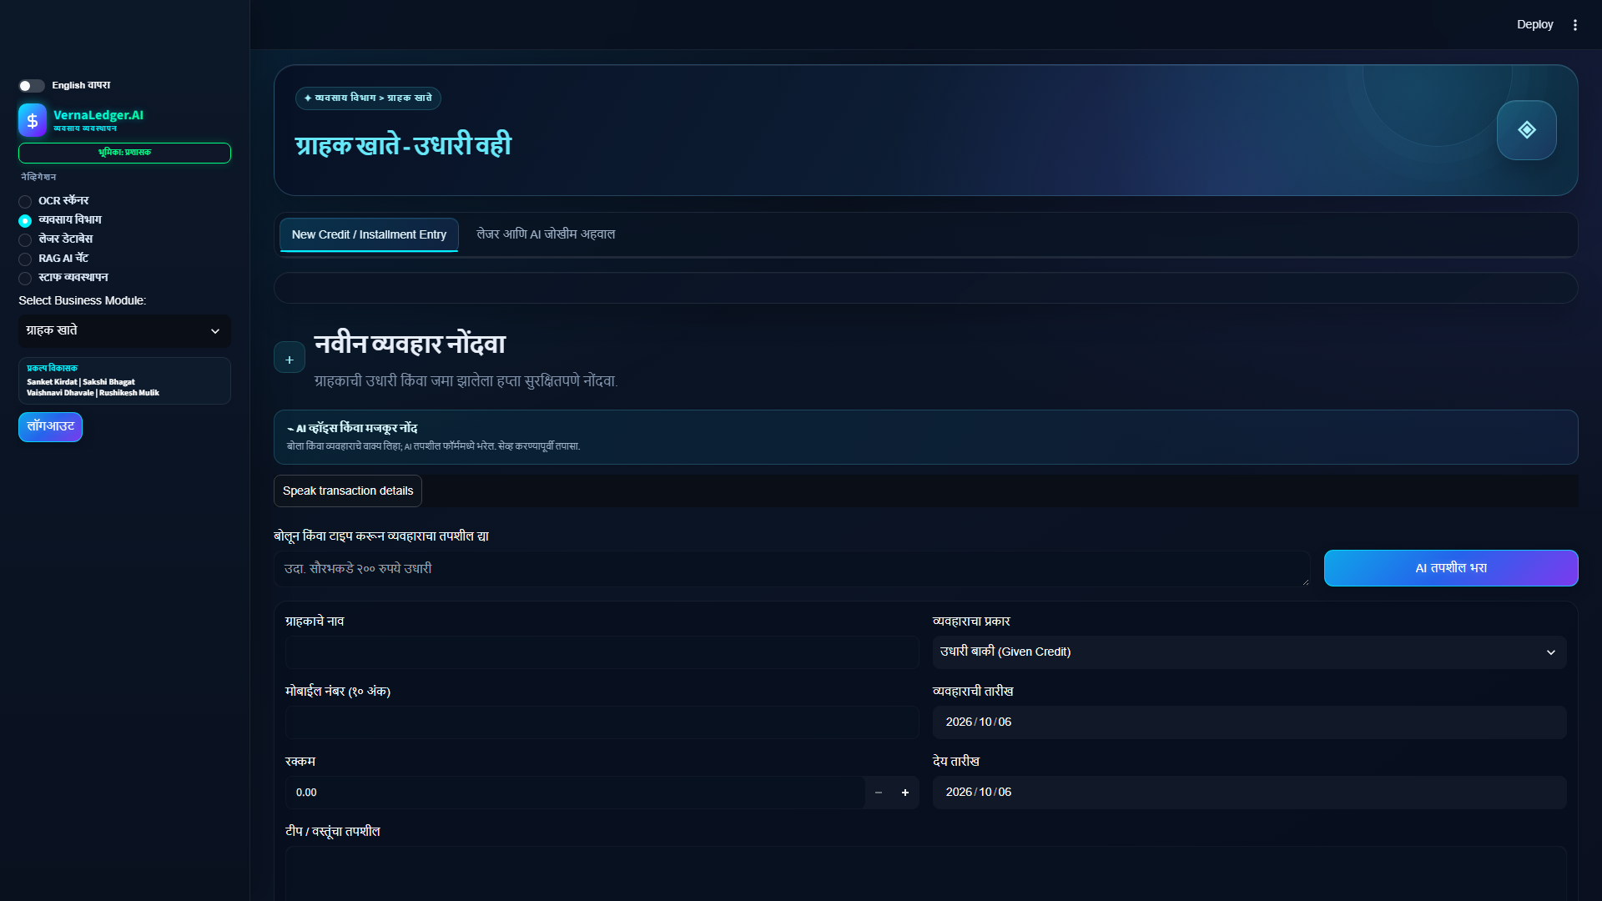
Result: Merchant Analytics Hub
Data Intelligence
• Sales Monitoring: Live KPI cards.
• Visualizations: Interactive pies and bar graphs.
• Timeframe Filtering: Daily, Weekly, Monthly.

Slide 5
Result: Customer Khata (Udhari)
Credit Management Dashboard
• Digital Ledger: Toggle Given & Received.
• Due Date Tracking: Automated high-risk alerts.
• One-Click Follow Up: WhatsApp links.

Slide 6
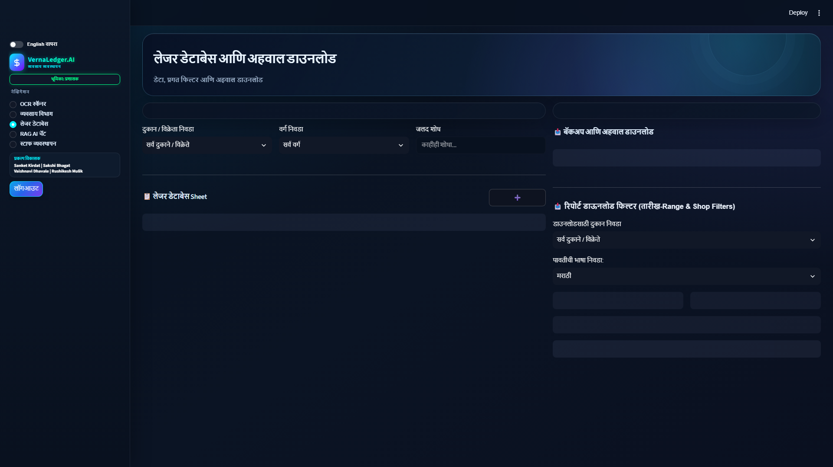
Result: Ledger Database Editor
Live Data Management
• ACID Storage & Live Editing: Interactive grid.
• Record Management: Secure deletions.
• Multi-Language Export: CSV or Marathi PDF.

Slide 7
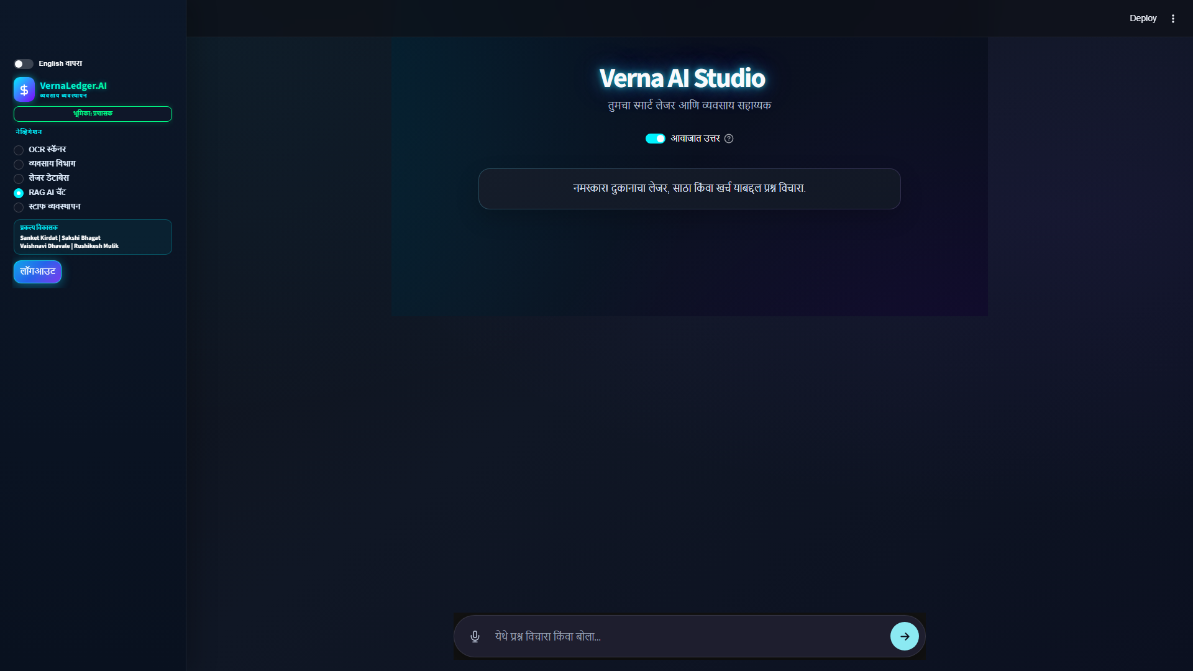
Result: Neural AI Studio (RAG)
Conversational Intelligence
• Context-Aware Chatbot: Chat with context.
• Voice Input: Ask in Marathi or Hindi.
• Quick Action Chips: One-tap prompts.

Slide 8
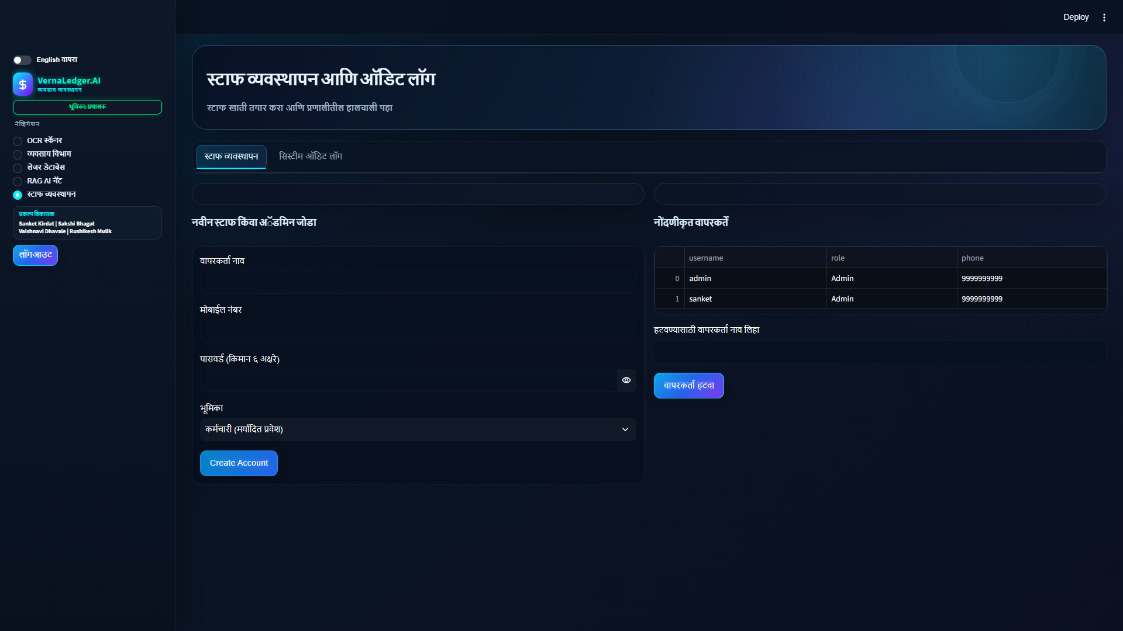
Result: Staff Management & Audit
System Accountability
• Role Access Setup: Wizard for Admin or Staff.
• System Audit Logs: Tracks 'Who did what'.
• Zero-Trust Security: Protects core system.

Slide 9
Thank You!

