Slide 1

Basic Details of the Team and Problem Statement
Ministry/Organization Name/Student Innovation: Student Innovation
PS Code: SM972
Problem Statement Title: Competitive Web Development Platform
Team Name: Goal Diggers Team Leader Name: Sanket Kittad
Institute Code (AISHE):
Institute Name: Pune Institute of Computer Technology
Theme Name: Smart Education

Slide 2
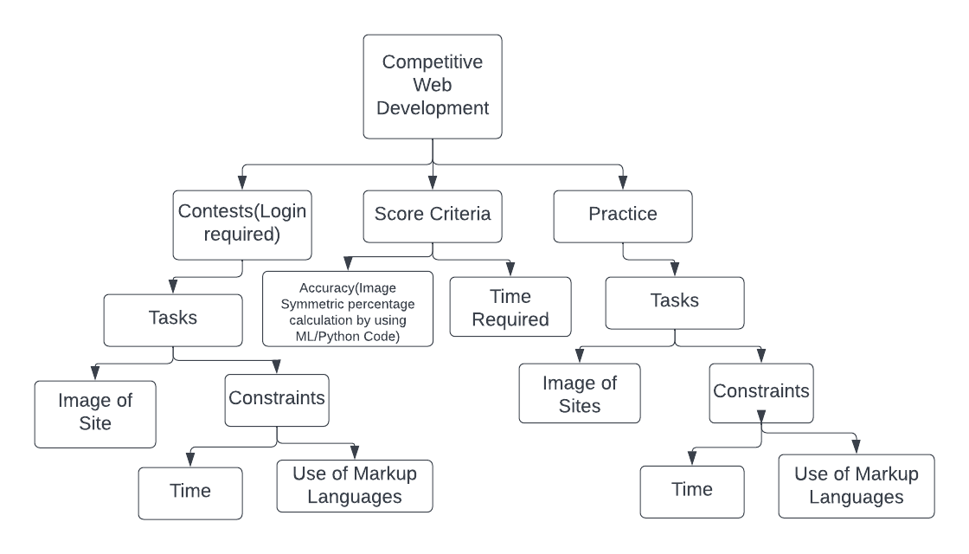
Idea/Approach Details
Describe your idea/Solution/Prototype here:
We aim at creating a website (platform) for users to showcase, test and improve their talents in the field of Web Development.
They will be given a task to clone a sample picture and would be assessed accordingly.
Assessment will be based on a few constraints like time limit, use of markup languages, etc.
Describe your Technology stack here:
We would be using opencv and python image processing algorithms to compare the submission page and the expected page.
It would be deployed on a Flask Backend.
The frontend would be made in basic HTML/CSS/JS/Bootstrap.

Slide 3
Idea/Approach Details
Describe your Dependencies / Show stopper here
Describe your Use Cases here
Online platform for coding practices in website development domain.
After signing in account:
User can practice some web dev problem statement as per his ability from simple to hard level.
User can participate in contest. He can try that problem statement and upload his responses. After submitting the responses he will get his result for that particular problem.
In future User can check history of his performance.
User can compare his code with the others or with the final code as already given on platform.
When the number of website visitors (traffic) increase, additional servers can be added to balance the load.
Using the ML/Python code for calculating the image similarity.
We cannot validate the syntax of the code.
We need to detect and analyse cases for where external platforms are used to avoid plagiarisms.

Slide 4
Team Member Details
Team Leader Name: Sanket Kittad
Branch (Btech/Mtech/PhD etc): Btech Stream (ECE, CSE etc): IT Year (I,II,III,IV): II
Team Member 1 Name: Yash Ashok Gurav
Branch (Btech/Mtech/PhD etc): Btech Stream (ECE, CSE etc): CSE Year (I,II,III,IV): II
Team Member 2 Name: Shreeya Khade
Branch (Btech/Mtech/PhD etc): Btech Stream (ECE, CSE etc): CSE Year (I,II,III,IV): II
Team Member 3 Name: Kalpesh Baviskar
Branch (Btech/Mtech/PhD etc): Btech Stream (ECE, CSE etc): CSE Year (I,II,III,IV): II
Team Member 4 Name: Yamini Tapde
Branch (Btech/Mtech/PhD etc): Btech Stream (ECE, CSE etc): ENTC Year (I,II,III,IV): II
Team Member 5 Name: Sushmita Hubli
Branch (Btech/Mtech/PhD etc): Btech Stream (ECE, CSE etc): ENTC Year (I,II,III,IV): II
Team Mentor 1 Name: Type Your Name Here
Category (Academic/Industry): Expertise (AI/ML/Blockchain etc): Domain Experience (in years):
Team Mentor 2 Name: Type Your Name Here
Category (Academic/Industry): Expertise (AI/ML/Blockchain etc): Domain Experience (in years):

Slide 5
THANK YOU

