Slide 1
Udaan institute
J.P.sir

Slide 2
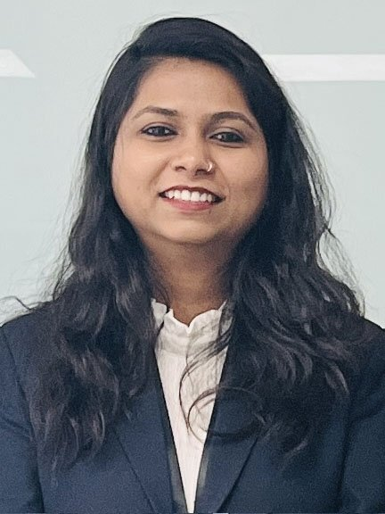
Founder & trustee
DIPMALA GUPTA
.They are the co-founder of udaan
There Colification :-
B A , MBA&DIPLOMA IN JO

Slide 3
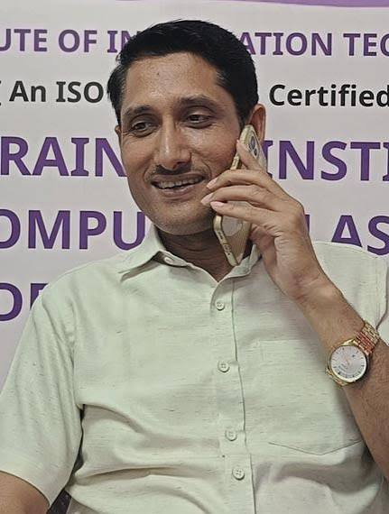
TRUSTEE
Dr. MANISH K DUBEY
They also the CEO of udaan
There Colification:-
MANAGING TRUSTEE IN UDAAN FOUNDATION (NGO) VOLUNTEER IN HELTH MISSION OF UDAAN

Slide 4
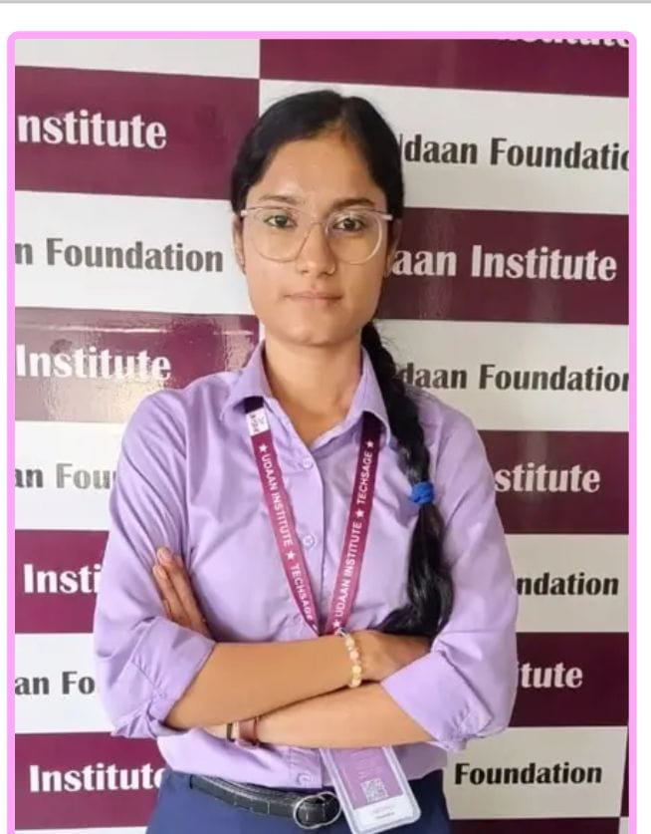
NANDANI MAM
They are my favorite DIDI.
SHE teach me web development .
Her Colification teach us :-
BASIC ,WEB DEVELOPMENT,POWER PONIT, DIGITAL MARKETING, EXCEL

Slide 5
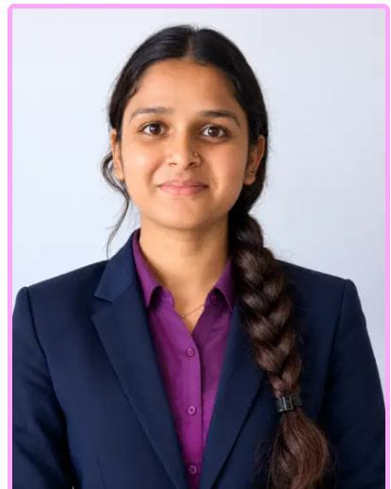
RAGINI MAM
They are teach me power point.
They are teach us :-
BASIC,TALLY, ADVANCE EXCEL ,POWER PONIT ETC.

Slide 6
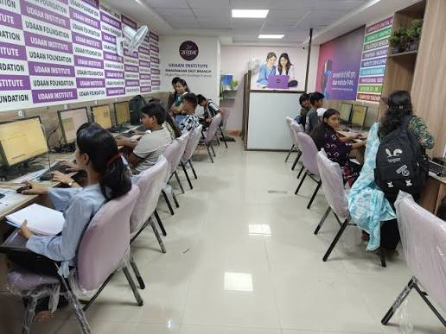
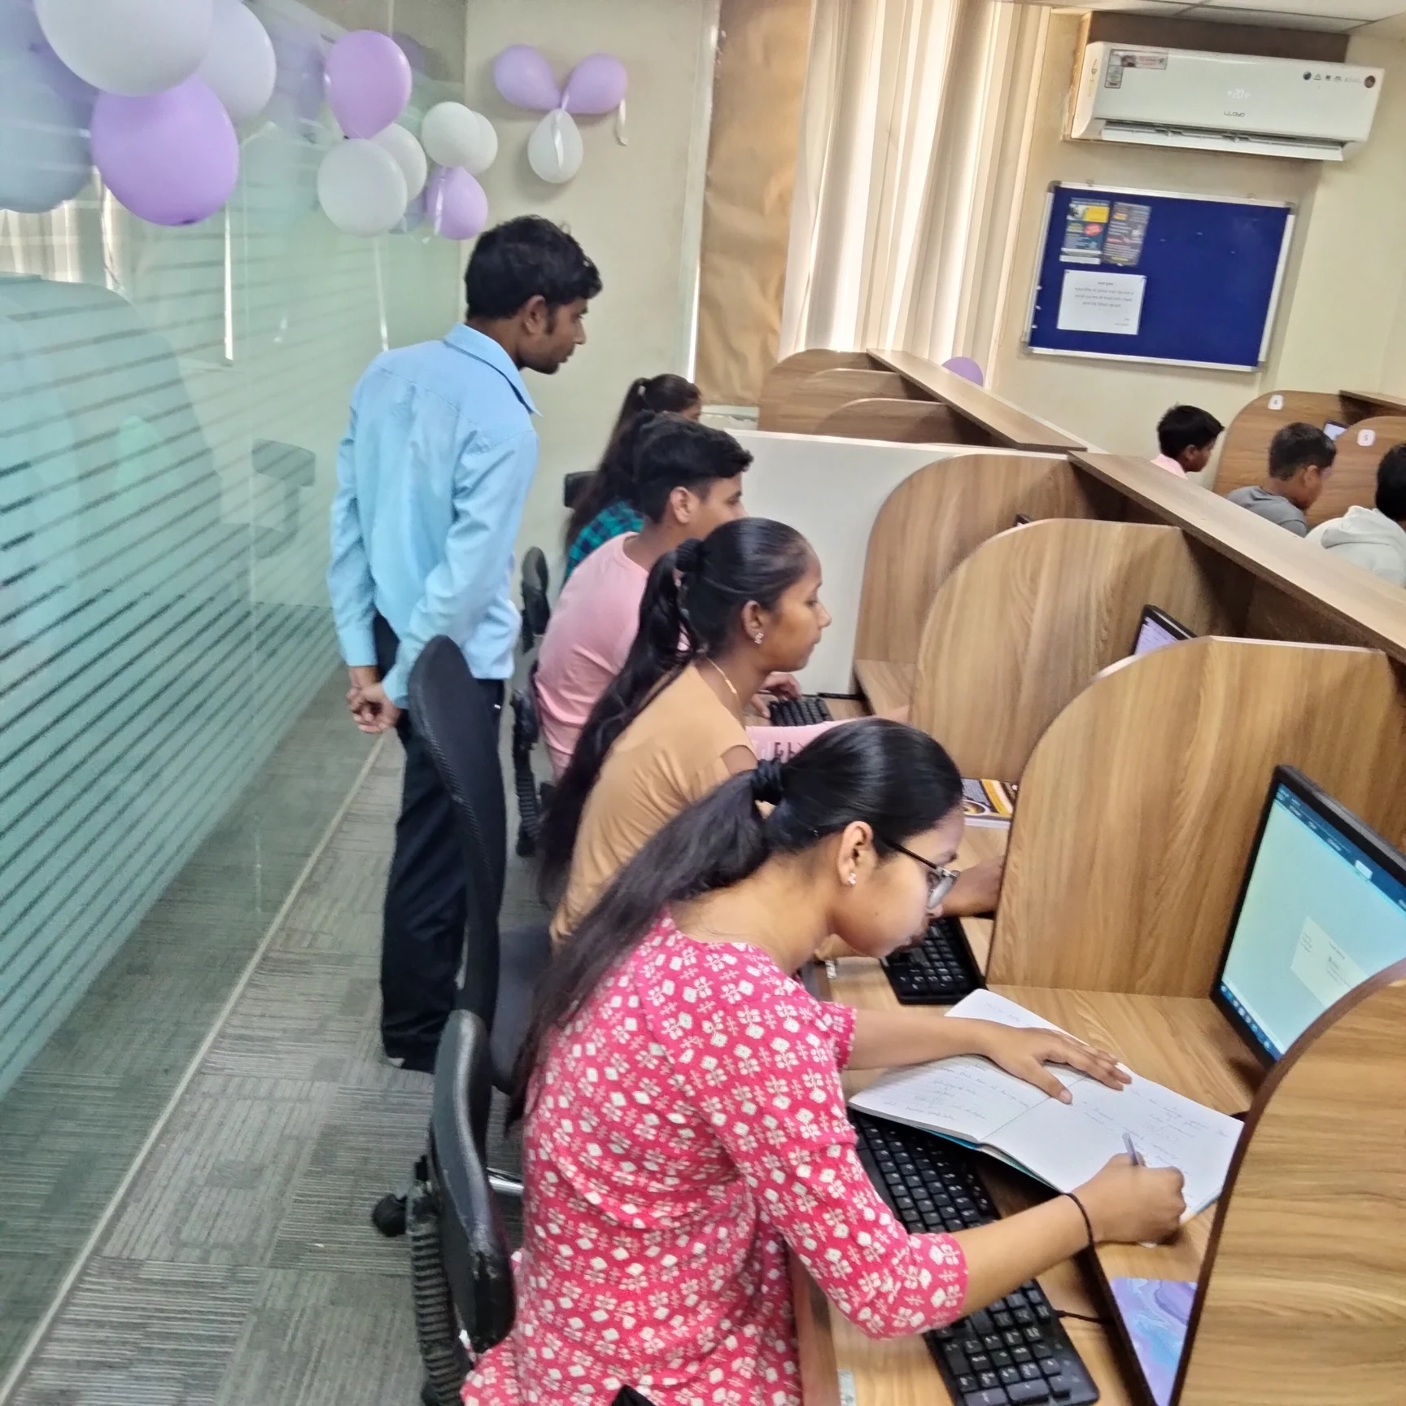
UDAAN BRACHES
KHOKRA BRACH
NAROL GAM

