Slide 1

Project Management Of Sanchay
Team number 15
Akshat Tandon
Anuj Rathore
Hemant Kasat
Sanket Markan

Slide 2
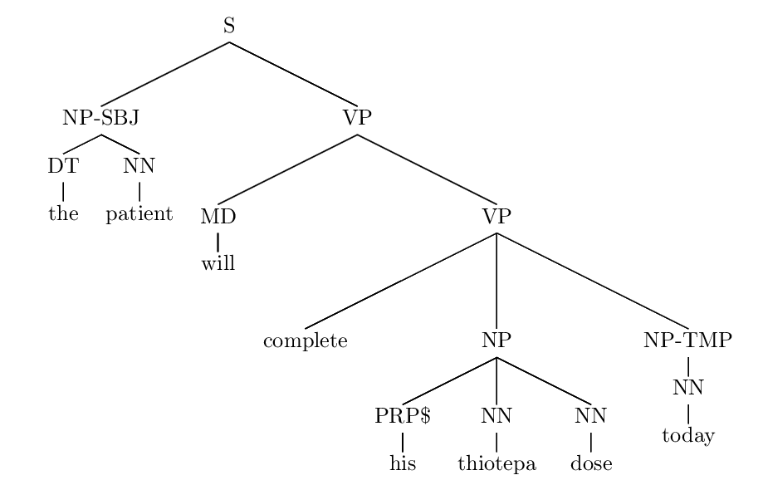
What is Sanchay ?
In a lay man’s term Sanchay is a special purpose text editor/processor which is used by people involved in the langauge processing community.
It is used mainly for syntactic annotation of documents which may be written in languages such as english,telugu,hindi etc.

Slide 3
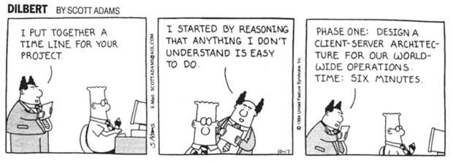
What is our project ?

Slide 4

Problem we are addressing
Language processing labs of various institutes like IIT-B,IIT-KGP,Jadavpur University use Sanchay for their annotation task however when there is a large project having hundreds of documents there is much chaos caused in dividing the work and distributing the documents to be annotated among research scholars.

Slide 5
How are we solving the problem?
By developing a system which allows lab/project heads to easily distribute and monitor a large language processing project involving hundreds of documents.

Slide 6
Our system has two components
A web interface through which a project head can upload the individual documents of the project,group them into batches and allot these batches to other project members.
Using this interface he can monitor whether the members have completed their task or not via batch status and deadlines and can communicate with the members via an internal messaging system.

Slide 7
Our system has two components
Extending the offline Sanchay tool by adding a module in it which allows project members to login and connect to the project server, download the files which have been allotted to him, annotate the files using Sanchay and sync his updated work back into the server.

Slide 8
Types of Users:
Moderator
Annotator

Slide 9
Moderator Features:
Batch Processing
View all the current batches.
Add/Edit batch.
Add/Edit files to a batch
View files to a batch
Assign batch to an annotator (user).
Status Tracker
Can see all upcoming deadlines of a batch assigned to an annotator.
If a deadline is approaching for a batch, then annotator can be reminded by a message from the moderator.

Slide 10
User Features:
Batch Features
View all the batches allotted to him/her.
Download files from the batch
Update files of a batch
Upload files to a batch..
Status Tracker
Can see all upcoming deadlines of a batch assigned to him/her.
If the deadline is approaching for a batch, then he/she can be reminded by an message from the Moderator.
Can send message to other users and moderator.

Slide 11
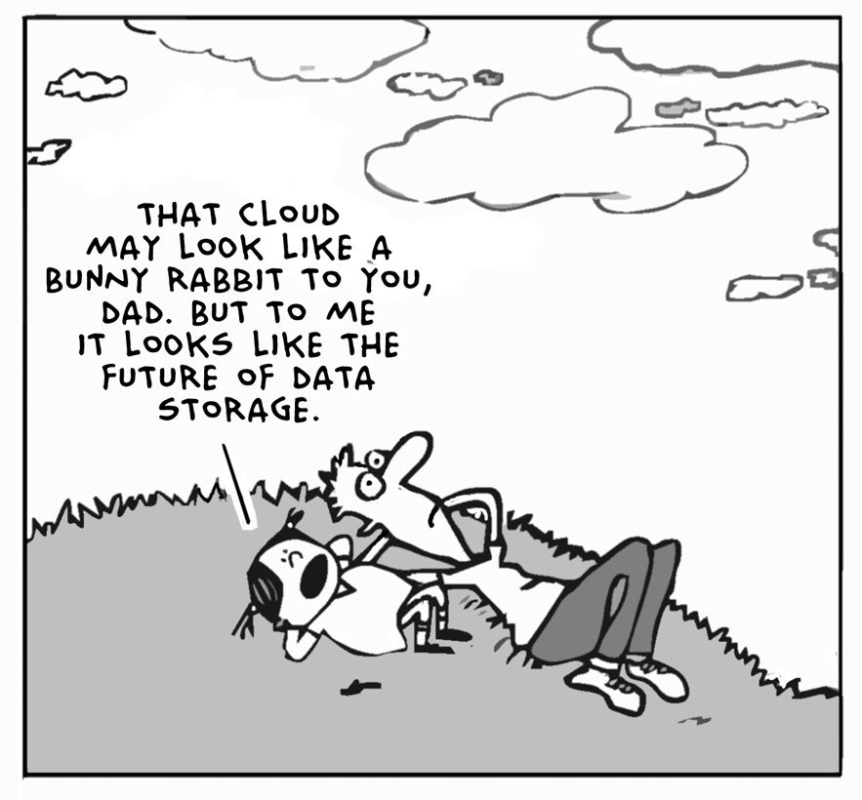

Slide 12
Login to Centralized Server
Remote file manager, for user to view allotted batches by the moderator.
View meta information of each batch such as deadline and annotation status.
Features added to Sanchay Annotation Tool

Slide 13
Ability to set the Annotation status of any batch.
Download files of any allotted batch from the server.
Upload annotated files back to the server.
Features added to Sanchay Annotation Tool

Slide 14
Thank you.

