Slide 1
Ant Colony Optimization
An adaptative nature inspired algorithm explained, concretely implemented, and applied to routing protocols in wired and wireless networks.

Slide 2
Plan
The ants
The double bridge experiment
From biological ants to agents
Java Implementation
  Demonstration 1
The different moves of the ants
  Demonstration 2
Adaptation of the Ants-based algorithm to routing protocols
ACO compared to RIP and OSPF
Examples of effective implementations
Results of the analysed reports
Questions

Slide 3
The ants
Can explore vast areas without global view of the ground.
Can find the food and bring it back to the nest.
Will converge to the shortest path.

Slide 4
How can they manage such great tasks ?
By leaving pheromones behind them.
Wherever they go, they let pheromones behind here, marking the area as explored and communicating to the other ants that the way is known.
Double Bridge experiment

Slide 5

Double Bridge experiment
Food

Slide 6
From biological ants to ant-agent
Distributed process:
  local decision-taking
  Autonomous
  Simultaneous
Macroscopic development from microscopic probabilistic decisions
Problem: adaptation to reality

Slide 7
From biological ants to ant-agent
Solution:
  Pheromone upgrade: evaporation.
  Ant aging: after a given time, ants are tired and have to come back to the nest.
  2 different pheromones : away (from nest) and back (from source of food).

Slide 8
Java Implementation
Object modeling:
  Definition of the objects:
    Ant
    Playground
    Traces
  Playground: central object, contains a list of ants, an array of traces. Manages the processes and the graphical output.
  Ant: can move by itself, according to the traces around it and a random decision.
  Traces: amount of pheromones of 2 types, Away and Back.

Slide 9
Demonstration 1
2-Bridge Experiment
Interesting Convergence

Slide 10
Possible moves of Ants
Four types:
  From home to food
    Goal has never been reached: moveStraightAwayFromAway();
    Goal reached: moveTowardAway();
  Back to home
    Goal has never been reached: moveFromFoodToHome();
    Goal reached: moveFromHomeToFood();
Idea: generates several random moves and see which one is the best among them.

Slide 11
Demonstration 2
A difficult playground

Slide 12
Adaptation of the Ants-based algorithm to routing protocols
E
F
D
A
Food
Nest
B
C
Ants will start from A the nest and look for D the food. At every step, they will upgrade the routing tables and as soon as the first one reaches the food, the best path will be known, thus allowing communication from D to A.

Slide 13
ACO Compared to RIP and OSPF
RIP / OSPF:
  Transmit routing table or flood LSPs at regular interval
  High routing overhead
  Update the entire table
  Based on transmission time / delay
ACO algorithm:
  Can be attached to data
  Frequent transmissions of ants
  Low routing overhead
  Update an entry in a pheromone table independently

Slide 14
Examples of effective implementations
Existing MANET routing protocols:
  DSDV, OLSR, AODV, DSR, ZRP (Zone Routing Protocol), GPSR (Greedy Perimeter Stateless Routing), TRP (Terminale Routing Protocol)
Routing protocols presented in the paper:
  ABC, Ant Based Control system, for wired networks.
  AntNet, for MANET.
  ARA, Ant-Colony-Based Routing Algorithm, for MANET.
  AntHocNet, for MANET.
  MARA, Multiple-agents Ants-based Routing Algorithm

Slide 15
Results of the analysed reports
ABC applied to SDH network (30 nodes): the routes are perfectly resumed and alternative possibilities are memorized as well.
AntNet in a complex wired network is more efficient than OSPF, and show very stable performances.
ARA, for 50 mobile nodes in 1500x300m area, give the same performance than DSR for less overhead traffic.
AntHocNet, simulated with QualNet: 100 nodes in 3000x3000m area, radio range of 300m, data rate 2Mbit/s. AntHocNet twice more efficient than AODV to deliver packets, and is more scalable

Slide 16
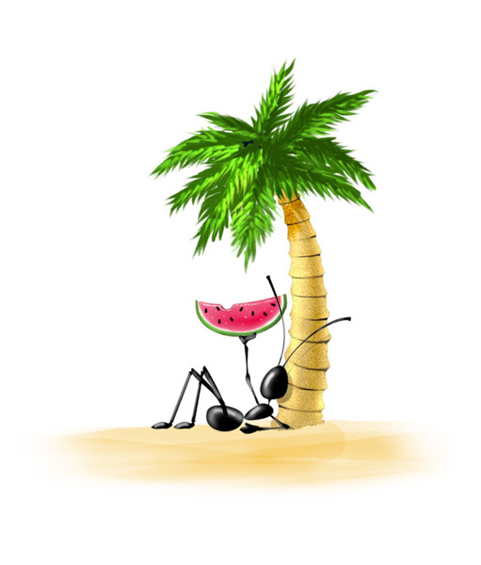
Questions ?

Slide 17
Thank you !

