Slide 1
Exam Review
3/18/2015
Genetic Code
Translation and Post-translation
Lectures 11-15
Dr. Binstock

Slide 2
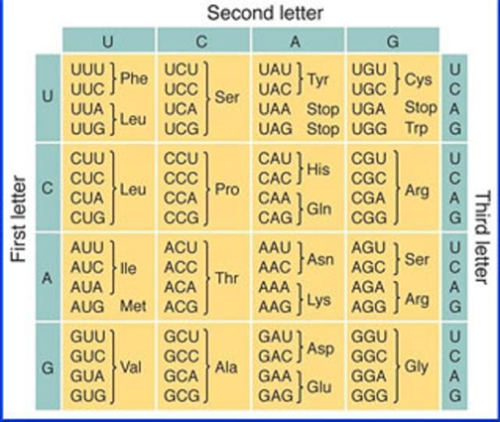
Problem 1
Given the following DNA antisense strand, what is the resulting peptide after translation? 5'ATGCCAGTAGGC3'
Met-Pro-Val -Gly
Gly-Pro-Val-Met
Pro-Thr-Trp-His
His-Trp-Thr-Pro
Ala-Tyr-Trp-His

Slide 3
Solution to Problem 1
5'ATGCCAGTAGGC3’
3’TACGGTCATCCG5’
mRNA:
5’ GCC UAC UGG CAU 3’
Ala Tyr Trp His

Slide 4
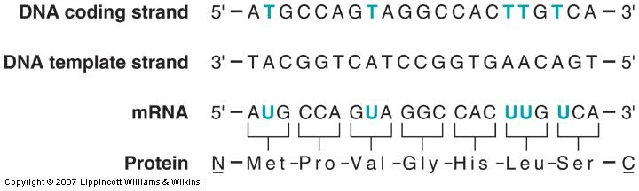
Coding & Template Strands
Non-template or sense: Same sequence as mRNA: Coding-makes protein
Antisense (does not code for protein): acts as Template for mRNA synthesis
This is the strand used for transcription
The coding (sense) strand of DNA has the same sequence as the RNA transcript
  DNA has T while RNA has U
The RNA transcript is complementary to the template (antisense) strand

Slide 5
Problem 2
Refer to the following mRNA sequence and the Genetic code:
5'AUGUGUAUGUUAUGA3'
If the ribosome slipped and read this message in the third reading frame, what would be the resulting C-terminus amino acid?
Leu
Tyr
Met
Stop
Leu

Slide 6
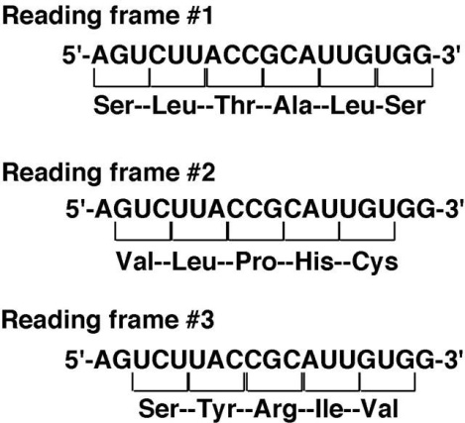
Translational Frameshift: Ribosomal Slippage
A shift in the ribosome when reading the triplet code→ Different reading frame

Slide 7
Problem 3
If a tRNA has a mutation in its anticodon sequence from AUG→GUG, which of the following will occur?
His→His
Met→Val
Tyr→His
Met→Stop
His→Leu

Slide 8
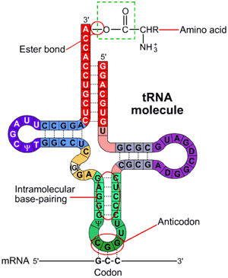
Aminoacyl-tRNA Synthetase: charging tRNA with amino acid
  Ester linkage of a.a. to the 3’OH of Adenosine at CCA 3’ end
Uses ATP--->AMP + PPi (2 high energy bonds)
20 different aminoacyl-tRNA synthetases
Contributes to high fidelity of translation: recognizes anticodon and charges 3’end of tRNA
Some tRNAs have proofreading
http://www.wiley.com/college/boyer/0470003790/structure/tRNA/trna_diagram.gif

Slide 9
Problem 4
The growing polypeptide chain on the ribosome during translation is attached to the ___________ after translocation.
small ribosomal subunit
3'end of a tRNA in the A site
5'end of a tRNA in the A site
3'end of a tRNA in the P site
5'end of a tRNA in the P site

Slide 10
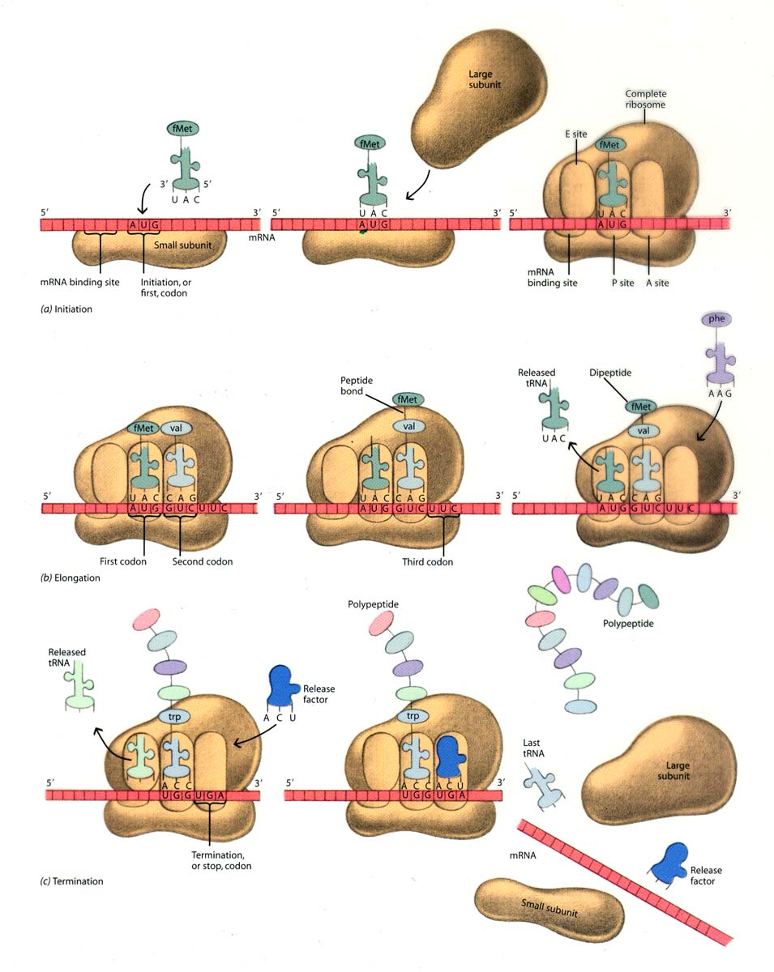
IF-2-GTP
(eIF2-GTP))
GTP→GDP + Pi
Initiation Complex
Steps in Translations
eIF-5
GTP→GDP + Pi
IF-1 + IF-3
1. IF-2-GTP brings charged initiator tRNA to P site and GTP is hydrolyzed
2. The large subunit joins to form initiator complex as
eIF-5 GTP is hydrolyzed
3. Elongation factors bring new charged tRNA to next codon in A site. GTP is hydrolyzed and EFs are recycled
4. Peptide bond is formed by peptidyl transferase activity located on the 23S (28S) RNA in large subunit (ribozyme)
5. Translocation of ribosome by EF-G exposes new codon while empty tRNA is released from E site. GTP is hydrolyzed for energy
6. Termination uses GTP and Release factors
IF-1 + IF-3
1
2
P site
Release of IFs
Peptidyl transferase
GTP→GDP + Pi
EF-Tu
EF-Ts
eEF-1a
GTP→GDP + Pi
3
4
5
EF-G
eEF-2
translocation
E site P site
A site
A site
Translocation
GTP→GDP + Pi
P site
RF-1,RF-2,RF-3
GTP→ GDP + Pi

Slide 11
Problem 5
In what direction does the ribosome move during translocation?
3’→5’
5’→3’
C-terminus→N-terminus
3’UTR→ 5’UTR
UAA codon→ AUG codon

Slide 12
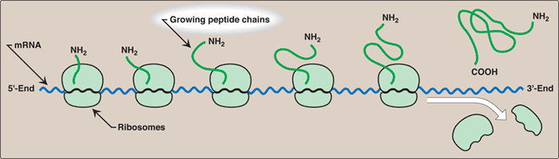
Direction of Translation
mRNA read from 5’end →3’
Proteins synthesized from NH₂ terminal end to the COOH terminal end
5’end of an ORF on the mRNA corresponds to the NH₂ terminus
3’end of an ORF mRNA corresponds to the COOH terminus
ORF: A sequence of triplets that code for a protein with a start and stop codon

Slide 13
Problem 6
The delta 508 mutation in the CFTR gene demonstrates that:
A Frameshift mutation of 2 bases can lead to a truncated protein
A Deletion of 3 bases can lead to a premature termination codon (PTC)
Deletion of a base from an Ile 507 codon can still maintain Ile at that position
An insertion of 4 bases leads to a frameshift mutation leading to a dysfunctional CFTR protein
A point mutation at the 508 position still maintains Phe at that position

Slide 14
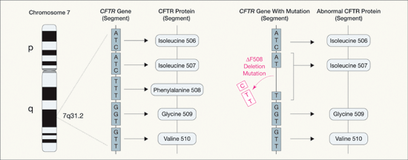
Cystic Fibrosis: Deletion of Triplet leads to deletion of Phe: Δ 508*
ATC: Ile507 normal
ATT:
Still Ile507
in CS gene
ATC: Ile in normal gene
ATT: Ile in CF gene due
to degeneracy of the genetic code
TTT: Phe in normal gene
Phe removed in CF gene
*mutation accounts for two-thirds (66-70%[) of CF cases worldwide and 90% of cases in US
Does NOT cause frameshift

Slide 15
Problem 7
Which of the following reactions is mediated directly by rRNA rather than by a protein?
Formation of the peptide bond
Activation of an amino acid during aminoacyl tRNA reaction
Movement of the ribosome by one codon
Bringing of the charged tRNA to the A site
Bringing of the charged tRNA to the P site

Slide 16
IF-2-GTP
(eIF2-GTP))
GTP→GDP + Pi
Initiation Complex
Steps in Translations
eIF-5
GTP→GDP + Pi
IF-1 + IF-3
1. IF-2-GTP brings charged initiator tRNA to P site and GTP is hydrolyzed
2. The large subunit joins to form initiator complex as
eIF-5 GTP is hydrolyzed
3. Elongation factors bring new charged tRNA to next codon in A site. GTP is hydrolyzed and EFs are recycled
4. Peptide bond is formed by peptidyl transferase activity located on the 23S (28S) RNA in large subunit (ribozyme)
5. Translocation of ribosome by EF-G exposes new codon while empty tRNA is released from E site. GTP is hydrolyzed for energy
6. Termination uses GTP and Release factors
IF-1 + IF-3
1
2
P site
Release of IFs
Peptidyl transferase:
Elongation of peptide
GTP→GDP + Pi
EF-Tu
EF-Ts
eEF-1a
GTP→GDP + Pi
3
4
5
EF-G
eEF-2
translocation
E site P site
E site P site
A site
A site
A site
Translocation
GTP→GDP + Pi
P site
RF-1,RF-2,RF-3
GTP→ GDP + Pi

Slide 17
Problem 8
Of all the reactions involved in translation, which step uses 2 high energy bonds for a single reaction?
Formation of the peptide bond
Activation of an amino acid during amino acyl tRNA reaction
Movement of the ribosome by one codon
Bringing of the charged tRNA to the A site
Bringing of the charged tRNA to the P site

Slide 18
Aminoacyl-tRNA Synthetase: charging tRNA with amino acid
  Ester linkage of a.a. to the 3’OH of Adenosine at CCA 3’ end
Uses ATP--->AMP + PPi (2 high energy bonds)
20 different aminoacyl-tRNA synthetases
Contributes to high fidelity of translation: recognizes anticodon and charges 3’end of tRNA
Some tRNAs have proofreading
http://www.wiley.com/college/boyer/0470003790/structure/tRNA/trna_diagram.gif

Slide 19
Problem 9
A patient with Cystic Fibrosis has a nonsense mutation that causes the disease. Which of the following might be the best therapy to try on this patient?
PTC
AON
RNAi
Hsp 100
Linezolide

Slide 20
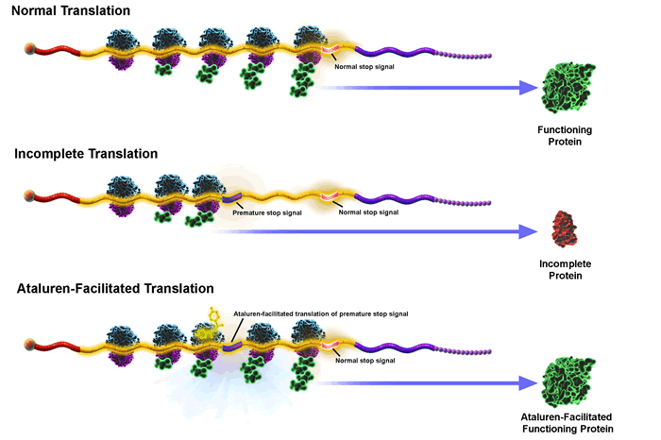
Therapy for DMD caused by a nonsense mutation (nmDMD);Cystic Fibrosis caused by a nonsense mutation (nmCF)
13-15% of DMD and ~10 of CF patients caused by nonsense
Ataluren (Translarna™) by PTC Therapeutics (formerly PTC 124)
Allows translation through a premature stop codon:
highest read-through:UGA

Slide 21
Gentamicin
Antibiotic: Aminoglycosides
Binds to sites on rRNA on 30S ribosome during translation of mRNA
This causes an impaired codon-anticodon recognition → ignoring the PTC stop codon
Has toxic side effects

Slide 22
Problem 10
Eukaryotic mRNA binding to the ribosomes is facilitated by:
the Shine Dalgarno sequence
the 7-methyl guanosine cap
tRNAi ^{fmet}
tRNAi ^{met}
EF-2

Slide 23
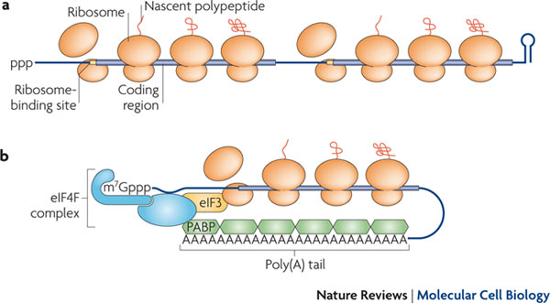
Initiation: Binding of Ribosome to mRNA
Prokaryotic
Prokaryotic mRNA Ribosome binding:
aided by base pairing between the 3′ end of 16S ribosomal RNA and a Shine–Dalgarno element adjacent to the initiation codon on the mRNA
b. Eukaryotic mRNA Ribosome binding:
eIF4: family of proteins that
  Binds 5’cap of mRNA (5’end)
  Associates with 40S
  Have RNA helicase activity
eIF3: high affinity for 40S ribosome and is recruited to mRNA with 40S by eIF4 factors
Eukaryotic
PABP: Poly A Binding Protein
http://www.nature.com/nrm/journal/v11/n7/images/nrm2917-f1.jpg

Slide 24
Problem 11
Proteolytic processing to active clotting factors during post-translational modification is via:
Ubiquitin proteolytic signaling
Serine Proteases
Proteasome activation
Removal of teleopeptides
Removal of C-peptide

Slide 25
Serine Proteases: Proteolytic Cleavage
Enzymes that cleave proteins using a Serine residue at the active site
The serine has an -OH group that is able to act as a nucleophile attacking the carbonyl carbon of the peptide bond of the substrate.
Examples of Serine Proteases:
  Trypsin
  Chymotrypsin
  Clotting factors
Irreversible

Slide 26
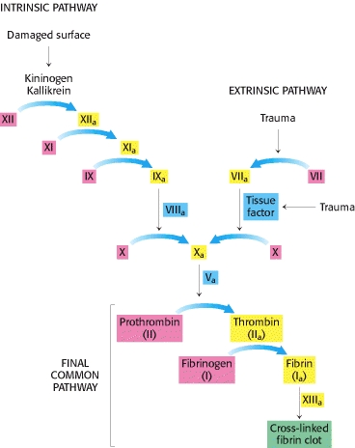
Clotting Pathway: Serine Proteases

Slide 27
Problem 12
Pick the most likely inhibitor of translation from the list below:
A. Diphtheria toxin
B. Doxycycline
C. Streptomycin
D. Clindamycin
E. Ciproflaxacin
Inactivates eukaryotic elongation factor, EF-2 by ADP-ribosylation and prevents translocation
A
B
C
D
E

Slide 28
General Type | Specific Names | Mode of Action | Spectrum
Aminoglycosides | Streptomycin, Kanamycin, Gentamicin, Tobramycin | Binds to 16S on 30S→misreading of mRNA | Many gram – Some gram+ Prolonged use can impair kidneys and cause deafness
Tetracyclines | Tetracycline, Minocycline, Doxycycline | Binds 30→ block tRNA binding to A site | Broad spectrum Doxycycline: Lyme disease
Chloramphenicol Lincosamides | Chloramphenicol Lincomycin, Clindamycin | Bind to 50S→ Inhibits peptide formation | Chloramphenicol-Broad Range Lincomycin, Clindamycin-Restricted Range
Macrolides | Erythromycin, Azithromycin (Z-pack),clarithromycin | Bind to 50S → Inhibits translocation | Gram +: Staph, Strep
Diphtheria toxin |  | Modifies EF-2→block s translocation(eukaryotes) | Toxin produced by Corynebacterium diphtheriae
Oxazolidinones | Linezolid | Binds to 50S→blocks P site Blocks initiation complex | Gram+ activity Penicillin and vancomycin resistant strains

Slide 29
Problem 13
Which type of control in eukaryotes involves changes in the polypeptide chain before it becomes functional?
replicative slippage
translational control
transcriptional control
posttranscriptional control
posttranslational control

Slide 30
Problem 14
Which of the following prevents aminoacyl-tRNA from binding its A site:
A. Diphtheria Toxin
B. Doxycycline
C. Streptomycin
D. Clindamycin
E. Azithromycin

Slide 31
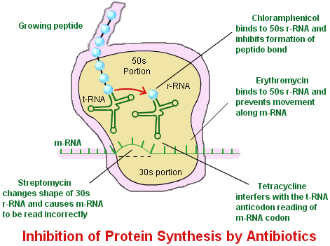
Aminoglycosides:
  Bacteriocidal
  Gentamicin, Neomycin, Amikacin, Tobramycin, Streptomycin “GNATS”
  Binds 30S→misreading of code
Tetracyclines:
  Bacteriostatic
  Doxycycline
  Binds 30S→Blocks tRNA binding to the A site
Chloramphenicol:
  Bacteriostatic
  Binds to 50S→Inhibits peptide formation
Lincosamides:
  Bacteriostatic
  Lincomycin, Clindamycin
  Binds to 50S→inhibits peptide formation
Macrolides:
  Bacteriostatic
  Erythromycin, Azithromycin
  Binds to 50S →Inhibits translocation
Oxazolidinones: Linezolid:
  Bacteriostatic
  Binds to 50S→blocks P site
  Inhibits initiation complex formation
Lincosamides and
Macrolides
Linezolid
http://images.tutorvista.com/cms/images/38/protein-synthesis-inhibitors.png

Slide 32
Problem 15
Two normal tRNAs that are charged with different amino acids MUST differ in their
3’ end base sequence
5’end base sequence
Anticodon loops
Hairpin loop formation
Wobble position

Slide 33
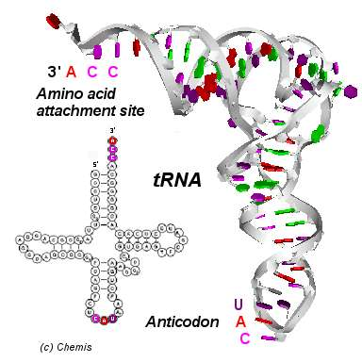
tRNA
Charged tRNA : a.a. on 3’ end
At least 1 specific tRNA
for each a.a.
  Some a.a. have multiple tRNAS (degeneracy of code)
At least 50 tRNAs in humans
Only 20 amino acids
Anticodon: reads mRNA

Slide 34
Problem 16
The function of ubiquitin is
To attach a signal to proteins for degradation by the proteasome
To act as a signal for secretory proteins
To block the reading of the mRNA by the 30S ribosome
To activate the SRP on the ER membrane
To act as an N-degron

Slide 35

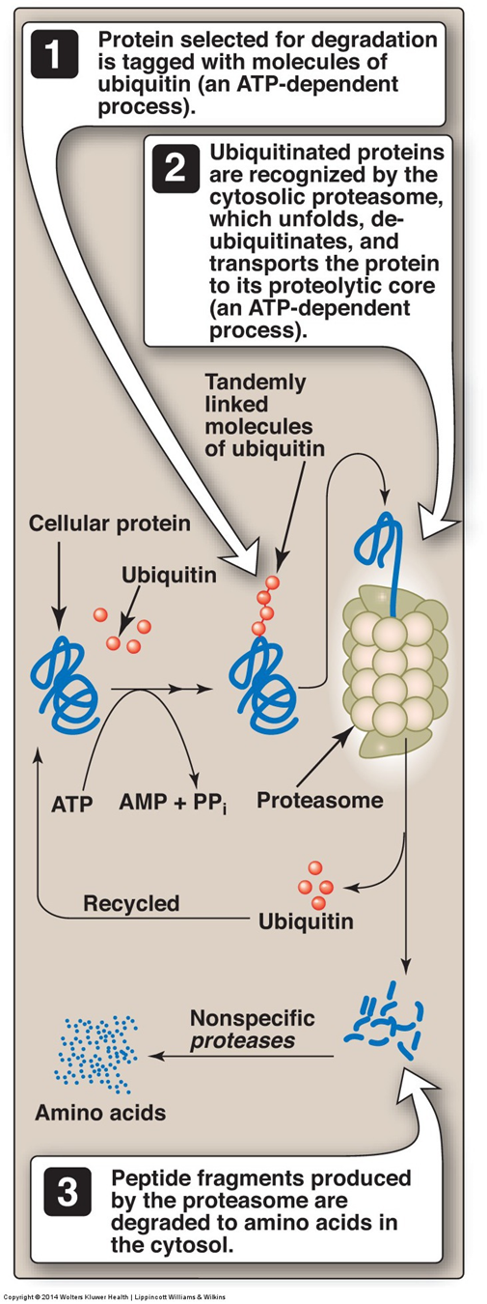

Protein Turnover:
Ubiquitin-proteasome (26S)
Cytosolic (nuclear also present)
Ubiquitin(Ub): marks some proteins for degradation
  76 a.a.: highly conserved in eukaryotes
  Covalently attached to the ε-amino group of Lys on the targeted protein via the α-carboxyl group of the C-terminal Gly on Ubiquitin
  Enzyme catalyzed: E1,E2,E3
    E3: ligase adds activated Ub onto protein
  Requires ATP→AMP + PPi
  Polyubiquitinated (4 or >Ub)
    Ubiquitination (or ubiquitylation) refers to the post-translational modification of a protein by the covalent attachment of ubiquitin
Methods Mol Biol. 2008;463:191-202. doi: 10.1007/978-1-59745-406-3_1

Slide 36
Problem 17
A patient was given an aminoglycoside for a urinary tract infection. Which of the following was prescribed?
Doxycycline
Chloramphenicol
Clindamycin
Tobramycin
Erythromycin

Slide 37
Aminoglycosides:
  Bacteriocidal
  Gentamicin, Neomycin, Amikacin, Tobramycin, Streptomycin “GNATS”
  Binds 30S→misreading of code
Tetracyclines:
  Bacteriostatic
  Doxycycline
  Binds 30S→Blocks tRNA binding to the A site
Chloramphenicol:
  Bacteriostatic
  Binds to 50S→Inhibits peptide formation
Lincosamides:
  Bacteriostatic
  Lincomycin, Clindamycin
  Binds to 50S→inhibits peptide formation
Macrolides:
  Bacteriostatic
  Erythromycin, Azithromycin
  Binds to 50S →Inhibits translocation
Oxazolidinones: Linezolid:
  Bacteriostatic
  Binds to 50S→blocks P site
  Inhibits initiation complex formation
Lincosamides and
Macrolides
Linezolid
http://images.tutorvista.com/cms/images/38/protein-synthesis-inhibitors.png

