Slide 1
Laboratory 11: Heat Transfer and Thermal Insulation
EG 1003 Section G1
Date of Experiment: 11/16/2014
Due Date: 11/18/2014
Alex Lopez, Kevin Zhao, Kyle Ireland

Slide 2
Overview
Objective
Introduction
Background Information
Materials
Procedure
Data/Observations
Results
Conclusion

Slide 3
Objective
Construct thermal retaining container
Minimize heat loss of boiled egg
Excel in competition

Slide 4
Introduction
Materials transfer heat differently
Retain or expel heat
Thermal insulation has many applications
Food
Humans
Spacecrafts

Slide 5
Background Information
Temperature – measure of energy in motion
Heat transfer – energy transfer between objects
Three heat transferring mechanisms
Conduction – objects in contact
Convection – fluid medium (air, water)
Radiation – electromagnetic energy release

Slide 6
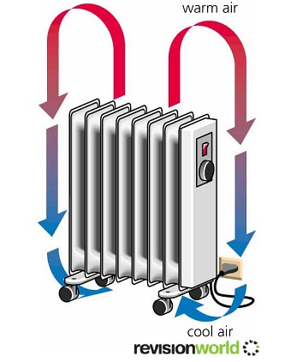
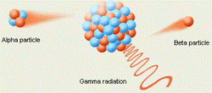
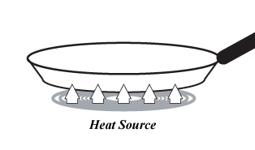
Background Information
Conduction
Convection
Radiation
http://www.productknowledge.com/images/tools_conduction.gif
http://www.revisionworld.com/files/convection%20copy.jpg
http://www.pnausa.org/uploads/1/4/6/7/14674962/1672466.gif

Slide 7

Background Information
MDR (Minimum Design Ratio)
Lowest ratio wins

Slide 8
Materials
Foam Cup
Lid
Paper cup
Styrofoam pieces
Tape
Aluminum foil
Plastic Wrap

Slide 9
Procedure
Consider available materials
Sketch then construct design
Setup LabVIEW with NI-ELVIS board
Measure Insulating Capacity of design

Slide 10
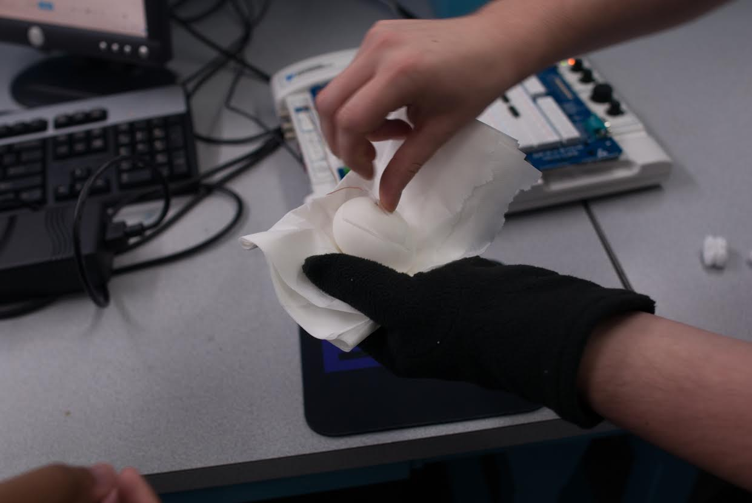
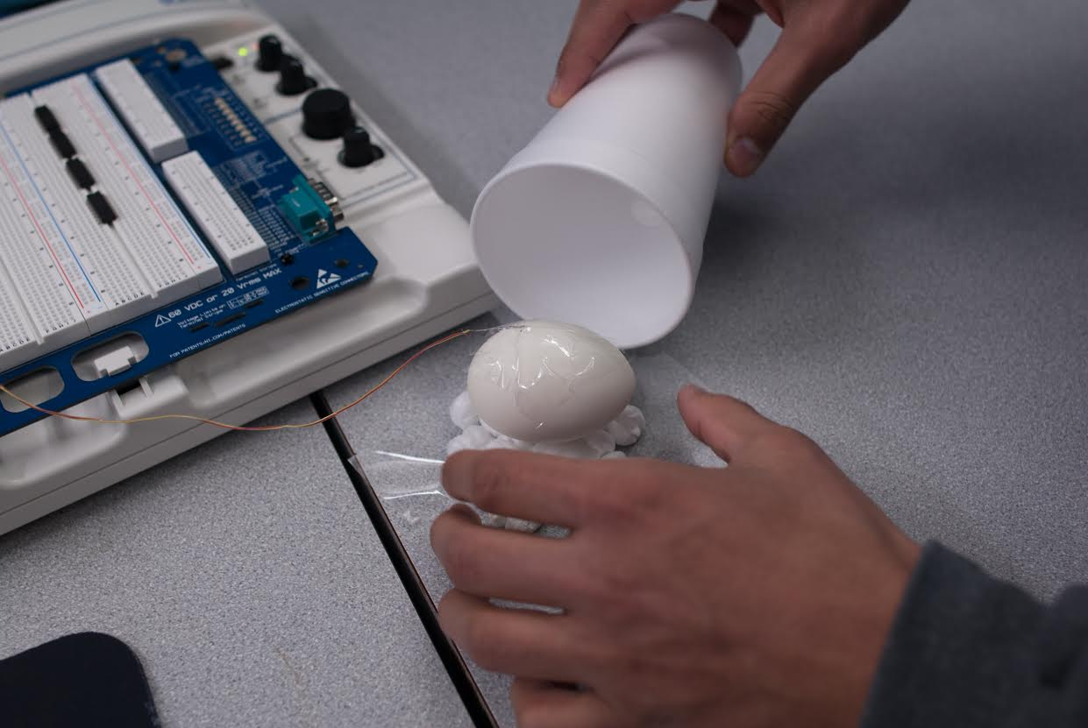
Procedure

Slide 11
Data/Observations
Item | Unit Cost (USD) | Quantity | Total (USD)
Large Foam Cup | 0.50 | 1.00 | 0.50
Styrofoam pieces | 0.05 | 2.00 | 0.10
Tape | 0.10 | 1.00 | 0.10
Grand Total |  |  | 0.70

Slide 12
Data/Observations
Design failed to retain heat effectively
Convection with air in container
Not enough material surrounding egg
IC | Cost | T_{R} | T_{F}
Mark and Warlon (Control) (control)
-0.65 | $0.50 | 72 °F | 140 °F |  | MDR: | 0.17 |  | Rank: | N/A
Alex B., Anmol, Jason
-0.34 | $0.62 | 69 °F | 147 °F |  | MDR: | 0.10 |  | Rank: | 1
Iven, Sevde, Dennis
-0.45 | $0.52 | 68 °F | 138 °F |  | MDR: | 0.12 |  | Rank: | 3
Kenny, Kevin A., Kevin H.
-0.30 | $0.70 | 69 °F | 130 °F |  | MDR: | 0.11 |  | Rank: | 2
Marcus, Adam, Kenneth
-0.51 | $0.99 | 70 °F | 147 °F |  | MDR: | 0.24 |  | Rank: | 4
Alex L., Kevin Z., Kyle
-0.74 | $0.70 | 72 °F | 131 °F |  | MDR: | 0.28 |  | Rank: | 5

Slide 13
Conclusion
Came in 5th place
Non-effective design
Could improve by surrounding egg with more material

Slide 14
Laboratory 11: Heat Transfer and Thermal Insulation
EG 1003 Section G1
Date of Expirement: 11/16/2014
Due Date: 11/18/2014
Alex Lopez, Kevin Zhao, Kyle Ireland

