Slide 1
Laboratory 5Digital Logic
EG1003 Section G1
Date of Experiment: Oct 6, 2014
Due Date: Oct 7, 2014
Alex Lopez, Kevin Xiuwen Zhao

Slide 2
Overview
Objective
Introduction
Background Information
Materials
Procedure
Data
Results
Conclusion

Slide 3
Objective
Fox eats hen
Hen eats corn
Two barns
Create logic circuit to set off alarm when fox is in same barn as hen or hen is in same barn as corn

Slide 4
Introduction
Boolean logic: 0 or 1, true or false
Established by English Mathematician George Boole
Boolean logic is basis for all digital circuitry

Slide 5
Background Information
3 logic gates used (AND, OR, NOT)
AND: 1 and 1 = 1, 1 and 0 = 0
OR: 1 or 0 = 1, 0 or 0 = 0
NOT:1 -> NOT -> 0, 0 -> NOT -> 1
Barn 1 = 1
Barn 2 = 0

Slide 6
Material
NI ELVIS Board
LabView
Logic Gates
Wires

Slide 7
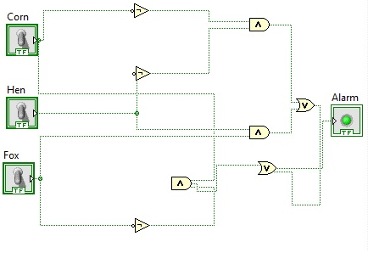
Procedure
List all possibilities for problem
Create K-Map
Simplify boolean equation
Draw outline of circuit
Create and test circuit in LabView
Build circuit on NI-ELVIS Board

Slide 8
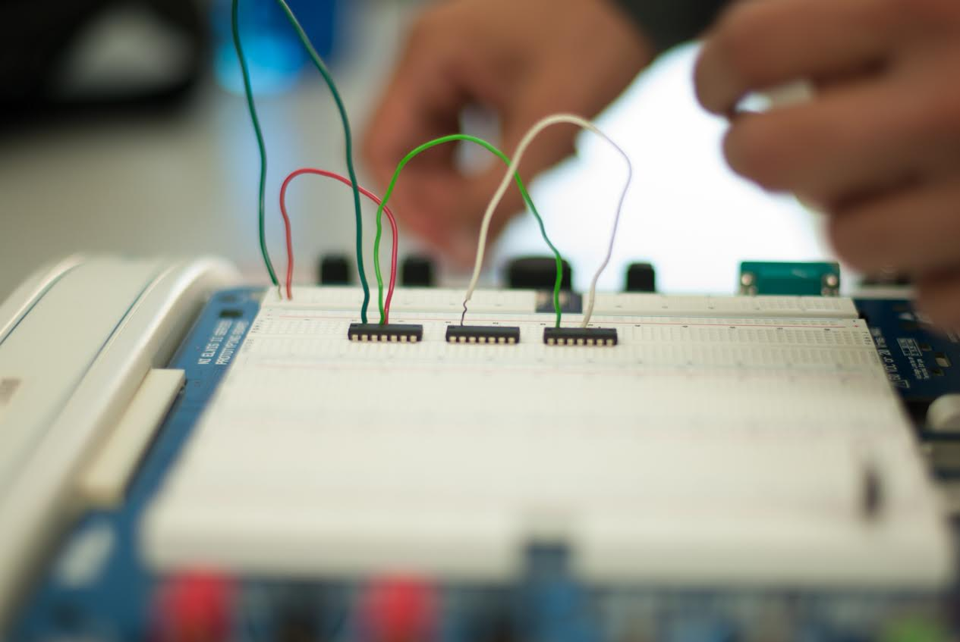
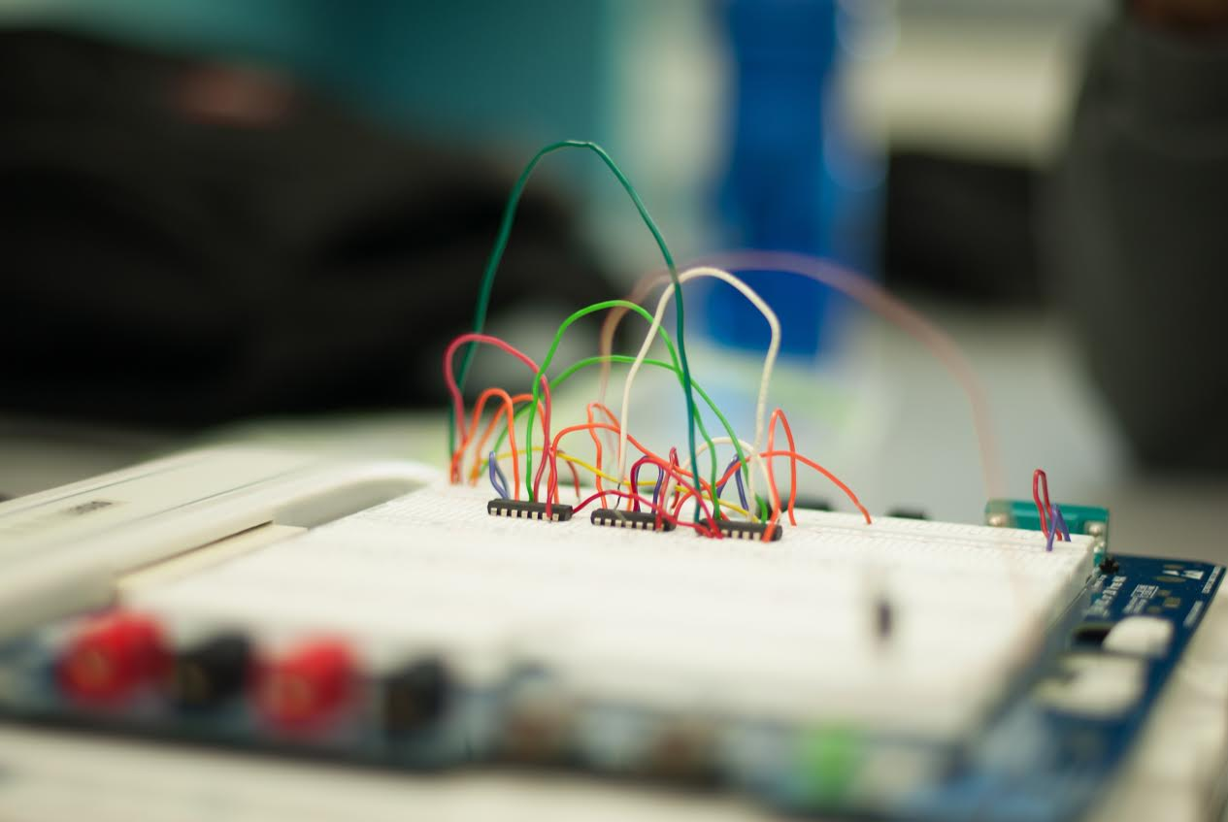
Procedure

Slide 9
Data
Corn | Hen | Fox | Output
0 | 0 | 0 | 1
1 | 0 | 0 | 1
1 | 1 | 0 | 1
1 | 1 | 1 | 1
0 | 1 | 1 | 1
0 | 1 | 0 | 0
1 | 0 | 1 | 0
0 | 0 | 1 | 1

Slide 10
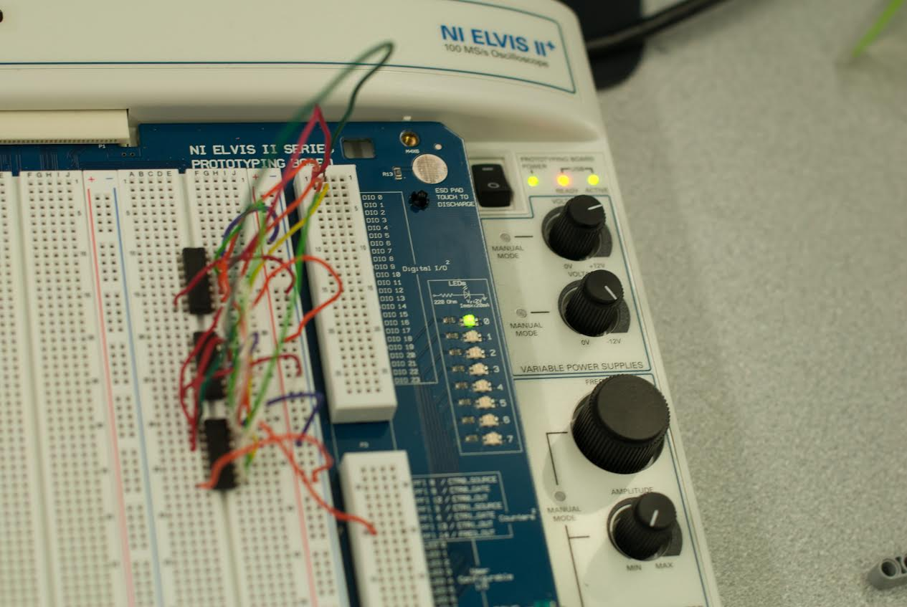
Results
When fox and hen were in same barn, the led alarm went off
When hen and corn were in same barn, the led alarm went off

Slide 11
Conclusion
Digital logic allows for “real world programming”
Simple lab assignment demonstrates power of digital logic when interfacing the physical world with the computer logic world

Slide 12
Laboratory 5Digital Logic
EG1003 Section G1
Date of Experiment: Oct 6, 2014
Due Date: Oct 7, 2014
Alex Lopez, Kevin Xiuwen Zhao

