Slide 1
Biochem exam 2

Slide 2
3/5/13
1. Which of the following is unique to “sticky ends” of DNA resulting from RE (restriction enzyme) cuts?
DNA ligase joins 2 DNA strands together
the DNA strands are ligated to the RE
The end of the DNA are overlapping
The end of the DNA do not contain complementary sequences
Notes:
The end of the DNA are overlapping

Slide 3
2. DNA fragments can be identified by which of the following blotting techniques?
Western
Eastern
Northern
Southern
Notes:
Southern

Slide 4
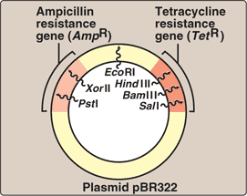
3. If you were to cut pBR322 with EcoR1 and Pst1. How many DNA fragments would appear on an agarose Gel when stained with Ethidium Bromide?
1
2
3
4
Notes:
2

Slide 5
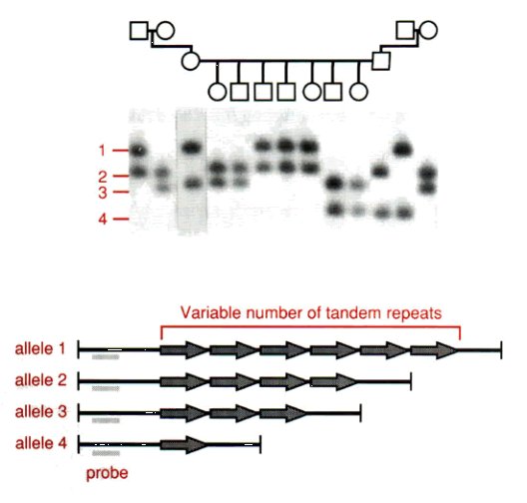
4. Which number corresponds to the largest number amount of STRs?
1
2
3
4
Notes:
1

Slide 6
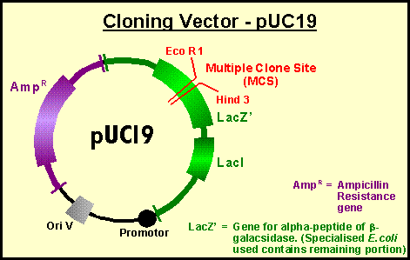
5. If a recombinant was formed using the above vector by cloning a fragment into the EcoR1 site, how would you choose the recombinant colonies versus the vector?
Look for the Amp sensitive colonies
Look for Amp resistance colonies
Look for blue colonies
Look for white colonies
Notes:
Look for white colonies

Slide 7
6. What are tag SNPS?
Polymorphisms that are linked to disease mutations
RFLPs that cause DNA shifts on Southern blots
SNPS that help define haplotypes
Point mutations that cause silent mutations
Notes:
SNPS that help define haplotypes

Slide 8
7. Which of the following is NOT required property for a cloning vector?
Lac Z gene
Autonomous replication
DNA restriction enzyme sites
ORC
Notes:
Lac Z gene

Slide 9
8. Which of the following distinguishes a genomic library from a cDNA library?
presence of exons
the use of cloning vectors
the ability to be amplified by PCR
the presence of multiple segments of DNA in different colonies
the absence of intronic DNA
Notes:
the absence of intronic DNA

Slide 10
9. Which of the following DNA techniques is most commonly used to specifically prepare a karyotype?
PCR
Southern blotting
FISH
Haplotyping Use of STRs for identification
Notes:
FISH

Slide 11
10. Which of the following applies most to a polymorphism?
Usually is associated with a disease
its frequency is lower than 1%
No single allele is considered “normal”
Presents as a rare and abnormal variant
Notes:
No single allele is considered “normal”

Slide 12
a cDNA version of a gene includes
Genomic DNA
Exons
Introns
Gene for RNA pol
Notes:
Answer: B
cDNA—made from RNA, mature RNA doesn’t have introns

Slide 13
production of which of the following needs the presence of reverse transcriptase
Genomic DNA library
Cloning into a pUC vector
Screening an expression vector
Labeling a probe
cDNA clone
Notes:
answer: E

Slide 14
a staggard cut produced by a RE, has which of the property?
Blunt end
Sticky end
Difficult to clone
Non-homologous sequences in each ss piece of DNA
Notes:
Answer: B

Slide 15
Which are not commonly used to identify recombinant plasmids
FISH
Antibiotic resistance gene
Lac Z gene
RE site
Southern blots
Notes:
Answer: A
Recombinant plasmids—cut and recombine
FISH—used to locate the DNA on chromosome

Slide 16
The presence of a white colony during a cloning experiment specifically indicates
Presence of RE sites
Interruption of an antibiotic resistance site
Interruption of the Lac Z gene
Presence of the pBR 322 vector
Staining of the clonies with EtBr
Notes:
answer: C
white colonies—when Lac Z gene is interrupted, when there’s a recombinant plasmids
blue colonies—Lac Z is intact, the plasmids close up without recombinant plasmids

Slide 17
hydridization of a probe to a DNA fragment requires all but
Denaturation of a the probe before hybridization
Denaturation of the DNA fragment before hybridization
Labeling the probe with a visual or radioactive indicator
Knowing the sequence of the DNA fragment
Complementarity with the DNA fragment
Notes:
Answer: A

Slide 18
What is unique about the primer is used for first strand cDNA synthesis from the mRNA
It has a poly A tail at the 3’ end
It has an oligo dT sequence at the 5’ end
It must complete complementary sequence to the mRNA before it can be used
It has both intron and exons before processing
Notes:
Answer: B
C—not a complete complementary, only at the primer part
D—primer doesn’t have introns, only exons
B—5’ end of the primer

Slide 19
What does a genome library contain
Only the introns of the genome with their regulatory sites for splicing
Only the coding sequences for the proteins in the genome
A piece of DNA that contains the whole genome
Only the exons of the genome
A composite of DNA fragments of the whole genome
Notes:
Answer: E

Slide 20
Which is NOT used when performing a southern blot?
A labeled ss probe
Florescent in situ hybridization
Transfer onto a PVC filter
Agarose gel electrophoresis
Restriction enzyme analysis
Notes:
Answer: B
Southern blot—for DNA
Ss=single strand

Slide 21
3/12/2013
1. A researcher just reveived the data for a cDNA microarray that was performed. He notied that the test sample had many more bright red dots compared to the control sample. Which of the following is the best interpretation of this data.
the control sample had a higher number of genes being expressed then the test sample
the test sample had a higher number of genes being expressed than the control sample.
the gene expression was equal between the control and test samples
the test sample had decreaed gene expression compared to the control sample
Notes:
the test sample had a higher number of genes being expressed than the control sample.

Slide 22
2. Which of the following abnormalities would cause a change in gene expression and most likely be detected using a cDNA microarray?
inactivation of transcription factors
breakdown of ribosomes
inactivation of DNA polymerases
misreading of mRNA
improper transport of protein in Golgi
Notes:
inactivation of transcription factors

Slide 23
3. Of the following techniques, which is the best method to determine the function of a protein?
cDNA microarray
western blot
RNA interference
Gel electrophoresis
Notes:
RNA interference

Slide 24
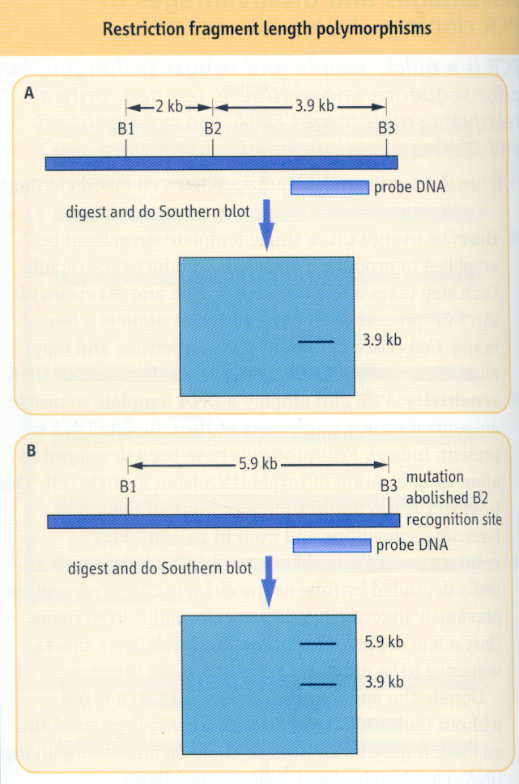
4. What size DNA bands would be seen on a sothern blot for a homozygous normal?
2 kB
3.9kb
5.9kB
2kb and 3.9 kb
3.9 kb and 5.9 kb
Notes:
3.9kb

Slide 25
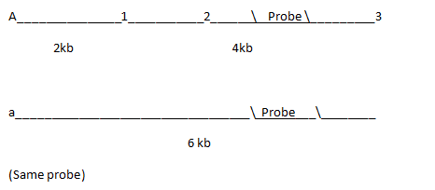
5. The figure above shows a segment of a gene with a mutation when cut with an RE. If a patient is heterozygous for this mutation. What size bands would you expect to see on a Southern blot using the above probe?
2kb 6 kb
6 kb
4 kb
2 kb 4 kb 6 kb
4 kb, 6 kb
Notes:
4 kb, 6 kb

Slide 26
6. Based on this RE digest map of a polymorphic HbA gene, what size band(s) would be expected for someone who is heterozygous for this polymorphism?
2.5 kb
2.5 and 7
2.5 and 7.5
2.5 7 and 7.6
7 and 7.6
Notes:
7 and 7.6

Slide 27
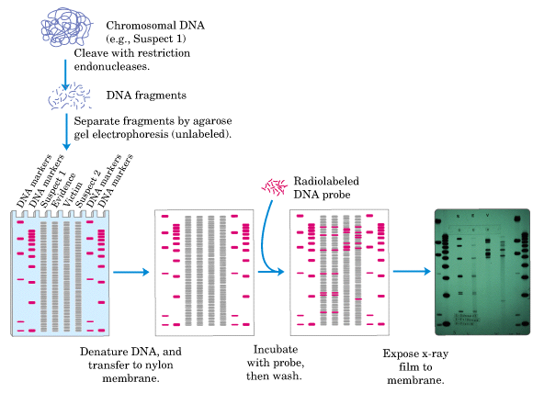
7. Given the forensic DNA blot, which suspect would be considered the criminal
1
2
1 and 2 jointly
neither
Notes:
1

Slide 28
8. At left is a DNA blot to test for paternity. Which lanes confirm the alleged father?
A1
B2
A3
C3
C3 and B3
Notes:
C3
*editor's note: sorry, can't find a paternity test in the slides that matches with this. Concept to take away is only one father, and match up Electrophoresis DNA marks.

Slide 29
3/19/2013
1. A 21 yo F was the victim of a rape and murder. She had been sexually assaulted and strangled. A semen sample was collected from her vaginal fluid and dried blood was isolated from under her fingernails. although the quantity of semen was small, how could it MOST efficiently be analyzed and compared with blood samples taken from the suspect?
Amplification of specific sequences with different restriction enzymes and probes
iD o fspecic sequences with different restriction enzymes and probes.
comparison of fingerprpint patterns from several suspects.
Notes:
Amplification of specific STRs of the recovered DNA by PCR

Slide 30
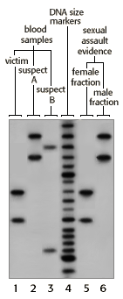
2. A key portion of the autoradiograph from a sinle locus probe analysis of various samples in a rape investigation in the figure. What is the appropriate conclusion.
both A and B are excluded as suspects
A is excluded but B is not
B is excluded but A is not
neither A or B is excluded
B cannot be excluded results for A are inclusive.
Notes:
B is excluded but A is not

Slide 31
3. A commonly employed method for antibody detection utilizes:
indirect ELISA
sandwich ELISA
preimplantation genetic diagnosis
CODIS polymorphism electrophoresis
muchal translucency
Notes:
indirect ELISA

Slide 32
4. Chromosomal analysis of amniocentesis samples is valuable in diagnosing all of the following except:
Turner Syndrome
Fragile X
trisomy 18
Klinefelters syndrome
ancephaly
Notes:
Ancephaly
don’t see E any more b/c ultrasound can catch it

Slide 33
5. What is elevated in amniotic fluid and maternal blood would suggest the presence of anencephaly?
Hg
alpha-fetoprotein
testosterone
creatinine
C-reactive protein
Notes:
alpha-fetoprotein

