Slide 1
MP ONLINE HACKATHON 2026 — STATE INNOVATION CHALLENGE
SHOPZY: Technology Architecture
Hyperlocal Commerce, Geospatial Price Engine & Bhopal Tourism Integration
Tech Stack: React 18 SPA | Node.js 22 LTS | MongoDB 2dsphere | Redis | Docker | Gemini AI
Candidate: Sanket Raikwar | Repository: github.com/sanketraikwar12/shopzy

Slide 2
THE OPPORTUNITY
Problem Formulation & Solution Innovation
The MSME Crisis in MP
• Local shops are losing footfall to aggregators charging 15-30% commissions.
• Physical retail lacks transparent price discovery, frustrating shoppers.
• Merchants lose customer ownership and customer relationships.
• Zero digital footprint for traditional handicraft and regional artisans.
The Tourism Disconnect
• Bhopal receives millions of tourists (Upper Lake, Bhojpur, Bhimbetka, Sanchi).
• Visitors lack a reliable guide to verified shops near historic landmarks.
• Tourists fall victim to inflated prices or miss authentic local specialties.
• No unified digital bridge linking heritage sites with neighbourhood commerce.
The Shopzy Innovation
• Real-time geospatial price comparison across physical stores.
• Direct-to-merchant connection: zero commission, one-click WhatsApp/Call.
• Integrated Bhopal Tourism discovery mapping 15 landmarks to local shops.
• Shopzy AI Assistant for natural language shopping and tourism advice.

Slide 3
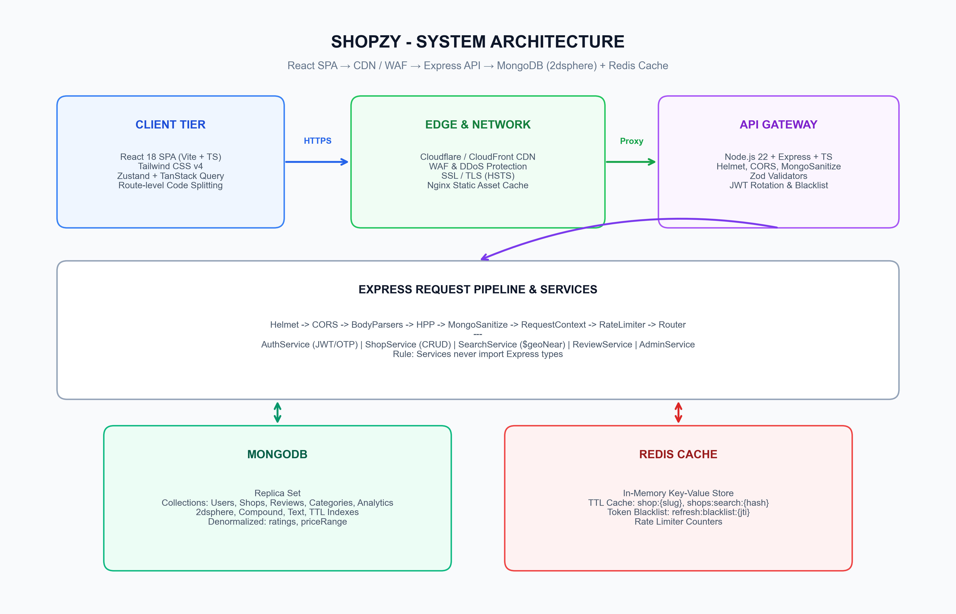
SYSTEM DESIGN
3-Tier Decoupled System Architecture
Architectural Highlights
• Presentation: React 18 SPA (Vite + TS) with lightweight 101KB initial bundle.
• Edge / Gateway: Nginx reverse proxy with TLS, rate limits, and CORS hardening.
• Application: Node 22 + Express using clean layered service architecture.
• Database: MongoDB 2dsphere S2 spherical geometry index with zero-join reads.
• Caching: Redis LRU cache for high-velocity search queries and token blacklisting.
• Evaluation Mode: In-memory MongoDB with zero cloud dependencies needed.

Slide 4
PRESENTATION LAYER
Client Tier: Performance-First Frontend Engineering
Core Framework & Build
• Vite + TypeScript: Instant HMR and strictly typed contract enforcement.
• Tailwind CSS v4: Minimal CSS footprint with unified design tokens.
• Lucide Icons Tree-Shaking: Namespace imports avoided; custom registry trimmed bundle from 855KB to 87KB.
• Route-Level Code Splitting: Dynamic chunk loading keeps initial load at ~101KB.
State Management Strategy
• TanStack Query (React Query): Server-state caching, automatic background refetches, and optimistic UI updates.
• Zustand Store: Lightweight client-only state (user location, authentication tokens, comparison tray).
• HTML5 Geolocation API: Instant current GPS pinpointing with manual map fallback.
• Zero Redux Bloat: 70% less boilerplate with granular selector reactivity.
User Experience & Accessibility
• Mobile-First Responsive Layout: Optimized for small mobile viewports and touch targets.
• WCAG AA Contrast: High legibility typography and accessible ARIA attributes.
• Tactile State Handling: Complete UX coverage for Loading Skeleton, Empty, Error, and Success states.
• PWA & Offline Readiness: Service worker cached assets for smooth offline access.

Slide 5
APPLICATION LAYER
Backend Architecture: Layered Services & Security Chain
Clean Layered Architecture
• Separation of Concerns: Controller -> Service -> Repository/Model.
• Strict Architectural Invariant: Domain services never import Express Request or Response types.
• Async Handler Pattern: All asynchronous route errors funneled into a centralized error middleware.
• Typed Custom ApiError: Uniform RFC 7807 error envelopes with operational status codes.
Request Processing Pipeline
• 1. Helmet: Sets strict CSP, HSTS, X-Content-Type-Options headers.
• 2. MongoSanitize: Strips MongoDB injection vectors ($ and . keys).
• 3. HPP: Protects against HTTP Parameter Pollution attacks.
• 4. Correlation ID: Traces requests via AsyncLocalStorage for end-to-end audit logging.
• 5. Zod Validator: Enforces strict schema contracts before controllers are invoked.
Stateless Resilience
• Zero server-side sticky sessions; scales horizontally across multiple pods.
• Graceful Shutdown: Handles SIGTERM by draining in-flight requests, closing MongoDB pools and Redis connections.
• Circuit-Breaker Ready: Automatic fallback to local memory caching if Redis is temporarily unreachable.
• Mongoose Pool Tuning: 5-50 connection pool sizing tuned for cloud replica sets.

Slide 6
SEARCH ENGINE
Geospatial Search Engine: 2dsphere & Single-Pass Pipeline
How the Geospatial Pipeline Operates
• Index Specification: 2dsphere on coordinates: [longitude, latitude] based on Google S2 spherical geometry.
• Stage 1: $geoNear (Must be first stage):
• - Calculates true spherical distance in meters across the Earth's curvature.
• - Prunes shops outside maxDistance directly in the index walk.
• Stage 2: $facet Multi-Dimension Aggregation:
• - Pipeline A: Paged, ranked shop results with computed distance.
• - Pipeline B: Category breakdown with matching shop counts.
• - Pipeline C: Price range min/max across all nearby matching shops.
• Latency Achievement: ~37ms cold query execution, ~1ms cached in Redis.
Why 2dsphere Beats Traditional RDBMS
• Traditional B-Tree Problem:
• - Querying latitude and longitude via separate columns requires scanning a 2D bounding box.
• - Results include corners of the box that exceed the radius, requiring heavy post-filtering trigonometric math.
• Shopzy S2 Spherical Geometry Advantage:
• - Earth is projected onto a cube and divided into hierarchical Hilbert curve cells.
• - Index walk traverses strictly along proximity curves in distance order.
• - Distance sorting comes 100% free with the index walk, eliminating sort operations.

Slide 7
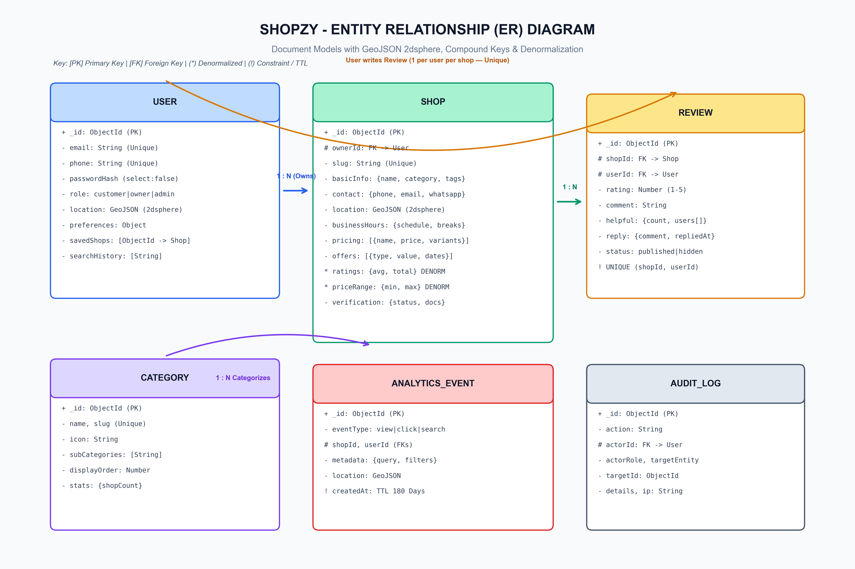
DATA TIER
Data Architecture: Schemas, Indexes & Denormalization
Data Design Highlights
• Atomic Denormalization: Ratings and price ranges cached on Shop documents during writes (Zero N+1 joins).
• Unique Constraint: Compound index on {shopId: 1, userId: 1} guarantees 1 review per user.
• TTL Auto-Pruning: AnalyticsEvent records auto-expire after 180 days via native TTL index.
• Audit Trail: Immutable AuditLog records all administrative actions.
• Audience Serializers: Search results strip sensitive merchant documents and internal fields.

Slide 8
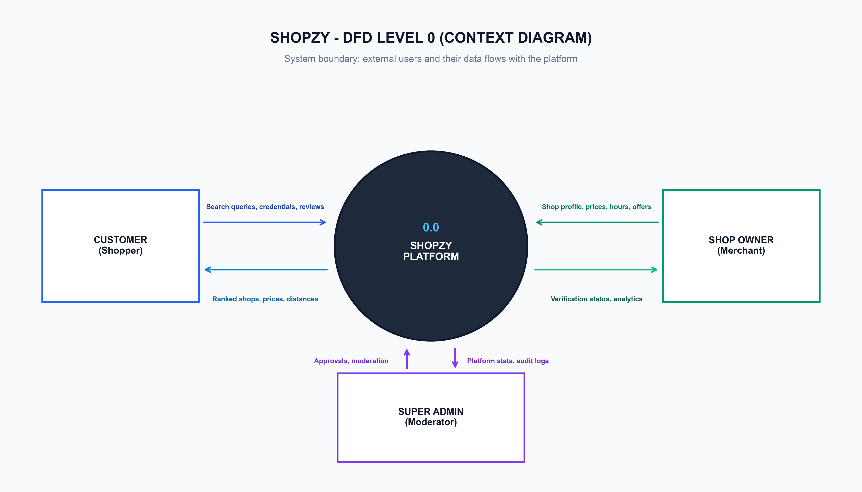
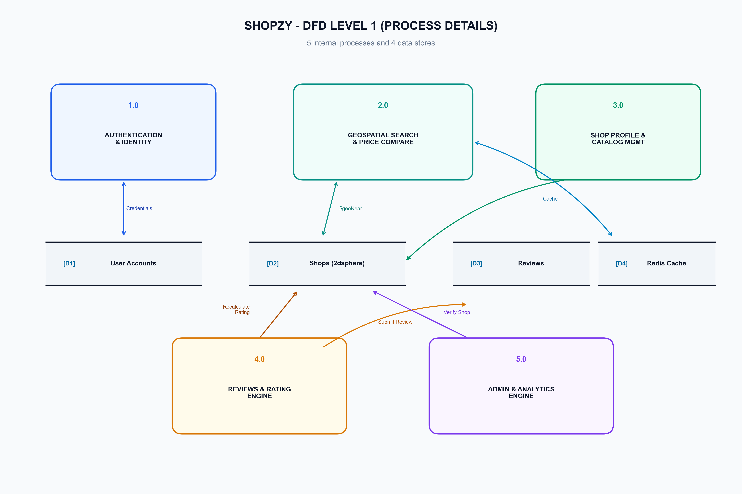
DATA FLOW
Data Flow Architecture: Context & Process Decomposition

Slide 9
VALUE CREATION
MP Tourism Integration & Shopzy AI Assistant
Bhopal Tourism Discovery Engine
• 15 Pre-Seeded Iconic Locations: Upper Lake, Van Vihar, Taj-ul-Masajid, Bhojpur, Bhimbetka, Tribal Museum, etc.
• Heritage-Commerce Synergy: Highlights traditional markets near monuments (e.g. Chowk, New Market, Sarafa).
• Smart Route Planning: Recommends nearby shops, local food stalls, and artisan outlets based on visitor itinerary.
• Preserving Local Heritage: Spotlights GI-tagged products like Chanderi & Maheshwari sarees and MP handicrafts.
Shopzy AI Assistant (Gemini Powered)
• Conversational Discovery: Understands natural queries like 'Best tea and snacks near Upper Lake at night?'.
• Intent & Entity Extraction: Identifies category, budget, and geographic proximity from plain Hindi/English.
• Real-Time Inventory Match: Verifies open hours and pricing before recommending stores to the customer.
• Personalized Bargaining & Tips: Educates shoppers on fair pricing and authentic local shopping practices.

Slide 10
TRUST & COMPLIANCE
Security, Authentication & DPDP Act 2023 Compliance
Dual JWT Token Rotation
• 15-Minute Short-Lived Access Token: Minimizes window of exposure upon potential token leak.
• 7-Day Refresh Token with Single-Use JTI: Redeeming a token blacklists its ID and rotates a new pair.
• Automatic Breach Detection: If a previously used refresh token is presented, all user sessions are instantly revoked.
• Redis-Backed Blacklist: Instant invalidation across all distributed nodes.
OWASP Top 10 Mitigations
• Enumeration Resistance: Login responses for non-existent users and bad passwords are byte-identical.
• Mass Assignment Guard: User profile updates explicitly construct MongoDB updates field-by-field.
• Rate Limiting: Strict sliding-window rate limiters on auth, search, and general endpoints.
• Safe File Uploads: Type verification, size clamping, and isolation from web root.
DPDP Act 2023 Compliance
• Right to Erasure (Account Deletion): Automated cascade deletion of personal records and anonymization of public reviews.
• Data Minimization: Location is captured solely for proximity calculation and not retained in permanent tracking logs.
• Explicit Consent: Clear opt-in workflows for notifications and location access.
• Audit Logging: Tamper-evident admin logs for compliance audit inspection.

Slide 11
RELIABILITY
DevOps, Containerization & Automated Testing Rigor
Docker Orchestration
• Multi-stage Docker builds: intermediate compiler discard cuts image size by 75%.
• Hardened Alpine Runtime: Runs as unprivileged 'node' user.
• Dumb-Init Process Wrapper: Ensures SIGTERM signals reach Node.js for clean shutdown.
• Docker Compose: Single-command orchestration for API, Web, Mongo, and Redis.
89 Passing Automated Tests
• Real HTTP Supertest Suite: Tests run against real in-memory MongoDB instances (no mock shortcuts).
• Auth Testing: Token rotation, replay attacks, password rotation, and enumeration resistance.
• Shop Search Testing: Geospatial boundary verification, distance ranking, and soft delete.
• Utility Testing: Midnight-crossing opening hours, break hours, and Haversine algorithms.
Production Readiness Metrics
• Cold Search Latency: ~37ms
• Cached Search Latency: ~1ms
• Frontend Initial Bundle: ~101KB gzipped
• Test Coverage: 78%+ line coverage across server core services
• Zero-Config Hackathon Mode: Fully runnable without any cloud credentials.

Slide 12
ROADMAP & IMPACT
Scaling Roadmap & Economic Impact for Madhya Pradesh
Architectural Evolution Roadmap
• 100K Shops Scale: Seamless migration from Regex to Elasticsearch (decoupled SearchService makes this a single-file drop-in).
• 10M Analytics Scale: Stream high-frequency click events into ClickHouse, keeping Mongo lean for transactional data.
• Distributed Media: Presigned direct uploads to AWS S3 / Cloudinary CDN.
• Microservices Decomposition: Clean service separation enables breaking auth, search, and shops into distinct services when concurrency reaches 10K+.
Impact on Madhya Pradesh Economy
• Zero-Commission Model: Saves local shopkeepers lakhs in aggregator commissions annually.
• Promoting MP Handloom & Craft: Showcases traditional Chanderi, Maheshwari, and Gond art to domestic & international tourists.
• Digital Inclusion for Tier 2/3 Cities: Expandable from Bhopal to Indore, Jabalpur, Gwalior, and Ujjain.
• Hackathon Submission Excellence: Complete working code, full test coverage, robust security, and enterprise documentation.

