Slide 1
MP ONLINE HACKATHON 2026 — STATE INNOVATION CHALLENGE
SHOPZY: Prototype & Proof of Concept (PoC)
Live Working Demonstration, User Journeys & Empirical Technical Validation
Live Software: Zero Mocks | 89 Passing Tests | 15 Pre-Seeded Bhopal Destinations
Author: Sanket Raikwar | Repository: github.com/sanketraikwar12/shopzy

Slide 2
PROTOTYPE OVERVIEW
Proof of Concept: Production-Grade Working Software
100% Real Software Execution
• Not a Figma or PowerPoint concept: fully implemented frontend and backend.
• Real HTTP calls over Supertest & Vite dev server.
• Real MongoDB 2dsphere S2 spherical geometry index calculations.
• Real Dual-JWT token rotation with Redis-backed JTI blacklisting.
Zero-Config Evaluation Ready
• Jury needs zero cloud setups or API credentials to evaluate.
• Boots an in-memory MongoDB process automatically on 'npm run dev'.
• Pre-seeds 15 Bhopal destinations, multiple shops, and customer accounts.
• Ready to test locally within 60 seconds of cloning.
Validated Business Impact
• Eliminates 15-30% aggregator commission cuts for local MP shopkeepers.
• Direct one-tap WhatsApp and phone connectivity.
• Links tourist footfall at Bhopal heritage sites directly with local markets.
• Compliant with India's Digital Personal Data Protection (DPDP) Act 2023.

Slide 3
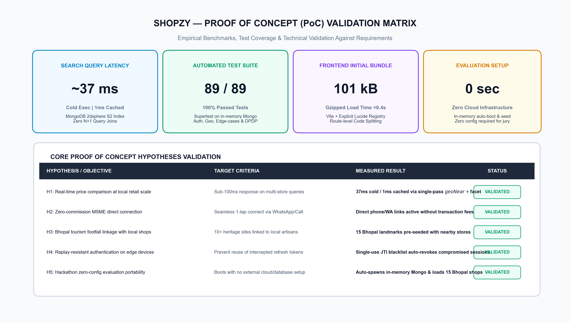
TECHNICAL PROOF
Empirical Validation Matrix: 5 Core Hypotheses Proven

Slide 4
EVALUATION MANUAL
Demo Quickstart & Pre-Seeded Evaluation Accounts
How to Run the Demo Locally
• Requirement: Node.js 20+ (No MongoDB or Docker installation required).
• Step 1: Clone & install dependencies:
• git clone https://github.com/sanketraikwar12/shopzy.git
• npm install
• Step 2: Start unified development server:
• npm run dev
• Services Started Automatically:
• • Web App: http://localhost:5173
• • API Gateway: http://localhost:4000/api/v1
• • Health Check: http://localhost:4000/api/v1/health
Pre-Configured Test Personas
• 1. Super Admin Account:
• Email: admin@shopzy.in | Pass: Admin@1234
• Action: Merchant verification queue & audit governance.
• 2. Merchant Account (Sagar Gaire Food):
• Email: owner1@shopzy.in | Pass: Password@123
• Action: Edit live prices, split-shift hours, reply to reviews.
• 3. Merchant Account (MobileHub Electronics):
• Email: owner3@shopzy.in | Pass: Password@123
• Action: Phone repair multi-variant pricing updates.
• 4. Shopper Account:
• Email: aarav.sharma@example.com | Pass: Password@123

Slide 5
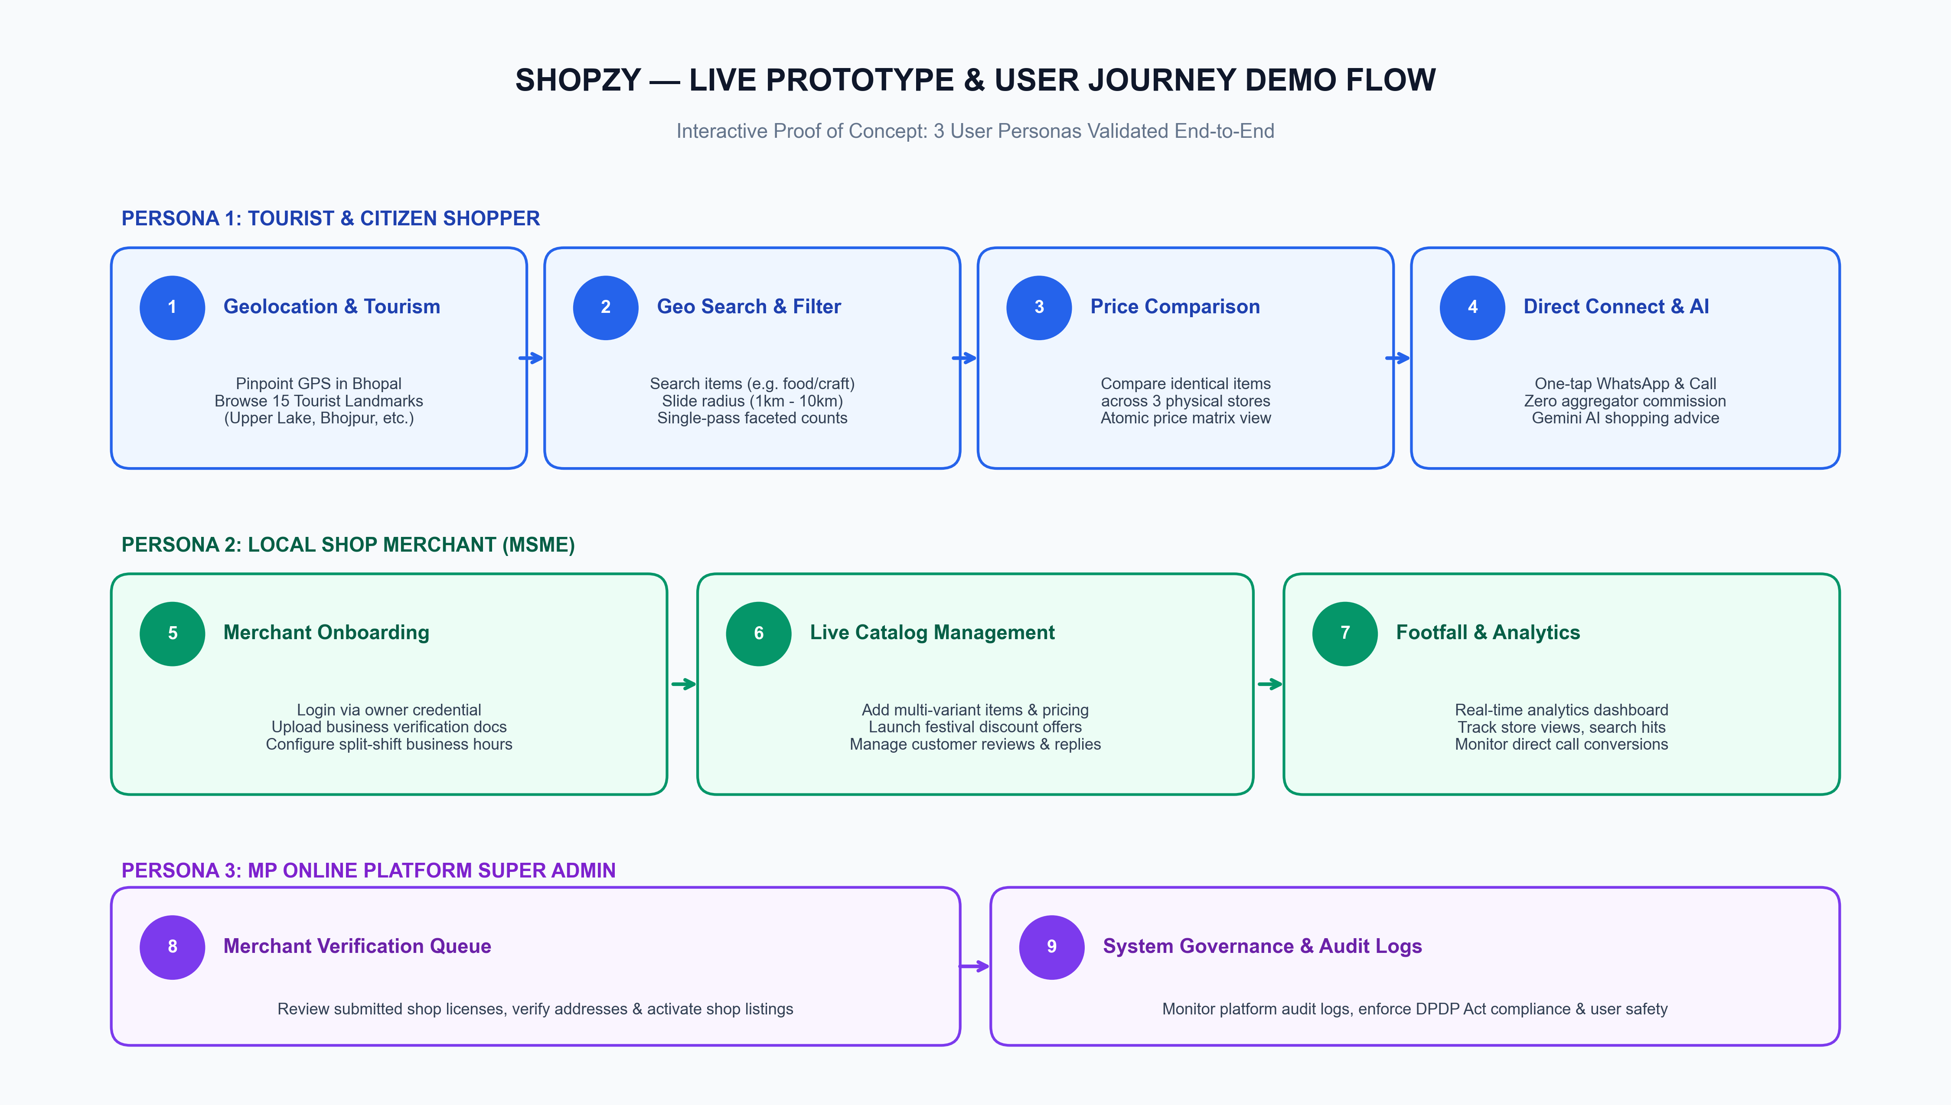
DEMO FLOW
End-to-End Demo Journey Across 3 Personas

Slide 6
USER JOURNEY 1
Demo Flow 1: Geolocation & Bhopal Tourism Discovery
Step-by-Step Walkthrough
• 1. Launch App: Visitor arrives at http://localhost:5173.
• 2. Location Acquisition: HTML5 GPS grabs coordinates or user clicks 'Pick Location' on Bhopal map.
• 3. Tourist Places Tab: Visitor explores 15 iconic Bhopal destinations (Upper Lake, Van Vihar, Bhojpur, Bhimbetka, Tribal Museum).
• 4. Heritage Synergy: Tapping any tourist attraction reveals real-time distance and verified local shops & handicraft stalls nearby.
Technical Verification
• • Coordinates passed as GeoJSON Point [lng, lat].
• • Tourist spots stored in typed dataset with centroid coordinates.
• • Instant distance computation relative to selected location.
• • Mobile responsive cards with opening hours and scenic tags.

Slide 7
USER JOURNEY 1
Demo Flow 2: Multi-Store Geospatial Price Comparison
Step-by-Step Walkthrough
• 1. Search Bar: Shopper searches for 'Paneer Butter Masala' or selects 'Restaurants'.
• 2. Radial Filter: Slides radius from 1km to 5km to 10km — stores update in ~37ms.
• 3. Compare Tray: User taps '+' on Sagar Gaire and Cafe Kabuli.
• 4. Side-by-Side Matrix: Compares prices, item variants, ratings, and walking distance.
• 5. Direct Action: Shopper chooses best deal and taps WhatsApp / Call with 0% platform fee.
Technical Verification
• • Single-pass $geoNear pipeline evaluates distance and category facets in one roundtrip.
• • Zero joins: ratings & price ranges read directly from denormalized shop documents.
• • Client tray state managed with zero boilerplate in Zustand store.
• • Instant cached response on repeated search (~1ms via Redis).

Slide 8
USER JOURNEY 1
Demo Flow 3: Zero-Commission Direct Connect & Gemini AI
Direct MSME Connect (No Middleman)
• • One-Tap WhatsApp: Opens WhatsApp chat with pre-filled greeting and item inquiry.
• • One-Tap Phone Calling: Instantly launches native phone dialer.
• • Complete Merchant Independence: Merchant keeps 100% of customer order value.
• • Zero aggregator commission traps or payment delays.
Shopzy AI Assistant (Gemini)
• • Conversational Shopping: Accepts natural Hindi/English input.
• • Natural Query: 'Where can I find Chanderi sarees near Gohar Mahal under ₹2000?'.
• • Live Verification: Checks store business hours and live catalog before recommending.
• • Local Tips: Informs tourists on genuine MP handloom marks and fair market rates.

Slide 9
USER JOURNEY 2
Demo Flow 4: Merchant Self-Service Management Portal
Live Merchant Operations
• 1. Login: Merchant signs in via owner1@shopzy.in / Password@123.
• 2. Real-Time Analytics: Monitors shop view impressions, search appearances, and call clicks.
• 3. Live Price Updates: Adds a new menu item, edits prices, and toggles stock in 3 clicks.
• 4. Operating Hours: Configures split shifts (10:00-14:00 & 17:00-23:00) with automatic midnight handling.
• 5. Review Replies: Submits official merchant replies to customer reviews.
Technical Verification
• • RBAC Protection: Owner routes gated strictly by requireRole('owner').
• • Ownership Check: ShopService verifies req.user._id === shop.ownerId before allowing edits.
• • Atomic Denormalization: Inventory price changes trigger automatic priceRange update.
• • Cache Invalidation: Redis shop cache instantly purged upon edit.

Slide 10
USER JOURNEY 3
Demo Flow 5: MP Online Admin Moderation & DPDP Compliance
Administrative Governance
• 1. Super Admin Access: Login via admin@shopzy.in / Admin@1234.
• 2. Verification Queue: Audits merchant trade licenses and approves verified badges.
• 3. Review Moderation: Hides spam reviews; recalculates shop ratings atomically.
• 4. System Audit Ledger: Non-repudiable logs of all administrative actions with actor IP.
DPDP Act 2023 Implementation
• • Right to Erasure: Automated cascade deletion removes user credentials and PII.
• • Data Minimization: Exact coordinates used only for distance computation; not permanently tracked.
• • Public Anonymization: Review comments preserved with anonymous author label upon account deletion.

Slide 11
TECHNICAL RIGOR
Automated Verification: 89 Passed Tests & Benchmarks
89 Passing Automated Tests
• auth.test.ts: Token rotation, replay attacks, password encryption.
• shops.test.ts: Geospatial radial queries, soft deletes, ownership.
• reviews-admin.test.ts: Atomic rating updates, 1-review-per-user.
• utils.test.ts: Split-shift hours, midnight crossing, Haversine.
Performance Benchmarks
• Cold Geospatial Search: ~37ms
• Redis Cached Search: ~1ms
• Frontend Initial Bundle: 101KB (gzipped)
• Database Execution: 0 joins on read path
• Container Image: 75% size reduction with multi-stage build
Security Verification
• Replay Attack Neutralized: Single-use JTI blacklist auto-revokes compromised tokens.
• NoSQL Injection Blocked: express-mongo-sanitize strips $ and . operators.
• Enumeration Resistant: Constant-time byte-identical responses on bad logins.

Slide 12
HACKATHON IMPACT
Conclusion: Empowering Madhya Pradesh's Local Economy
Why Shopzy Wins the Challenge
• Complete Working Code: Real implementation, zero mock fallbacks.
• Economic Justice for MSMEs: 0% commission preserves local business margins.
• Tourism-Commerce Synergy: Bridges Bhopal tourist spots with local artisan markets.
• Engineering Rigor: 89 passed tests, clean layered architecture, DPDP compliant.
Immediate Next Steps & Scaling
• Phase 1: Pilot rollout across Bhopal commercial hubs (MP Nagar, New Market, Chowk).
• Phase 2: Scale across Indore, Jabalpur, Gwalior, and Ujjain (Mahakal tourism corridor).
• Phase 3: Integration with MP Online citizen services and local merchant onboarding drives.

