Slide 1
MZ B cells
February 2022

Slide 2
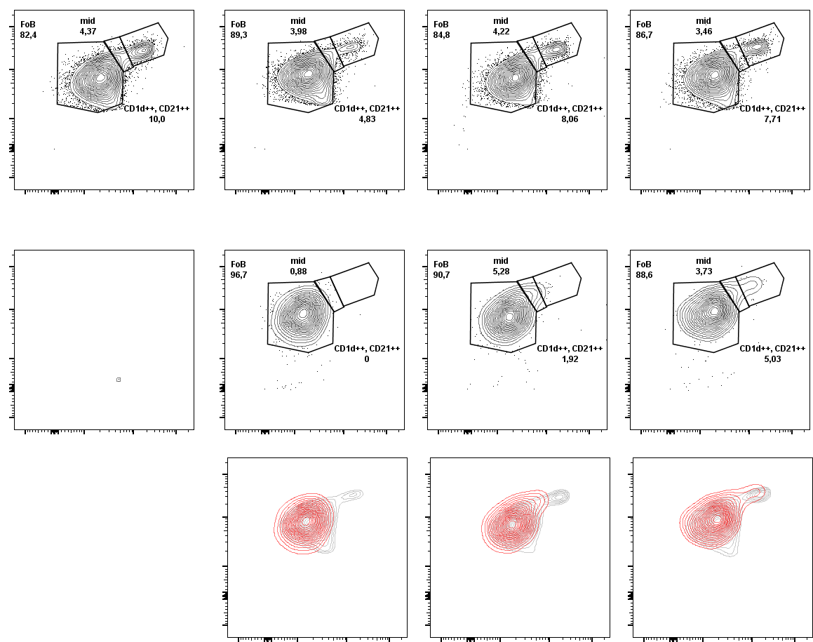
Adoptive transfer experiment
Transplanted animals
Wild type control
Day 1
Day 4
Day 14
CD45.2
CD21-BV-421
CD1d-APC
CD45.1
Overlay
CD45.2
CD45.1

Slide 5
Dynamical model to compare MZ B cell development
T2 B cells
α₁
α₂
?
Host
β
Host
Donor
Donor
FO B cells
MZ B cells
δ
λ

Slide 6
Kinetics of donor fractions within FO and MZ B cells
Data needed:
Fraction of FO, MZ, T2 (T1) B cells.
Fraction of donor and host within each subset.
Total # of B cells in spleen.
This simple model can inform us on,
Rates of differentiation and average time taken for T2 or FO B cells to become MZ.
Mean clonal lifetimes of FO and MZ B cells
It would be nice to capture the decay of donor cell in FO and MZ B cell compartments – Long term follow up? may be >1 month?
Depletion of Transitional cells after transfer? Or entire host compartment? – Competition for Notch2 ligands.
Trans-differentiation of MZ to FO?

Slide 7
Immunization experiment

Slide 9
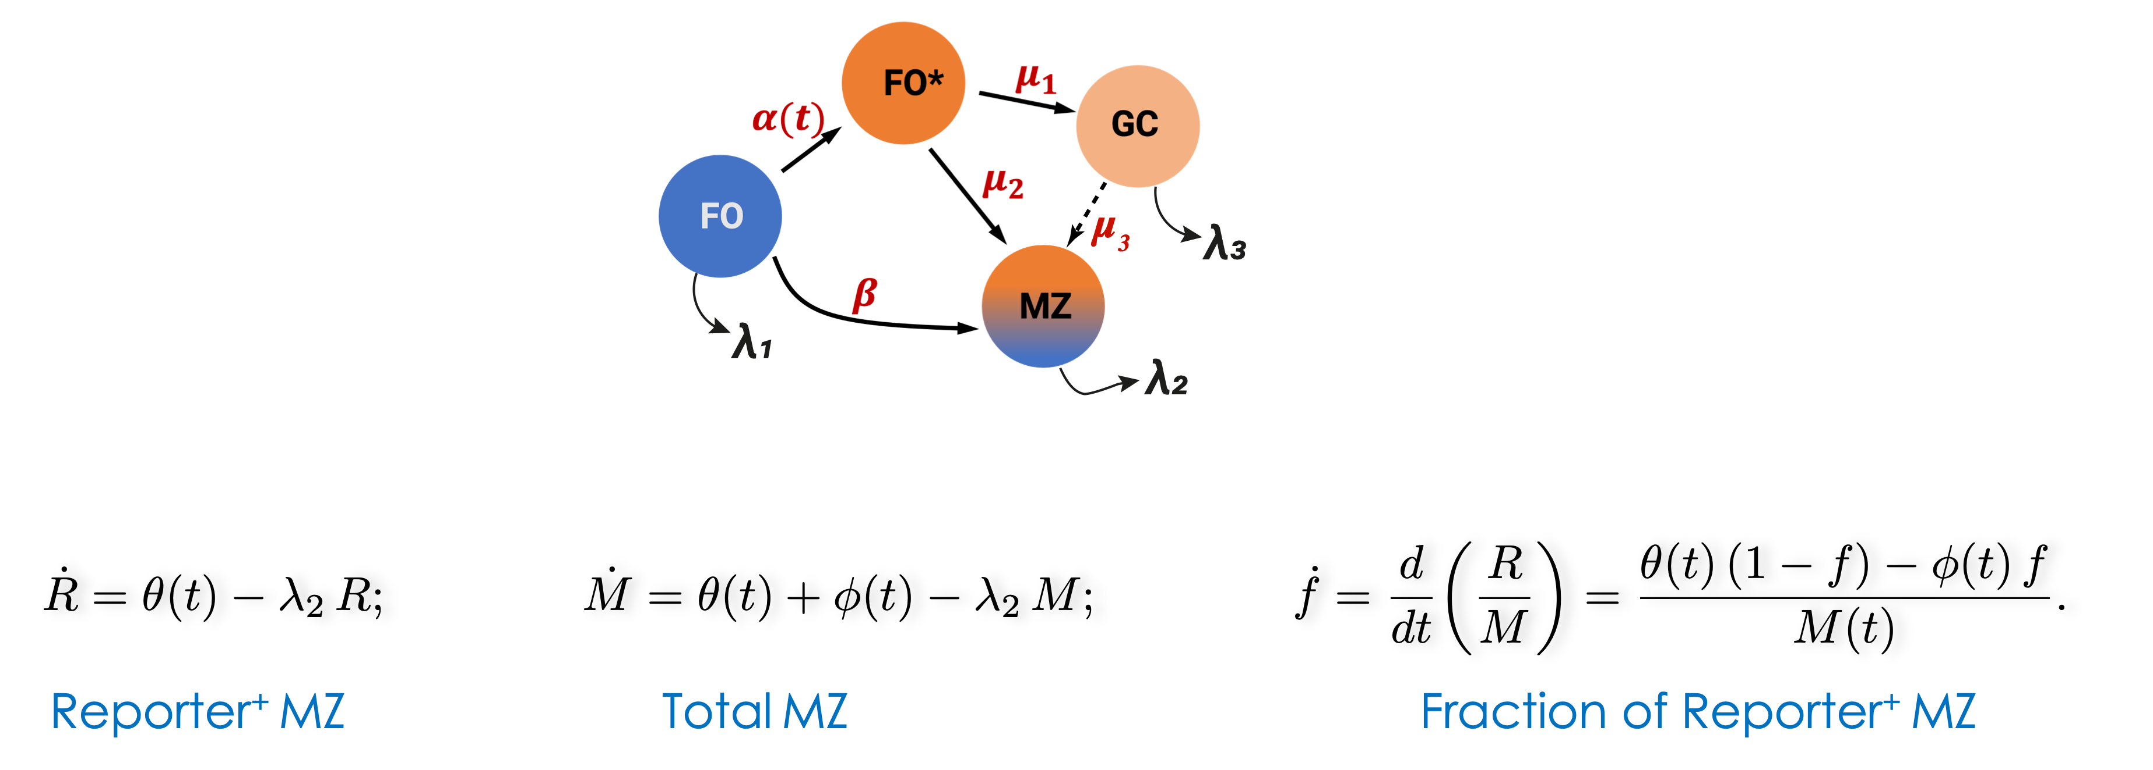
Reporter chimerism in MZ
θ
= β
φ
= μ₂
+ μ₃
FO
FO*
GC

Slide 10
MZ B cell development during an ongoing immune response
Data needed:
Fraction of FO, MZ, GC B cells.
Fraction of Rep+ cells in each subset.
Total # of B cells in spleen.
Precise contributions of activated FO and newly developed GC B cells to MZ development – depends on the kinetics of Rep+ cells in FO and GC compartment.
Selection model – selection of high notch2 expressing clones into MZ.
Early/late time-points possible Rep+ fraction is changing (more) dynamically?

Slide 11
Notch2-IC experiment

Slide 12
Notch2-IC experiment

