Slide 1
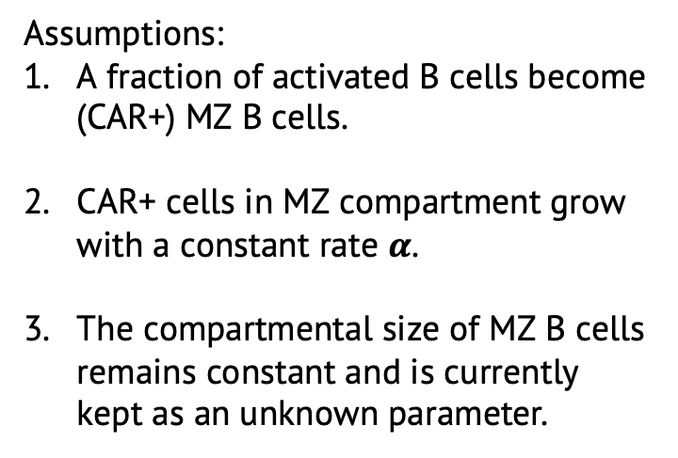

Quasi Steady state model
Phenomenological function as an input
Total B
MZ
$$α$$
p
CAR+
CAR+
Assumptions:
A fraction of activated B cells become (CAR+) MZ B cells.
CAR+ cells in MZ compartment grow with a constant rate $α$.
The compartmental size of MZ B cells remains constant and is currently kept as an unknown parameter.

Slide 2
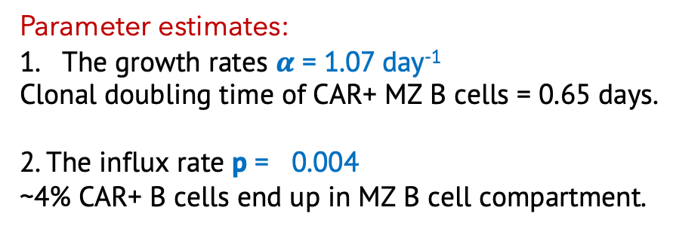
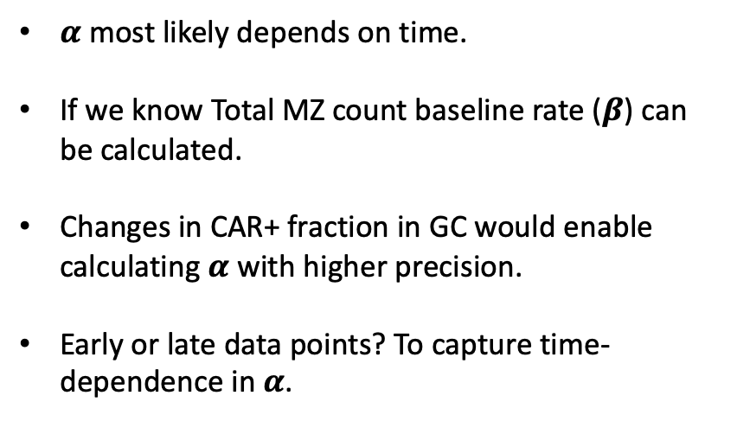
Model fit
Parameter estimates:
The growth rates $α$ = 1.07 day⁻¹
Clonal doubling time of CAR+ MZ B cells = 0.65 days.
2. The influx rate p = 0.004
~4% CAR+ B cells end up in MZ B cell compartment.
$α$ most likely depends on time.
If we know Total MZ count baseline rate ($β$) can be calculated.
Changes in CAR+ fraction in GC would enable calculating $α$ with higher precision.
Early or late data points? To capture time-dependence in $α$.

Slide 3
X
1
MZB
B*
2
GC
PC

