Slide 1
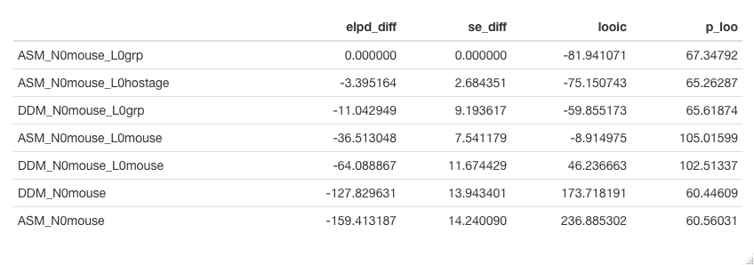
Timestamp data: adding density dependence models to the analysis

Slide 2
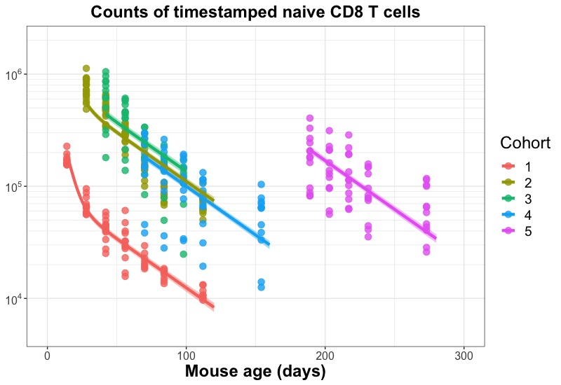
Model fit from DDM_N0mouse_L0grp

Slide 3
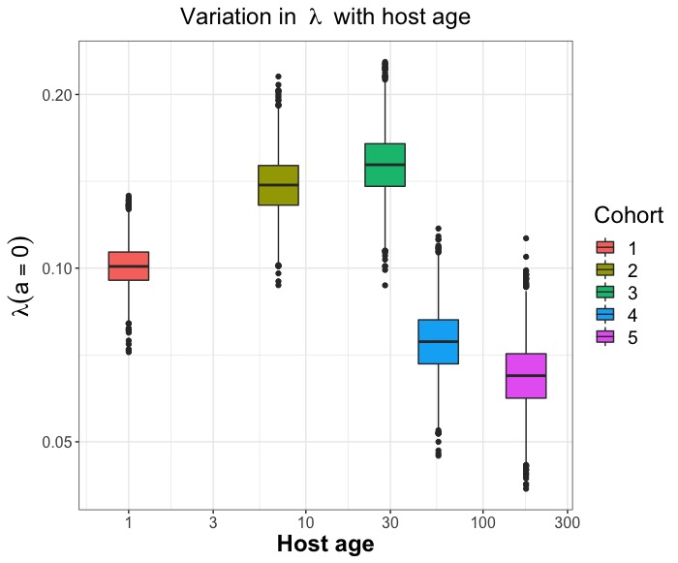
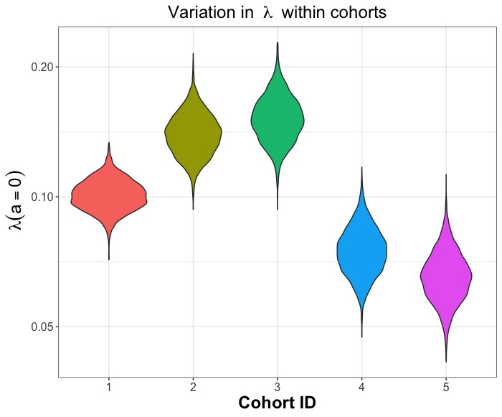

Slide 4
