Slide 1
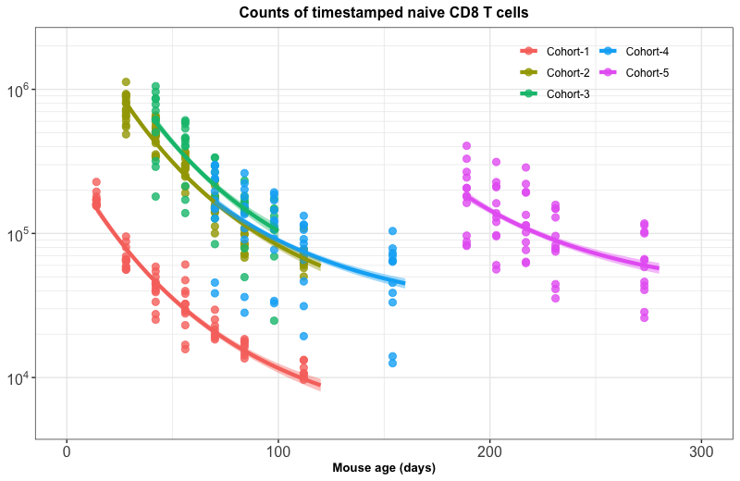
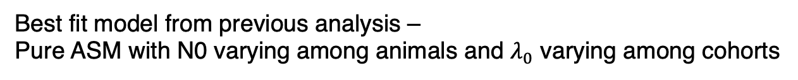
Best fit model from previous analysis –
Pure ASM with N0 varying among animals and $λ_{0}$ varying among cohorts

Slide 2
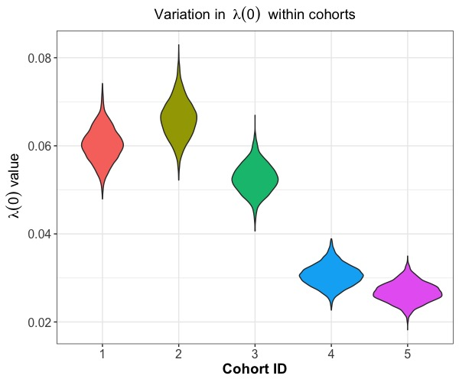
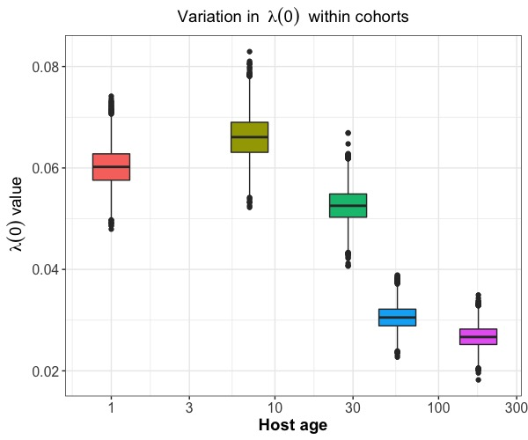

Variation in $λ\left(0\right)$ with host age

Slide 3
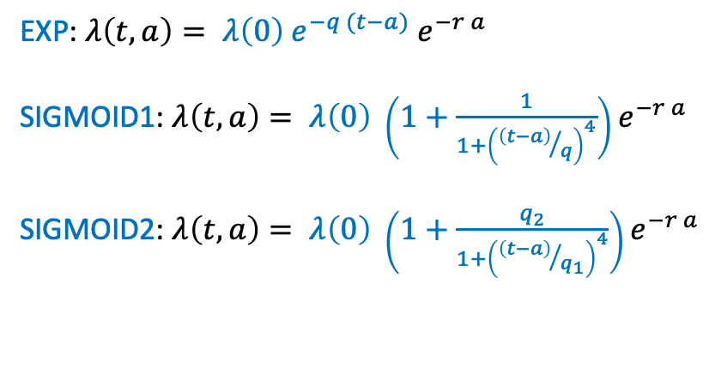
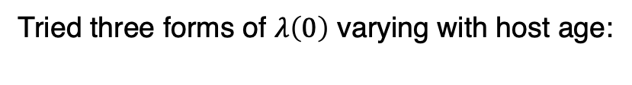
Tried three forms of $λ\left(0\right)$ varying with host age:
EXP: $λ\left(t, a\right)= λ\left(0\right) e^{−q (t−a)} e^{−r a}$
SIGMOID1: $λ\left(t, a\right)= λ\left(0\right) \left(1+\frac{1}{1+{\left({\left(t−a\right)}/q\right)}^{4}}\right)e^{−r a}$
SIGMOID2: $λ\left(t, a\right)= λ\left(0\right) \left(1+\frac{q_{2}}{1+{\left({\left(t−a\right)}/{q_{1}}\right)}^{4}}\right)e^{−r a}$

Slide 4
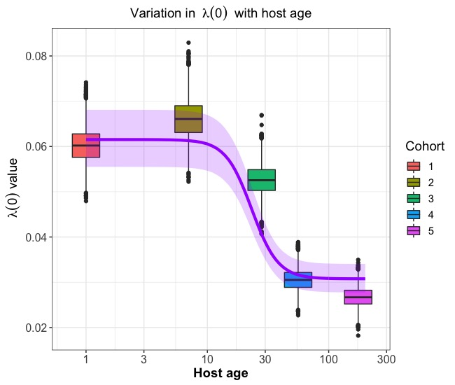
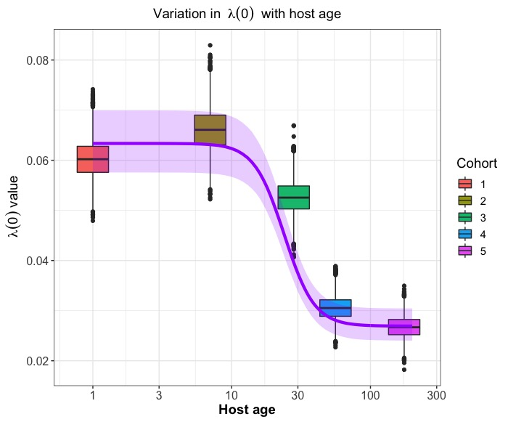
ASM + host age effects: $λ\left(0\right)$ variation
Estimated $λ\left(0\right)$ varying with host age overlayed on random effects observed in $λ\left(0\right)$ in Pure ASM model
N0mouse_L0HostAge_SIGMOID1
N0mouse_L0HostAge_SIGMOID2

Slide 5
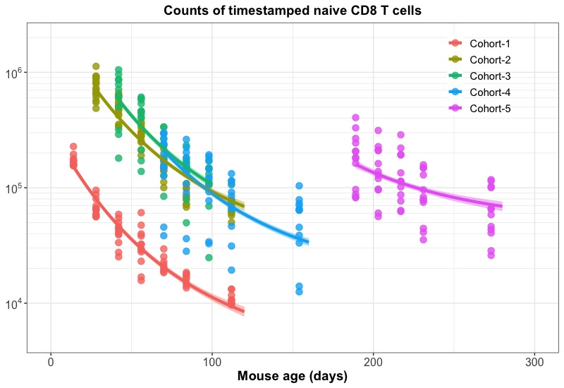
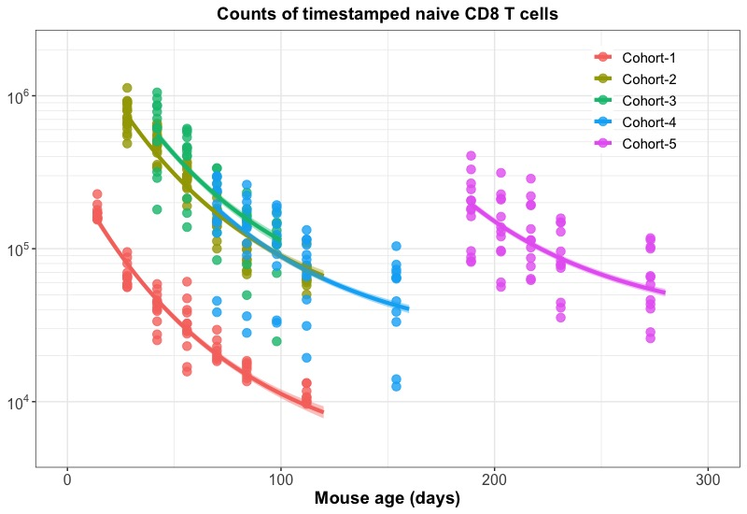
ASM + host age effects: model fits
N0mouse_L0HostAge_EXP
N0mouse_L0HostAge_SIGMOID

