Slide 1
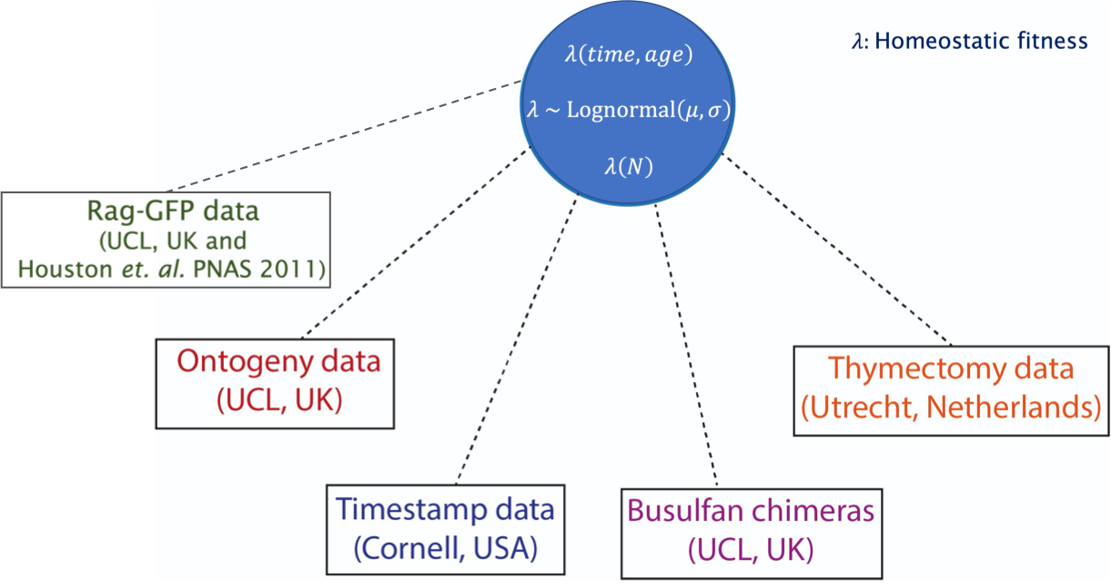
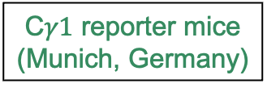

Naïve CD4 T cells
Naïve CD8 T cells
MZ B cells
Regulatory T cells
FO B cells
$$Φ\left(age, time\right)$$
$$Φ∼P\left(\hat{Φ, }σ\right)$$
$$Φ(N)$$
C$γ1$ reporter mice
(Munich, Germany)

Slide 2

Naïve CD4 T cells
Naïve CD8 T cells
MZ B cells
Regulatory T cells
FO B cells
$$Φ\left(age, time\right)$$
$$Φ∼P\left(\hat{Φ, }σ\right)$$
$$Φ(N)$$
C$γ1$ reporter mice
(Munich, Germany)

Slide 3
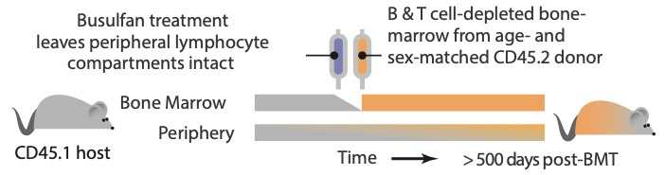
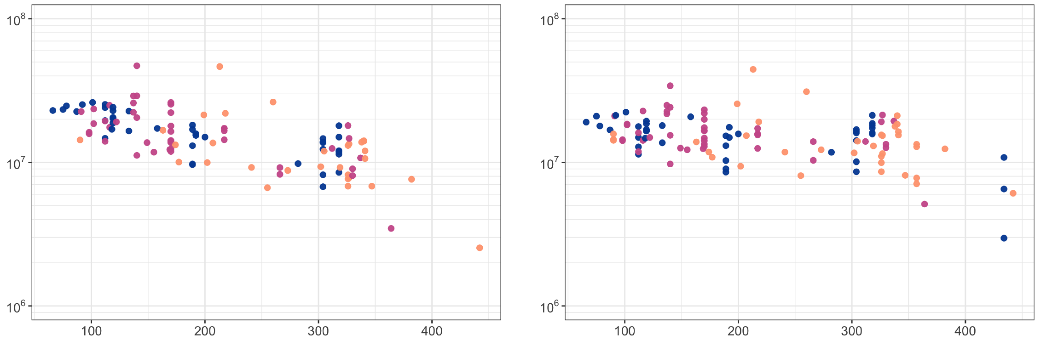
Variation in pool size
Naïve CD4
Naïve CD8
Cell counts
Host age BMT
Host age (days)

Slide 4
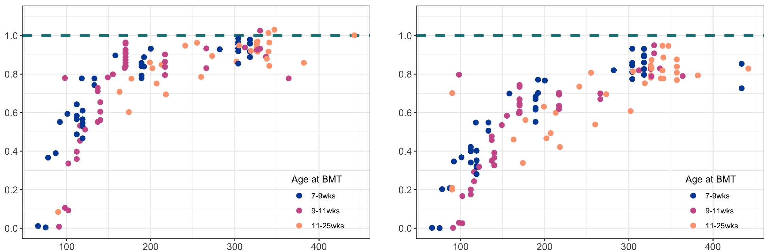
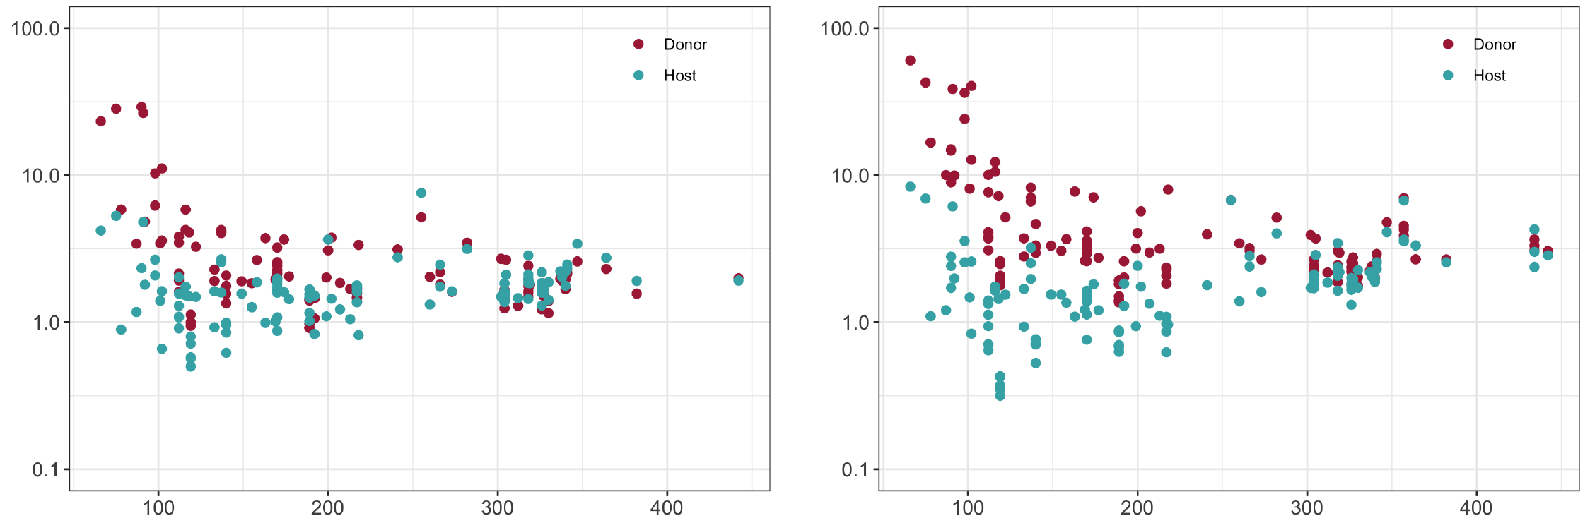
Constitutive replacement in lymphocyte pool
Naïve CD4
Naïve CD8
Normalized
Donor fraction
Extent of division in lymphocytes
Naïve CD4
Naïve CD8
% Ki67 expression
Host age (days)

Slide 5
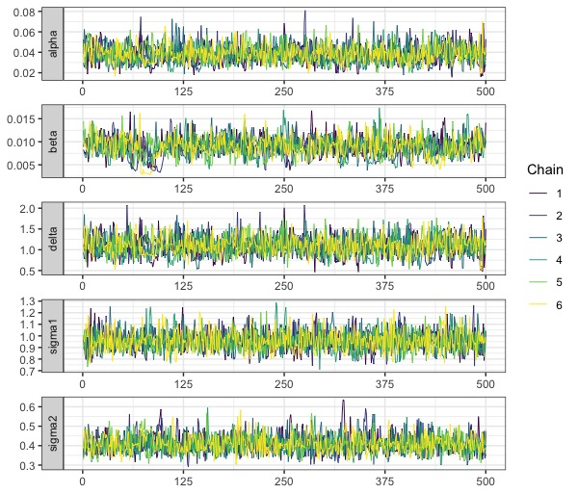
Prior
Density
Posterior

Slide 6
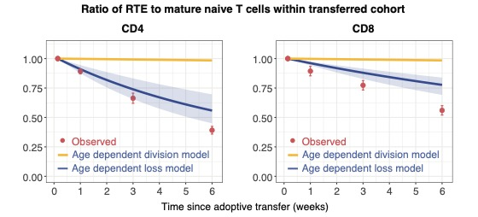

Slide 7
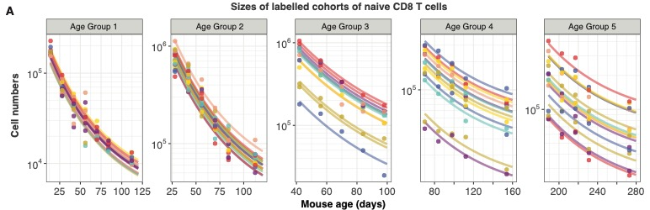

Slide 8
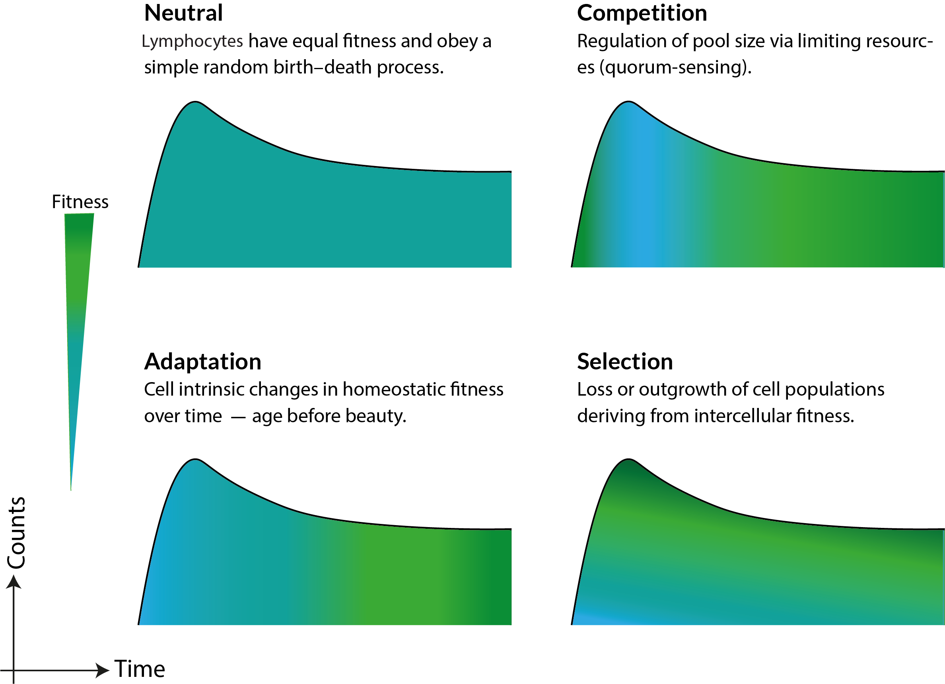




$$\frac{dN}{dt}=ψ S\left(t\right)+Φ N$$
$$\frac{dN}{dt}=ψ (N) S\left(t\right)+Φ \left(N\right) N$$
$$∂N_{t}+∂N_{a}=Φ (a) N(a, t)$$
$$\frac{dN}{dt}=ψ f_{0}\left(Φ\right) S\left(t\right)+Φ N(Φ, t)$$
S(t): Source Population

Slide 9
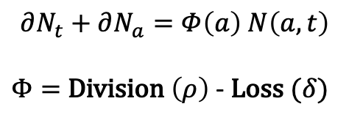

Fitness
$$Φ$$
$$∂N_{t}+∂N_{a}=Φ\left(a\right) N\left(a, t\right)$$
$Φ=$ Division $\left(ρ\right)$ - Loss $(δ)$

Slide 10
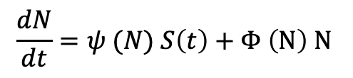
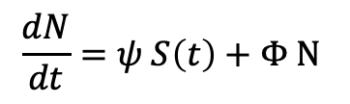
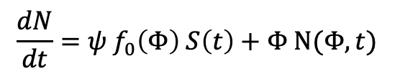

$$\frac{dN}{dt}=ψ S\left(t\right)+Φ N$$
$$\frac{dN}{dt}=ψ (N) S\left(t\right)+Φ \left(N\right) N$$
$$∂N_{t}+∂N_{a}=Φ (a) N(a, t)$$
$$\frac{dN}{dt}=ψ f_{0}\left(Φ\right) S\left(t\right)+Φ N(Φ, t)$$

Slide 11
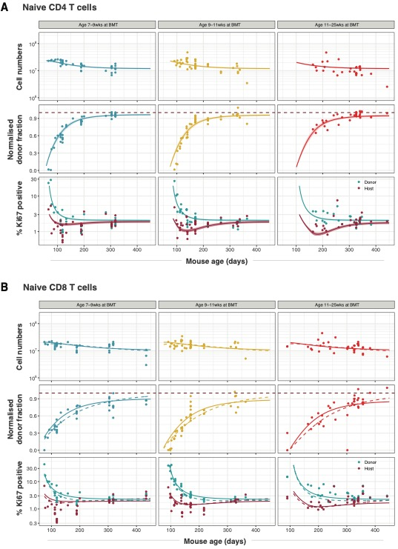

Slide 12
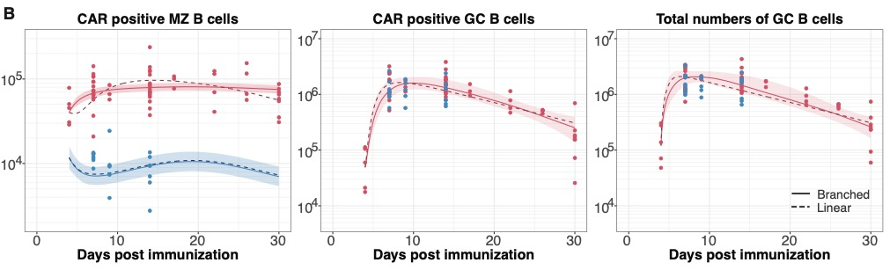
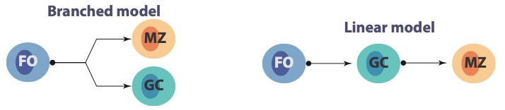
WT
Notch2^{KO}

Slide 13

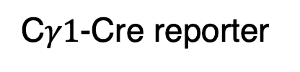
C$γ1$-Cre reporter
C$γ1$-Cre Notch2^{KO}/reporter

Slide 14
WT
Notch2^{KO}

