Slide 1
Hybrid Application Development
Ionic Framework
Mobile App Development
Hybrid App
Team members:
Prathamesh Bagwe TE IT-1
Sanket Devlekar TE IT-1
Notes:
White papers are sales and marketing documents used to entice or persuade potential customers to learn more about or purchase a particular product, service, technology or methodology.

Slide 2
Mobile Application Development

Slide 3
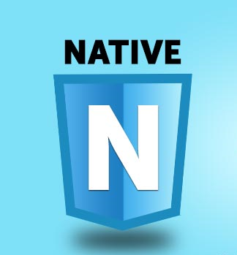
Native Applications
Downloaded directly to the device and stored locally.
Interfaces directly with the mobile OS.
It can access all the API’s that are made available by the OS.
Developer writes source code and includes images, audio files and puts in into a binary executable file.
These tools are included in the Software Development Kit(SDK).
Notes:
Native apps have binary executable files that are downloaded
directly to the device and stored locally.
The installation process
can be initiated by the user or vendor company.
The most popular way to download a
native app is by visiting an app store, such as Apple’s App Store,
Android’s Marketplace or BlackBerry’s App World, but other
methods exist and are sometimes provided by the mobile vendor.
Add examples such as Angry Birds, Retrica(camera app).

Slide 4
Application Programming Interface(API)
It is a set of routines, protocols, and tools for building software applications.
Low-level APIs
The app can interact directly with the touch screen or keyboard, render graphics, connect to networks, process audio received from the
microphone, play sounds through the speaker or headphones, or
receive images and videos from the camera.
High-level APIs
Browsing the web, managing the calendar, contacts, photo album and, of course, the ability to make phone calls or send and receive text
messages.
Notes:
Once the native application is installed on the mobile device
and launched by the user, it interacts with the mobile operating
system through proprietary API calls that the operating system
exposes.
These can be divided into two groups: low-level APIs
and high-level APIs.

Slide 5
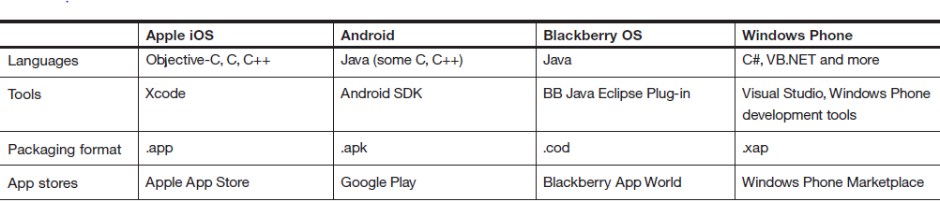
APIs for various platforms

Slide 6

Web Applications
A web application or web app is any software that runs in a web browser.
It is created in a browser-supported programming language such as the combination of JavaScript, HTML and CSS.
HTML5 provides access to rich media, geolocation services and offline availability.
To help developers build the client-side UI, a
growing number of JavaScript toolkits have been created, such as dojox.mobile,
Sencha Touch and jQuery Mobile.
Notes:
some companies go even further and
enhance the user experience by creating a mobile website that
looks like a native app and can be launched from a shortcut that
is indistinguishable from that used to launch native apps.
One of the most prominent advantages of a web app is its multiplatform
support and low cost of development.
Most mobile vendors utilize the same rendering engine in their browsers,
WebKit—an open-source project led mainly by Google and
Apple that provides the most comprehensive HTML5
web apps run within the browser
Add examples such as Google docs, icloud.

Slide 7
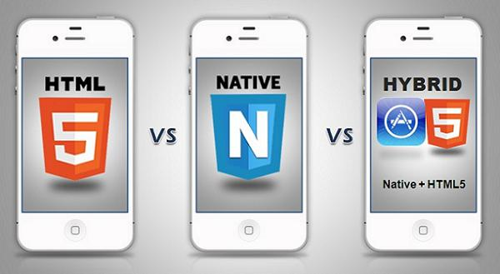
Hybrid Applications
Notes:
The hybrid approach combines native development with web
technology.
The native portion of the application uses the operating system
APIs to create an embedded HTML rendering engine that
serves as a bridge between the browser and the device APIs.
This bridge enables the hybrid app to take full advantage of all
the features that modern devices have to offer.

Slide 8
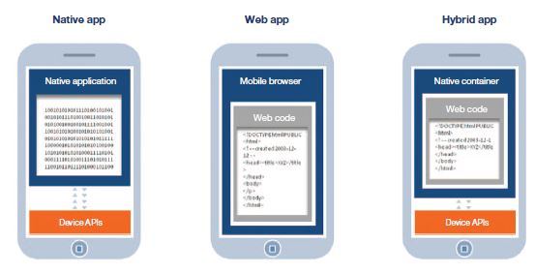
Notes:
Explain from knowledge of previous slides notes

Slide 9
Overview
The hybrid approach combines native development with web
technology.
Developers write significant portions of their application in cross-platform web technologies, while maintaining direct access to native APIs when required.
The native portion of the app can be developed independently, whereas the web portion of the app can be either a web page that resides
on a server.
Notes:
The native portion of the application uses the operating system APIs to create an embedded HTML rendering engine that serves as a bridge between the browser and the device APIs.
This bridge enables the hybrid app to take full advantage of all the features that modern devices have to offer.

Slide 10
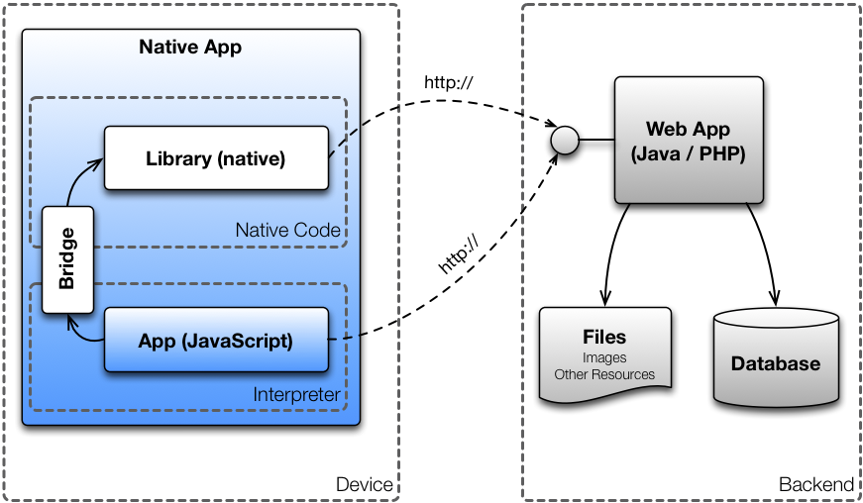
Architecture of Hybrid Apps

Slide 11
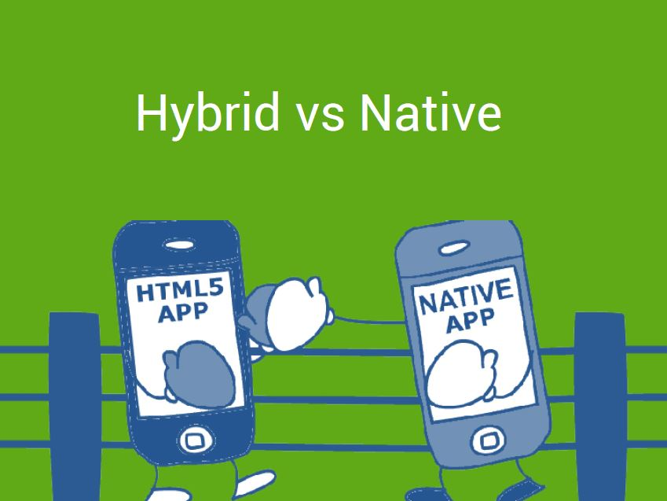

Slide 12
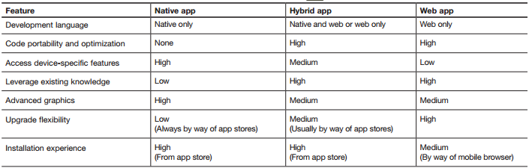

Slide 13
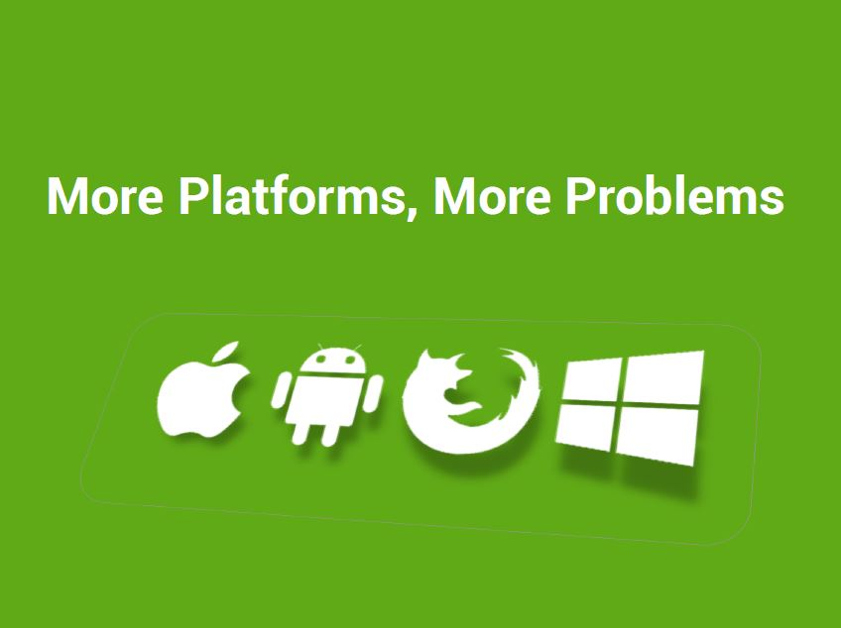

Slide 14
Hybrid App Features
Platform independent (iOS, Android etc.)
HTML5, CSS3 & JS
Quick development
Direct access to native APIs with Cordova
Hybrid Apps

Slide 15
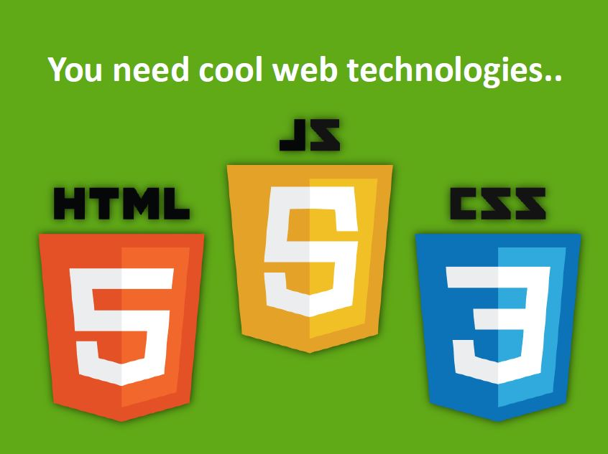

Slide 16

Cordova , Angular JS and Ionic

Slide 17
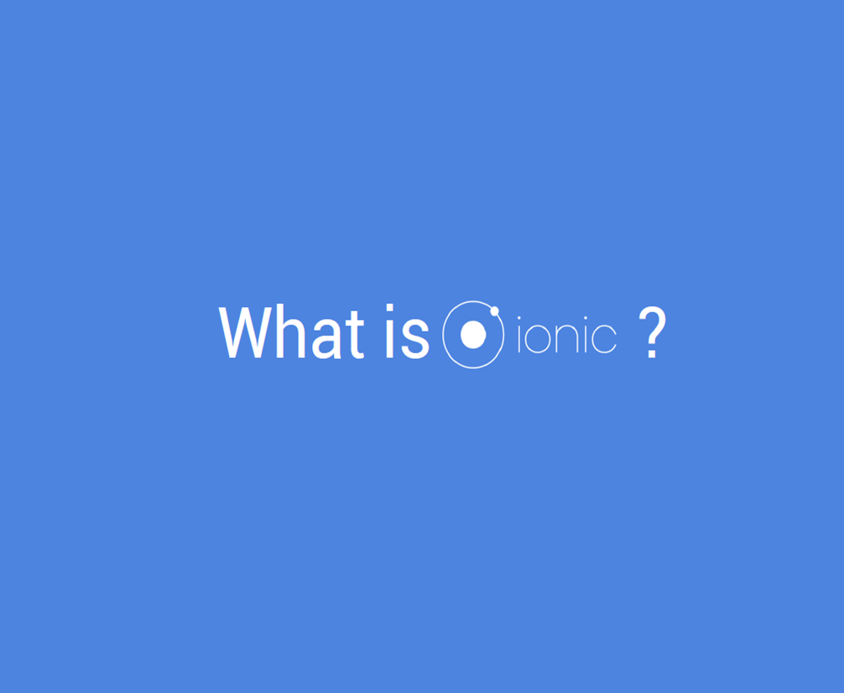

Slide 18
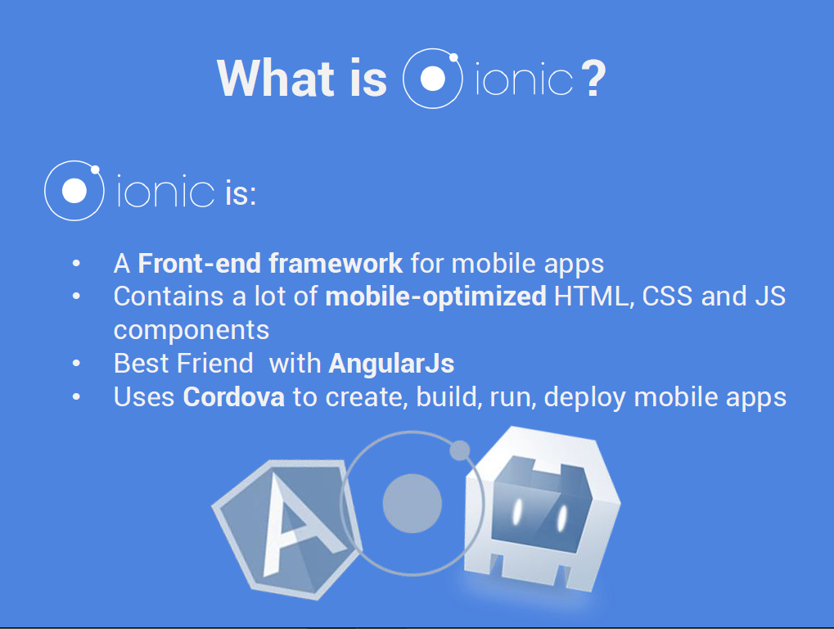

Slide 19
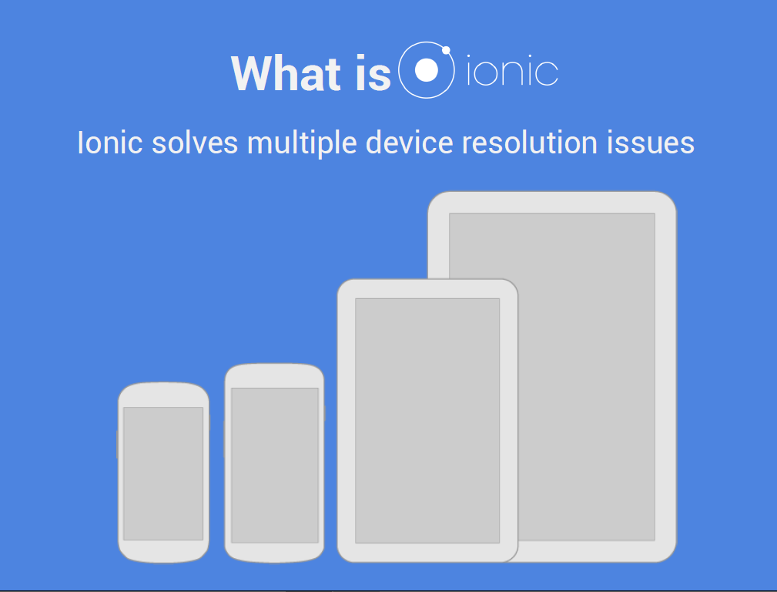

Slide 20
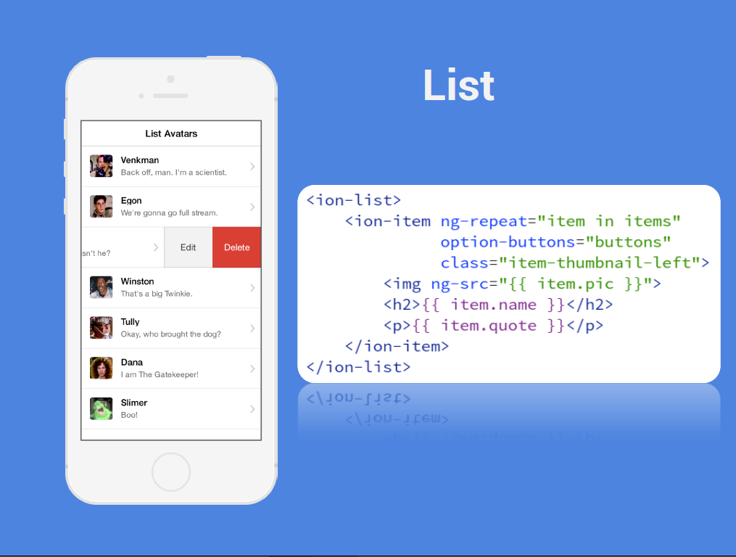

Slide 21
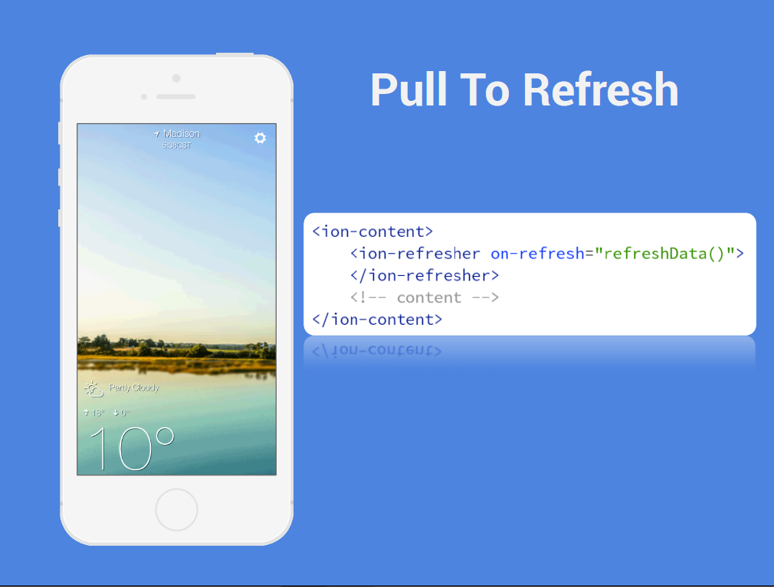

Slide 22
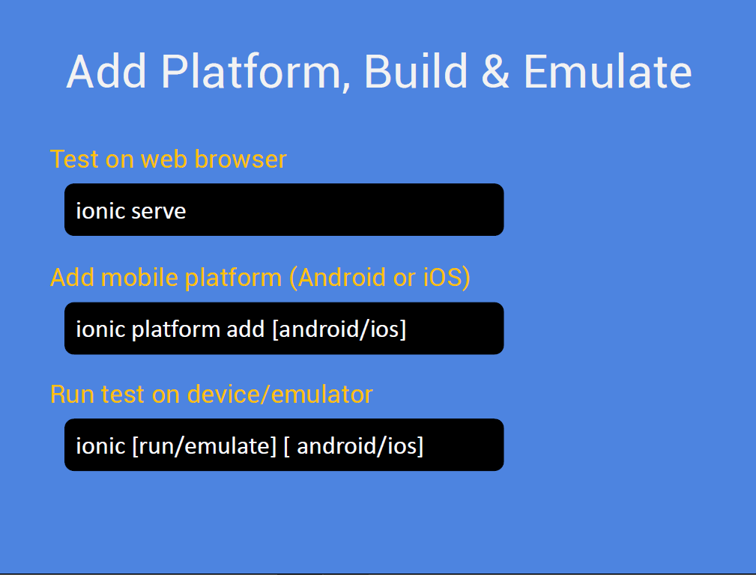

Slide 23
Thank you!

